Slide 1
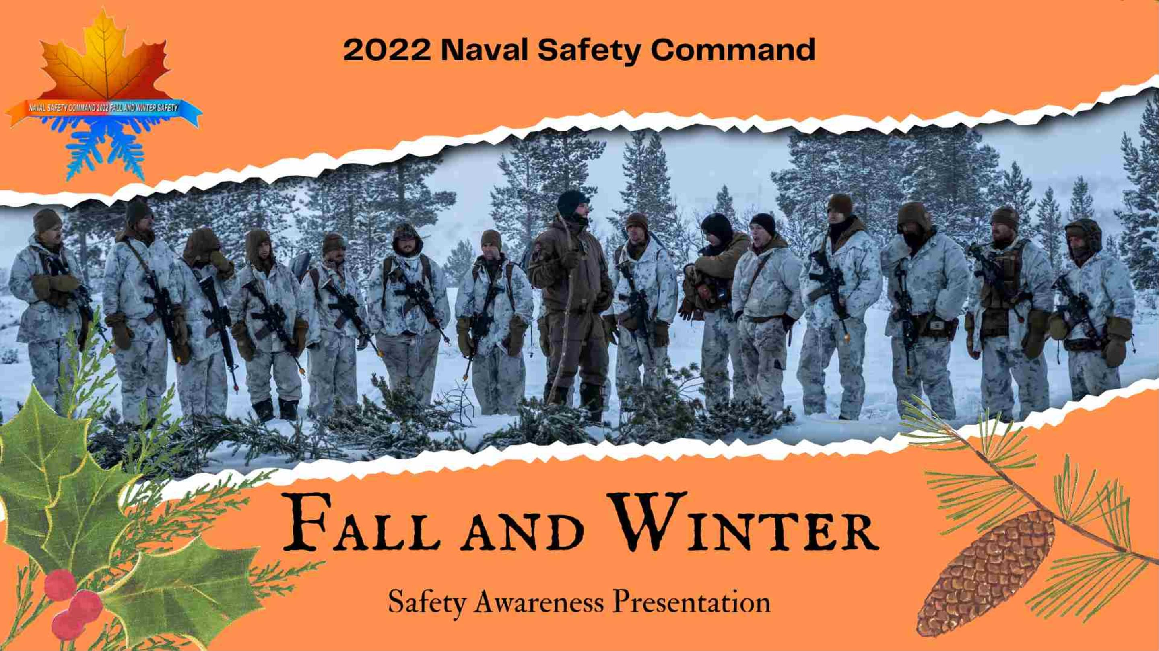

Slide 2
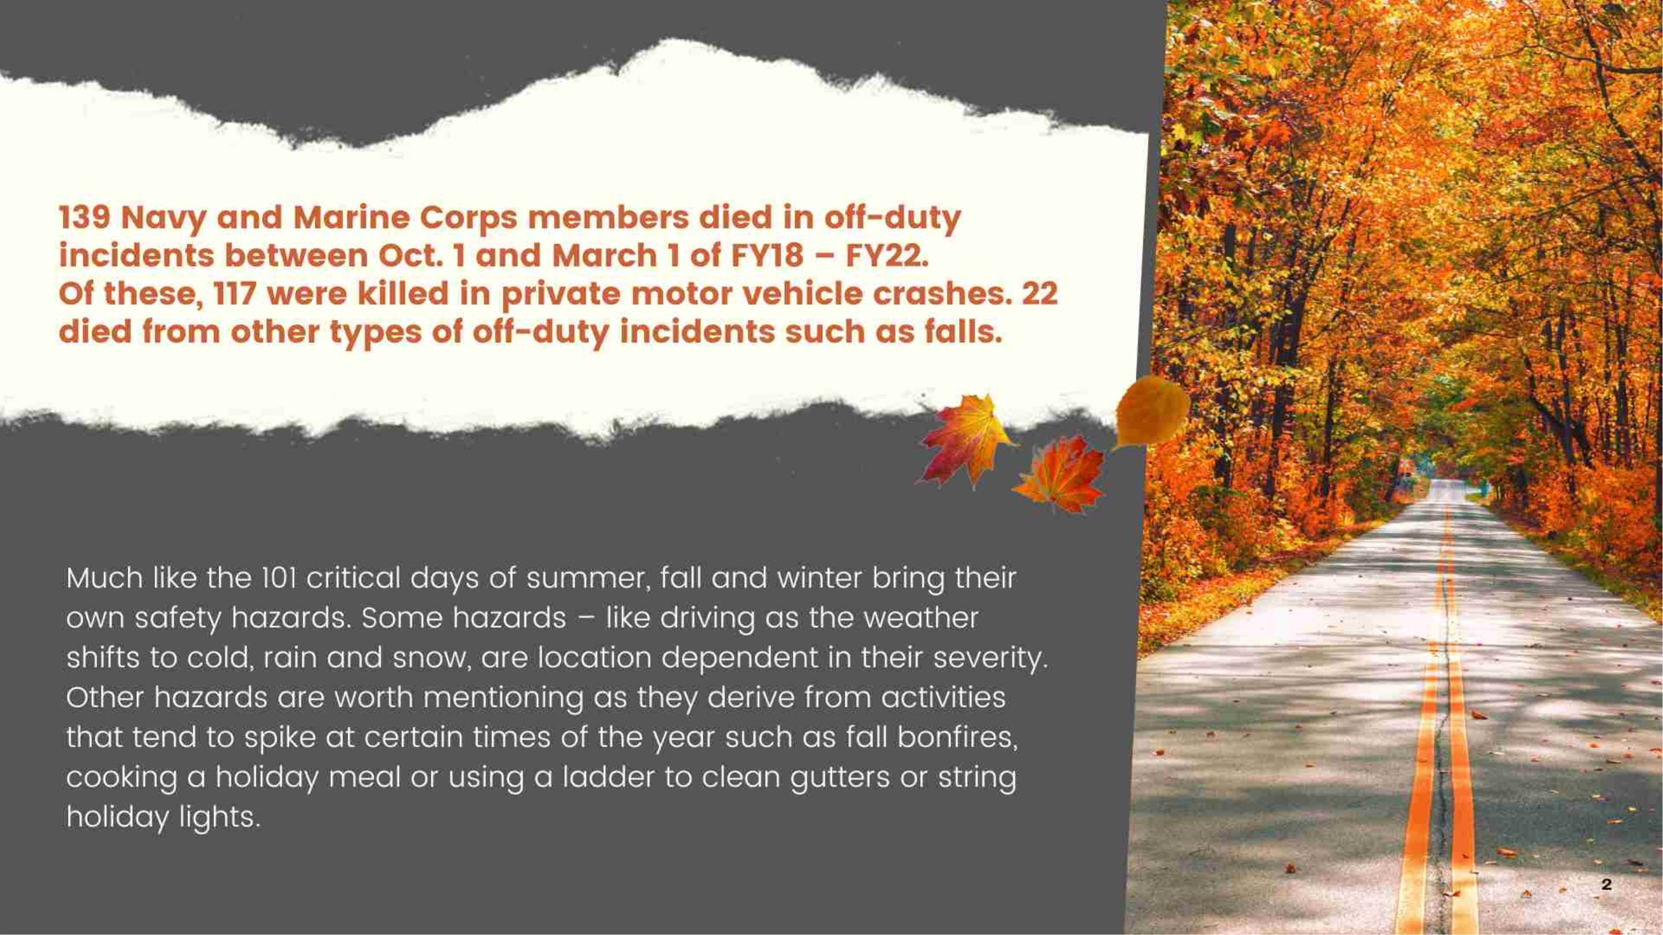

Slide 3
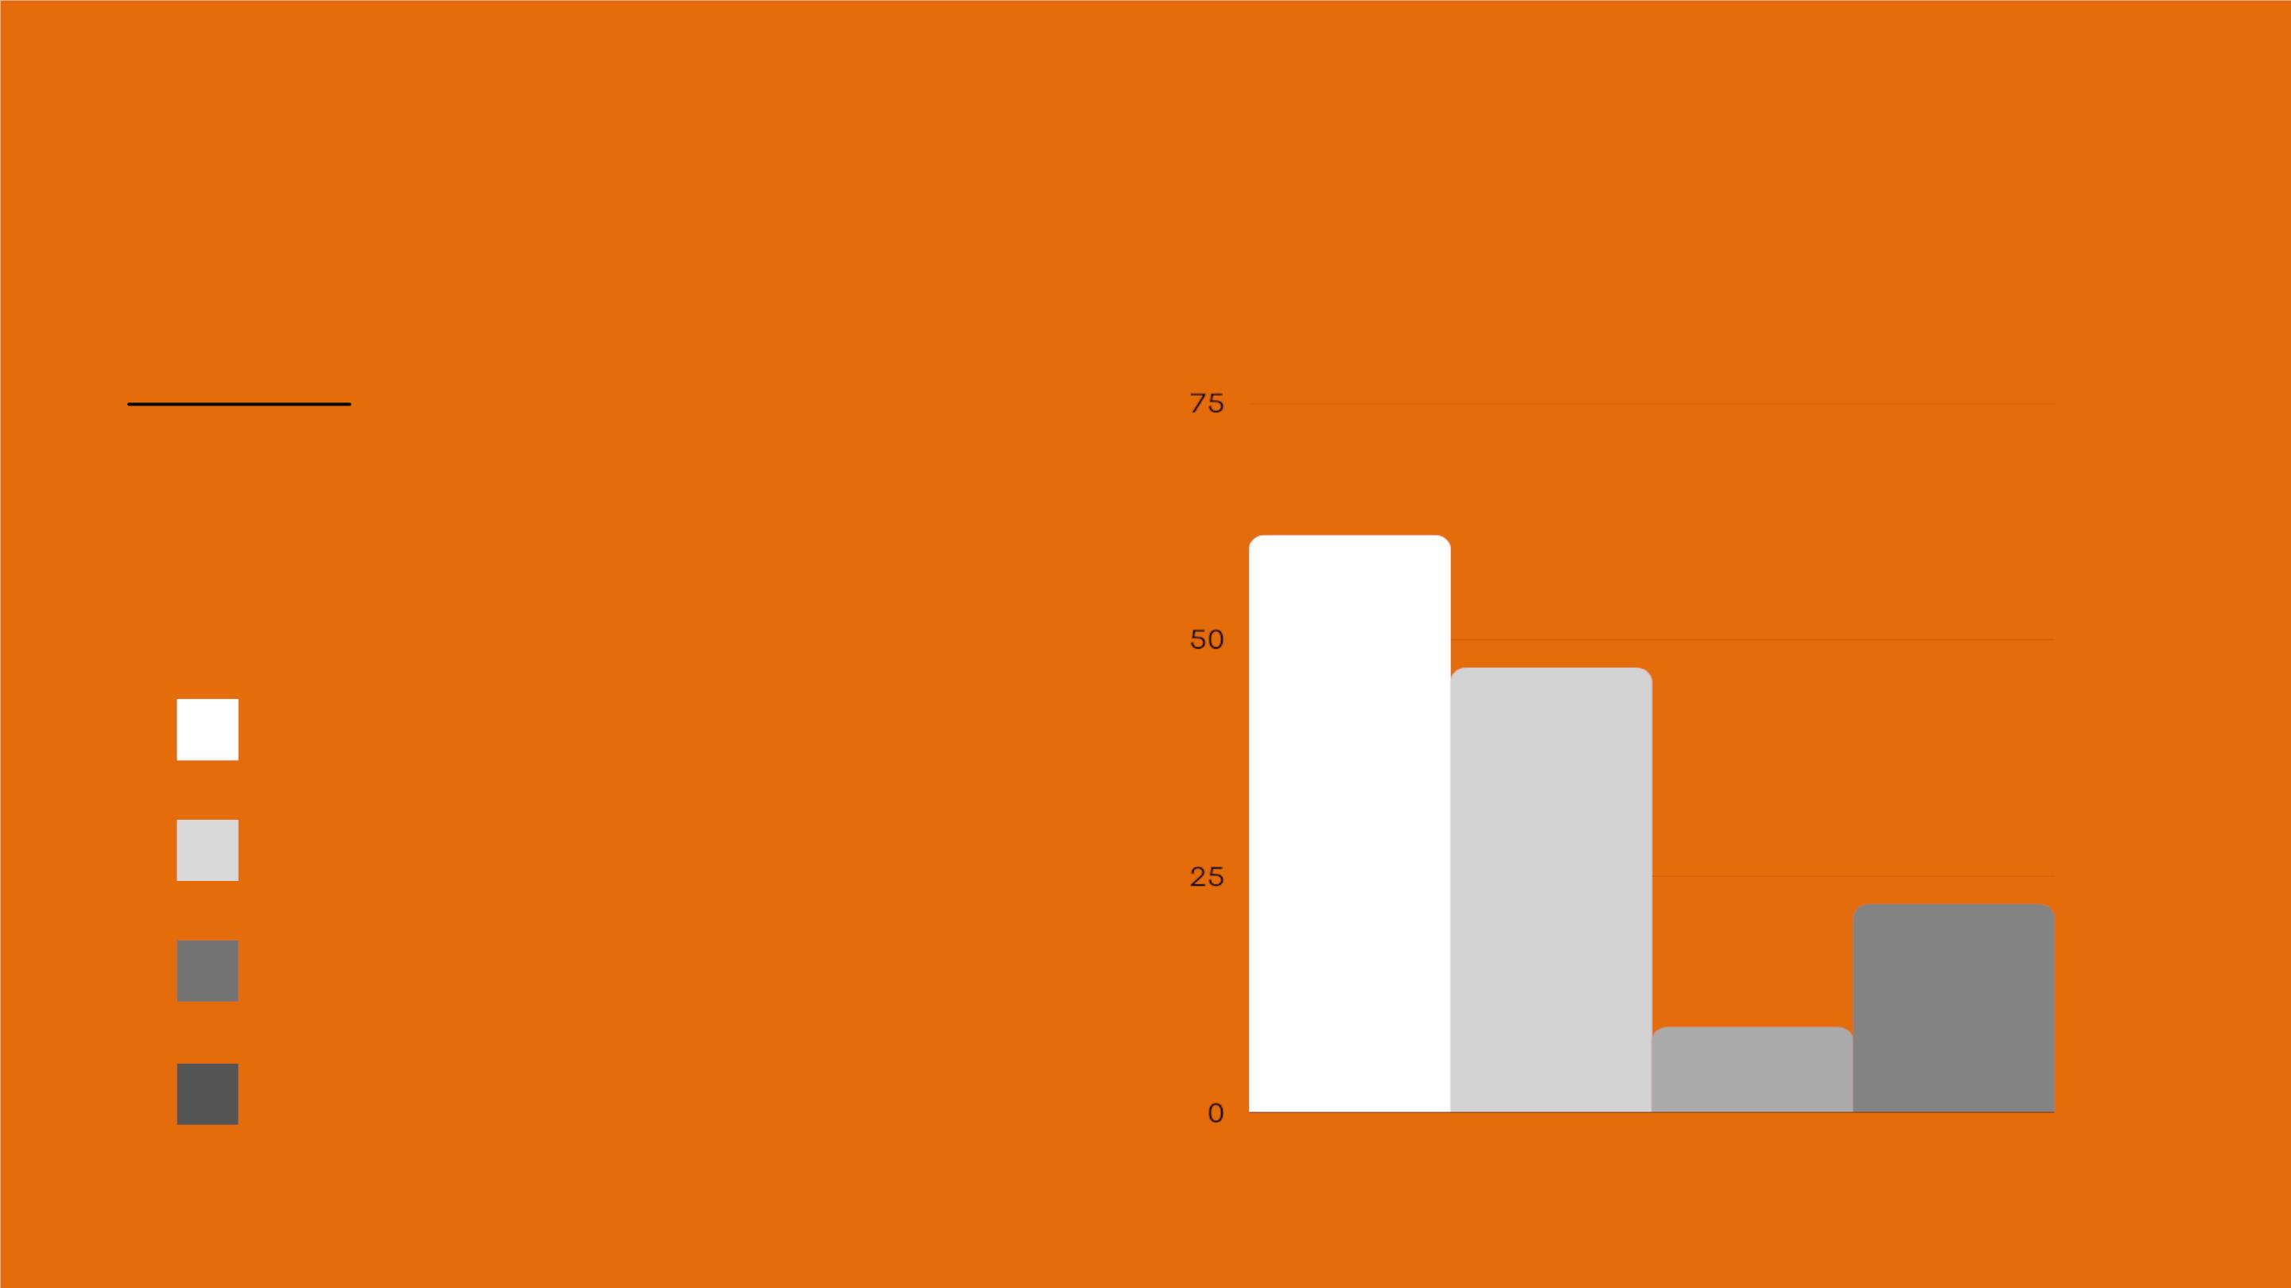
OFF-DUTY MISHAPS
OCT-MAR, FY18-FY22
DON Off-Duty Mishap
Fatalities:
Automobile fatalities - 61
Motorcycle Fatalities - 47
Pedestrian Fatalities - 9
Off-Duty/Recreation Fatalities - 22

Slide 4

FALL AND WINTER SAFETY HAZARDS
Shifting from Summer to Fall to Winter
While motor vehicle crashes are still the leading cause of death and injury across the Navy and Marine Corps, there are many other activities we
engage in that come with a fair amount of risk and can lead to severe injuries or death. It's important to think about how our environment and the
activities we engage in change as we leave summer behind and head into fall and then winter.
Some of these include: slips, trips and falls during recreational activities or from routine activities inside and outside the home, and fires - during social
gatherings or those resulting from seasonal decorating, heating systems and cooking.
Understand and minimize risk, even in the activities seen as routine. The likelihood you'll end up in the ER paralyzed, with a skull fracture, or severe
burns requiring multiple skin graph surgeries, drops significantly when you pay attention and make good decisions. It only takes one second, misstep
or poor decision for you to sustain a life-altering injury or worse, to lose your life or contribute to the loss of another.
4

Slide 5
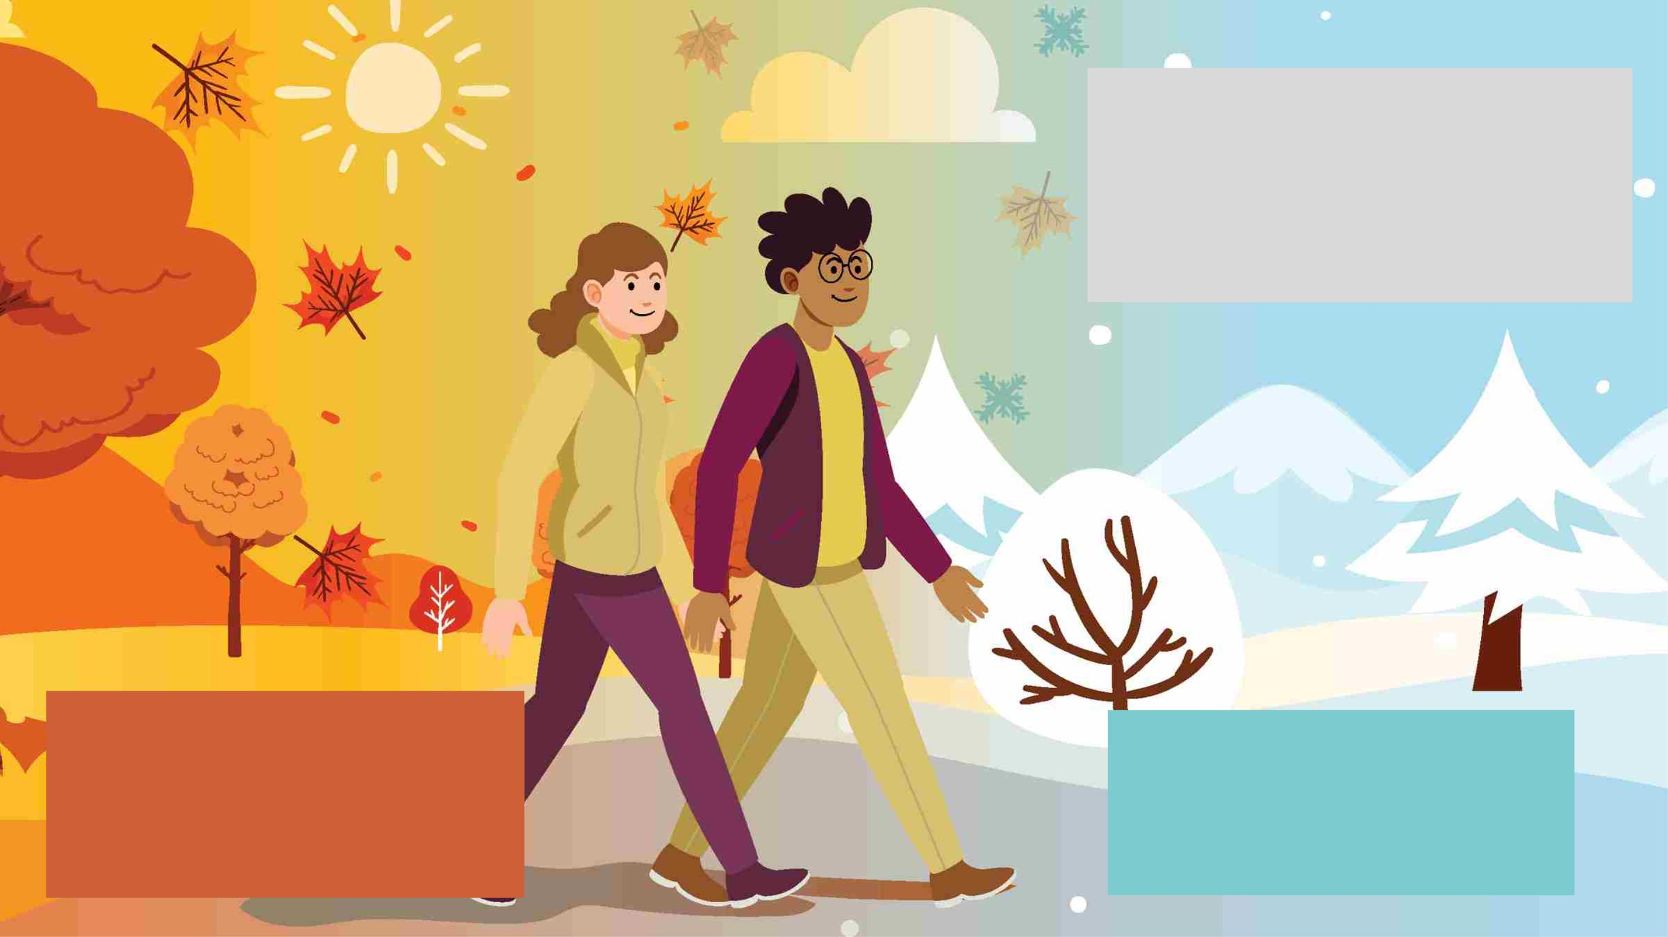
WINTER SAFETY
• Winter Fire Safety
• Winter Holiday Safety
• Winter-related Slips, Trips and Falls
• Winter Sports Safety
FALL SAFETY
• Fall-related Slips, Trips and Falls
• Fall Fire Safety
• Fall Holiday Safety
+
SEASONAL
DRIVING SAFETY
5

Slide 6

FALL-RELATED SLIPS, TRIPS AND FALLS
SLIPS, TRIPS AND FALLS
Falls are the second leading cause of unintentional injury-related deaths in the United States and in 2020, nearly 42,115 people died from
falls that occurred at work or at home. These incidents include:
SLIPS: on wet surfaces or ice;
TRIPS: over objects on the ground or floor;
FALLS: from a higher level, such as ladders, step ladders, roofs or any other higher level object or structure.
6

Slide 7

FALL-RELATED SLIPS, TRIPS AND FALLS
Avoiding Slips, Trips and Falls
If you’re out and about, be mindful of where you’re walking. Wet leaves can be more slippery than they look.
Additionally, leaves may obscure trip hazards or holes in the ground. It’s not uncommon for someone to
inadvertently step into a hole and either twist or break an ankle.
• Wear proper footwear with good traction. Wet grass can be as slippery as an icy sidewalk, so plan accordingly.
• Keep walkways and stairs free of leaves. As they accumulate or get wet, they become slippery.
• Pay attention to where you’re going and what you’re doing.
Over the past five years during fall and winter months, 39 Sailors and Marines sustained injuries from off-duty
ladder falls. Keep these tips in mind when you're using any kind of ladder.
• Ladders should extend at least three feet above your roof or the surface you are working with.
• Never stand on your toes or the top rung of the ladder. If you have to do this, the ladder is not tall enough for
your purposes. The second rung from the top is as high as you should climb on a step ladder.
• Only use ladders on flat, solid surfaces.
• While on the ladder, keep your body weight centered and do not overreach. Both your feet should be securely
planted on the ladder at all times.
Inside the Home
• Avoid running cords and wires across common walking areas.
• Wipe up spills as soon as they happen.
• Keep steps and stairs clear and make multiple trips versus carrying so much that you can’t see where you’re
going.
7

Slide 8

FALL FIRE SAFETY
Fall Fire Safety
There were 115 Sailors and Marines injured in off-duty incidents involving fires during the FY18-FY22 fall and winter
seasons.
• 46 were burned during cooking fires, 3 injured in house fires.
• 31 fell into an “other” category.
• Of the remaining incidents, 24 involved a campfire.
• 11 members “fell into a fire.” Of the latter, alcohol was involved in nearly every incident.
Outdoor Fire Safety
The majority of off-duty, outdoor fire burns sustained by Sailors and Marines - whether in designated fire pits or open fires, were
caused by someone, either the service member or another person, pouring or shooting a flammable liquid into or near a fire;
while burning yard debris or by tripping and falling into the fire. Many incidents resulted in 2nd degree burns to the service
members’ face and torso.
• Do not pour, aim or shoot gasoline, alcohol, lighter fluid or any other flammable liquid into or near a fire.
• Keep the area around designated fire pits, campfires or bonfires free of trip hazards.
• Pay attention to where you’re walking and don’t run in the vicinity of an open fire.
• Keep a hose or water source nearby to extinguish the fire quickly if needed.

Slide 9

SEASONAL DECOR HAZARDS
Fall Fire Safety
Keep in mind that Halloween or other Fall decor are potential fire hazards if fire risk mitigation actions aren’t in place. According to the
National Fire Protection Association (NFPA):
• From 2015-2019, an average of 790 home structure fires per year began with decorations, excluding holiday trees.
• More than two of every five of these fires occurred because the decorations were too close to a heat source, such as a candle or hot
equipment.
• More than one-third of these fires were started by candles.
• 19% of the decoration-related fires started in the kitchen; 12% involved electrical distribution and lighting equipment.
Remember:
• Teach children to stay away from open flames, including jack-o-lanterns with candles in them.
• Dried flowers, cornstalks and crepe paper catch fire easily. Keep all decorations away from open flames and other heat sources
like light bulbs and heaters.
• Keep exits clear of decorations so nothing blocks escape routes. Ensure all smoke alarms are working.

Slide 10
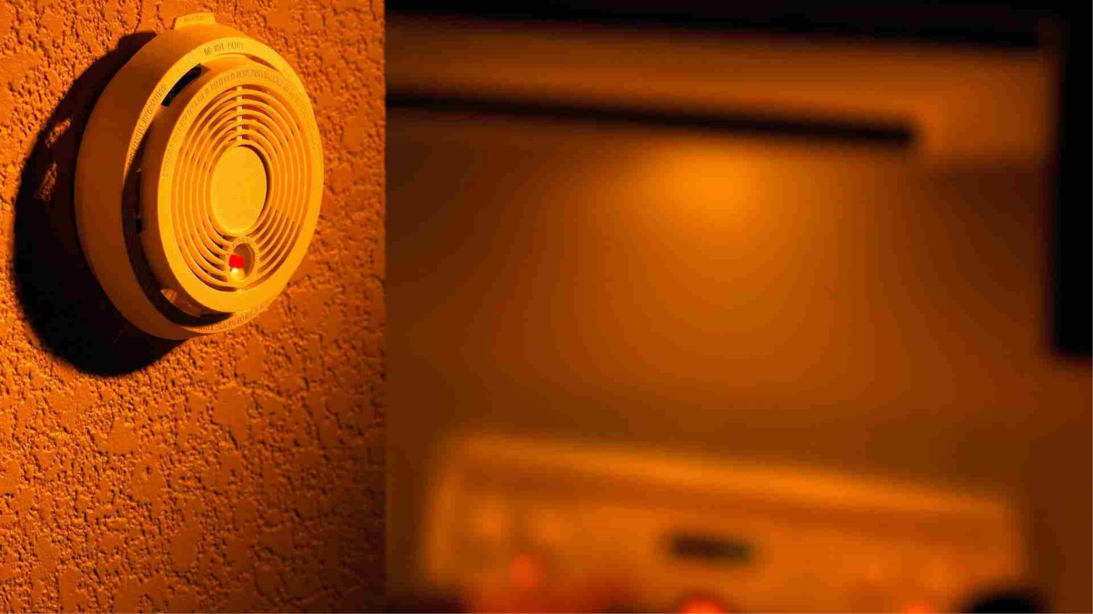
GENERAL FIRE SAFETY
Time to check out your Smoke
and Carbon Monoxide Detectors
Smoke Detectors
According to the NFPA, nearly three of every five home fire deaths resulted from fires in which
no smoke alarm was present (41%) or at least one alarm was present but non-operational
(16%).
• Check the manufacture date on your smoke detector. They should be replaced every 10
years.
• Smoke detectors should be installed in every bedroom, outside of every sleeping area and
on every level including basements.
• Smoke alarms should be installed at least 10 feet from a cooking appliance to minimize
false alarms when cooking.
• Mount smoke alarms high on walls or ceilings (remember, smoke rises). Wall-mounted
alarms should be installed not more than 12 inches away from the ceiling (to the top of the
alarm).
• Smoke alarms should be maintained according to manufacturer’s instructions.
• Test smoke alarms at least once a month using the test button.
• Smoke alarm batteries must be replaced at least once a year. If the alarm chirps, warning
the battery is low, replace the battery right away.
• Manufacturer’s instructions are specific to the batteries (brand and model) that must be
used. The smoke alarm may not work if the wrong battery is used.

Slide 11
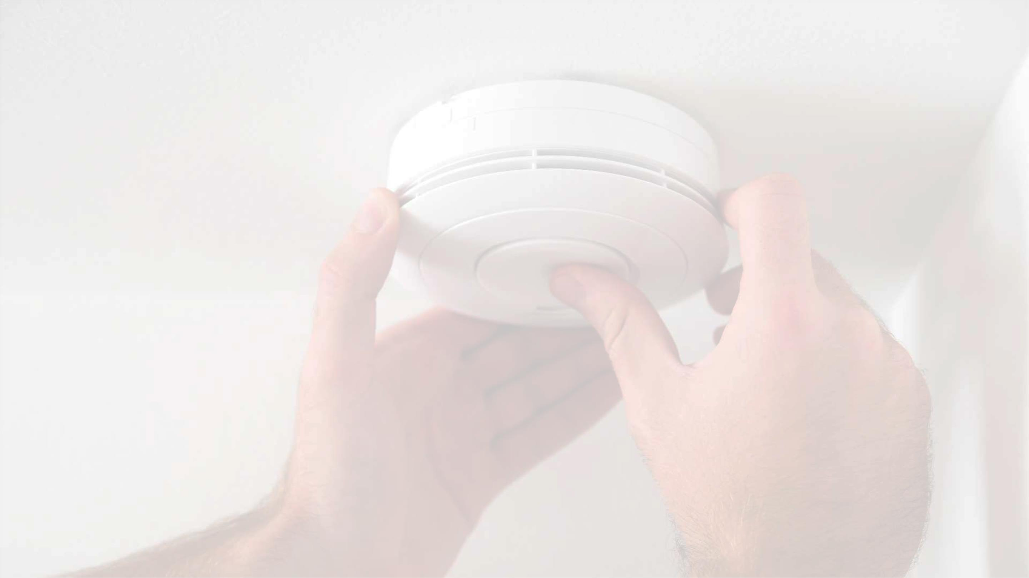
GENERAL FIRE SAFETY
Carbon Monoxide Safety (cont.)
• If you need to warm a vehicle, remove it from the garage immediately after starting it. Do not run a vehicle or other fueled engine or
motor indoors, even if garage doors are open.
• Make sure the running vehicle's exhaust pipe is not covered with snow or mud.
• During and after a snowstorm, make sure vents for the dryer, furnace, stove and fireplace are clear of accumulated snow.
• The most common source of CO poisoning is from unvented fuel-based (kerosene or natural gas) space heaters in the home.
• If using a fuel-based space heater, ensure it is installed correctly and works properly. Ones that are not working properly can release
CO and other toxic fumes, and use up most of the oxygen in the room.
• A generator should be used in a well-ventilated location outdoors away from windows, doors and vent openings. Gas or charcoal grills
can produce CO — only use outside.
• Never use a generator inside your home, basement, or garage or less than 20 feet from any window, door, or vent.
• When using a generator or portable space heater, use a battery-powered or battery backup CO detector in your home.
Symptoms of Possible CO Poisoning
• Symptoms of CO poisoning include headache, dizziness, weakness, nausea and vomiting, shortness of breath, seizures, chest pain,
cardiac arrest, loss of hearing, blurry vision, disorientation
• If you suspect you or others may be experiencing the effects of CO poisoning, leave the area and get fresh air right away. Turn off the
source of CO if you can do so quickly and without endangering yourself or others.
• Call 911 or emergency services.
11

Slide 12

FALL HOLIDAY SAFETY
Staying Safe over the Thanksgiving Holiday
Thanksgiving is the peak day for home cooking fires with more than three times the daily average for such incidents.
Christmas Day and Christmas Eve ranked second and third respectively, with both having nearly twice the daily average.
• In 2019, U.S. fire departments responded to an estimated 1,400 home cooking fires on Thanksgiving.
• Unattended cooking was the leading contributing factor in cooking fires and fire deaths.
• Cooking caused half (49%) of all reported home fires and home fire injuries and was the second leading cause of home fire deaths from 2015-2019.
Most DON "cooking-related" burn or fire mishaps were caused by overheating oil and spilling or splashing boiling oil. Injuries often included 2nd and 3rd
degree burns requiring medical care. Some required surgeries and skin grafts. Complacency, inattention and lack of appropriate firefighting response caused
or worsened outcomes in most cases. Follow these tips to avoid cooking fires and these types of burn injuries:
• Stand by your pot or pan. If you leave the kitchen, turn off the burner.
• Watch what you are cooking. If oil or grease starts to boil, turn off the burner immediately. Overheated oil or grease leads to fires.
• Turn pot and pan handles toward the back of the stove so they can’t be bumped or pulled over.
• Keep a pan lid or baking sheet nearby to cover the pan if it catches fire.
• Keep dish towels, rags and other materials such as loose sleeves away from burners.
Most cooking fires can be extinguished quickly if you follow basic fire control principles:
• Remove oxygen: Cover the pot or pan;
• Remove the heat source: Power or flame.
12

Slide 13

HOLIDAY TRAVEL
Holiday Travel
As one of the peak traveling times of the year, staying safe on the road is paramount, regardless of where you live and where
you’re going. For some, Thanksgiving travel involves driving to and from mild climates where inclement weather is not an
issue. For others, visits to spend time with friends and family may involve driving through snow, sleet or ice.
Traveling by car during the holidays has the highest fatality rate of any major form of transportation based on fatalities per
passenger mile. From 2018 to 2022, 117 Sailors and Marines lost their lives in private motor vehicle crashes between Oct. 1
and March 1.
According to the National Safety Council (NSC), in 2020, about 163 people died on New Year's Day, 485 on Thanksgiving Day
and on Christmas Day 2019, an estimated 115 lost their lives. Impairment is involved in about a third of the fatalities.
Familiarizing yourself with the Navy's Traffic Safety Program, can help you stay safe and arrive alive. Navy policies and
requirements for both on and off-duty driving for Navy military members and civilians can be found in the Traffic Safety
Program, CH. 36 in OPNAVINST 5100.23. The program covers policies such as maximum daily driving times, mandatory safety
belt use and trip risk management assessments.
13

Slide 14

WINTER
SAFETY
Depending on where you live, winter's official arrival typically means a shift to colder weather and the
likelihood of snow or freezing temperatures. The holiday season usually means an increase in traveling,
holiday decorating and meals, as well as an increase in winter sports and activities. Here are some things
to keep in mind as we transition from fall to winter.
14

Slide 15
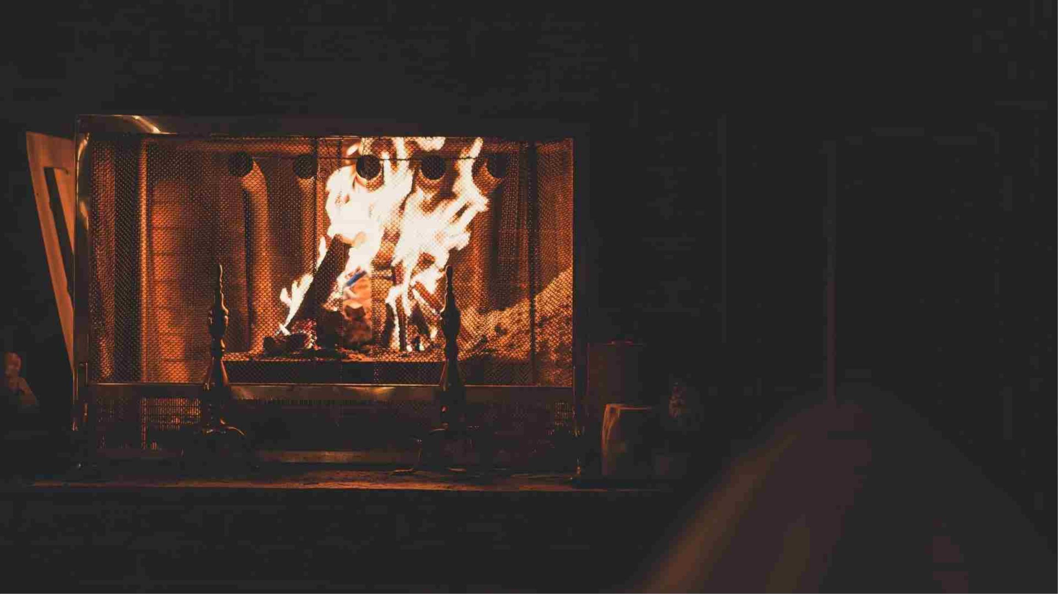
WINTER FIRE SAFETY
Common Causes of Home Fires
According to the NFPA, December and January are the peak months for home fires, deaths and injuries.
December is the peak time of year for home candle fires; the top two days for home candle fires are Christmas and Christmas Eve.
Candles started an average of 7,600 home fires annually (2% of all home fires), resulting in an average of 80 deaths (3%), 680 injuries (6%), and $278 million in direct property damage (4%) per year.
Use Candles Safely
Place candles where they cannot be knocked down or blown over blown over and out of reach of children.
Keep matches and lighters up high, preferably in a locked cabinet, and out of children’s reach.
Use flameless candles near flammable objects; consider battery-operated candles throughout.

Slide 16

WINTER FIRE SAFETY
Home Heating
Heaters
• Heating is the second leading cause of U.S. home fires and home
fire injuries and third leading cause of home fire deaths.
• December, January and February are the peak months for heating
fires.
Fireplace and Chimney Safety
• If you use a fireplace, have it inspected annually and make repairs
as needed.
• Clean the fireplace regularly after use and never leave a fire
burning unattended.
• Ensure you have the correct fire door or screen.
• Do not hang stockings or other decorations near a lit fire.
• Keep all flammable materials, fabrics, and liquids away from any lit
fire.
• Embers smolder; ensure all embers are completely out before
going to bed or leaving the home.
Space Heaters
• Space heaters should always be placed on the smoothest floor
surface possible.
• Avoid placing a space heater within three feet of anything
flammable.
• Do not leave unattended!

Slide 17

WINTER HOLIDAY SAFETY
Holiday Trees
Between 2015-2019, U.S. fire departments responded annually to an average of 160
home fires that started with holiday trees.
These fires caused an annual average of two deaths, 12 injuries and $10 million in
direct property damage. Roughly three-quarters of holiday tree fires occurred in
December or January. More than two of every five (42%) home holiday tree fires
started in the living room.
Preventing holiday tree fires
• Water live trees regularly. Do not let them dry out. Keep an eye out for
browning or drying needles.
• Keep live and artificial trees at least three feet away from heat or
flame sources such as heating vents, fireplaces, candles and portable
heaters. Do not block doorways.
• Follow instructions on holiday lights and do not overload outlets,
power strips or circuits.
• Remove live trees as soon as they start to dry out and stop retaining
water.
• If using a live tree, cut off about 2 inches of the trunk to expose fresh
wood for better water absorption.
• If using an artificial tree, check it is labeled “fire resistant.”
17

Slide 18

HOLIDAY SAFETY
Holiday Decorating
• Only use indoor lights indoors and outdoor lights outdoors and choose the right ladder
for the task when hanging lights.
• Replace light sets that have broken or cracked outlets, frayed or bare wires or loose
connections.
• Follow the package directions on the number of light sets that can be plugged into
one socket
• Turn off all lights and decorations when you go to bed or leave the house.
• Never nail, tack or stress wiring when hanging lights and keep plugs off the ground
away from puddles and snow.
• Avoid placing breakable ornaments or ones with small, detachable parts on lower tree
branches where small children can reach them.
• Keep potentially poisonous plants – mistletoe, holly berries, Jerusalem cherry (also
known as Christmas or winter cherry) and amaryllis away from children.

Slide 19

HOLIDAY SAFETY
Gift Safety
• Toys are age-rated for safety, not for children’s intellect
and physical ability, so choose toys in the correct age
range.
• Choose toys for children under 3 that do not have
small parts which could be choking hazards.
• For children under 10, avoid toys that must be plugged
into an electrical outlet.
• Be cautious about toys that have button batteries or
magnets, which can be harmful or fatal if swallowed.
• When giving riding toys, give the gift of appropriate
safety gear, too; helmets should be worn at all times
and sized to fit.
19

Slide 20
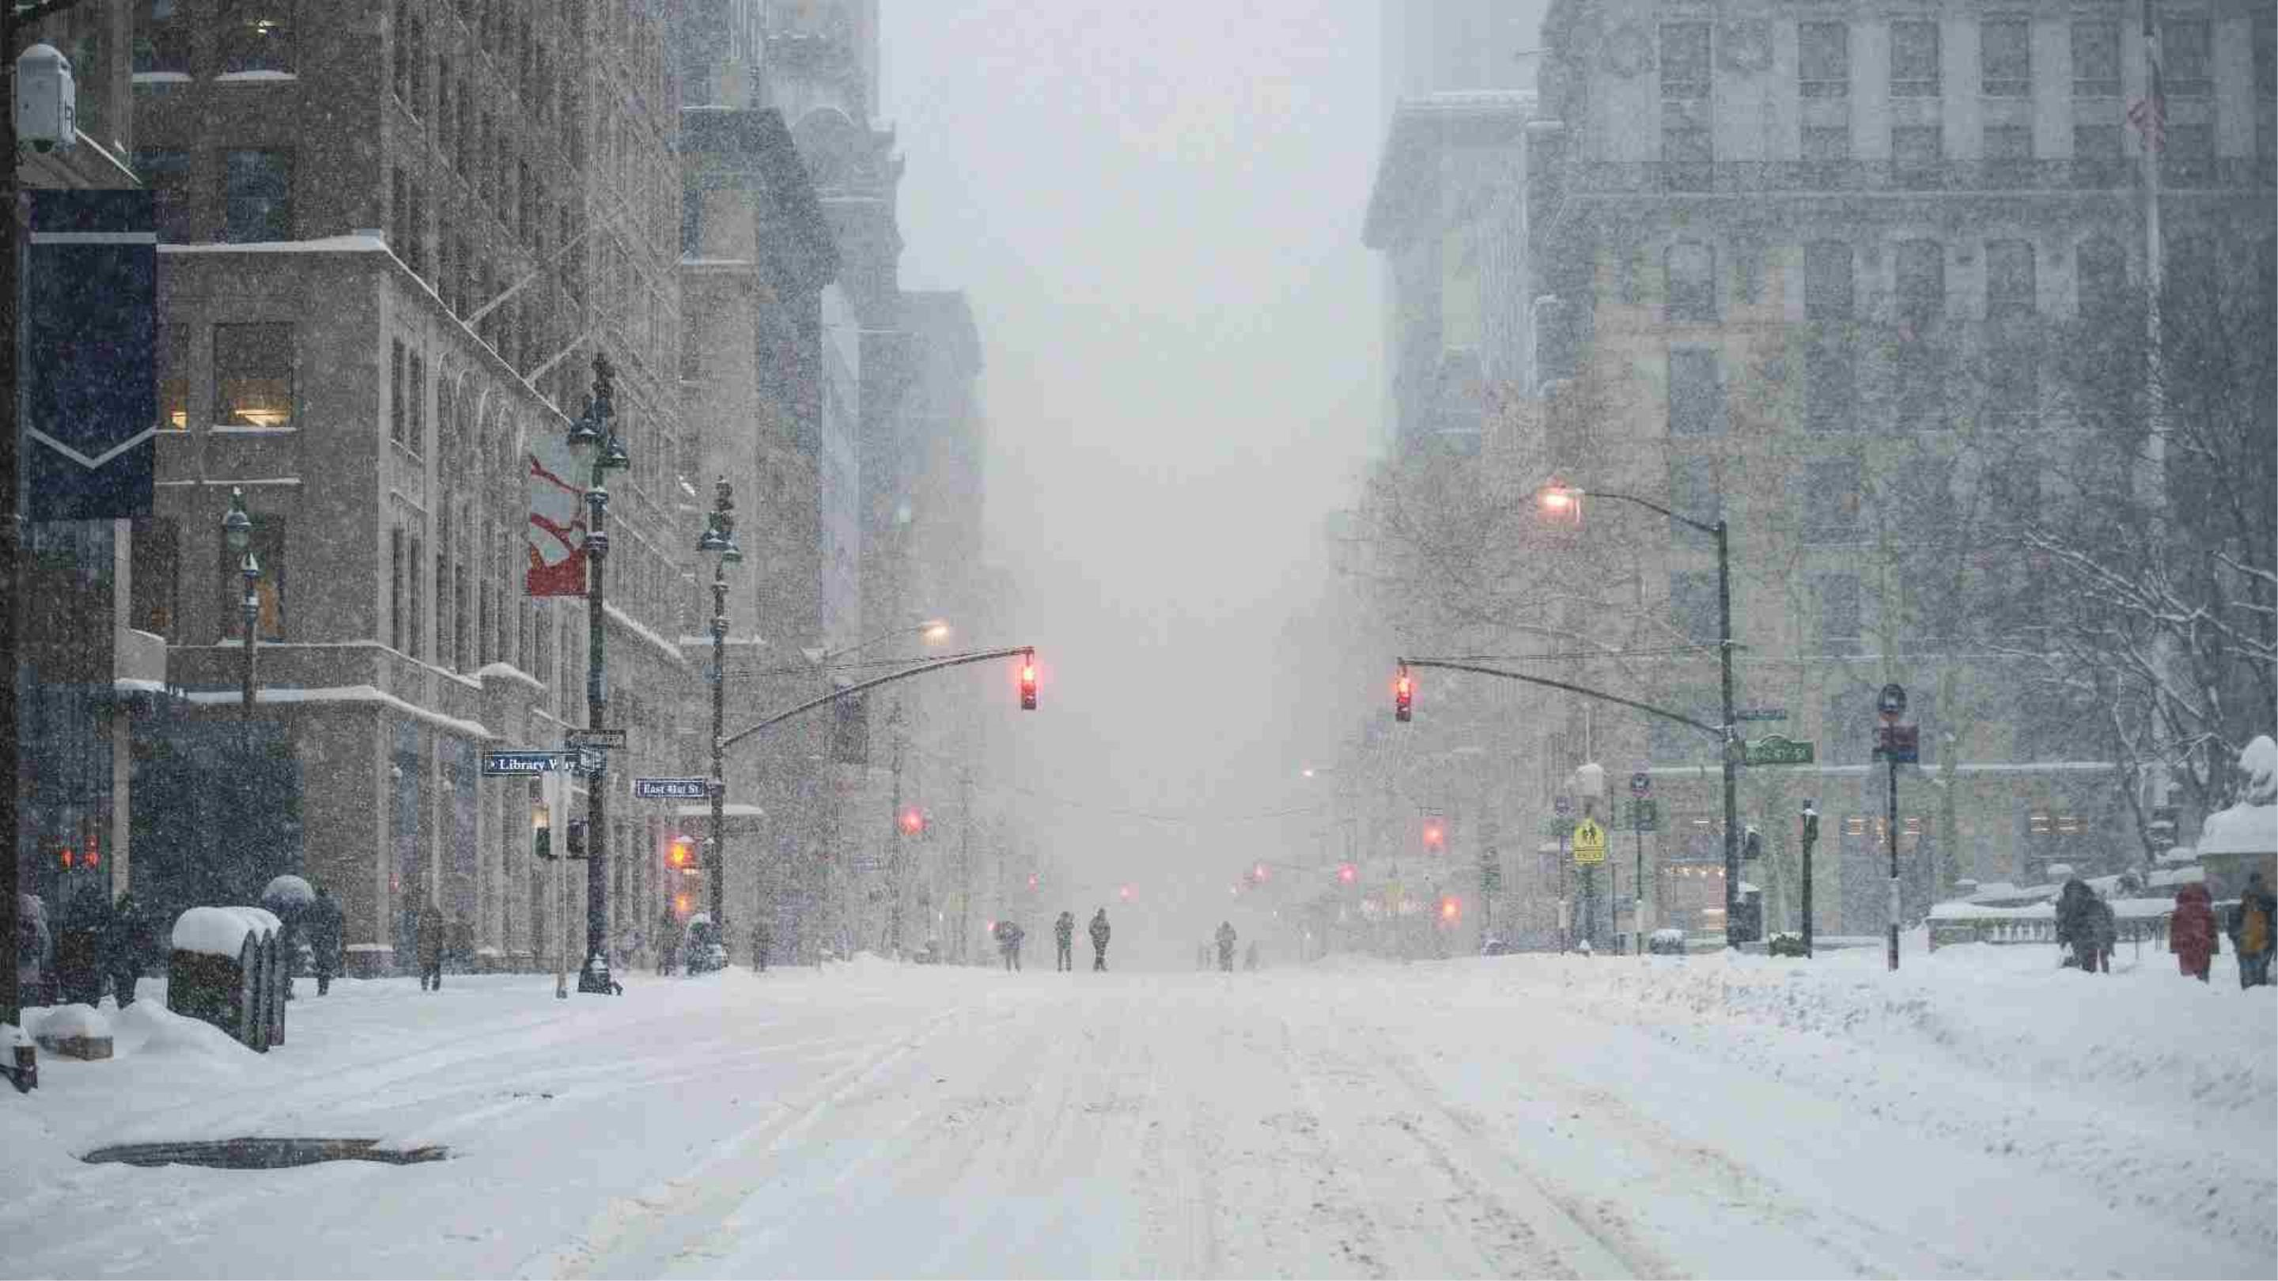
Preparing for Winter Weather
20

Slide 21

WINTER SPORTS SAFETY
Winter Sports Safety
Skiers and snowboarders, no matter how experienced, should never ski alone. Nor should they ski
off designated trails.
Almost 200,000 people were treated at hospitals, doctors' offices and emergency rooms for winter
sports-related injuries in 2018, according to the U.S. Consumer Product Safety Commission. This
figure includes 76,000 injuries from snow skiing and 22,000 injuries from sledding and tobogganing.
Safety Tips
• Get in shape for the season and not just the week before a ski trip; a regular exercise routine
will help reduce fatigue and injury.
• Beginners should invest in proper instruction, including learning how to fall and get back up;
experienced skiers and snowboarders should take a refresher course.
• Always know the weather conditions before heading to the slopes; time of day can also affect
visibility and make obstacles difficult to see.
• Give skiers and snowboarders in front of you the right of way; they most likely can't see you.
• If you have to stop, stop on the side of a run, not in the middle.
• Helmets reduce head injuries. However, even though helmet use has increased over the years,
traumatic brain injuries still can occur with helmet use.
• Severe injury and death are prevented by avoiding risk-taking behaviors.
21

Slide 22
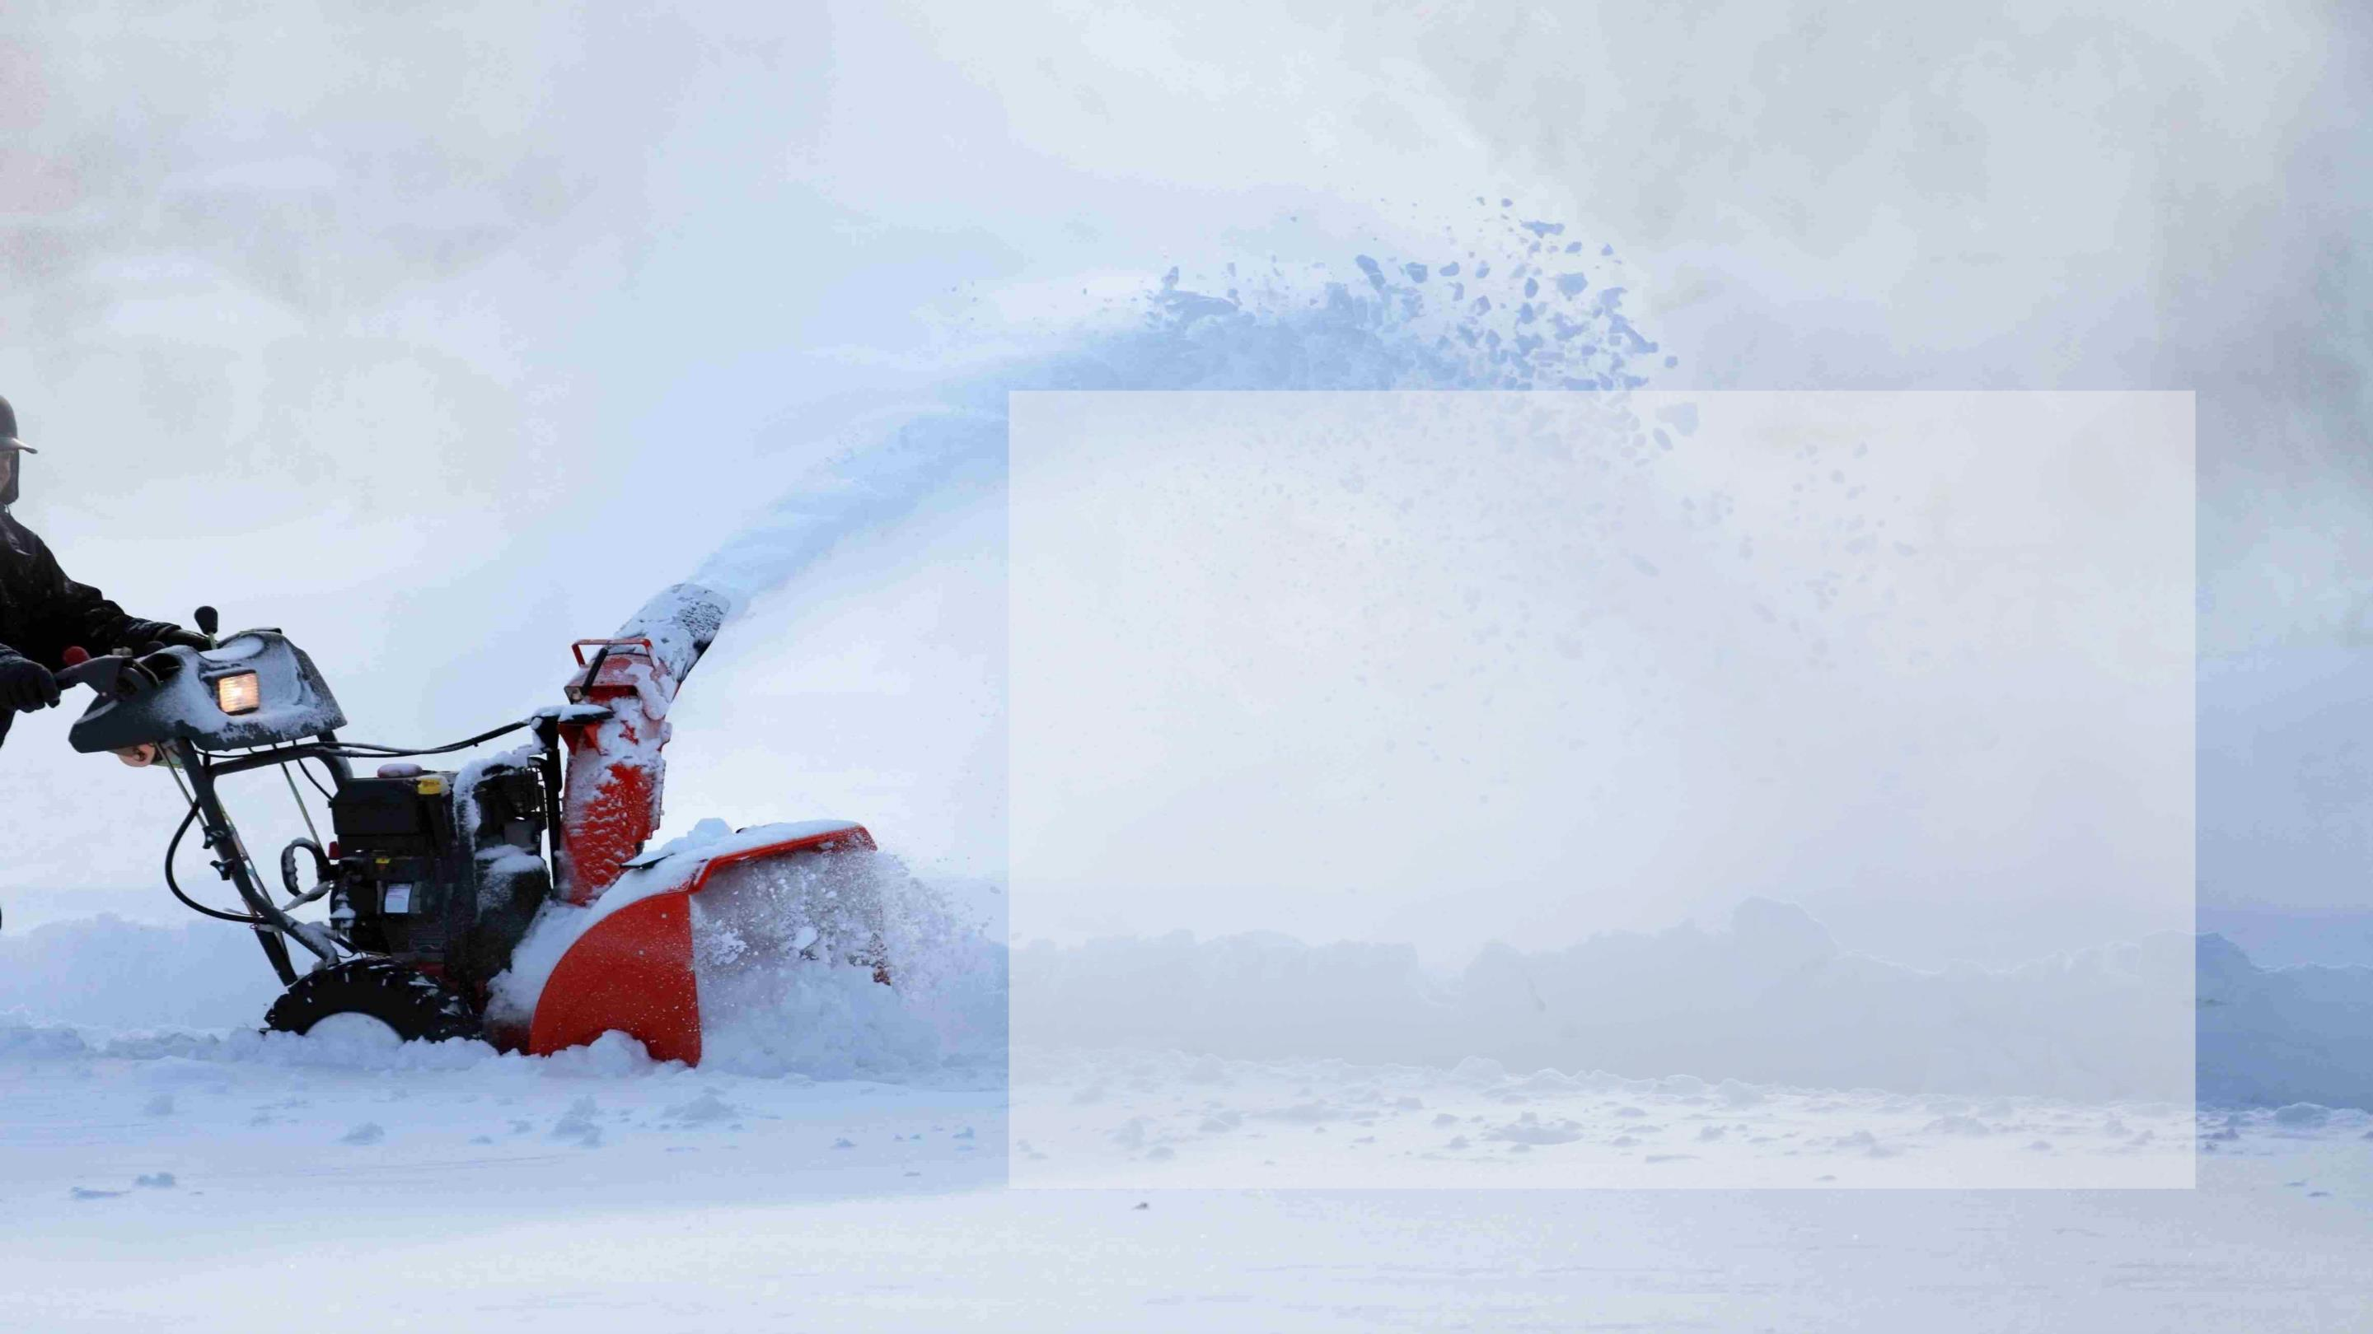
WINTER-RELATED ACTIVITIES
Snow Blower Safety
• It is important that powered equipment such as snow blowers are properly
grounded to protect workers from electric shock or electrocution.
• When performing maintenance or cleaning, ensure the equipment is properly
guarded and is disconnected from power sources.
• Snow blowers commonly cause lacerations or amputations when operators
attempt to clear jams while equipment is on.
• Never attempt to clear a jam by hand. First, turn the snow blower off and wait for
all moving parts to stop, and then use a long stick to clear wet snow or debris
from the machine.
• Keep your hands and feet away from moving parts.
• Fuel a snow blower before starting the machine; do not add fuel when the
equipment is running or when the engine is hot.
22

Slide 23
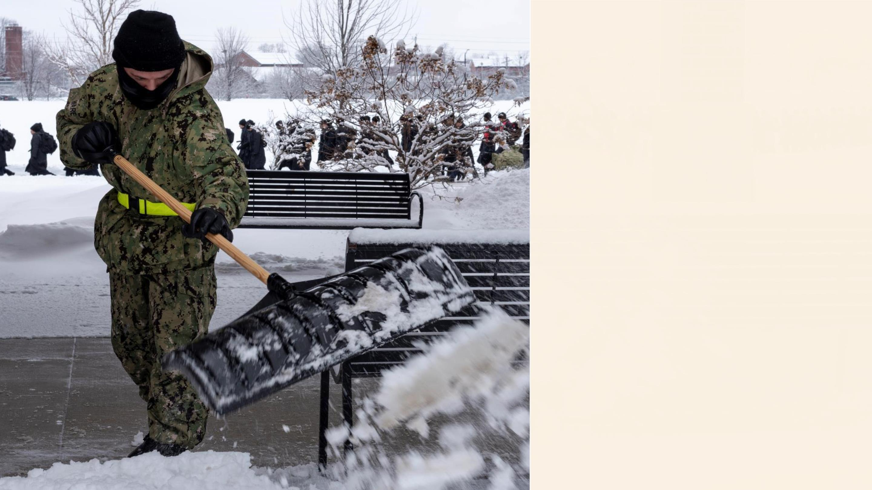
WINTER-RELATED ACTIVITIES
Shoveling Safety
Shoveling snow can be a strenuous activity, particularly
because cold weather can tax a body. There is a potential
for exhaustion, dehydration, back injuries or heart attacks.
During snow removal, in addition to following tips for
avoiding cold stress, such as taking frequent breaks in
warm areas, there are other precautions people can take to
avoid injury.
• Warm up before the activity, scoop small amounts of
snow at a time and where possible, push the snow
instead of lifting it.
• Use proper lifting techniques to avoid back and other
injuries when shoveling snow: keep the back straight,
lift with the legs and do not turn or twist the body.
23

Slide 24
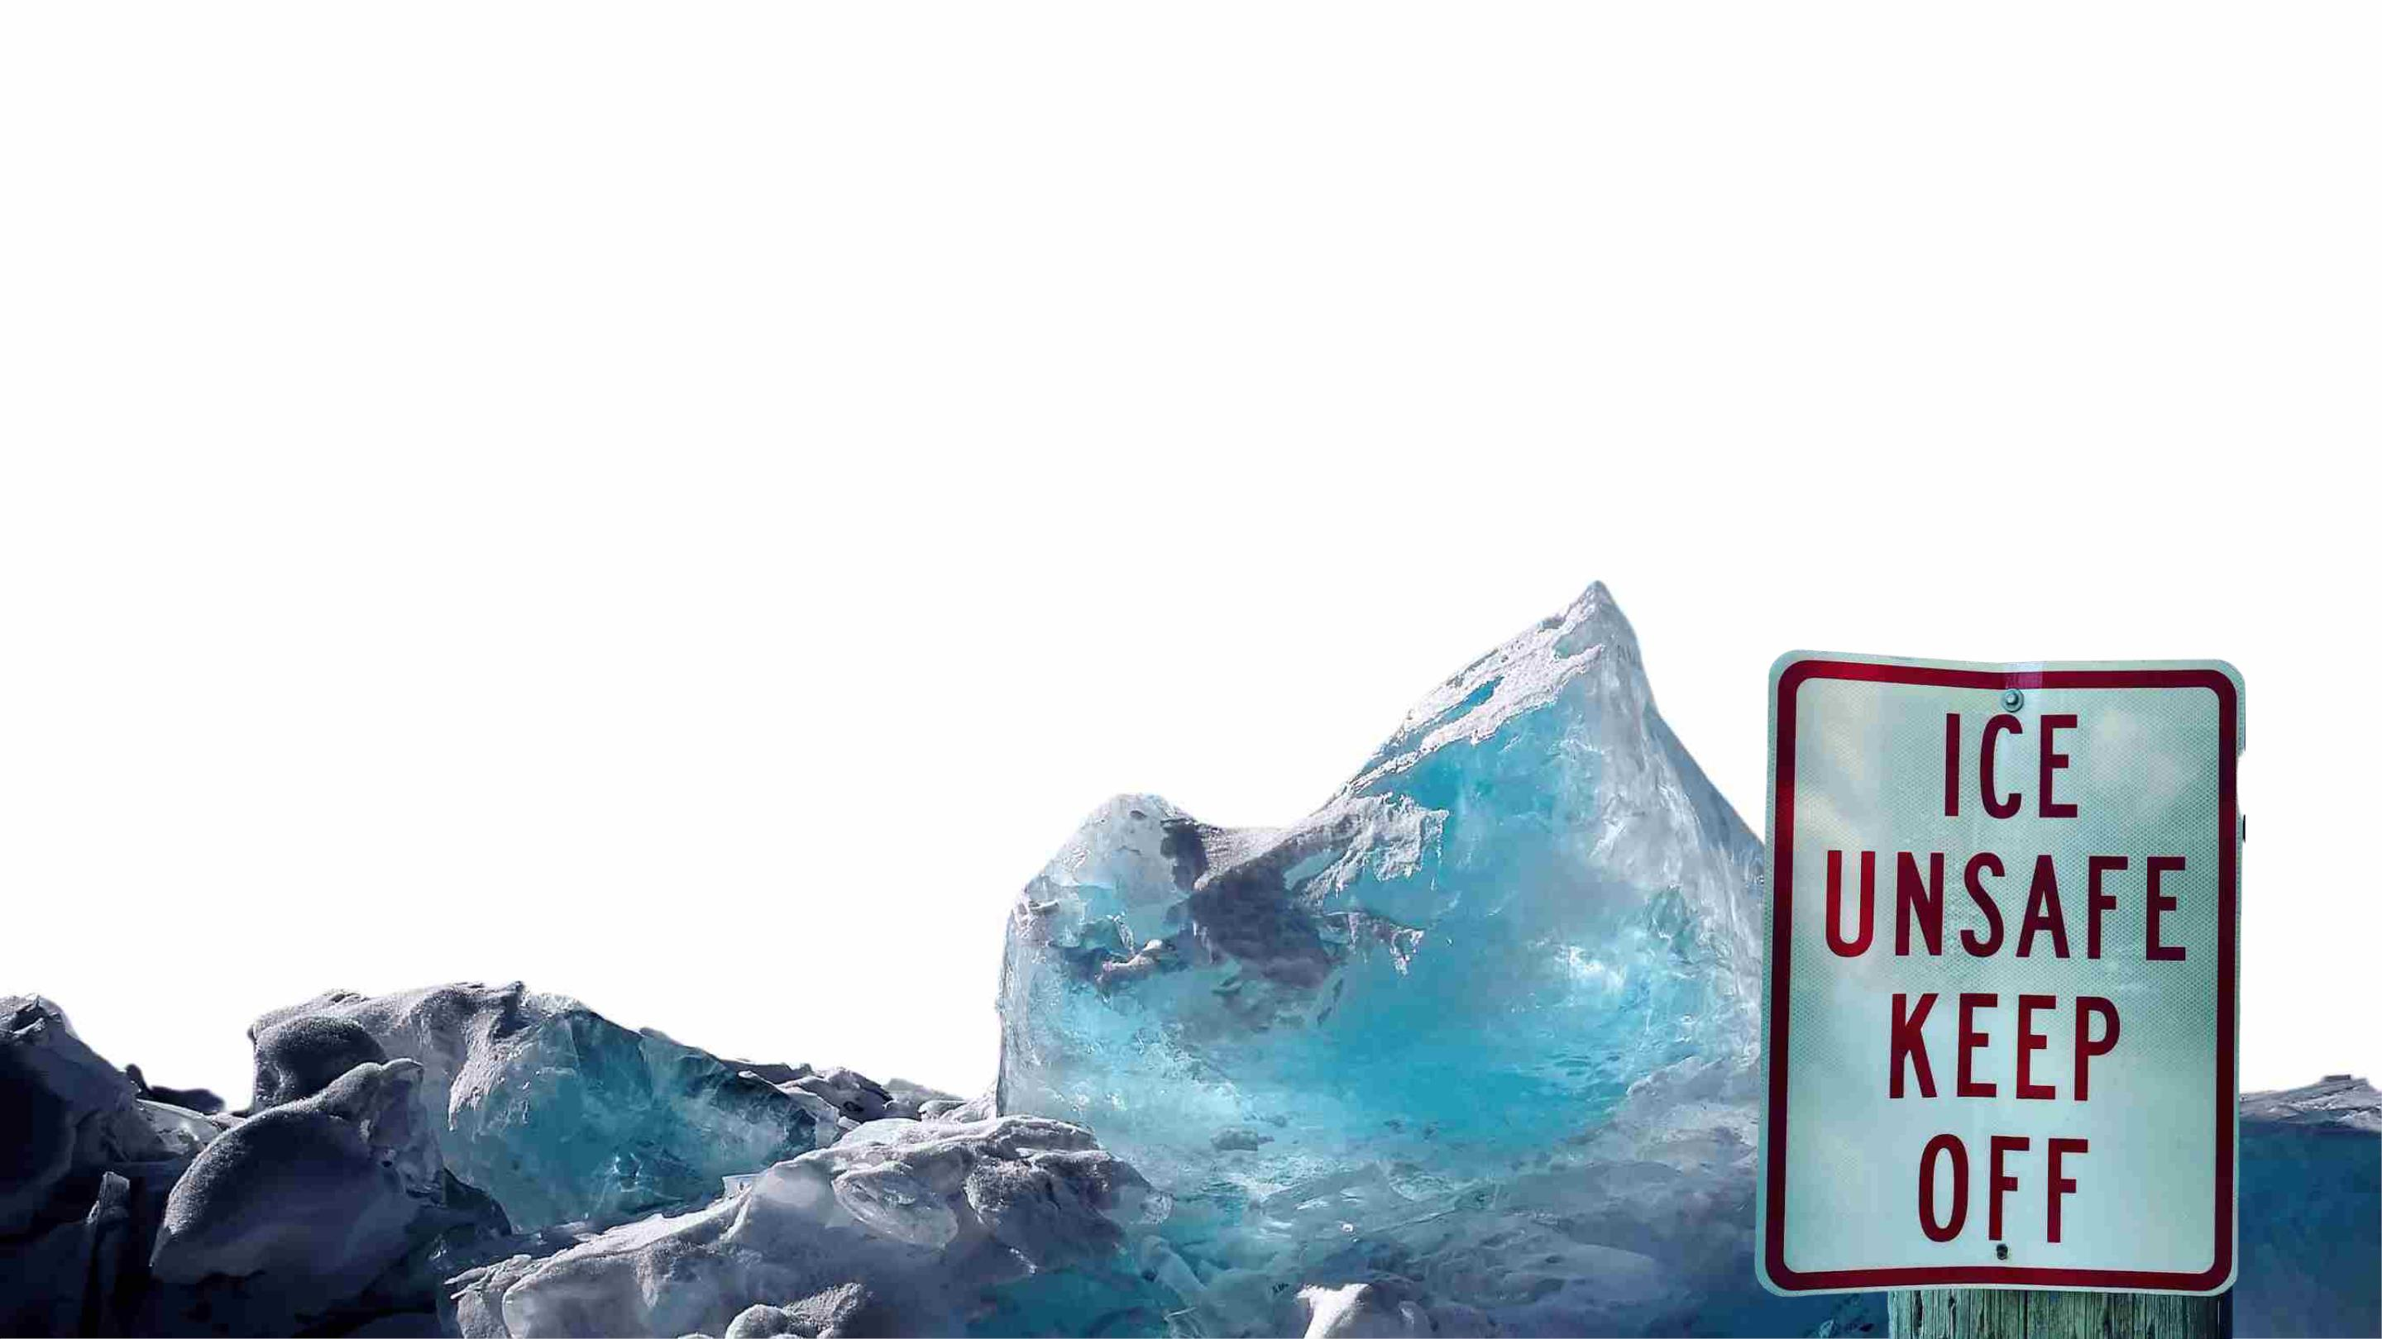
WINTER-RELATED SLIPS, TRIPS AND FALLS
Stay on your feet in wet or icy weather
• Wear proper footwear that is right for the weather. Non-skid boots or shoes with plenty of traction can help prevent falls in wet or snowy
weather. Wet grass can be as slippery as an icy sidewalk, so plan accordingly.
• Keep your driveway, walkways and stairs clear and free of leaves. As they accumulate or get wet, leaves become slippery.
• Apply de-icing materials such as salt to reduce ice buildup.
• Take short steps over ice. Point toes slightly outward to maintain a stable base of support and try
to use only cleared sidewalks and walkways.
• Pay attention to where you’re going, stay on cleared sidewalks and paths and
keep an eye out for patches of black ice.
• Use handrails where available to help keep your balance when walkways or
steps may be slick.

Slide 25

WINTER SAFETY
Cold Weather Injuries
Hypothermia:
First Aid
When exposed to cold temperatures, your body begins to lose heat faster than it can be
produced. Prolonged exposure to cold will eventually use up your body’s stored energy. The
result is hypothermia or abnormally low body temperature. A body temperature that is too
low affects the brain, making the victim unable to think clearly or move well. This makes
hypothermia particularly dangerous because a person may not know it is happening and will
be unable to do anything about it. The signs and symptoms of hypothermia can vary
depending on how long you have been exposed to the cold temperatures.
• Take the following steps to treat someone with hypothermia:
• Alert the supervisor and request medical assistance.
• Move the victim into a warm room or shelter.
• Remove their wet clothing.
• Warm the center of their body first-chest, neck, head, and
groin-using an electric blanket, if available; or use skin-to-skin
contact under loose, dry layers of blankets, clothing, towels or
sheets.
• Warm beverages may help increase the body temperature,
but do not give alcoholic beverages. Do not try to give
beverages to an unconscious person.
• After their body temperature has increased, keep the victim
dry and wrapped in a warm blanket, including the head and
neck.
Early Signs and Symptoms:
• Shivering
• Fatigue
• Loss of coordination
• Confusion and disorientation
Late Signs and Symptoms:
• No shivering
• If the person has no pulse, begin cardiopulmonary
resuscitation (CPR).
• Blue skin
• Dilated pupils
• Slowed pulse and breathing
• Loss or decline in consciousness
25

Slide 26
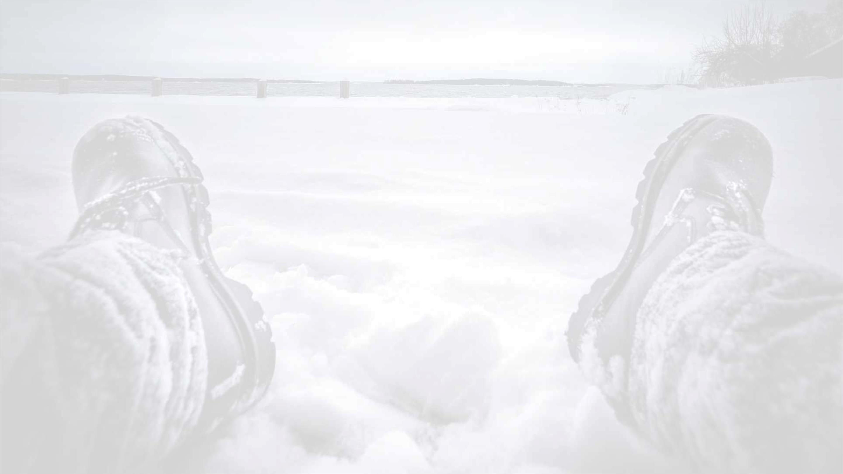
WINTER SAFETY
Cold Weather Injuries (cont.)
Frostbite is an injury to the body caused by freezing. Frostbite
causes a loss of feeling and color in the affected areas. It most often
affects the nose, ears, cheeks, chin, fingers or toes.
People suffering from frostbite should:
• Get into a warm room as soon as possible.
Frostbite can permanently damage body tissue and severe cases
can lead to amputation. In extremely cold temperatures, the risk of
frostbite is increased in people with reduced blood circulation and
among those who are not dressed properly.
• Unless absolutely necessary, do not walk on frostbitten feet
or toes - this increases the damage.
• Immerse the affected area in warm-not hot-water (the
temperature should be comfortable to the touch for
unaffected parts of the body).
Symptoms include:
• Reduced blood flow to hands and feet (fingers
or toes can freeze)
• Numbness
• Warm the affected area using body heat; for example, the
heat of an armpit can be used to warm frostbitten fingers.
• Tingling or stinging
• Achiness
• Bluish or pale, waxy skin
• Swelling, loss of coordination, and blisters
• Do not rub or massage the frostbitten area; doing so may
cause more damage.
• Do not use a heating pad, heat lamp, or the heat of a stove,
fireplace, or radiator for warming. Affected areas are numb
and can be easily burned.
26

Slide 27
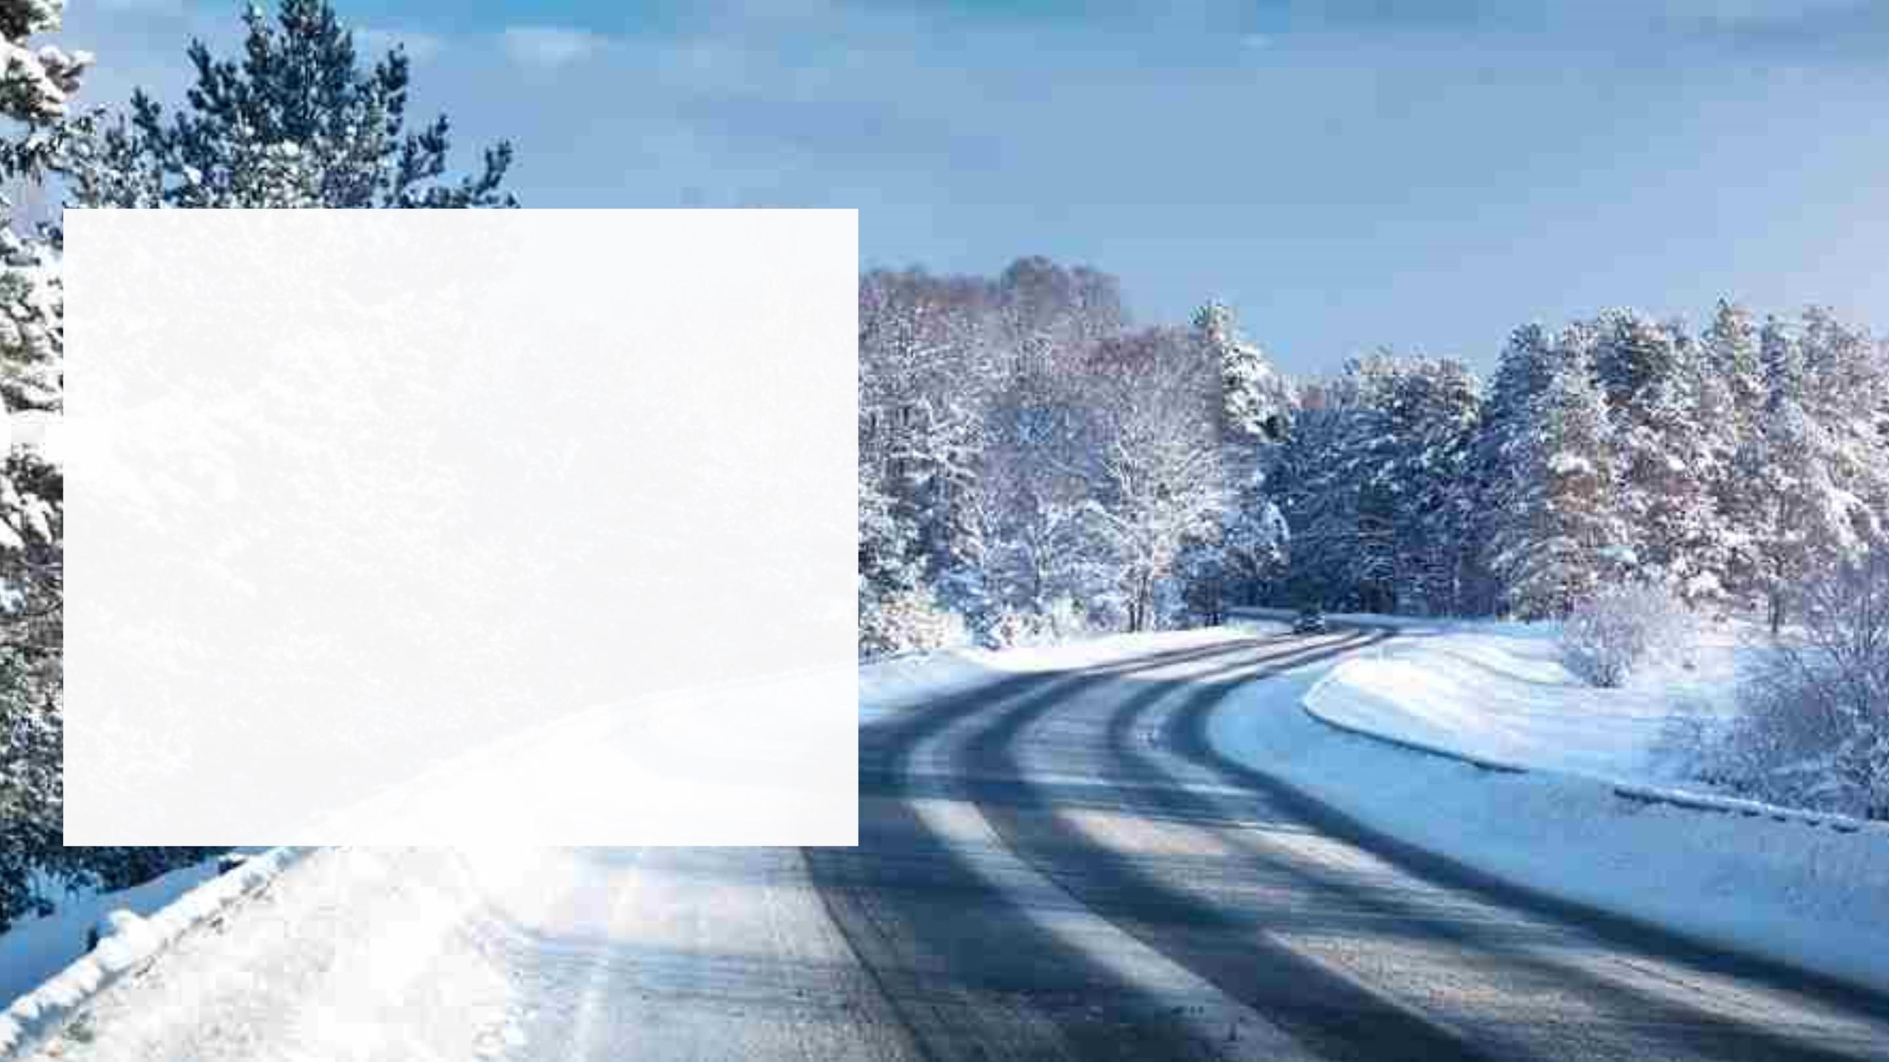
SEASONAL DRIVING
Fall and Winter driving conditions vary depending on where you
live, where you’re going and the route you choose. Regardless of
where you’re going, it pays to plan ahead and prepare
accordingly.
• Drive Safely as it Gets Darker
• How can you make it home safely during rush hour?
• Winter Driving Conditions
• Winter Driving Preparedness
• Black Ice
• What To Do If You Get Stranded or Stuck?
• Emergency Vehicle Kit
• Distracted Driving
• Additional Safe Driving Tips
• Drowsy Driving
• Driving Under The Influence

Slide 28
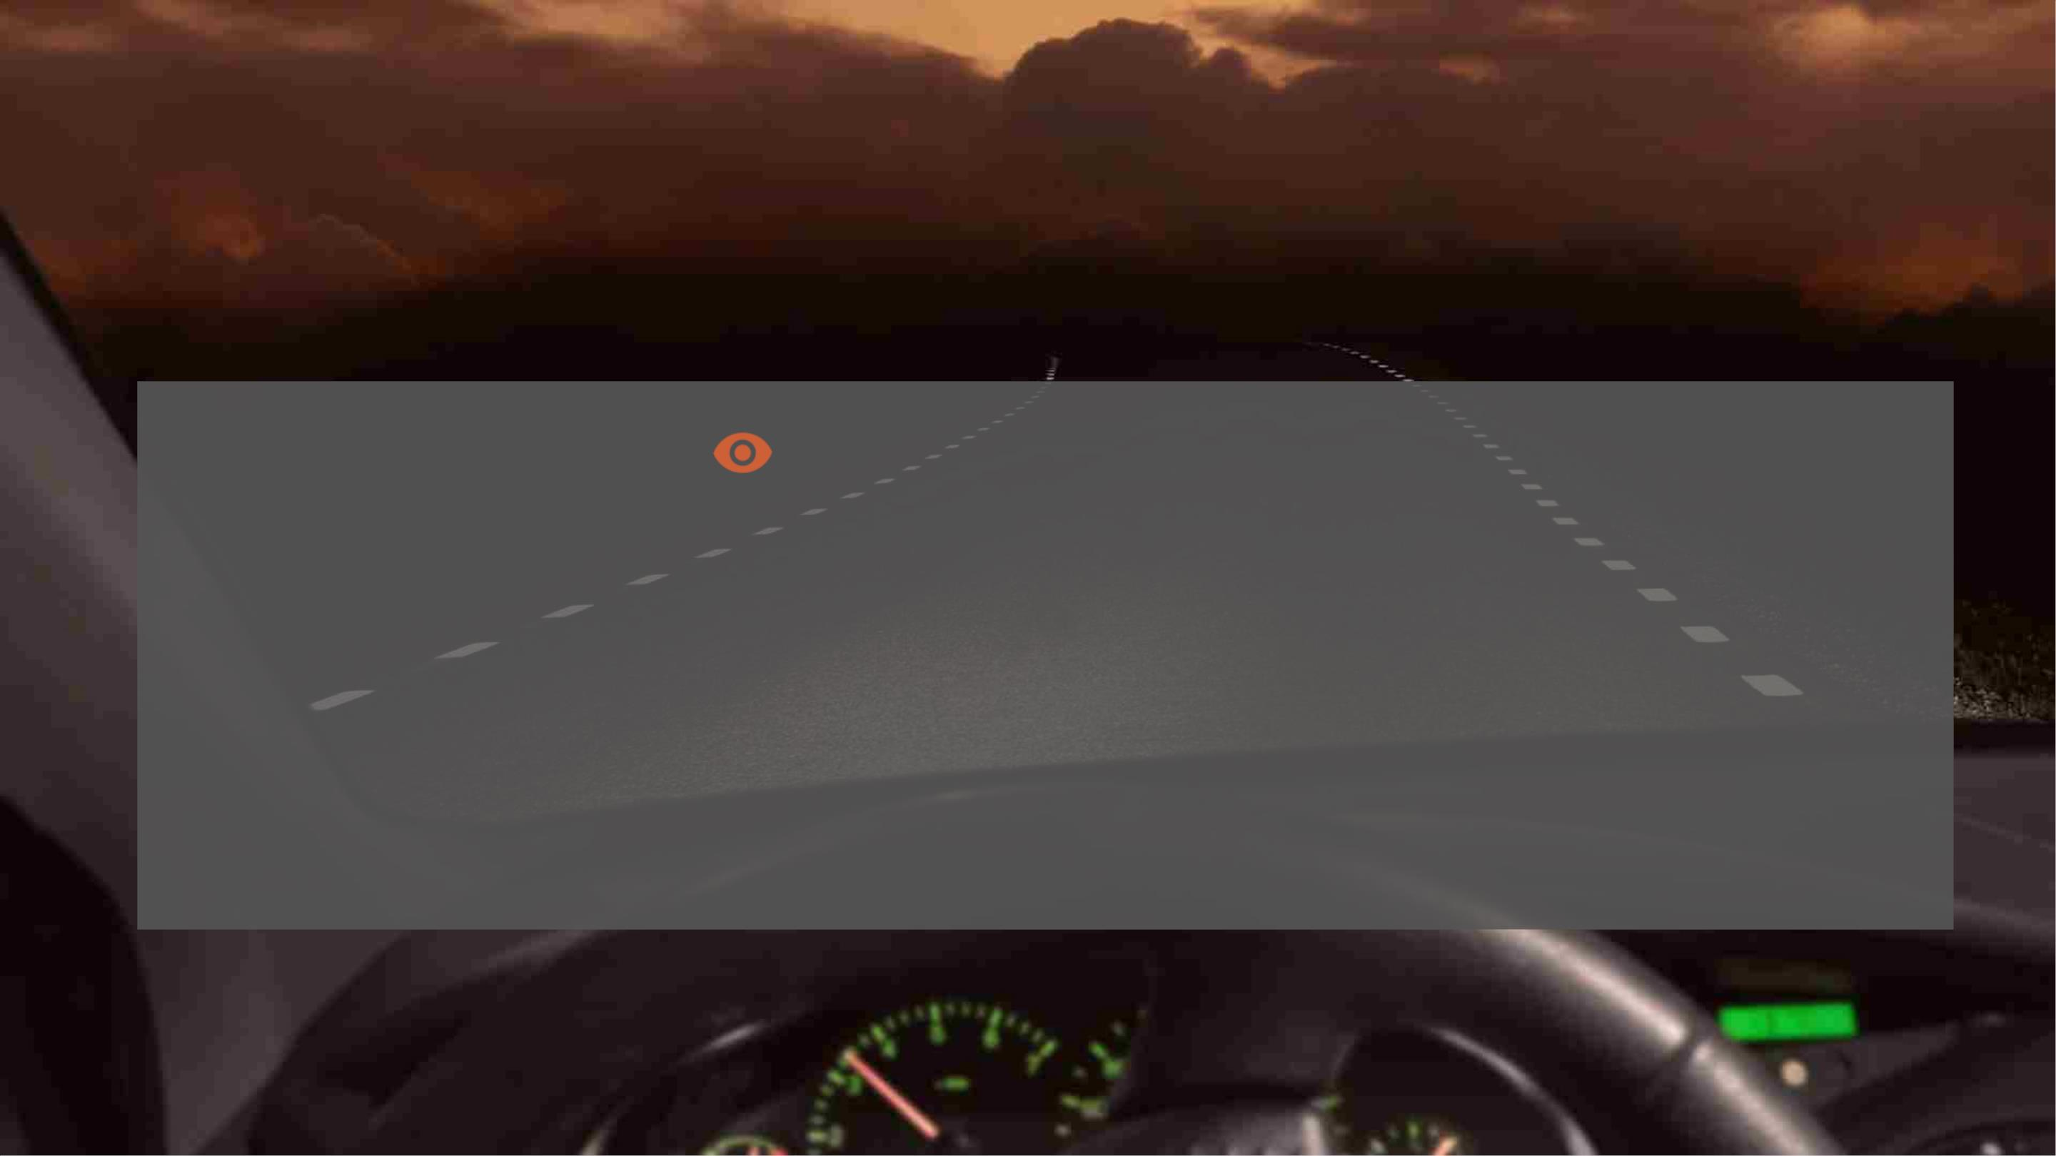
SEASONAL DRIVING SAFETY
Drive s fely as it gets darker
As we 'Fall Back' to Shorter Days, Take Extra Care on the Road:
• Shorter days, fatigue, compromised night vision, rush hour and impaired drivers are some of the risks we face when driving at night. These risks
become especially pronounced moving into the weekend, with fatal crashes peaking on Saturday nights, according to NSC analysis of National
Highway Traffic Safety Administration (NHTSA) data.
• When Daylight Saving Time ends – for 2022 that's 2 a.m. Nov. 6, many people will find themselves spending more time driving in the dark. Depth
perception, color recognition and peripheral vision can be compromised in the dark and the headlights glare from oncoming vehicles can
temporarily blind a driver.
• Even with high-beam headlights on, visibility is limited to about 500 feet (250 feet for normal headlights), creating less time to react to
something in the road, especially when driving at higher speeds.

Slide 29
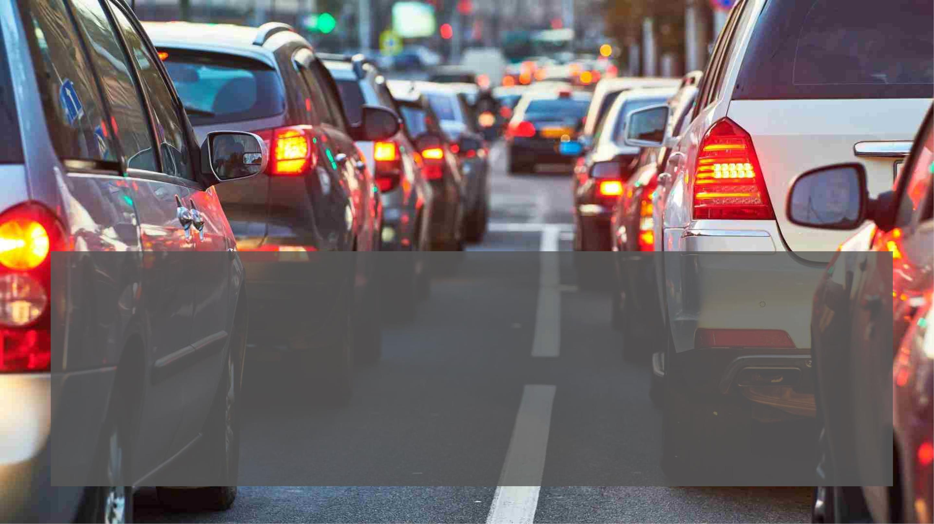
SEASONAL DRIVING SAFETY
Make it home safely during rush hour
Evening rush hour (weekdays between 4 and 7 p.m.) is a dangerous time to drive due to crowded roadways and drivers eager to get home
after work. In winter, it's dark during rush hour, compounding an already dangerous driving situation.
• Don't be an impatient driver; slow down
• Stay in your lane and beware of drivers who dart from lane to lane
• Even though the route may be familiar, don't go on autopilot; stay alert
• Consult directions if you'll be driving in unfamiliar areas and memorize your route
• Don't touch your phone, eat, drink or do other things that are distracting
• Limit driving to daytime hours if necessary

Slide 30
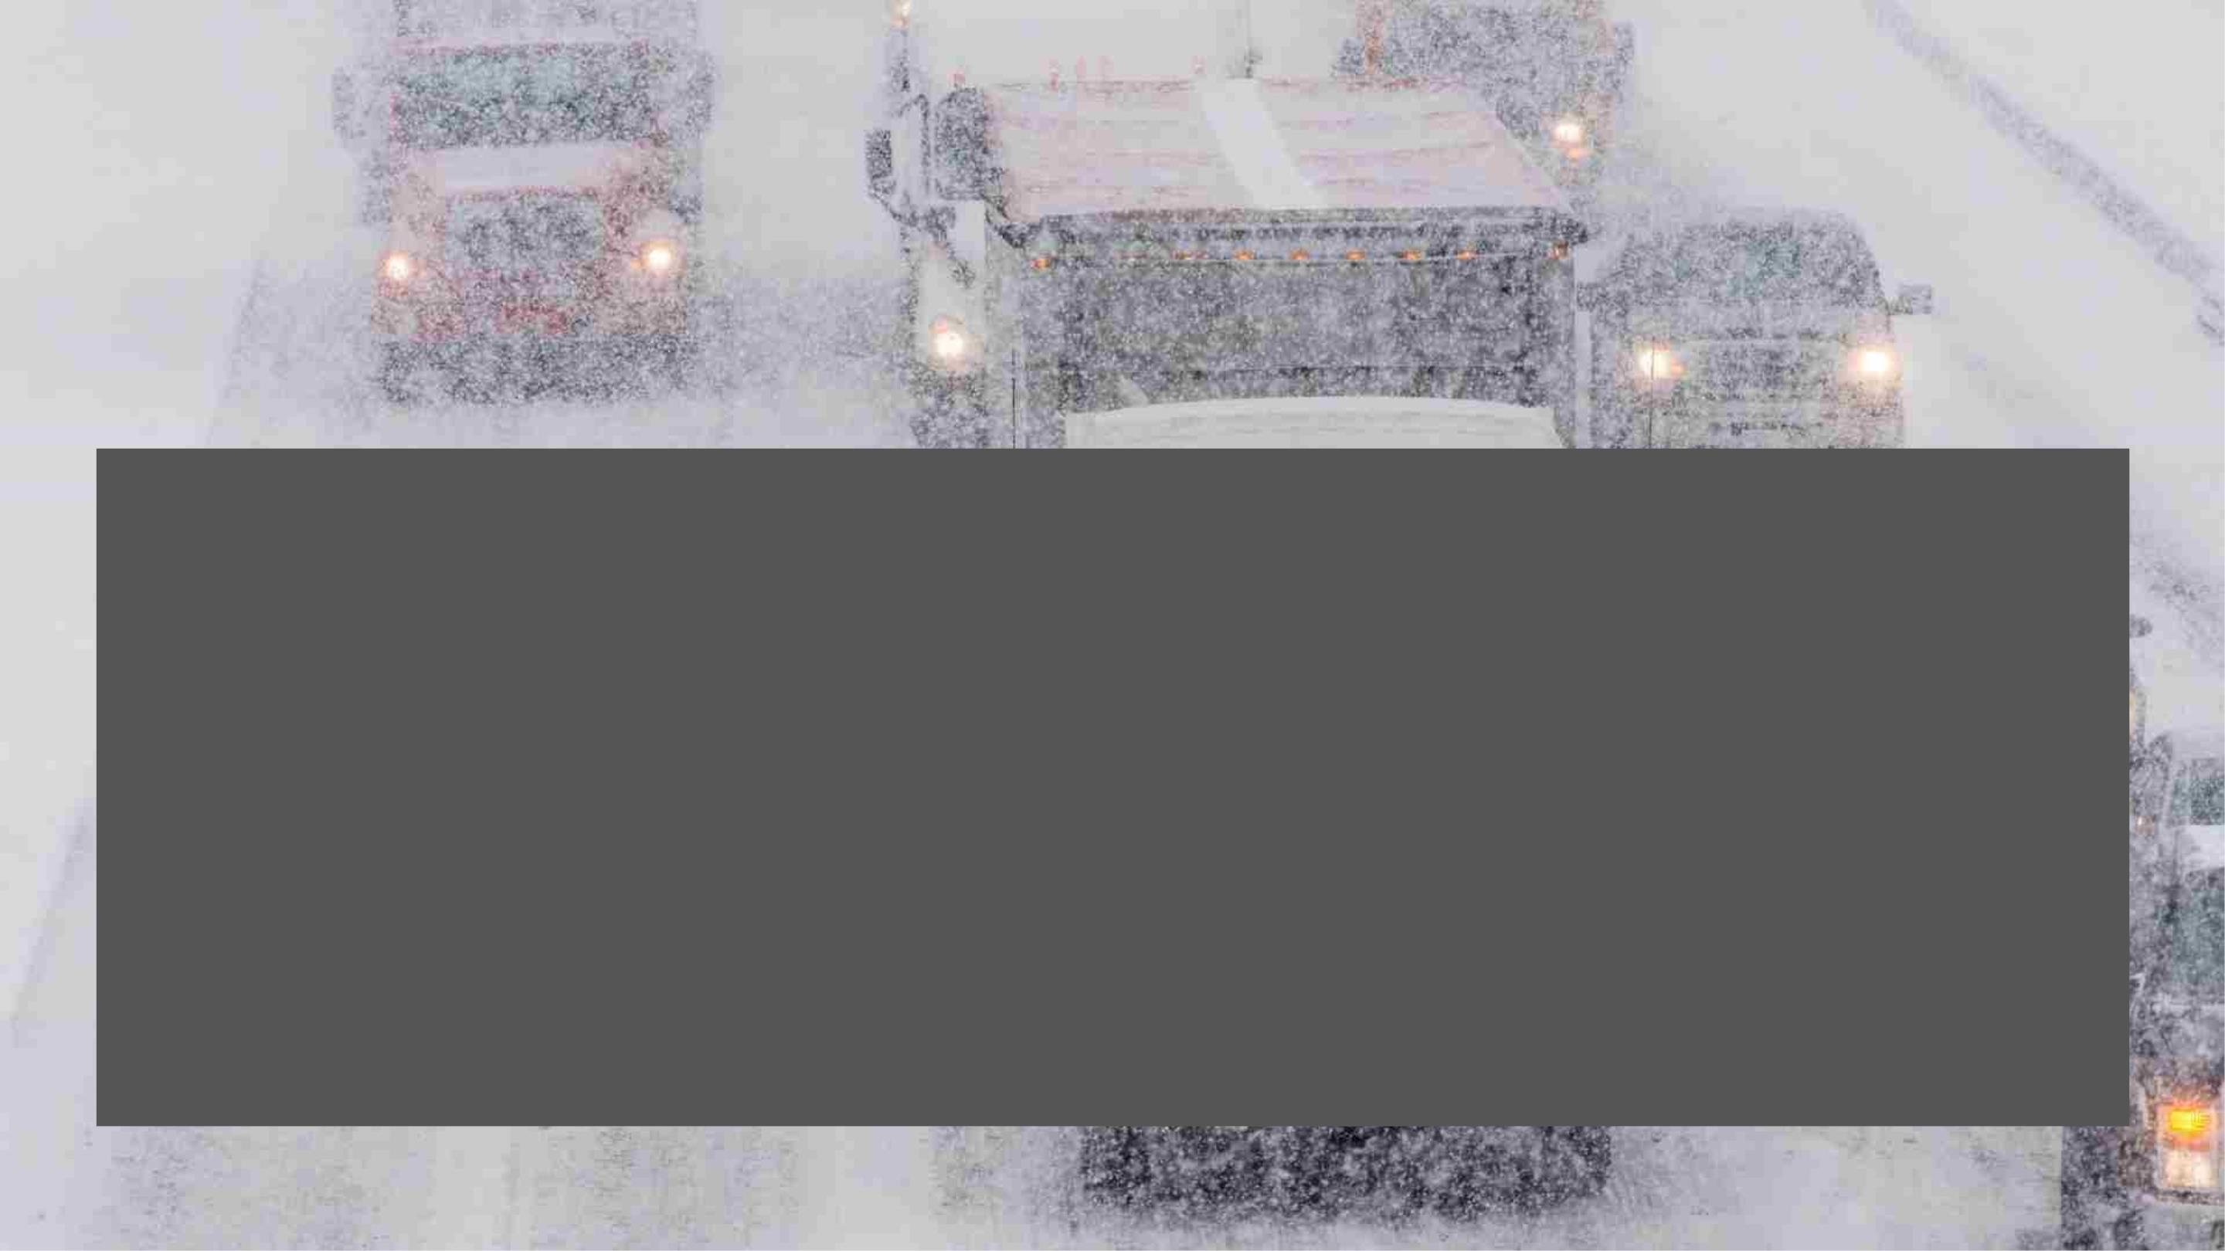
SEASONAL DRIVING SAFETY
Winter Driving Conditions
More than 70% of the nation's roads are located in snowy regions, which receive more than five inches average snowfall
annually. In 2019, there were 440 fatal crashes and 33,000 injury crashes that occurred during wintry conditions according to the
NHTSA.
Depending on where you’re traveling to, running out of gas, getting a flat tire or having your vehicle break down on the side of
the road can have far more disastrous consequences in the winter, than in the spring or summer. Preparing yourself – and your
vehicle – for winter weather is key.
So how should you prepare?
31

Slide 31
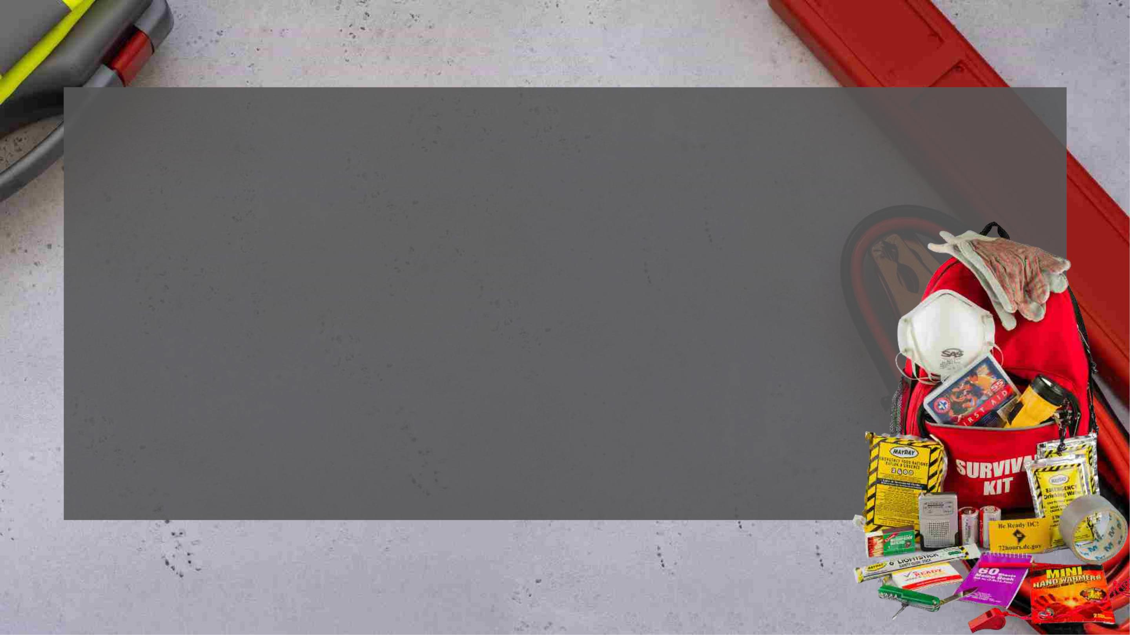
SEASONAL DRIVING SAFETY
Winter Travel Preparedness
• Plan and evaluate your route ahead of time and anticipate adverse weather conditions.
• Check your vehicle's tires, windshield wipers, coolant, lights and other systems before you hit the road.
If you’re heading to areas known for snowy conditions, install snow tires before you hit snowy
conditions.
• Have an emergency kit and ensure you know how your vehicle handles adverse road conditions.
• Look out for common hazards including hidden potholes, blowing snow or unplowed roads, snowdrifts
obscuring roads, sun glare, black ice, bridges or roads near bodies of water (slow down and take your
time), tractor-trailers skidding or reducing visibility, other vehicles going too fast for conditions.
• Inform family or friends of your route and expected arrival time and share your location if traveling
through remote areas, so they know where you were before losing contact if something happens.
• Maintain your distance from other vehicles.

Slide 32

SEASONAL DRIVING SAFETY
Black Ice
What is black ice — and why is it so dangerous? Black ice is a thin glaze of ice that forms over the road during freezing or near-freezing
temperatures. Although clear, drivers call it black ice because the ice looks the same as the asphalt beneath.
This ice proves dangerous for several reasons:
• It’s hard to spot on the road.
• It can form before the weather reaches freezing temperatures.
• It can catch you off guard, leading to an unsafe reaction.
• It can cause you to slide, skid or otherwise lose control of your car.
• Black ice can form anywhere, but you should watch out for bridges or driving on or under overpasses. Also, watch for shaded areas like tree
lines and patches that look shiny or glossy.

Slide 33
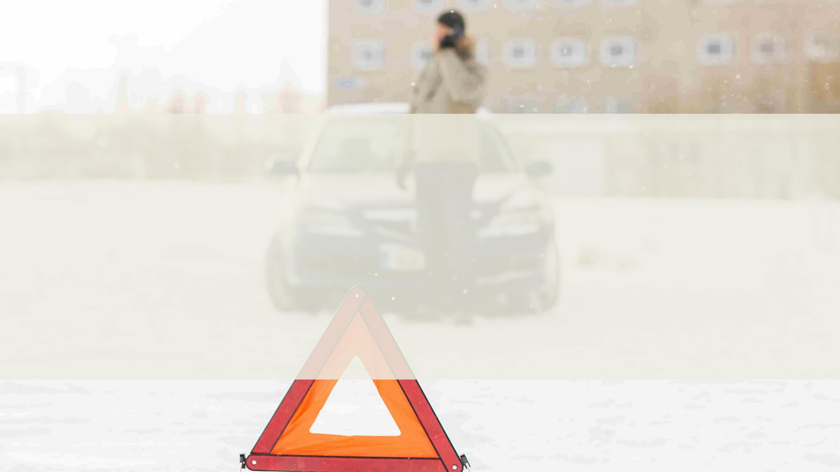
What To Do If You Get
Stranded or Stuck
SEASONAL DRIVING SAFETY
• If you are stranded in a vehicle, stay in the vehicle. Call for emergency assistance if needed, Notify your supervisor and family or
friends of your situation.
• Do not leave the vehicle to search for assistance unless help is visible within 100 yards. You may become disoriented and get lost in
blowing and drifting snow.
• Display a trouble sign by hanging a brightly colored cloth on the vehicle’s radio antenna and raising the hood. Turn on the vehicle's
engine for about 10 minutes each hour and run the heat to keep warm. Also, turn on the vehicle's dome light when the vehicle is
running as an additional signal.
• Beware of carbon monoxide poisoning. Keep the exhaust pipe clear of snow and open a downwind window slightly for ventilation.
• Watch for signs of frostbite and hypothermia. Do minor exercises to maintain good blood circulation in your body. Clap hands and
move arms and legs occasionally. Try not to stay in one position for too long.
• Stay awake, you will be less vulnerable to cold-related health problems. Use blankets, newspapers and even the removable car mats
for added insulation.
• Avoid overexertion since cold weather puts an added strain on the heart. Unaccustomed activities such as shoveling snow or pushing
a vehicle can bring on a heart attack or make pre-existing medical conditions worse.
33

Slide 34
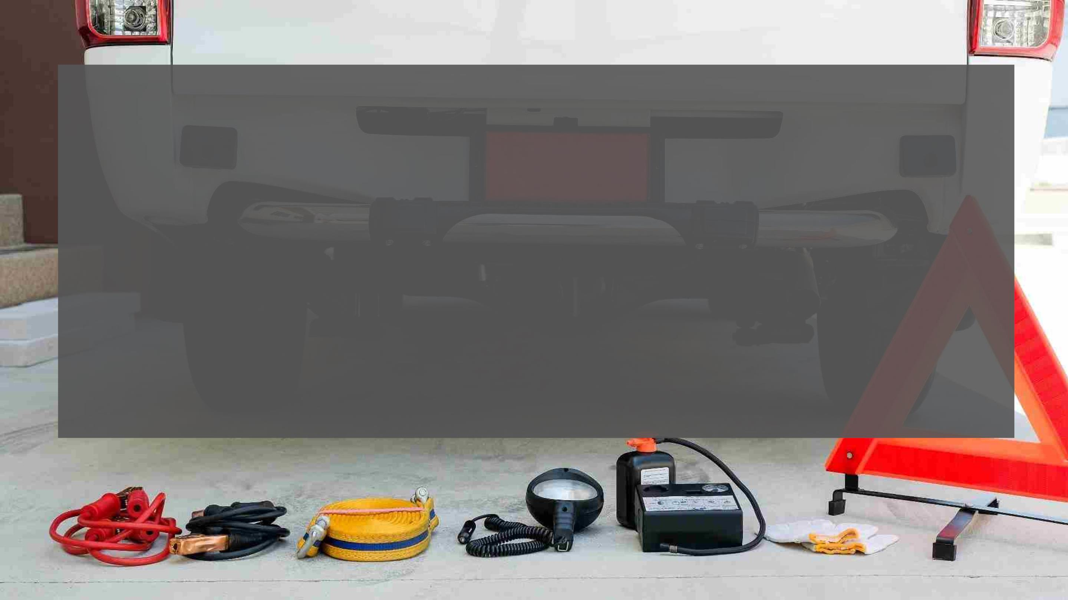
SEASONAL DRIVING SAFETY
Emergency Vehicle Kit
What Should You Keep in Your Vehicle?
• A properly inflated spare tire, wheel wrench and tripod jack
• Jumper cables
• Tool kit and a multipurpose utility tool
• Flashlight and extra batteries
• Reflective triangles and brightly colored cloth to make your vehicle more visible
• Multi-tool (such as a Leatherman multi-tool or a Swiss Army knife)
• First aid kit with gauze, tape, bandages, antibiotic ointment, aspirin, non-latex gloves, scissors, hydrocortisone, thermometer, tweezers and
instant cold compress
• Nonperishable, high-energy foods, such as unsalted nuts, dried fruits, and hard candy
• Reflective vest in case you need to walk and get help
• Drinking water, compass, car charger for your cell phone, fire extinguisher, duct tape, rain poncho
Additional items for cold weather include a snow brush, shovel, windshield washer fluid, warm clothing, blankets and cat litter or sand for traction.
34

Slide 35

SEASONAL DRIVING SAFETY
Distracted Driving
• Distracted driving encompasses talking or texting on your phone, eating and drinking, talking to fellow passengers, fiddling with the
entertainment or navigation systems — anything that takes your attention away from driving safely.
• According to the NHTSA, texting is the most alarming distraction. Sending or reading a text takes your eyes off the road for 5 seconds. At 55
mph, that's like driving the length of an entire football field with your eyes closed.
• You cannot drive safely unless the task of driving has your full attention. Any non-driving activity you engage in is a potential distraction and
increases your risk of crashing.

Slide 36

SEASONAL DRIVING SAFETY
Additional Safe Driving Tips
When we're behind the wheel we must stay focused on one task: safe driving.
Drowsy driving, distracted driving and driving under the influence can have lethal consequences whether
you're driving home for the holidays, to and from work or are out socializing with friends.

Slide 37

SEASONAL DRIVING SAFETY
Drowsy Driving
A National Sleep Foundation (NSF) poll says 60% of adults have driven while they were tired and another 37%, or 103 million people, have
fallen asleep at the wheel. Of those, 13% say they fall asleep while driving at least once a month, and 4% say they have caused a crash by
falling asleep while driving. The reasons vary – shift work, lack of quality sleep, long work hours, sleep disorders, and it doesn't only happen on
lengthy trips.
• These staggering numbers are backed up by a report by NHTSA that 100,000 police-reported crashes are a result of driver fatigue. Most
crashes or near-misses happen at times you would expect drivers to be tired: 4 to 6 a.m., midnight to 2 a.m. and 2 to 4 p.m., according to
the NSF.
• Drowsy driving puts everyone on the road at risk. Depending on the person, losing two hours of sleep may have the same effect on driving
as drinking three beers. Tired drivers are three times more likely to be in a car crash if they are fatigued.
The NSF offers this advice:
• Get seven or more hours of sleep a night.
• Don't drive if you've been awake for 16 hours or more.
• Stop every two hours to rest.
• Pull over and take a nap if you're drowsy.
• Travel during times you are normally awake
Please refer to OPNAVINST 5100.23, Ch. 36, Traffic Safety Program, for more information on maximum driving times and pre-drive risk
assessments.

Slide 38

SEASONAL DRIVING SAFETY
Driving Under the Influence
• Every day, about 32 people in the United States die in drunk driving crashes – That’s one person every 45 minutes. In 2020, 11,654
people died in alcohol impaired driving accidents, a 14% increase from 2019 according to the NHSTA. Drivers impaired by
prescription medicines and other drugs increase that number significantly.
• Impaired drivers are most frequently on the road after dark – particularly between the hours of midnight and 3 a.m., on weekends.
• While drunk driving has declined by about one-third since 2007, the number of drivers under the influence of drugs has increased.
• SAFETY FACT: 56% of drivers involved in serious injury and fatal crashes who tested positive for at least one drug.
• The NHTSA also found the prevalence of THC (found in marijuana) among drivers on weekend nights has increased 48% since 2007,
from 8.6% of drivers to 12.6%. Many states have not yet updated their impaired driving laws to address this growing problem.
3

Slide 39
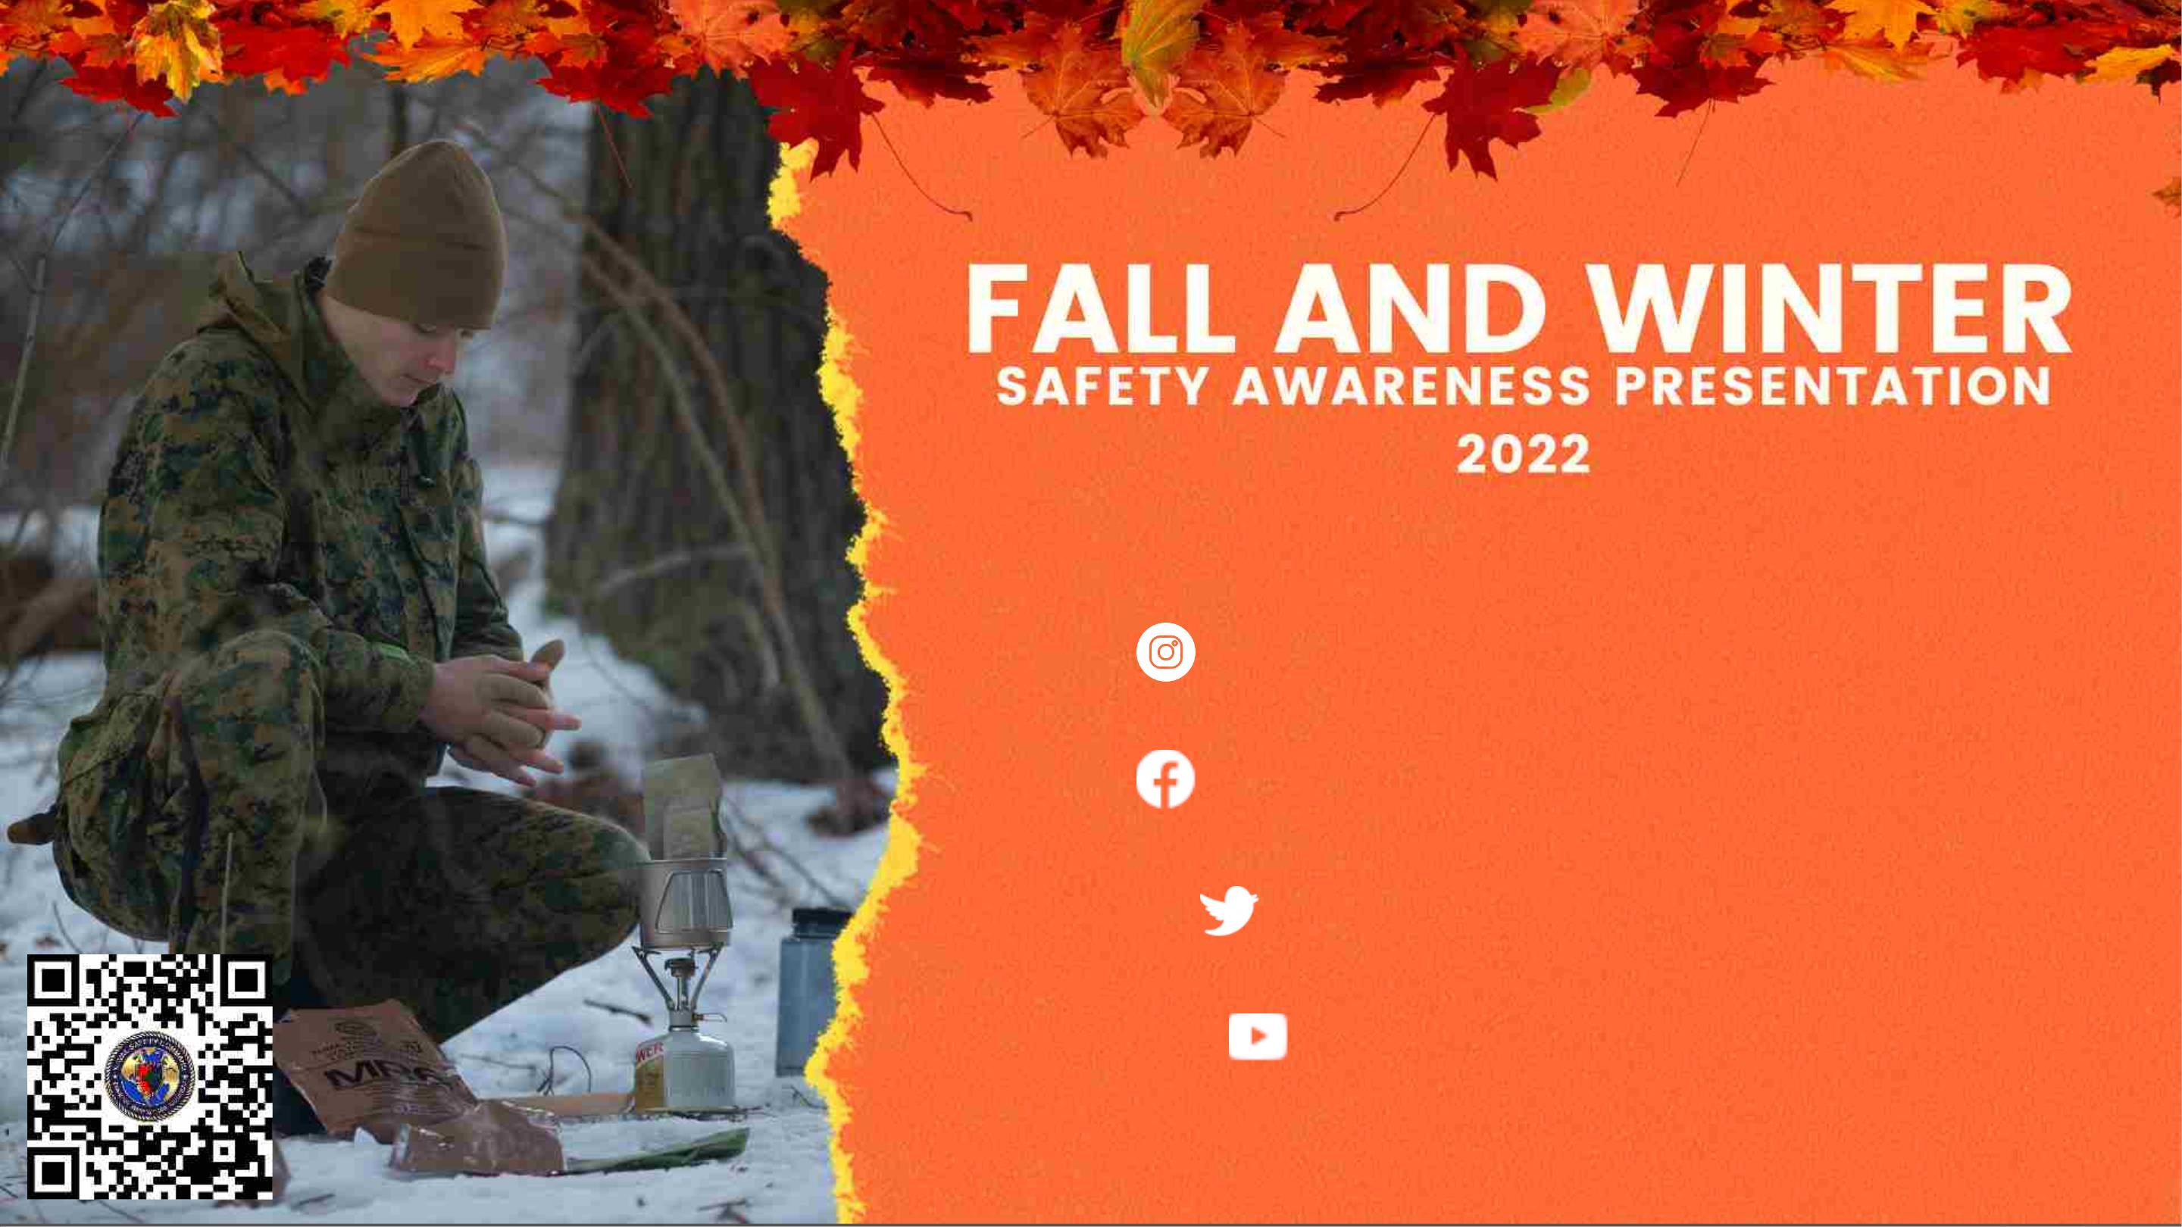
Follow us on social media:
Instagram: navalsafetycommand
Facebook: NavalSafetyCommand
Twitter: @NavalSafetyCmd
navalsafetycommand
For more information from Naval Safety Command,
check our website at www.navalsafetycommand.navy.mil

