Slide 1




NAVAL SAFETY COMMAND PRESENTS
101 CRITICAL DAYS OF SUMMER

Slide 2


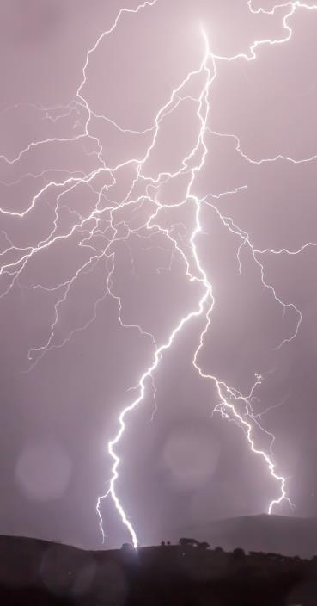




WEATHER SAFETY
Severe weather can cause accidents, property damage, injuries and death. Consider the following:
Know the difference between a weather watch and a weather warning.
Sign up for alerts through your installation, TV and radio station.
Consider purchasing a portable emergency weather radio with weather band capabiity.
Did you know?
In 2024, there were 17 severe storms, five tropical cyclones, one winter storm, one major flood, one heat wave and one major wildfire. Click HERE for more information.

Slide 3
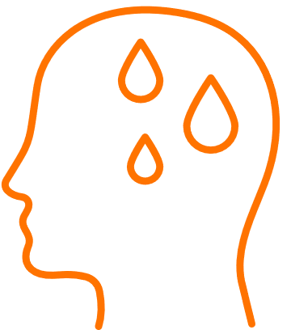

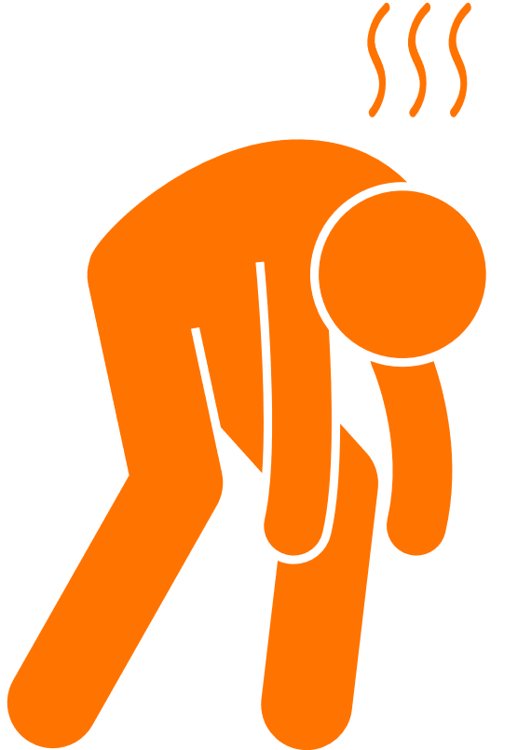
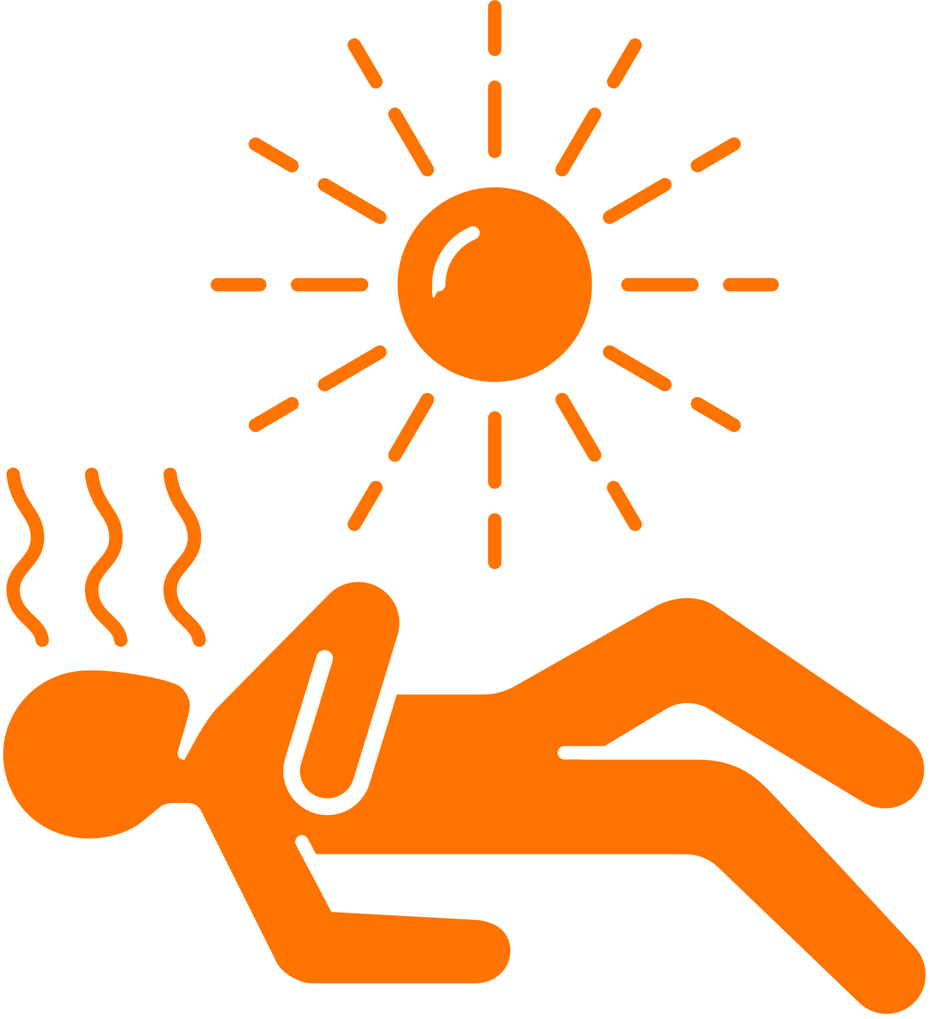
Heat and Sun Safety
When treating a heat-related illness, immediately begin aggressive fluid replacement and cooling of your core body temperature. This is critical in reducing illness and preventing death.
Hyperthermia
Heat Cramps
Heat Exhaustion
Heat Stroke
Sourced from: www.cdc.com

Slide 4
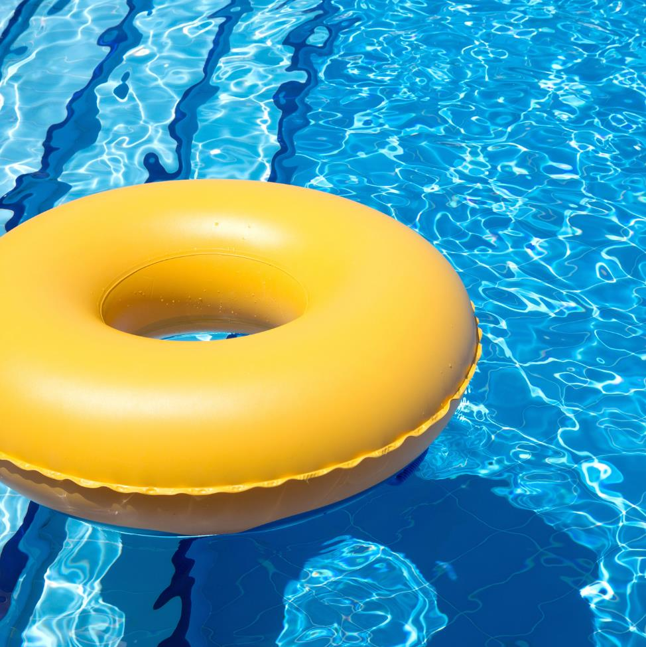

Swimming Safety
Things to remember before you “dive in”:
Always test the water depth before diving.
Know and observe your swimming
limitations and capabilities.
Avoid swift-moving water. If caught in a current, swim with it and angle toward shore or the edge.
Stay out of the water during thunderstorms and severe weather.
Don’t swim under the influence of alcohol, drugs or medication.
For more info: www.nsc.org

Slide 5

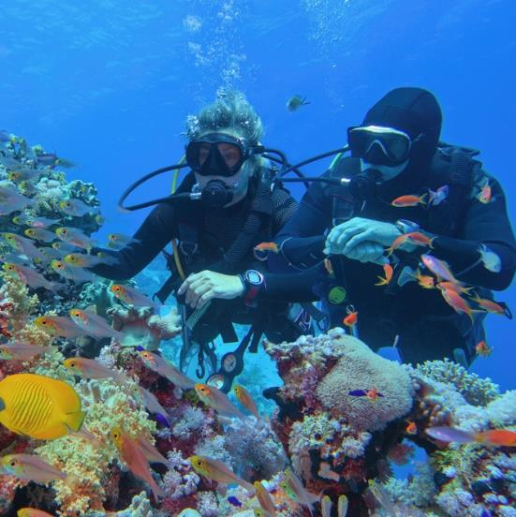
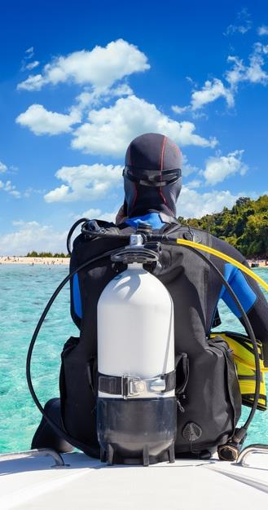
Diving Safety
Planning a dive this summer? Follow the tips below to help minimize your risk:
Perform a thorough safety check of your gear.
Make sure you are up-to-date on your medical assessment as some medical conditions aren’t compatible with diving.
Don’t drink before a dive as it entails several risks including nitrogen narcosis.
For more info: www.epa.gov

Slide 6

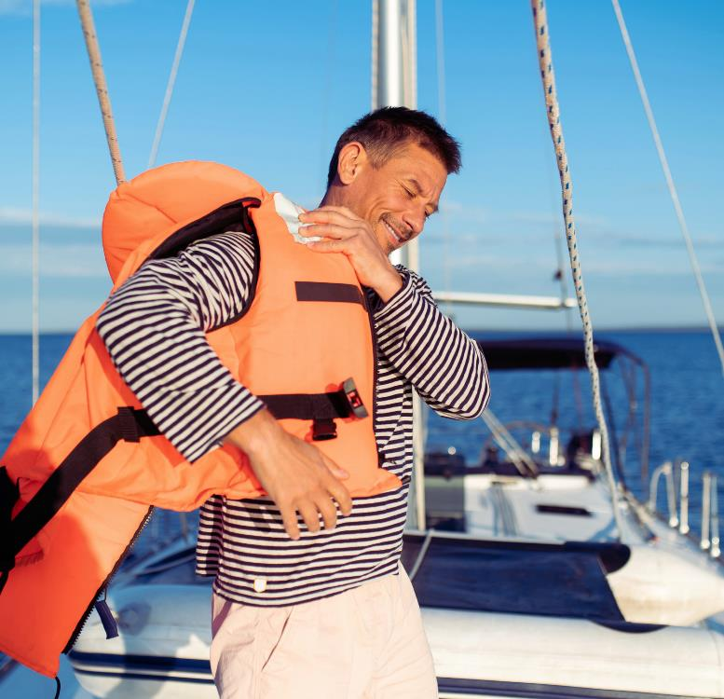
Boating Safety
A day spent on the water during the warmer months is a classic American pastime. Remember these safety tips before and during your journey:
  Always check local, route and destination weather and water conditions.
  Operate at a safe speed.
  Know the nautical rules of the seas.
For more info: www.nsc.org

Slide 7
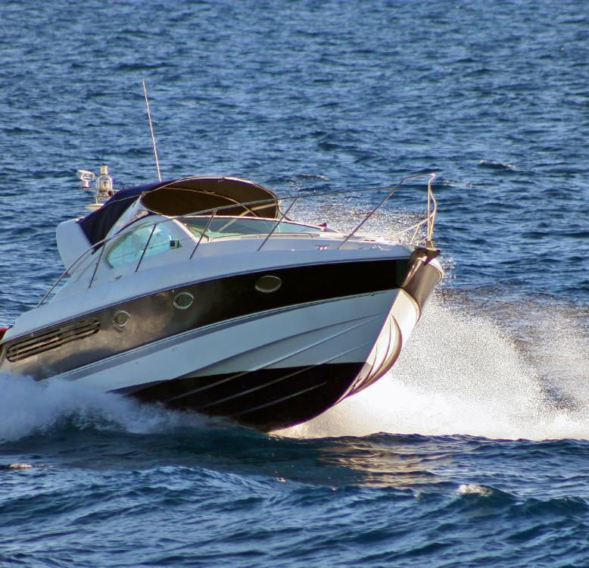
Boating Safety
Remain sober if you are the skipper.
Develop a float plan.
Have life jackets available.
Have a way to call for help.
For more info: www.nsc.org

Slide 8

Sports and Fitness Activities
In 2024, there were 21 reported mishaps in off-duty recreational activities.
Top reported mishaps during the summer timeframe between 2019-2024:
Basketball
Bicycling
Baseball/Softball
Skateboarding
Jogging/Running/Walking
For more info: www.nsc.org

Slide 9
Sports Injury Prevention
Wear PPE
Warm Up/ Cool Down
When engaging in cardio activities ensure you are executing proper warm up and cool down exercises.
Wear all proper personal protective equipment required for the sport.
Maintain Awareness
Hydration
Know your routes even in a familiar area; wear bright colors to improve visibility.
Be sure to drink plenty of fluids before, during and after exercising.
More Info

Slide 10
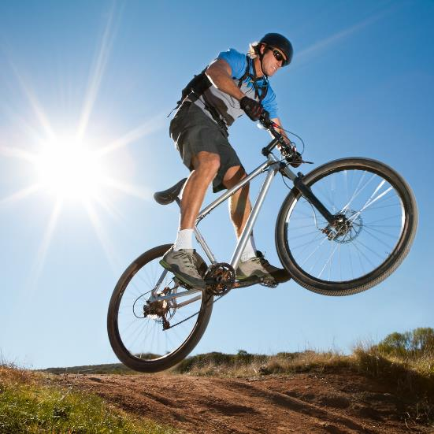
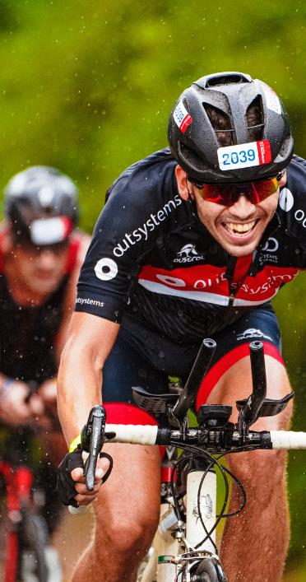
Bicycling
When a crash occurs between a vehicle and a bicycle, it’s the cyclist who is more likely to be injured. A large percentage of crashes can be avoided if motorists and cyclists follow the rules of the road and watch out for each other.
In 2023, 857 cyclists were killed in traffic accidents in the United States, representing a 10% increase from the previous year.
For more info: www.nhtsa.gov

Slide 11
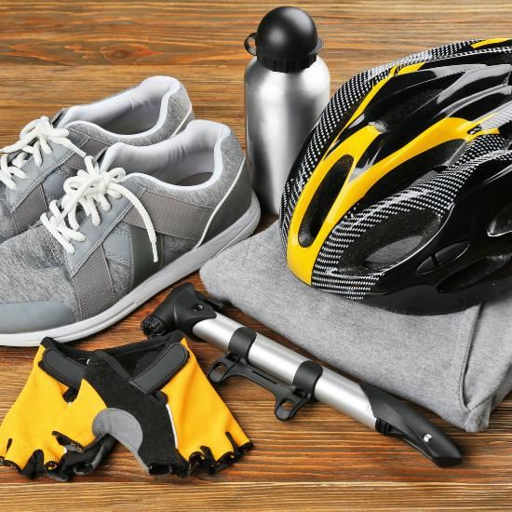
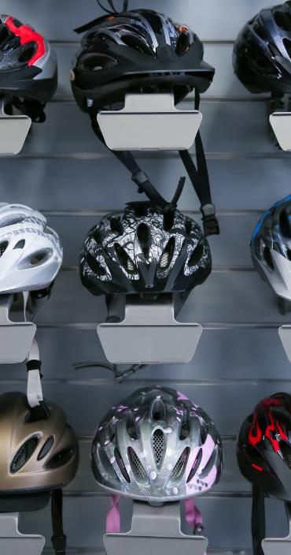
Bicycling Safety Tips
Here are additional bicycling safety tips to keep in mind:
Wear equipment to protect yourself and to make yourself more visibile to others.
Plan your route, choose routes with less traffic and slower speeds.
Avoid riding at night, if possible, but if you must ride at night, install front and rear lights on your bicycle and wear reflectiving clothing.

Slide 12

ATV Safety
There are over 700 deaths and 100,000 injuries every year involving ATVs. Follow these tips for a safer ride:
Read the owner’s manual before you ride.
Ensure your ATV is in good working condition.
Always wear an approved helmet.
Never drive an ATV while under the influence of drugs or alcohol.
For more info: www.cpsc.gov

Slide 13
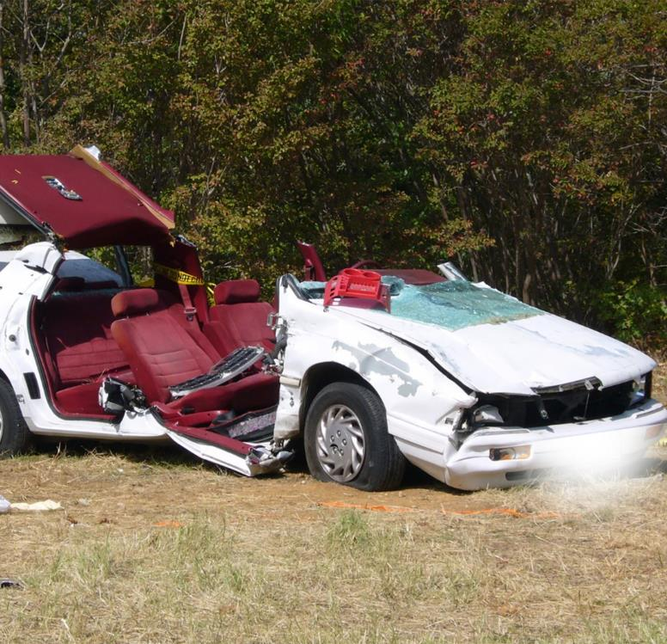
Car Safety
During the 101 Critical Days of Summer in 2024, the Department of the Navy lost 21 Sailors and Marines to preventable off-duty mishaps.
Overall, there were 24 PMV-4 and 48 PMV-2 Class A-E mishaps.
One off-duty mishap is too many.
CUT DOWN THE DISTRACTION. PRACTICE SAFE DRIVING.

Slide 14
Driving Safety Tips
Minimize Distractions
Don’t Drink and Drive
Keep your attention on the road at all times.
Call a friend, call a cab or use a ride-share app.
Safety Check
Slow Down
Ensure you and your vehicle are in proper working order before you get behind the wheel.
Speeding not only lessens your reaction time, but increases your risk for an accident.

Slide 15
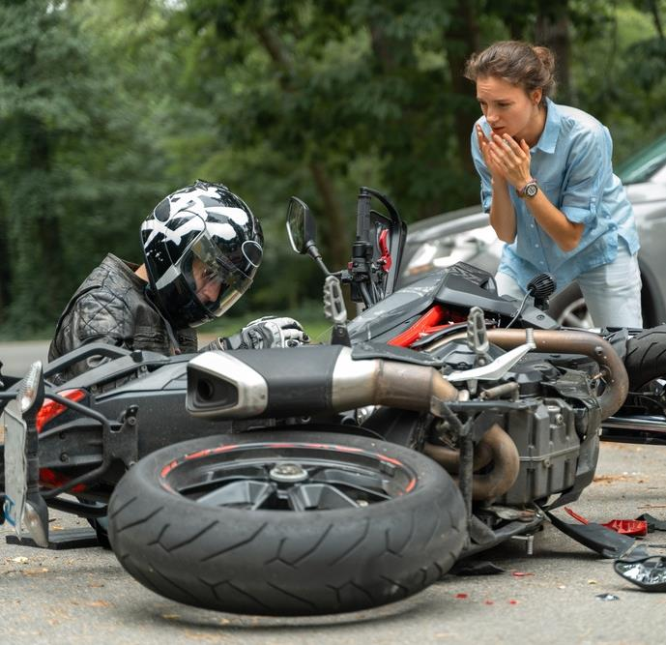
Motorcycle Safety
In 2024 during the 101 Critical Days of Summer, the Department of the Navy lost 12 Sailors and Marines as a result of motorcycle (PMV-2) mishaps.
Remember these important tips:
Complete a formal riding education program.
Obey the speed limit and follow local traffic laws.
Always wear an approved helmet with face shield.
Always ride defensively.
For more information, check out our motorcycle safety stand-down

Slide 16
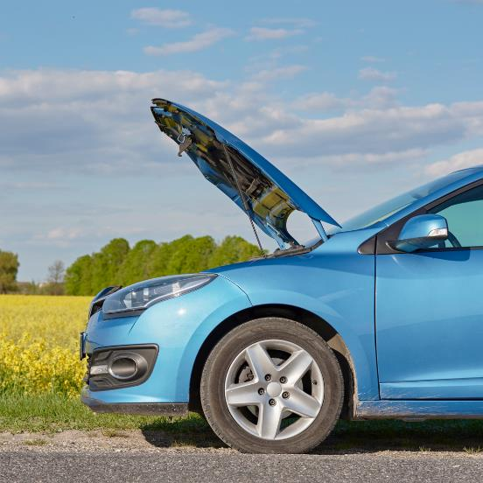
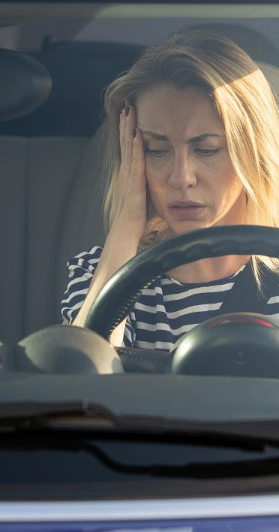
Pedestrian Roadside Safety
Your physical safety should always be top priority in the event of a roadside emergency. Always keep these tips in mind:
Pull over to a safe place such as the shoulder during a roadside emergency and call for
roadside assistance.
The safest place to be during a roadside emergency is in the seat of your car with the seatbelt fastened.
Warn others you are having trouble by turning on warning lights and have an emergency kit on hand.
For more info: www.nhtsa.gov

Slide 17

Pedestrian Safety
Over the past five years, the Department of the Navy lost 7 Sailors and Marines to pedestrian related mishaps during the 101 Critical Days of Summer.
Adhere to these guidelines when walking:
Use crosswalks and always maintain awareness.
Avoid walking while impaired by alcohol.
Never assume a driver sees you and maintain eye contact with them as they approach.
For more info: www.nhtsa.gov

Slide 18
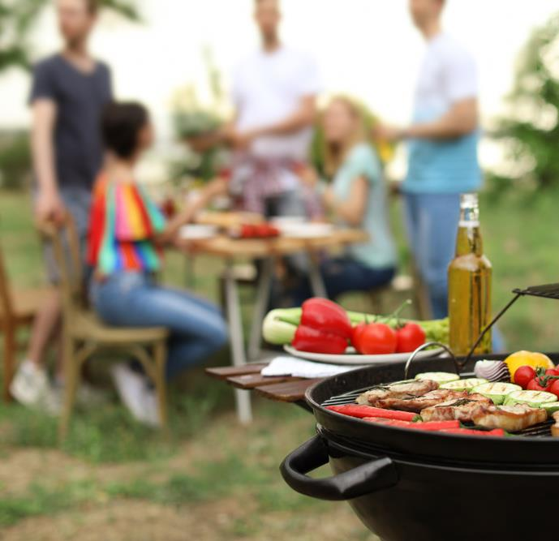
Grill Safety
Grill fires on residential properties result in an estimated average of 10 deaths, 100 injuries and $37 million in property loss each year.
Remember these tips for grill safety:
Ensure that your grill is outside, away from siding and overhanging branches.
Clean grills regularly and remove
grease build-up.
Keep a source of water nearby to quickly extinguish the fire if needed.
For more info: www.nfpa.org

Slide 19
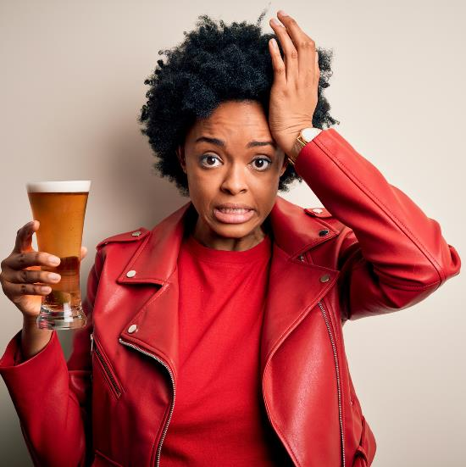
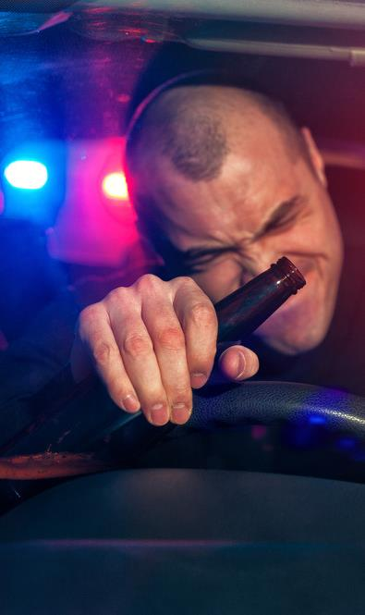
Alcohol Safety
Risky drinking can seriously damper your summer plans.
The sun can cause your body to sweat more in an effort to stay cool and you may feel thirsty, dizzy or fatigued.
When people drink alcohol, their awareness decreases and they tend to become more reckless in their behavior.
Be smart and have a plan before you begin drinking!
For more info: www.cdc.gov

Slide 20
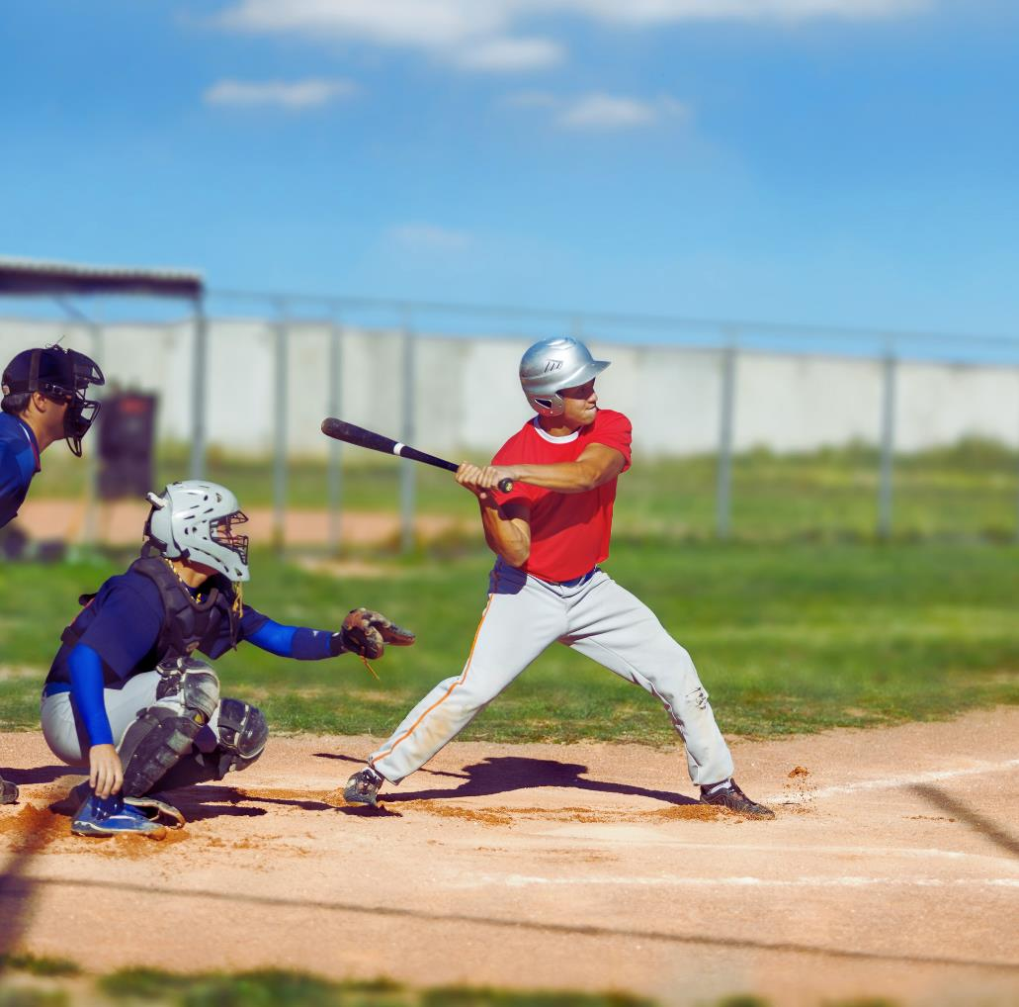


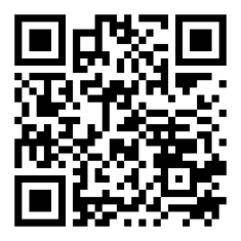
Conclusion
Email: NAVSAFECOM_PAO@us.navy.mil
https://www.navalsafetycommand.navy.mil

