Slide 1

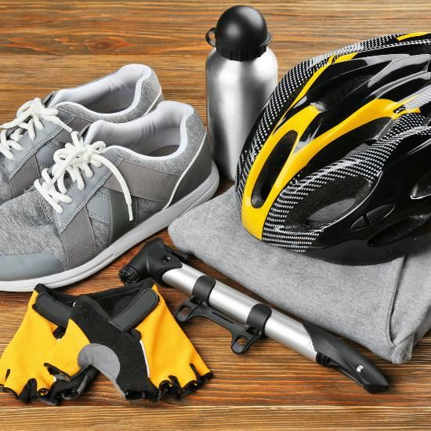
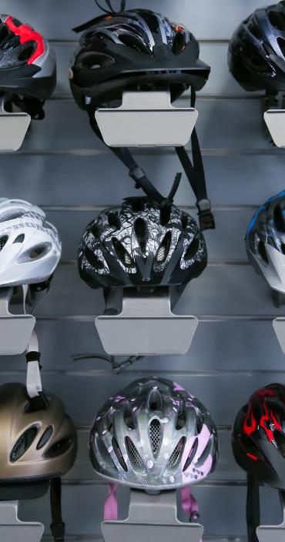




Bicycling Safety Tips
Here are additional bicycling safety tips to keep in mind:
Wear equipment to protect yourself and to make yourself more visibile to others.
Plan your route, choose routes with less traffic and slower speeds.
Avoid riding at night, if possible, but if you must ride at night, install front and rear lights on your bicycle and wear reflectiving clothing.

Slide 2


ATV Safety
There are over 700 deaths and 100,000 injuries every year involving ATVs. Follow these tips for a safer ride:
Read the owner’s manual before you ride.
Ensure your ATV is in good working condition.
Always wear an approved helmet.
Never drive an ATV while under the influence of drugs or alcohol.
For more info: www.cpsc.gov

Slide 3

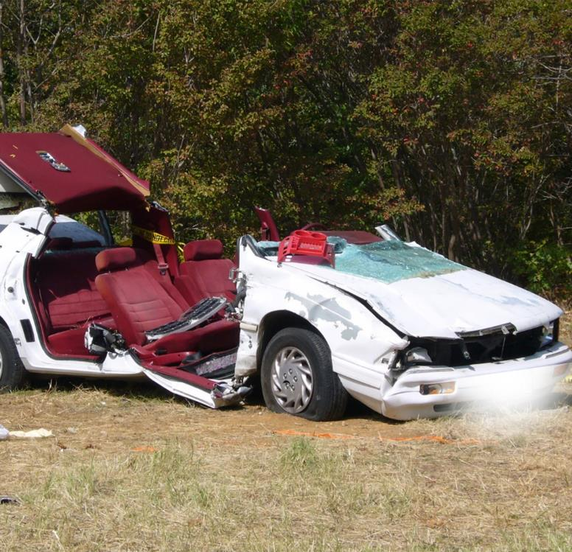
Car Safety
During the 101 Critical Days of Summer in 2024, the Department of the Navy lost 21 Sailors and Marines to preventable off-duty mishaps.
Overall, there were 24 PMV-4 and 48 PMV-2 Class A-E mishaps.
One off-duty mishap is too many.
CUT DOWN THE DISTRACTION. PRACTICE SAFE DRIVING.

Slide 4
Driving Safety Tips
Minimize Distractions
Don’t Drink and Drive
Keep your attention on the road at all times.
Call a friend, call a cab or use a ride-share app.
Safety Check
Slow Down
Ensure you and your vehicle are in proper working order before you get behind the wheel.
Speeding not only lessens your reaction time, but increases your risk for an accident.

Slide 5
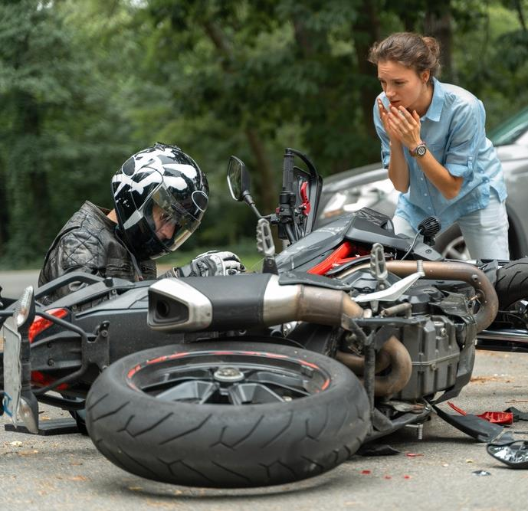
Motorcycle Safety
In 2024 during the 101 Critical Days of Summer, the Department of the Navy lost 12 Sailors and Marines as a result of motorcycle (PMV-2) mishaps.
Remember these important tips:
Complete a formal riding education program.
Obey the speed limit and follow local traffic laws.
Always wear an approved helmet with face shield.
Always ride defensively.
For more information, check out our motorcycle safety stand-down

Slide 6
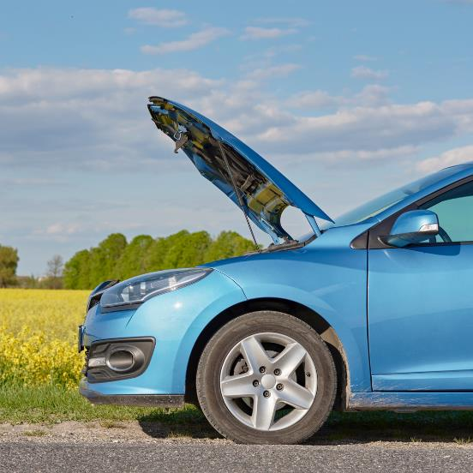
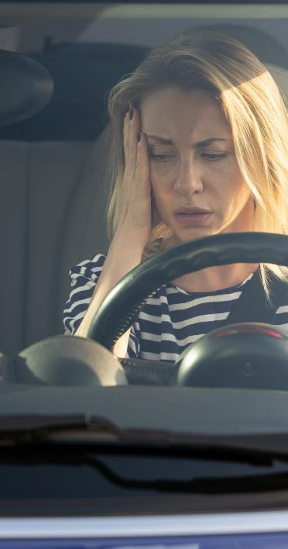
Pedestrian Roadside Safety
Your physical safety should always be top priority in the event of a roadside emergency. Always keep these tips in mind:
Pull over to a safe place such as the shoulder during a roadside emergency and call for
roadside assistance.
The safest place to be during a roadside emergency is in the seat of your car with the seatbelt fastened.
Warn others you are having trouble by turning on warning lights and have an emergency kit on hand.
For more info: www.nhtsa.gov

Slide 7

Pedestrian Safety
Over the past five years, the Department of the Navy lost 7 Sailors and Marines to pedestrian related mishaps during the 101 Critical Days of Summer.
Adhere to these guidelines when walking:
Use crosswalks and always maintain awareness.
Avoid walking while impaired by alcohol.
Never assume a driver sees you and maintain eye contact with them as they approach.
For more info: www.nhtsa.gov

Slide 8
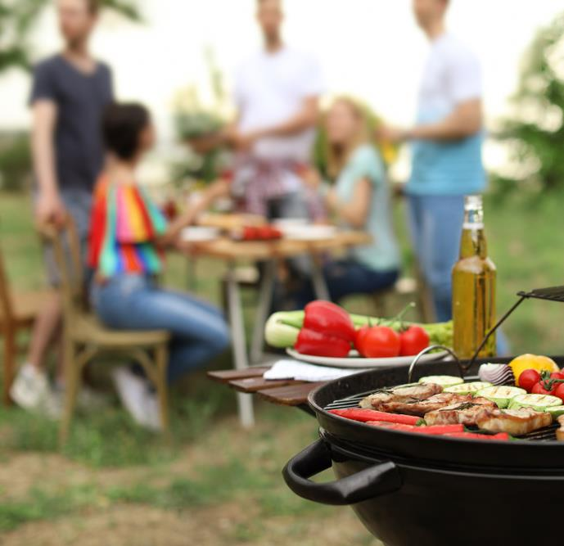
Grill Safety
Grill fires on residential properties result in an estimated average of 10 deaths, 100 injuries and $37 million in property loss each year.
Remember these tips for grill safety:
Ensure that your grill is outside, away from siding and overhanging branches.
Clean grills regularly and remove
grease build-up.
Keep a source of water nearby to quickly extinguish the fire if needed.
For more info: www.nfpa.org

Slide 9
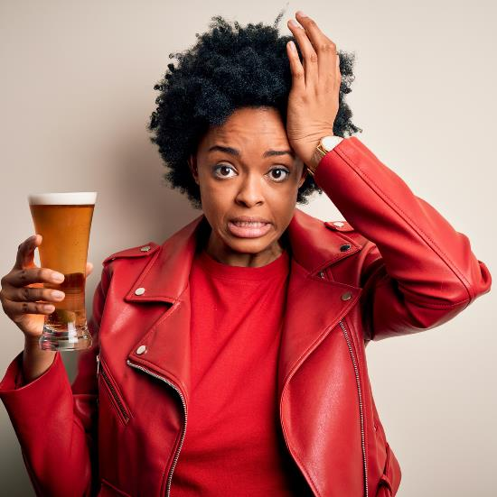
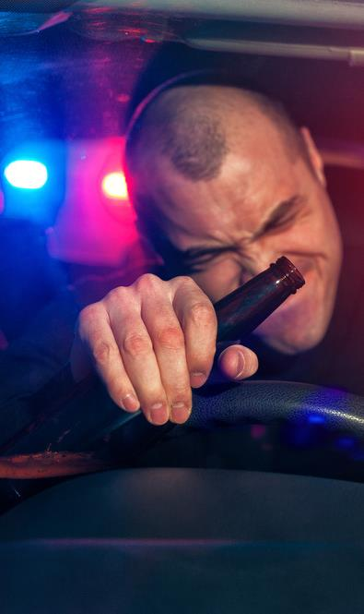
Alcohol Safety
Risky drinking can seriously damper your summer plans.
The sun can cause your body to sweat more in an effort to stay cool and you may feel thirsty, dizzy or fatigued.
When people drink alcohol, their awareness decreases and they tend to become more reckless in their behavior.
Be smart and have a plan before you begin drinking!
For more info: www.cdc.gov

Slide 10
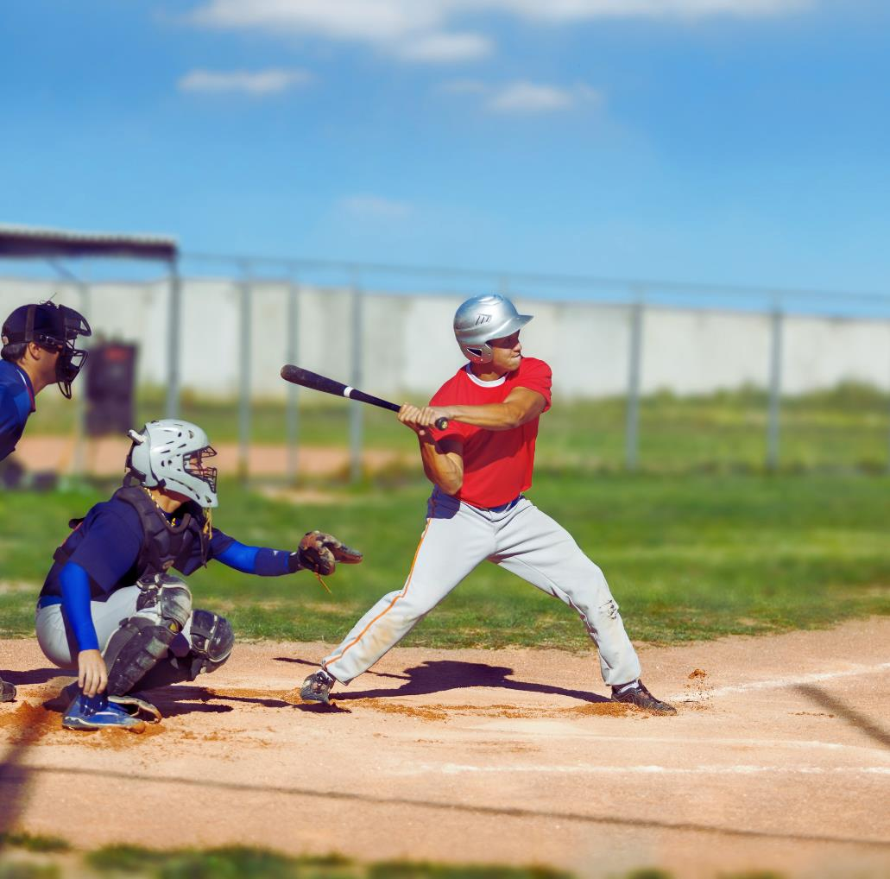


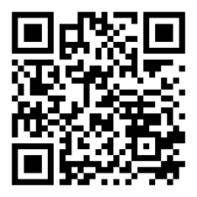
Conclusion
Email: NAVSAFECOM_PAO@us.navy.mil
https://www.navalsafetycommand.navy.mil

