Slide 1
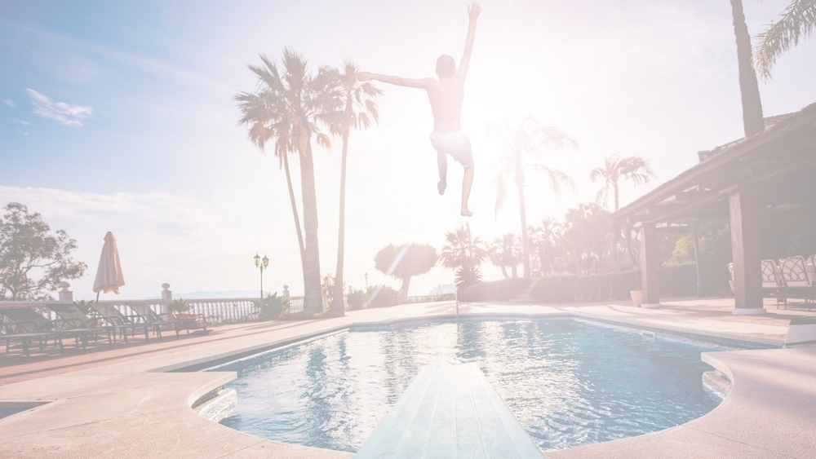




Notes:
We encourage you to tailor and localize this brief for your organization.

Slide 2
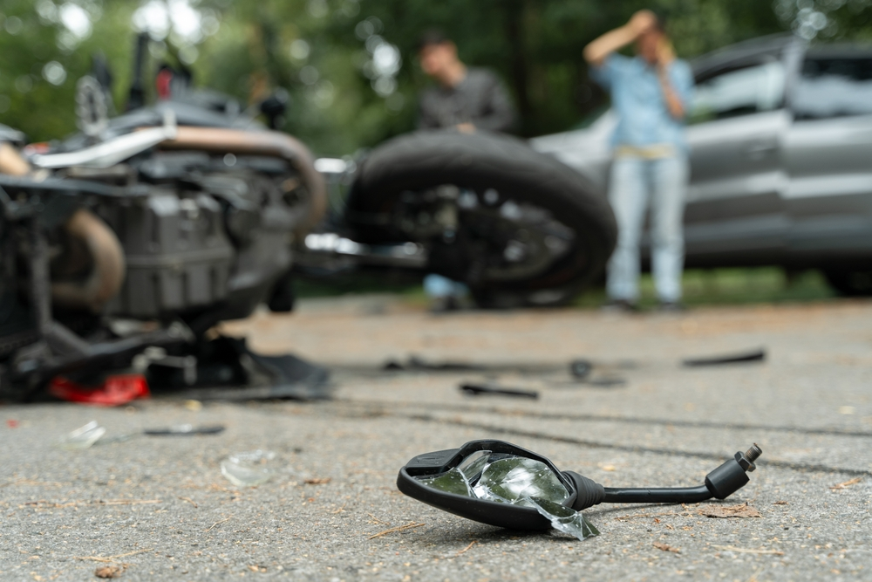
Introduction
The period from Memorial Day to Labor Day is known as the 101 Critical Days of Summer due to the potentially high number of mishaps and incidents that occur as Sailors and Marines enjoy recreational activities during the summer months:
Last summer, 27 Sailors and Marines died in off-duty mishaps while many more were injured.
Most of the deaths were in roadway mishaps: 11 involved motorcycles, 12 were four-wheeled vehicles and one was a pedestrian.
Off-duty recreational deaths claimed three more lives- a drowning, an All-Terrain Vehicle (ATV) mishap and an electric bike mishap.
Notes:
The period known as the 101 Critical days of Summer encompasses the longest portion of the year. Typically, from Memorial Day to Labor Day, people tend to take advantage of the warm weather for their vacations or a long extended weekend. This season, including the 4th of July holiday weekend, creates the potential for mishaps. Statistics from previous years continue to prove that judgement in lapses still occur while engaging in summer activities. During this timeframe in 2024, 27 off-duty servicemembers were killed while many more were injured. Most of those deaths were in roadway mishaps, where 11 deaths resulted from motorcycle crashes, 12 from four-wheeled vehicles and one pedestrian. Furthermore, the summer mishaps reflect a 10% increase in motorcycle deaths and a 33% increase in vehicle mishap deaths in comparison to a five-year average (FY 2020 – 2024) over the same timeframe. Data continues to show a general lack of situational awareness and complacency for numerous off-duty mishaps. Off-duty recreational deaths claimed three additional lives, including a drowning, ATV mishap and an electric bike mishap. ​
​
This brief a general summer safety stand-down presentation that is filled with information for the betterment of yourself and your team. It can help you maintain an active risk-management mindset to help you ensure a safe and enjoyable summer and keep our warriors focused on the task and players on the field.​

Slide 3
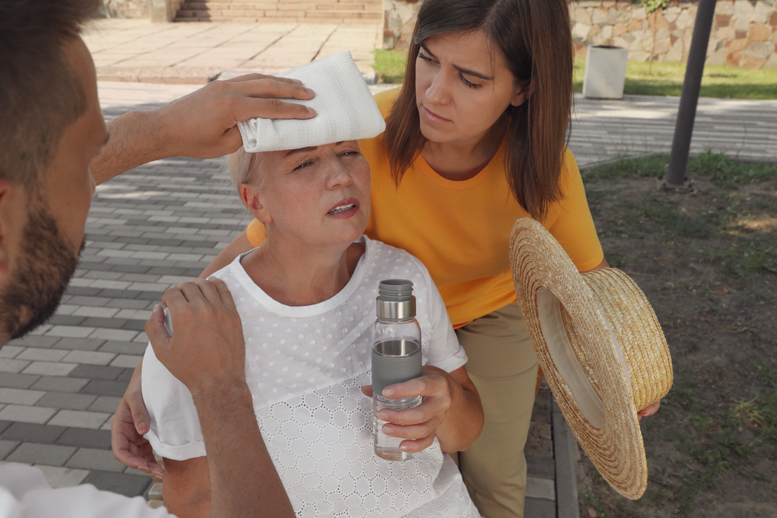



Heat Illness
Despite readily available information the effects of heat stress continue to be underestimated. The human body under normal conditions can regulate its temperature through sweating, usually until it is exposed to more heat than it can handle. This can quickly lead to:
Delirium
Organ Damage
Death
You are more at risk if you are:
Ill, have chronic health conditions or are taking certain medications
Overweight
Working in or exercising in excessive heat
Notes:
Extreme heat is a period where high heat meets high humidity and exceeds temperatures above 90 degrees for 2-3 days. Your body works hard to maintain a normal temperature. In extreme heat, this can lead to your body working harder than ever, leading to injury or death. In 2023, 294 people perished in the U.S. from weather-related excessive heat. Our warfighters had more heat-related injury mishaps in FY24 compared to the previous three years. You are more at risk for suffering from a heat-related illness if you are ill or have other chronic health conditions, taking certain medications, overweight, working in or enjoying strenuous exercise in the heat.

Slide 4
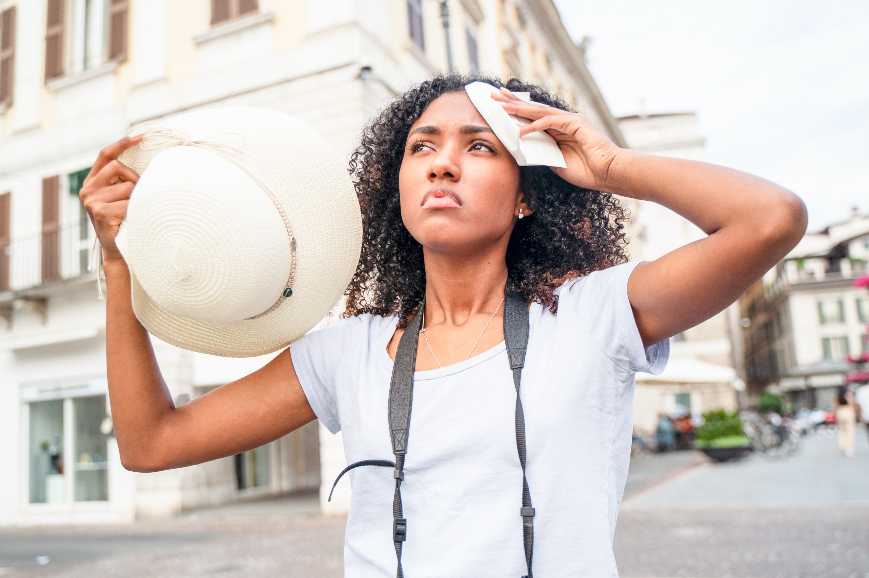
Signs and Symptoms
Heat Cramps:
Muscle spasms with heavy sweating during or after intense activity or exercise
Heat Exhaustion:
Heavy sweating, weakness, dizziness, nausea, headache and cool, clammy, pale skin
Heat Stroke:
Very high body temperature, skin hot to touch, confusion, fainting, seizures
CALL 9-1-1 or other local emergency service IMMEDIATELY.
First Aid
Take the affected person to a cooler area (shade or air conditioning)
Cool the person immediately
Never leave a person with heat-related illness alone. The illness can rapidly become worse, stay with the worker and call 9-1-1 or your local emergency operator
Notes:
Early recognition of heat-related illness symptoms followed by quick action is imperative to stop symptoms from progressing. Symptoms of heat cramps include painful muscle cramps and spasms that usually occur in the legs and abdomen, followed by heavy sweating. For first aid, apply firm pressure on cramping muscles or gently massage to relieve the spasm. Give sips of water unless the person complains of nausea. Seek medical attention of the cramps last more than an hour.​
For heat exhaustion, symptoms include heavy sweating, weakness or tiredness, cool, pale clammy skin, fast, weak pulse, muscle cramps, dizziness, nausea or vomiting, headache and fainting. For first aid treatment, move the person to a cooler environment, loosen clothing and apply cool, wet cloths or have the person sit in a cool bath. Offer sips of water. Call for medical attention if the person vomits or symptoms worsen or last longer than 1 hour. Symptoms of a heat stroke include throbbing headache, confusion, slurred speech, nausea, dizziness, body temperature above 103 degrees F, hot,r ed, dry or damp skin, rapid or strong pulse, fainting and loss of consciousness. Call 9-1-1 or other local emergency services, and get the victim to a hospital immediately. Heat stroke is a severe medical emergency and delaying can be fatal. Move the victim to a cooler, air-conditioned environment. Reduce body temperature with cool cloths or bath and use a fan only if the heat index is below the high 90s (a fan can make you hotter at higher temperatures). It is important to NOT GIVE FLUIDS during a heat stroke. ​
​
Drink enough water to prevent heat illness. Although estimates are everywhere, the average person should aim to drink ¾ of a gallon of water daily, though needs vary according to the person. You can check if you are getting enough water by your urine color. Darker colored urine indicates that you are not drinking enough. Additionally, try to avoid sugary, caffeinated and alcoholic beverages. Combine water with a sports drink to replace the salt and minerals you lose if you are sweating a lot. Your body needs fuel while in the heat. Always keep in touch with your PCM if you have a medical condition or taking medications that can be affected by the heat. ​
​

Slide 5

Fireworks Safety
In 2024, there were 11 reported fireworks-related deaths nationwide.
  Most involved misuse and device misfires/malfunctions
Fireworks injured 14,700 people in 2024.
  Sharp increase of 38% in deaths and 52% in injuries compared to 2023
Adults aged 25 to 44 accounted for the largest share of reported injuries (32%), followed by:
  People aged 15-24 (24%)
  The most frequently injured body parts were hands and fingers (35%) followed by head, face and ears (22%)
Notes:
Each year, thousands of people are injured from fireworks-related incidents to which medical treatment is often necessary. Most of these incidents are due to amateurs attempting to use professional-grade or even homemade fireworks. Regardless, improper handling of fireworks can cause significant injuries, so it’s best to leave them to the professionals. In 2024, there were 11 reported fireworks-related deaths, most of which involved the misuse of fireworks or device misfires and malfunctions. 14,700 people were injured in 2024 alone, where there was a 38% sharp increase in deaths and 52% increase in injuries in comparison to the previous year.
Adults aged 25-44 account for the largest share of injuries followed by people aged 15-24. Hands and fingers are the most frequently injured part of the body, accounting for 35% of total injuries. Second is head, face and ears at 22%.

Slide 6
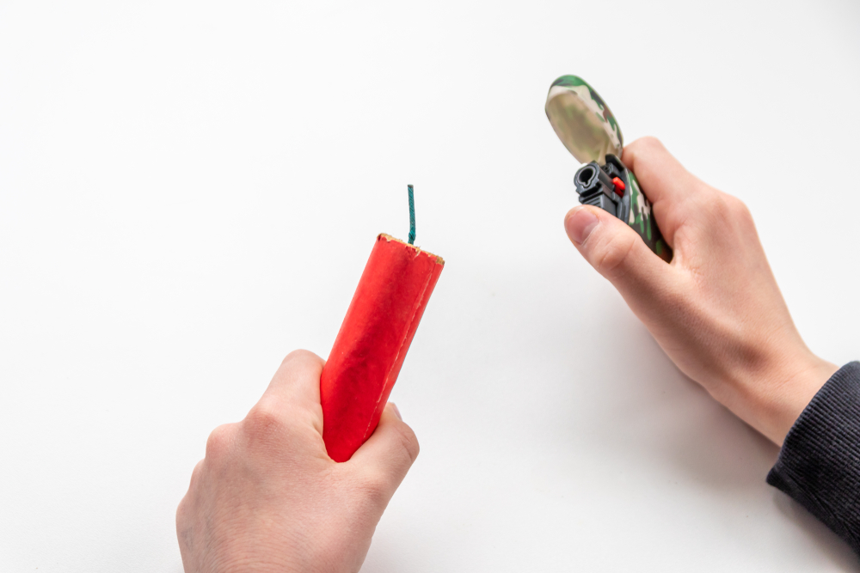
Fireworks Safety
Keep safe this summer, and especially during the 4th of July with these fireworks-related safety tips:
  Never use fireworks while impaired by alcohol or drugs
  Leave the fireworks to the professionals
  Keep a bucket of water or a garden hose handy, in case of fire or other mishap
  Consider attending a locally hosted fireworks show or use other festive alternatives
Notes:
Want to enjoy a safe and relaxing Fourth of July holiday? Keep these safety tips in mind, leave it up to the professionals or consider using other festive alternatives for a safe and mishap-free holiday.

Slide 7
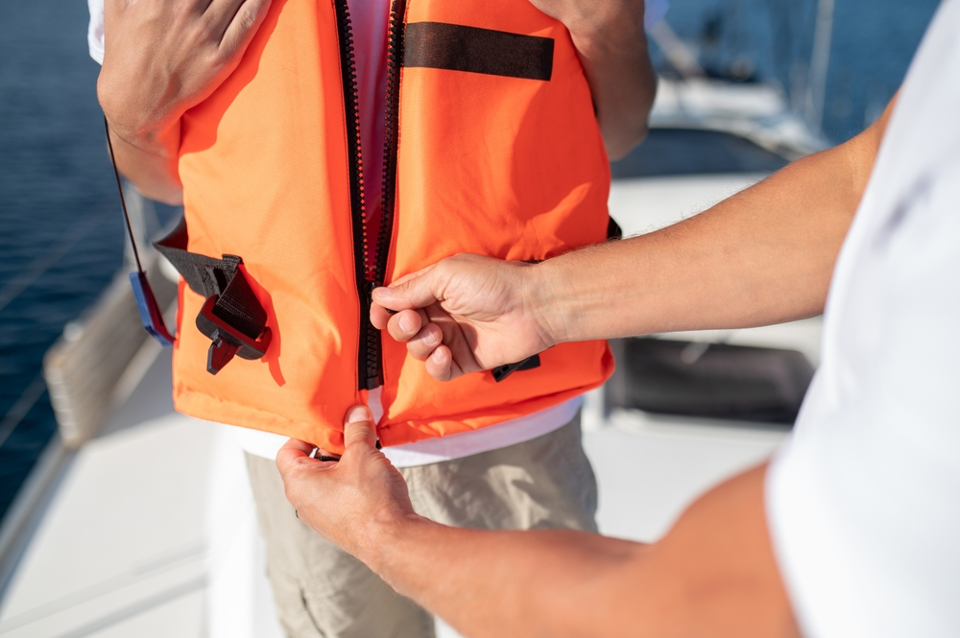
Boating Safety
The U.S. Coast Guard’s 2024 report on Recreational Boating Statistics notes 76% of boating deaths were due to drowning, 87% of victims were NOT wearing a life jacket and 2/3 of drowning victims were considered good swimmers. (https://safeboatingcampaign.com/get-the-facts/)
Life Jacket Wear Guidelines:
Life jackets for adults do not work for children
Make sure life jackets are properly fastened
Ensure all straps, buckles and zippers are secure
Ask a friend to help ensure you have a secure fit
Notes:
Boating Safety Advocates recommend all boaters and passengers always wear a life jacket while boating.
The best life jacket is the one you will wear. Modern life jackets are more comfortable, lightweight and stylish than the bulky orange style most boaters know. You don’t want your life jacket too large or too small. A snug fit is a proper fit. Hold your arms straight over your head. Ask a friend to grasp the tops of the arm openings and gently pull up.
All life jackets that are U.S. Coast Guard approved have an approval number. Look for it to ensure your life jacket meets the law requirements and is safe.

Slide 8
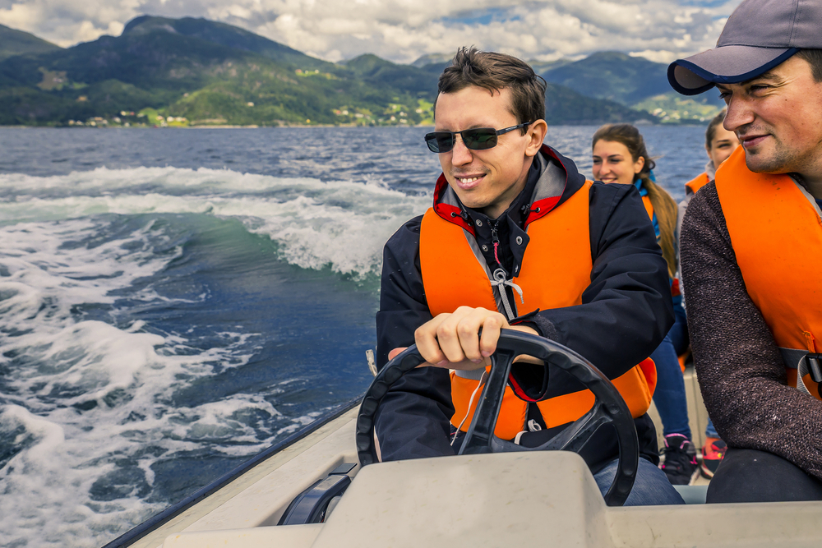
Rules of the Road
Always operate at a safe speed (especially in congested areas) and no wake zones; stay alert and steer clear of large vessels and watercraft that can be restricted in their ability to maneuver
Maintain a proper lookout and be mindful of buoys and other navigational aids, all of which have been placed there to ensure your safety and the safety of the boats around you.
To learn more, check out the USCG Navigation Rules Information page: https://www.dco.uscg.mil/NavRules/
Notes:
New boaters and experienced experts alike need to be familiar with the boating rules of the road. Boating safety courses are offered locally, inexpensive, and often completed in a day in-person or online. Make sure to stay alert and steer clear of large vessels and watercraft. Maintain a proper lookout and remember to be respectful of buoys and other navigational aids. They are there for your safety and the safety of other boats around you. To learn more, check out the USCG Navigation Rules Information page.

Slide 9
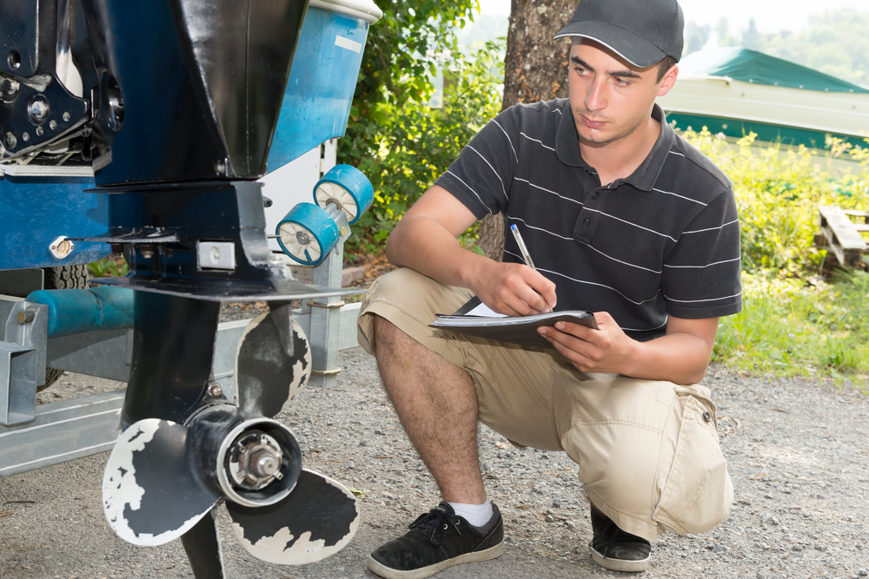
Prep and Good Judgment
Always check the local, route and destination weather and water conditions before departure
Have a float plan before heading out and ensure a reliable friend or family member has knowledge of your plan
The U.S. Coast Guard Auxiliary and U.S. Power Squadrons offer complimentary vessel safety checks and boat examinations.
https://wow.uscgaux.info/content.php?unit=013-04-06&category=1329844473
Notes:
1) GET FREE VESSEL SAFETY CHECKS
The U.S. Coast Guard Auxiliary and U.S. Power Squadrons offer complimentary boat examinations to verify the presence and condition of specific safety equipment required by state and federal regulations. Free of charge, they also offer virtual vessel exams.
https://wow.uscgaux.info/content.php?unit=013-04-06&category=1329844473
2) CHECK THE WEATHER
Always check local, route, and destination weather and water conditions before departure and ensure it is safe to go out.
3) HAVE A FLOAT PLAN
Just like pilots file a flight plan before takeoff, boaters should file a float plan before heading out on the water. It's one of the most important things you can do to prepare for an emergency and ensure a fast, effective response if you need assistance on your journey. Give your float plan to a family member, reliable friend, marina dock master, or anyone you trust to contact the US Coast Guard in an emergency. If your plans change due to weather, mechanical issues, or even personal preferences, reach out to your contact and update them.
When preparing your float plan, include the following details:
Vessel Description: Include the make, model, size, color, type, engine size (if applicable), and vessel identification number.
Number of Persons Onboard: List names, along with contact information and any special medical needs.
Departure Details: Include the name and location of the marina, launch ramp, or dock you'll be leaving from.
Tow Vehicle Info: Add your tow vehicle's location and license plate number.
Destination & Route: Provide your general route and specific stops or areas you plan to visit (e.g., anchor points, dive sites, fishing grounds).
Estimated Time of Return: Be specific about when you expect to return or check in.
Communication Equipment: List cell phone numbers, VHF radio channel(s), and even satellite devices, if available.

Slide 10
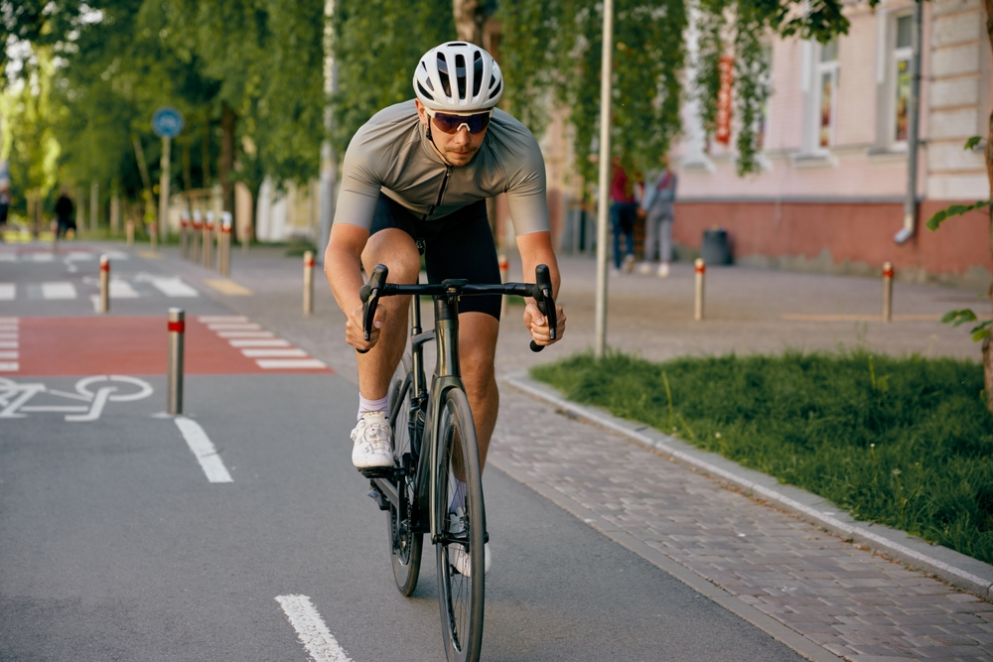
Bicycle Safety
Quick facts:
In the United States, over 1,000 cyclists are killed and 130,000+ injured in crashes each year​
Most fatal crashes involve motor vehicles, not just solo falls​
Head injuries are the leading cause of death in bicycle crashes
Wearing a helmet reduces the risk of serious head injury
The majority of fatal bicycle crashes occur in urban areas​
Dusk to nighttime is the highest risk period for fatal
cyclist crashes​
Alcohol is a factor in ~1/3 of fatal bicycle crashes (cyclist
or driver)
Notes:
​
Every year, we lose nearly a thousand cyclists on U.S. roads and see well over 100,000 injuries. Biking is a great way to stay active, although it has its risks. One of the things that surprises most people regarding bicycle incidents is that most fatal crashes don't occur from simple falls, but from collisions with motor vehicles. Both drivers and cyclists must maintain awareness. Keep in mind when you are commuting, riding with others or just out enjoying the summer fun, that bicyclists are out there and it can be difficult to spot them. On the flip side, if you are out enjoying a stroll on your bicycle, assume that drivers may not always notice you and proceed safely and accordingly.​
​
When crashes do happen, the largest danger remains head injuries which are the leading cause of death in bicycle crashes. The good news is that wearing a helmet can cut your risk of a head injury significantly by around 60%. Unfortunately, many riders still skip wearing a helmet. The risk climbs higher when alcohol is involved. The takeaway here is a simple one: stay visible, stay alert and protect yourself (including your head) every time you ride.​
​

Slide 11
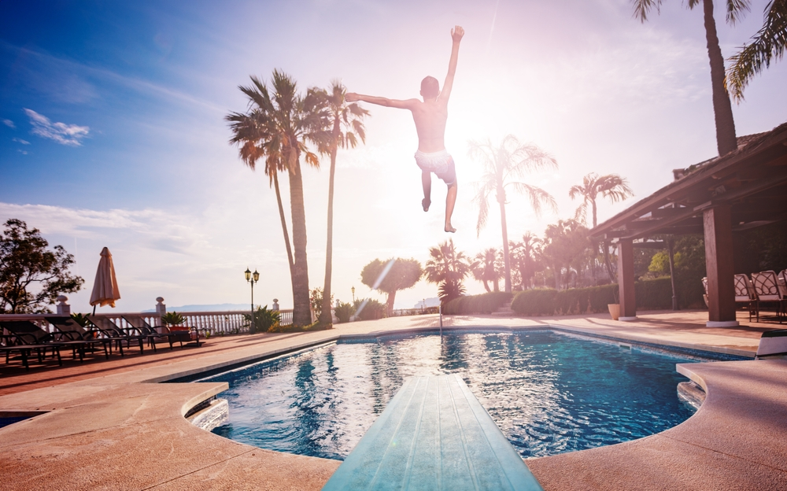
Water Activities
Drowning is a leading cause of unintentional injury/ death in the United States
Over 4,000 fatal unintentional drownings occur each year (~11 per day)​
For every fatal drowning, there are ~8 nonfatal drowning incidents requiring emergency care​
Rip currents account for ~80% of beach rescues​
Most drownings happen in open water (lakes, rivers, ocean), not pools
Notes:
When it comes to water activities, the risks are often underestimated. Drowning remains one of the leading causes of unintentional injury/deaths in the U.S. More than 4,000 lives are lost each year (about 11 people every day) from drowning. However, drowning is not always fatal. Fatal drowning happens when the drowning results in death. Nonfatal drowning happens when a person survives a drowning incident
Even more so, there are roughly 8 more incidents that require emergency care. These situations, appearing benign in nature can quickly turn serious. Natural water environments add an additional risk. For example, rip currents in our oceans can pull even the strongest swimmer away from shore. Lakes and rivers have hidden currents or drop-offs.

Slide 12
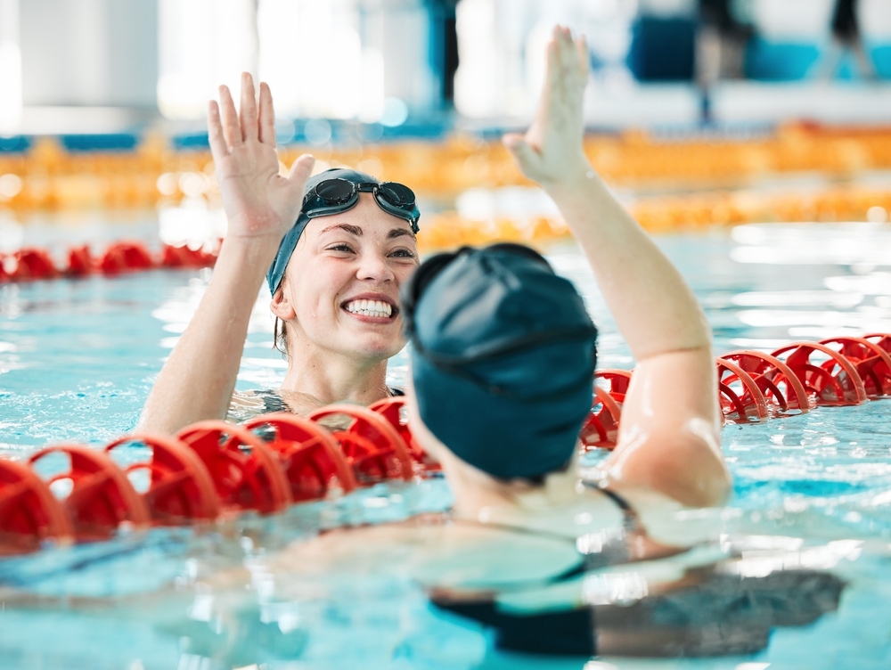
Tips to Swim Safely
Always swim with a buddy, never swim or go into any open body of water alone
If swimming indoors, always use the ladder to enter and exit the pool. Wear slip-resistant footwear around the pool area
Learn how to spot and escape rip currents.
Be cautious in natural waters such as lakes, rivers and the ocean.
Notes:
When you head out for a day on the water, respect it and stay aware of any changing conditions. Take notice of any hazards. Make smart decisions, such as:​
Even the best swimmers need company. Always swim with a buddy, never go into the open water alone​
Use caution when swimming indoors. Use the ladder in the pool to enter and exit, and be mindful that you are wearing slip-resistant footwear around the pool area.
Be aware of your surroundings. Look out for hazards. Learn how to spot and escape rip currents (check out our graphic here and swim parallel to shore, not against the current.)
Be cautious in natural waters such as lakes, rivers and even the ocean. Conditions can change quickly and hazards may not always be visible.​

Slide 13
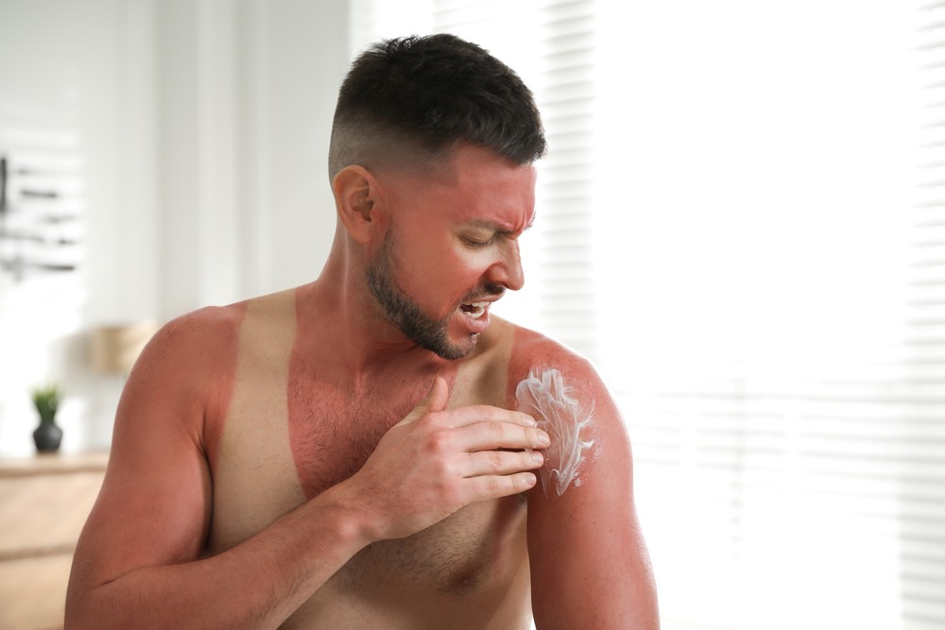


Sun Exposure
Here are some of the not so “cold” hard facts on sun exposure:
Sun exposure significantly increases the risk of dehydration, heat exhaustion and heat stroke
Sunburn is a radiation injury where severe burns can cause blistering, infection and systemic illness
UV exposure + heat = faster fatigue and reduced physical performance
Did you know?
Just one severe sunburn can lead to fever, chills and dehydration, also known as
“sun poisoning”
Certain medications can increase sun sensitivity and dehydration risks
Notes:
​
Sunburn isn't just a cosmetic issue. It is damage to the skin from the sun that can have serious health consequences. When people work or exercise outdoors in high heat, they face a dual threat: Injury from UV exposure and heatrelated illness. These injuries can cause blistering, infection and systemic illness. Furthermore, increased sun exposure increases your risk of dehydration and suffering from various heat illnesses. Remember, heat exhaustion and heat stroke are medical emergencies that require immediate attention.

Slide 14
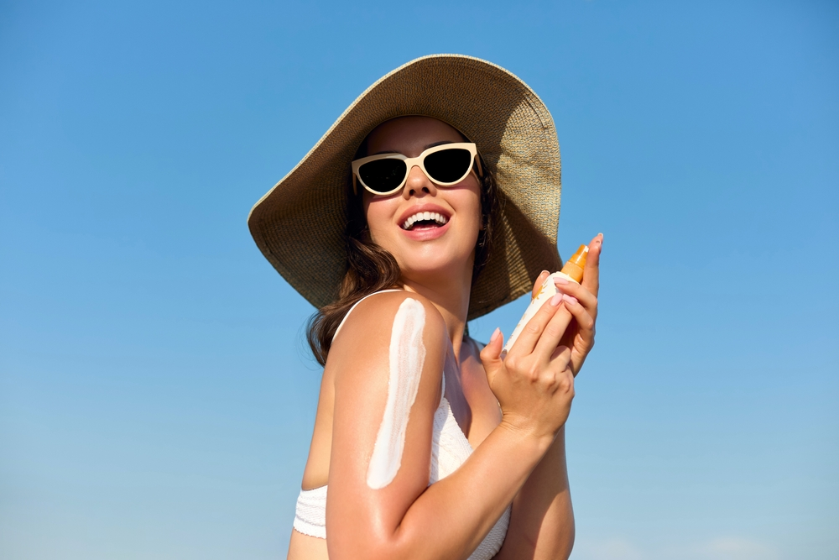
Staying Safe in the Sun
Here’s how you can protect yourself from sun exposure:
Apply sunscreen with an SPF rating of at least 30 or higher to all exposed skin
Reapply sunscreen every two hours or more after sweating or swimming
Stay in the shade as much as possible; Wear a hat or use an umbrella to reduce heat and sun exposure
Did you know?
Sunglasses aren’t there just to make you
look cool; they help block harmful UV radiation.
Wear sunglasses that will block out 99-100% UV-A and UV-B radiation
Notes:
Here are some prevention methods to keep you safe while enjoying the sun:​
Aim to drink at least one cup of water every 20 minutes while outside in the heat. Furthermore, apply sunscreen with an SPF rating of at least 30 or higher to all exposed skin. You'll want to reapply this every two hours, or even more so after sweating or swimming. Stay in the shade as much as possible. It isn't just for your comfort, it can reduce heat and sun exposure significantly. Pay attention to the clothes you wear. Ensure they are light-colored, loose-fitting that cover as much skin as possible. Sunglasses aren't just there to make you look cool. A good pair will block out 99-100% of UV-A and UV-B radiation. ​
​

Slide 15
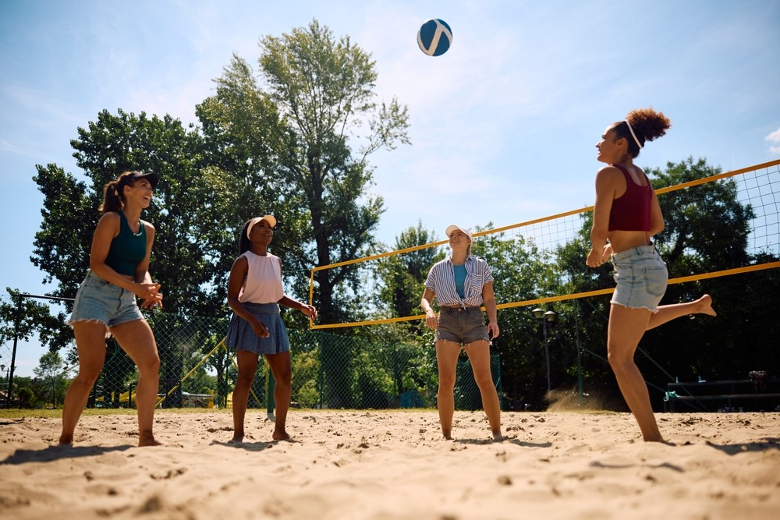
Sports Safety
What you should know:
Exertional heat illness is one of the leading causes of death during physical activity​
Runners can lose 1–3 liters of fluid per hour, even in moderate heat​
Starting activity already dehydrated significantly increases risk of heat injury​
Most heat-related incidents occur during sustained activity (30+ minutes)​
Lack of acclimatization (first 3–5 days of activity in heat) greatly increases risk
Notes:
Playing sports has both physical and psychological benefits. However, you can be at risk for sports injuries without proper planning. Exertional heat illness is one of the leading cases of preventable death during physical activity. Runners especially can lose up to three liters of fluid per hour, even in moderate heat. Drinking water is important, but especially when sports are part of your routine. If you start a physical activity already dehydrated, you significantly increase your risk of heat injury. Most heat-related incidents and injuries typically occur within the first 30 minutes of sustained activity. Exertional heat illness can increase the risk of muscle cramps, strains and overuse injuries. Furthermore, failure to acclimate during the first 3-5 days of activity in heat greatly increases the risk that you will get hurt.

Slide 16
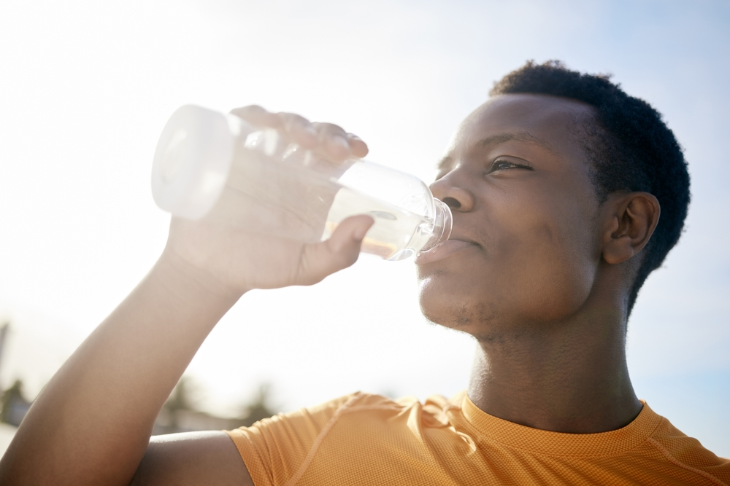
The Effects of Dehydration
Symptoms of Dehydration:
Muscle cramping​
Fatigue​
Lightheadedness​
Dizziness​
Confusion​
Dry mouth/mucous membranes​
Increased heart rate and breathing​
Notes:
Keep in mind the symptoms of dehydration, some of which include muscle cramping, dizziness or dry mouth. Water is the most basic form of hydration and the least expensive. Sports drinks and electrolyte beverages can also make a person feel better if they are experiencing dehydration. Exercise related heat exhaustion occurs when your body can no longer get rid of the extra heat made during exercise, and your body temperature rises more than what is healthy. Not drinking enough fluids can cause dehydration which can lead to collapse.

Slide 17
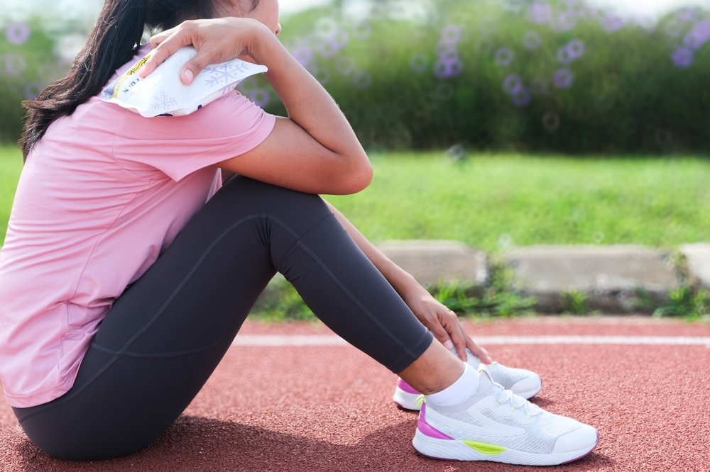
Playing It Safe
Tips for Sports Safety:
Hydrate before, during and after physical activity​
Wear lightweight, light-colored, loose-fitting clothes​
Listen to your body and take frequent breaks​
Check with your doctor before starting an exercise routine​
Avoid exercise outside in the early afternoon​
Work out or play sports with a friend, not alone​
Notes:
Here are some preventative measures that you can take to ensure that you don't get "winded" while enjoying sports:​
Hydrate even if you don't feel thirsty. Bring water and depending on the intensity, an electrolyte or sports beverage with you. Wear clothing that has moisture-wicking fabric. Furthermore, protect yourself from the sun with sunglasses, a hat and sunscreen. Take frequent breaks and drink water before you are thirsty. Allow yourself enough time to adapt to the heat. This can take between 3-5 days, or even as long as 14 days. Do not push yourself to have an intense workout when it is hot. Always check with your healthcare professional before starting any exercise routine or sport. Certain medications and health conditions can exaggerate your body's response to heat. Working out with a friend or partner can ensure that if something does happen, you can get assistance.

Slide 18
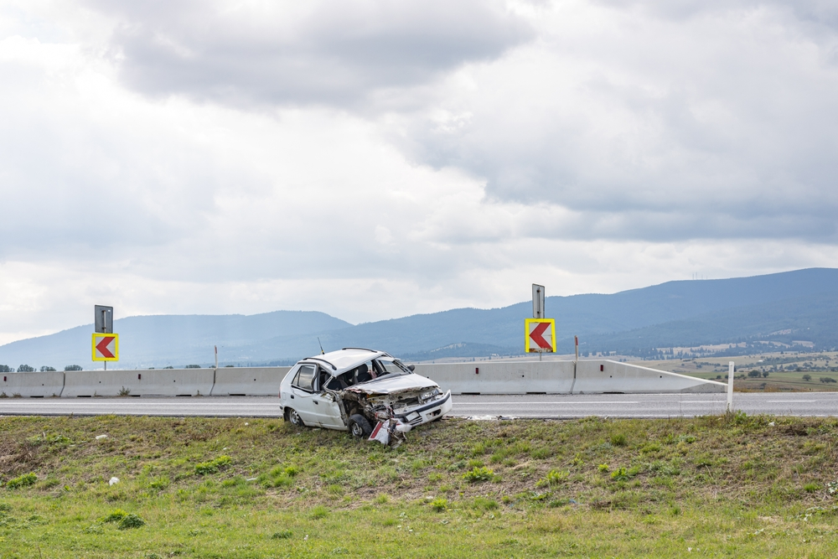
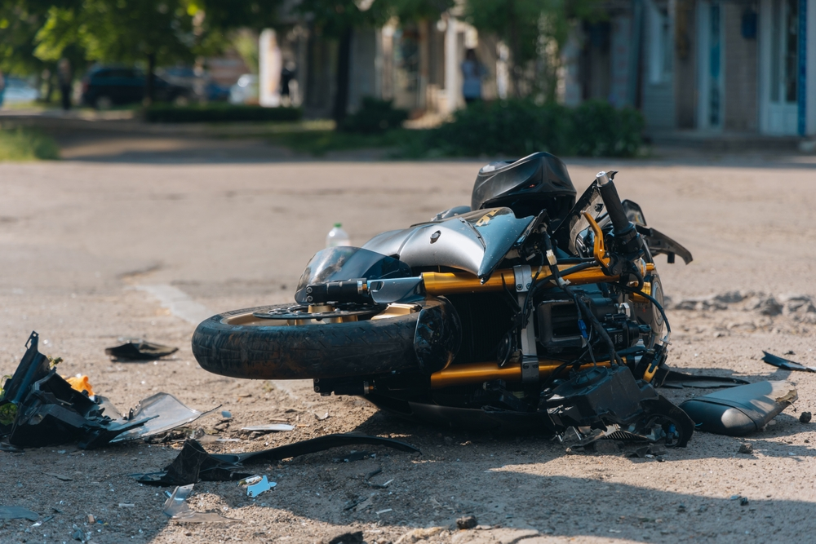
Safe Driving
Quick facts
According to the NHTSA, per vehicle miles traveled in 2023, motorcyclists were about 28 times more likely than passenger car occupants to die in a vehicle crash and were five times more likely to be injured. Motorcycle riders continue to be overrepresented in fatal traffic crashes. In 2023, there were 6,335 motorcyclists killed — 15% of all traffic fatalities.
Speed affects your safety even when you are driving at the speed limit; going too fast for road conditions -- such as bad weather or a road under repair.
Notes:
​
Summertime usually means vacations and summer road trips, with more people driving, walking, and biking. However, vehicle crashes remain a growing concern. Last year was a deadly year for motorcyclists in the Navy and Marine Corps, where 45 Sailors and Marines were killed due to motorcycle crashes. Speeding contributed to about one-third of all motor vehicle fatalities. In 2023, speeding was a factor in 29% of all traffic deaths, according to the National Highway and Traffic Safety Administration. Now is a good time to review these summer driving safety tips.

Slide 19
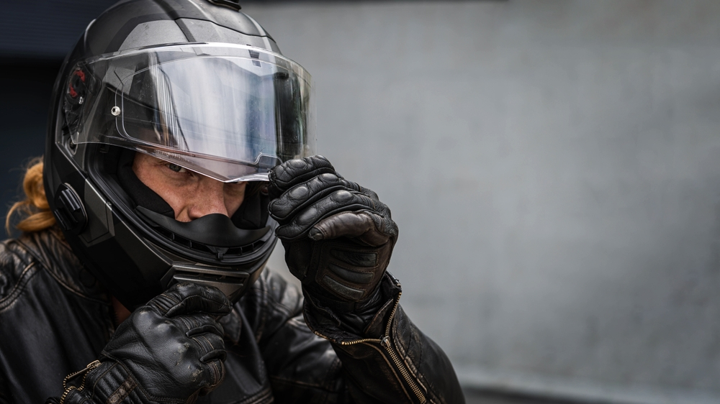
Ride Right, Stay in the Fight
Before the Ride:
Check tire pressure and tread depth
Check your hand and foot brakes, as well as signal indicators and fluid levels
Check for gas or oil leaks
During the Ride:
Don’t take any unnecessary risks
Obey speed limits, traffic lights, signs and lane markings
Ride defensively and proceed with caution through intersections
Notes:
BEFORE THE RIDE Check your motorcycle’s tire pressure and tread depth, hand and foot brakes, head and brake light signal indicators, and fluid levels before you ride. You should also check under the motorcycle for signs of oil or gas leaks. If you're carrying cargo, you should secure and balance the load on the cycle; and adjust the suspension and tire pressure to accommodate the extra weight. If you're carrying a passenger, they should mount the motorcycle only after the engine has started; should sit as far forward as possible directly behind you; and should always keep both feet on the footrests, even when the motorcycle is stopped. Remind your passenger to keep his or her legs and feet away from the muffler. Tell your passenger to hold on firmly to your waist, hips, or belt; keep movement to a minimum; and lean at the same time and in the same direction as you do. Do not let your passenger dismount the motorcycle until you say it is safe.
Always wear a helmet that meets U.S. Department of Transportation (DOT) Federal Motor Vehicle Safety Standard (FMVSS) 218. Look for the DOT symbol on the outside back of the helmet. Snell and ANSI labels located inside the helmet also show the helmet meets the standards of those private, non-profit organizations.
DURING THE RIDE Experienced riders know local traffic laws - and they don't take risks. Obey traffic lights, signs, speed limits, and lane markings; ride with the flow of traffic and leave plenty of room between your bike and other vehicles; and always check behind you and signal before you change lanes. Remember to ride defensively. Most multi-vehicle motorcycle crashes generally are caused when other drivers simply don’t see the motorcyclist. Proceed cautiously at intersections and yield to pedestrians and other vehicles as appropriate. You can increase your visibility by applying reflective materials to your motorcycle and by always keeping your motorcycle’s headlights on, even using high beams during the day.
https://www.nhtsa.gov/road-safety/motorcycles

Slide 20
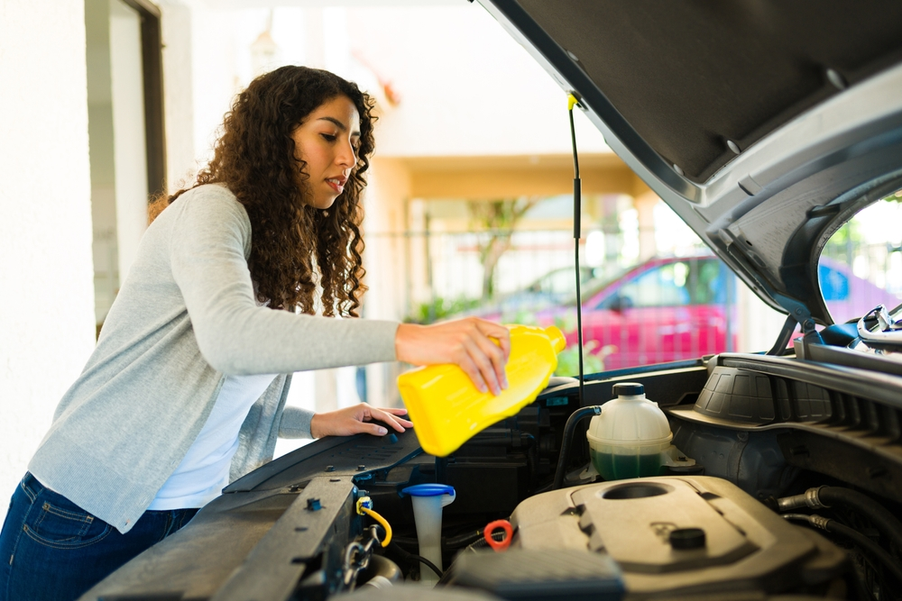
Motor Vehicles Too
Safety Planning Tips
Check the weather, road conditions and traffic as you plan your route.
Allow plenty of time to get to your destination safely.
Check your A/C performance and cabin air filter before the temperature rises
Check under your hood and inspect all belts and hoses to ensure good working order
NEVER LEAVE A CHILD UNATTENDED IN A PARKED/LOCKED VEHICLE.
Notes:
PLAN YOUR ROUTE
Before heading out, check the weather, road conditions, and traffic. Don’t rush through your trip; allow plenty of time to get to your destination safely. Always review directions and maps before you go, even if you use a navigation aid, and let others know your route and ETA.
SUMMER WEATHER TIPS
A/C
As the temperatures rise, your A/C works harder to keep your vehicle cool. Check A/C performance and cabin air filter before traveling. A lack of air conditioning on a hot summer day affects everyone, especially children and older adults sensitive to heat or in poor health.
BELTS AND HOSES
As summer temperatures rise, rubber belts and hoses degrade. Look under the hood and inspect all belts and hoses for bulges, blisters, cracks, or cuts in the rubber. It’s best to replace them now if they show signs of obvious wear. Also, make sure all hose connections are secure.
HEATSTROKE
Heatstroke in vehicles can happen when a child is left unattended in a parked vehicle or enters an unattended vehicle. Never leave children alone in a car. A child’s body temperature rises three to five times faster than an adult's. Even if it’s 60 degrees outside with the windows cracked, the temperature inside a vehicle can quickly reach deadly levels.

Slide 21
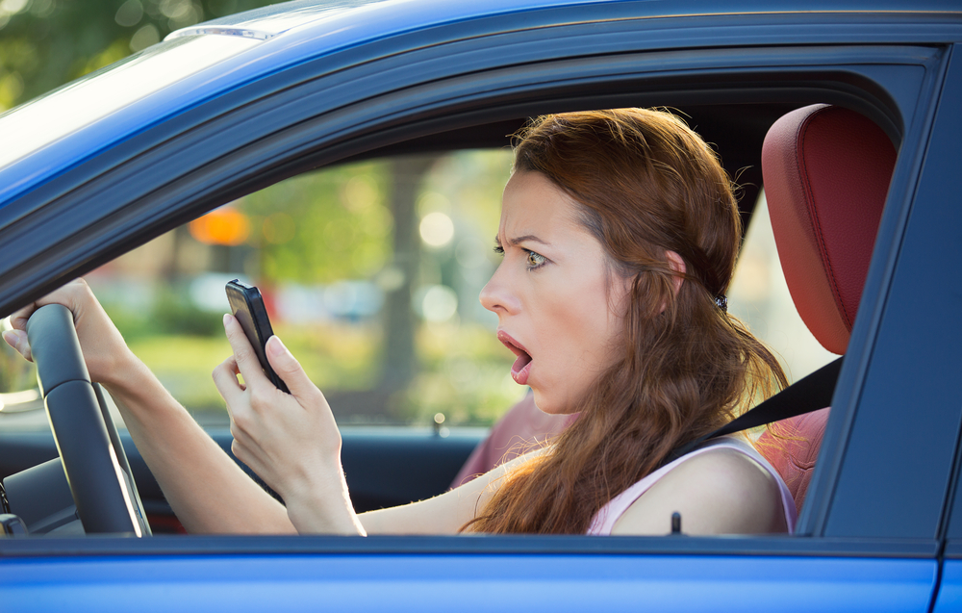
Distracted Driving
Distracted Driving Tips:
Do not text while driving
Obey posted speed limits
Encourage friends and family to drive phone-free
Put down your phone and focus on the road
Speak out as a passenger if the driver is distracted
Notes:
Here are AAA’s Top 10 Tips to Avoid Distractions While Driving
10. Fully focus on driving. Do not let anything divert your attention, actively scan the road, use your mirrors and watch out for pedestrians and cyclists.
9. Store loose gear, possessions and other distractions that could roll around in the car so you do not feel tempted to reach for them on the floor or the seat.
8. Make adjustments before you get underway. This includes adjusting your seat, mirrors and climate controls before hitting the road. Also, decide on your route and check traffic conditions ahead of time.
7. Finish getting ready at home – instead of once you get on the road.
6. Snack smart. If possible, eat meals or snacks before or after your trip, not while driving. On the road, avoid messy foods that can be difficult to manage.
5. Secure children and pets before getting underway. If they need your attention, pull off the road safely to care for them. Reaching into the backseat can cause you to lose control of the vehicle.
4. Put aside your cell phone. Never text, read email, play video games or scroll the internet or social media while driving.
3. If you have passengers, let them be your co-pilot or navigator so you can focus safely on driving.
2. If another activity demands your attention, instead of trying to attempt it while driving, pull off the road and stop your vehicle in a safe place
1. As a general rule, if you cannot devote your full attention to driving because of some other activity, it’s a distraction. Take care of it before or after your trip, not while behind the wheel.

Slide 22
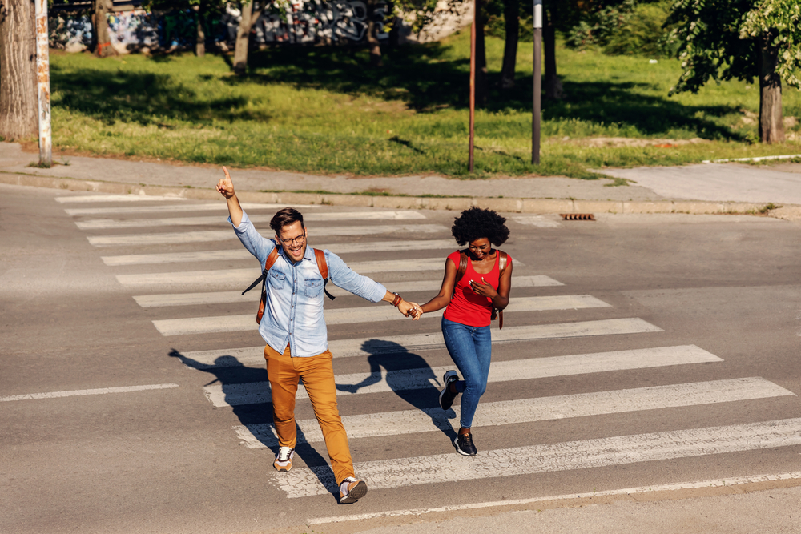
Pedestrian Safety
Safety tips for Pedestrians:
Stay alert while in crosswalks
When driving, scan around your vehicle to check for children before backing out of a driveway or parking spot
As a pedestrian, walk on sidewalks whenever available
Make eye contact with drivers whenever possible and wait for a clear, complete stop before crossing
Obey signs and signals
Notes:
Stay alert and look out for pedestrians and cyclists. To prevent back overs, always walk around your vehicle to check for children running or playing before backing out of a driveway or parking spot. While backup cameras are helpful, they have limitations; kids, pets, and objects can still be in your path but out of the camera’s view. When children play, they are often oblivious to cars and trucks around them. Every vehicle has a blind zone.

Slide 23
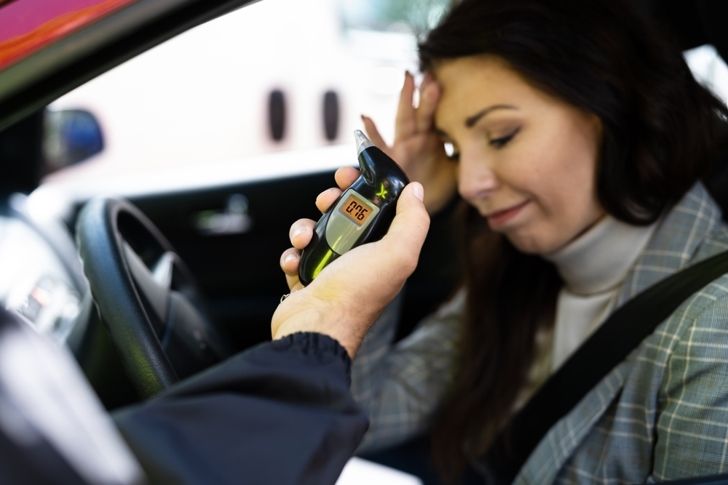
Alcohol Safety
Cold Hard Facts about Alcohol:
Alcohol involvement leads in water-related drowning deaths, typically peaking in the summer months​
Alcohol consumption is the leading cause of boating accidents involving property damage, injury and death.​
Drinking more while on vacation can lead to unforeseen issues​
Hot weather and alcohol are a dangerous risk combination for dehydration.
Do not drink and operate any motorized vehicles.​
Be smart this summer, think before you drink.
Notes:
Understand this: Alcohol use impairs judgment and increases risk taking. Did you know that alcohol is a leading contributor in water-related drowning deaths? Not only does alcohol impair your judgment and increase risk-taking, it is a dangerous combination for swimmers. People tend to become overconfident the more they drink and push beyond their natural ability at different sports or activities, increasing the risk of injury. ​
​
Keep in mind how much alcohol you consume when traveling or on vacation. Drinking often leads to higher blood alcohol concentrations and increases the risk for accidents and injuries. It can worsen certain health conditions as well, or interact with medications. Alcohol and heat can equal trouble. Heat can cause fluid loss through perspiration while alcohol intensifies this fluid loss through increased urination. Together, these two things can quickly lead to dehydration or heat stroke. Be smart this summer and think before you drink. ​
​
Avoid alcohol while piloting a boat, driving a car, exploring the great outdoors, swimming, surfing or any activity that requires concentration and can lead to severe injuries or death. Be a good host; if you are serving alcohol at a summer gathering, be sure to:​
-Provide a variety of healthy foods and snacks. Food can slow the absorption of alcohol and reduce the peak level of alcohol in the body by 1/3.​
-Offer alcohol-free beverages such as water, juice and sparkling sodas. This will help counteract the dehydrating effects of alcohol.​
-Have a plan for your guests to get home safely. Use designated drivers, ride-hailing services or taxis. Do not drive if you drink.​
​

Slide 24
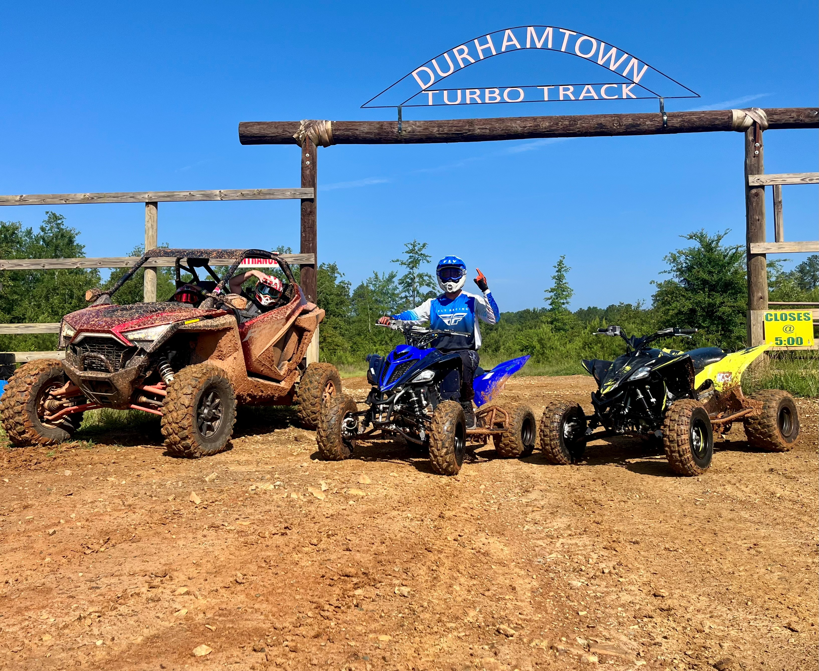
ATV Safety
Having a safe ATV Experience:
Before you hit the trails, it's essential to: ​
Get hands-on training from a qualified instructor.​
Always wear a helmet and other protective gear, such as eye protection, boots, gloves, long pants and a long-sleeved shirt.​
Never consume alcohol or drugs before or during your ride.​
Never ride with more passengers than there are seats.​
Stay off paved roads and stick to designated trails
Notes:
The U.S. Consumer Product Safety Commission (CPSC) urges all consumers using all-terrain vehicles (ATVs) to understand the risks and necessary safety measures of ATVs before riding them. Latest data shows that more than 800 deaths and an estimated 100,000 emergency department-treated injuries occur involving off-highway vehicles (OHVs). Over a five year period form 2018 to 2023, ATVs were the vehicle involved in 92% of OHV injuries. Before you hit the trails, keep the following tips in mind:​
-Get hands-on training from a qualified instructor. ​
-Always wear a helmet and other protective gear and ensure that they are in good condition and working order. Don’t consume alcohol before or after you ride. Use common sense and don't ride with more passengers than there are seats available. Use designated trails, stay off of paved roads. Exercise overall caution when riding an ATV.

Slide 25
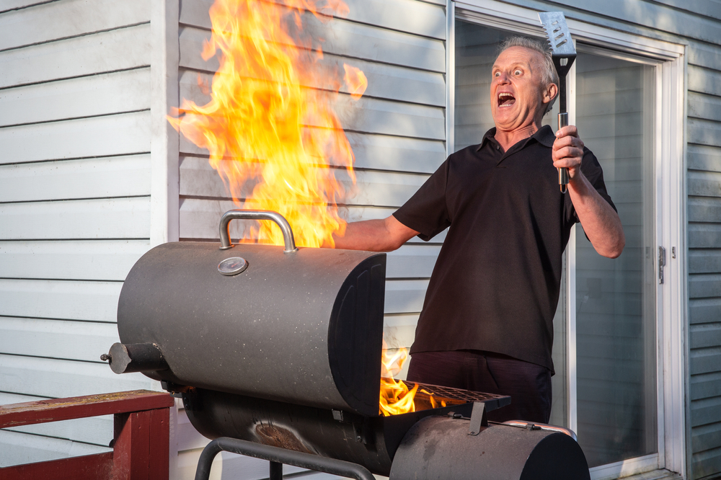
Grilling/Open Fire Safety
Safe Tips while Grilling:
As the warmer weather approaches and you fire up the grill, be mindful of these tips for a safe grilling experience:​
Never leave your grill unattended when in use.​
Check your gas tank for leaks.​
Grill away from your home and anything flammable.​
Remove grease or fat build up before use.​
Keep children and pets at least three feet away.
Notes:
Before you fire up your grills in celebration of warm weather, hear this: Based on annual averages from 2019-2023, July was the peak month for grill fires, followed by June, May and then August. Gas grills were involved in an average of 9,287 home fires per year, including 4,682 structure fires and 4,605 outdoor fires. From 2020-2024, an average of 21,682 patients per year went to the emergency room because of injuries involving grills.​
Keep the following safety tips in mind to keep your BBQ weekend plan from going up in smoke:​
Never leave your grill unattended when in use. Before use, check your gas tank for leaks. Push your grill away from your home or anything flammable. Clean your grill before and after each use. Ensure you remove grease or fat build up from the grill and trays below your grill. Keep children and pets at least three feet away from the grill.​
With these simple tips, you will be on your way to safe grilling.

Slide 26
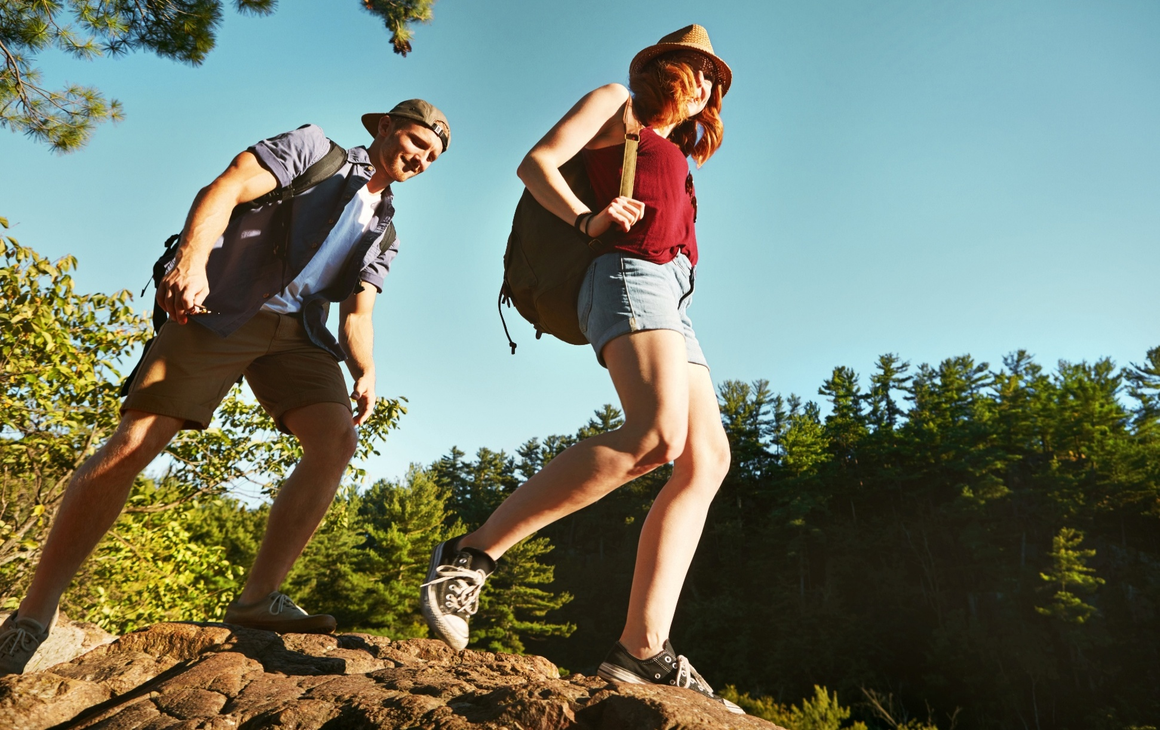
Conclusion
Keep in mind that:
Toward the end of the 101 CDOS last year, 69 servicemembers had been killed in vehicle-related crashes, resulting in a 20% increase over the previous year's total. ​
From the most junior Sailor/Marine to the highest ranking leader, help us keep YOU from being one of these numbers. ​
See the risks, get the information out so that your personnel can avoid the same fate.
Notes:
We have reached the end of the presentation. But, we have to remind all servicemembers of these important facts. FACT: Towards the end of the 101 CDOS last year, 69 servicemembers had been killed in vehicle-related mishaps, resulting in a 20% increase from the previous year's total. Furthermore, we lost 30 Sailors and 15 Marines during FY 2025 from motorcycle accidents. From the most junior person to the highest ranking leader, help us keep YOU from being part of these unfortunate statistics.​
​
See the risk, get the information out so that your personnel can avoid the same fate. We at the Naval Safety Command Risk Management Directorate - Safety Division want you to enjoy your summer—safely. YOU are valuable to our team, and we need to keep all players on the field and focused on the mission.

Slide 27


Contact Us!
NAVSAFECOM_CODE04_PAO@US.NAVY.MIL
https://www.navalsafetycommand.navy.mil
https://www.safety.marines.mil/
Notes:
Have any questions? Send an email or visit the website on the slide.

