Slide 1
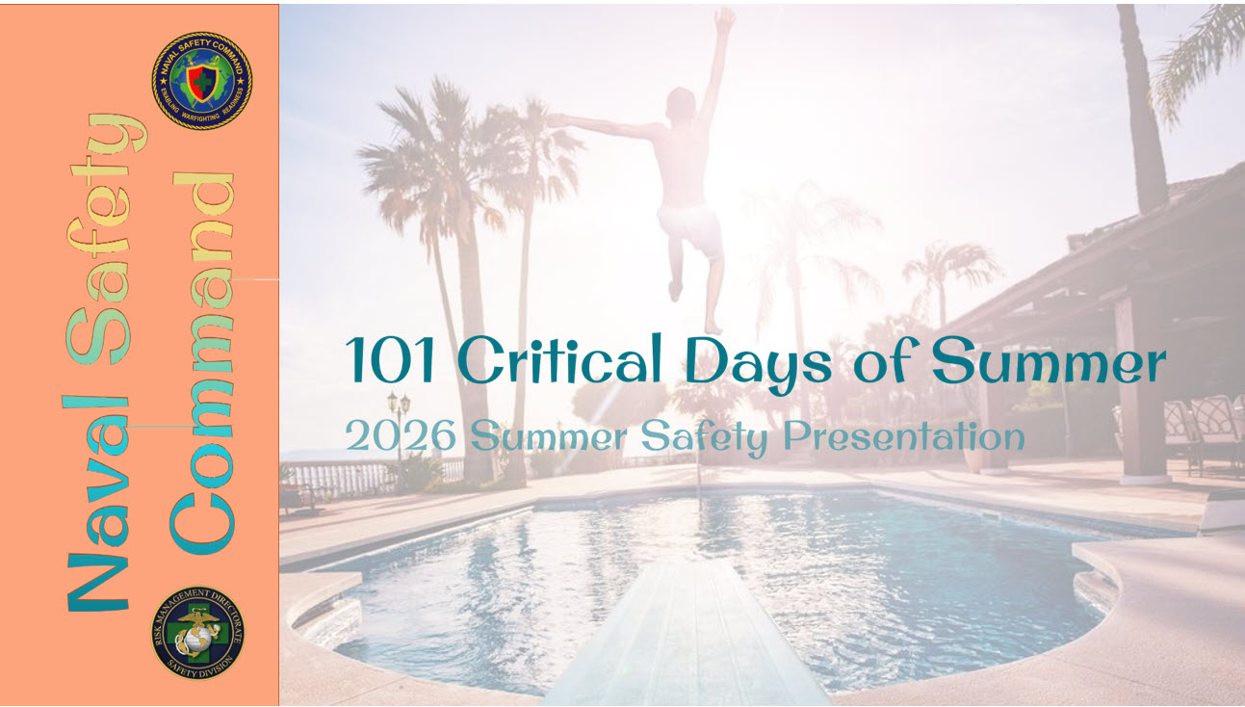
Notes:
We encourage you to tailor and localize this brief for your organization.

Slide 2
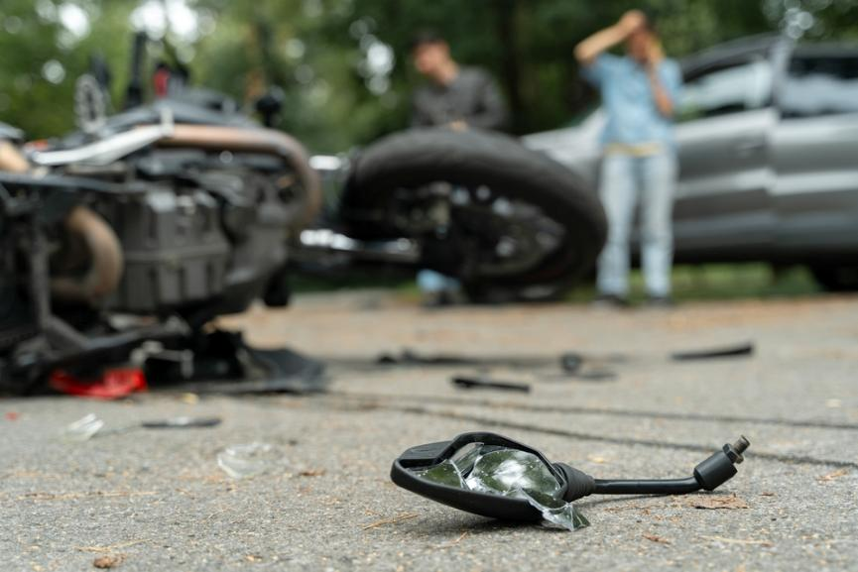
Introduction
The period from Memorial Day to Labor Day is known as the 101 Critical Days of Summer due to the potentially high number of mishaps and incidents that occur as Sailors and Marines enjoy recreational activities during the summer months:
Last summer, 27 Sailors and Marines died in off-duty mishaps while many more were injured.
Most of the deaths were in roadway mishaps: 11 involved motorcycles, 12 were four-wheeled vehicles and one was a pedestrian.
Off-duty recreational deaths claimed three more lives- a drowning, an All-Terrain Vehicle (ATV) mishap and an electric bike mishap.
Notes:
The period known as the 101 Critical days of Summer encompasses the longest portion of the year. Typically, from Memorial Day to Labor Day, people tend to take advantage of the warm weather for their vacations or a long extended weekend. This season, including the 4th of July holiday weekend, creates the potential for mishaps. Statistics from previous years continue to prove that judgement in lapses still occur while engaging in summer activities. During this timeframe in 2024, 27 off-duty servicemembers were killed while many more were injured. Most of those deaths were in roadway mishaps, where 11 deaths resulted from motorcycle crashes, 12 from four-wheeled vehicles and one pedestrian. Furthermore, the summer mishaps reflect a 10% increase in motorcycle deaths and a 33% increase in vehicle mishap deaths in comparison to a five-year average (FY 2020 – 2024) over the same timeframe. Data continues to show a general lack of situational awareness and complacency for numerous off-duty mishaps. Off-duty recreational deaths claimed three additional lives, including a drowning, ATV mishap and an electric bike mishap. ​
​
This brief a general summer safety stand-down presentation that is filled with information for the betterment of yourself and your team. It can help you maintain an active risk-management mindset to help you ensure a safe and enjoyable summer and keep our warriors focused on the task and players on the field.​

Slide 3
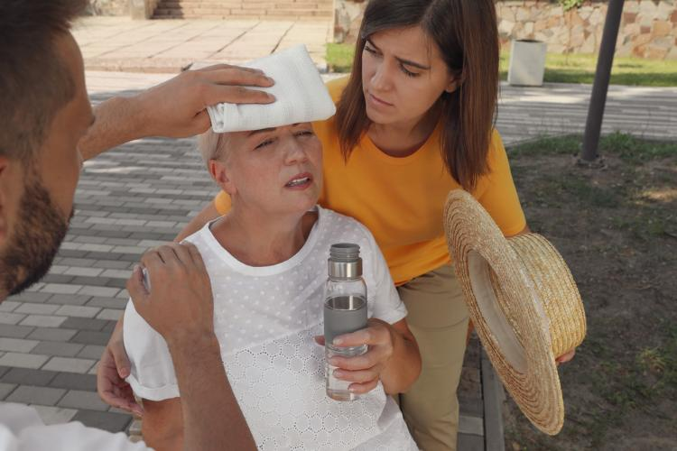



Heat Illness
Despite readily available information the effects of heat stress continue to be underestimated. The human body under normal conditions can regulate its temperature through sweating, usually until it is exposed to more heat than it can handle. This can quickly lead to:
Delirium
Organ Damage
Death
You are more at risk if you are:
Ill, have chronic health conditions or are taking certain medications
Overweight
Working in or exercising in excessive heat
Notes:
Extreme heat is a period where high heat meets high humidity and exceeds temperatures above 90 degrees for 2-3 days. Your body works hard to maintain a normal temperature. In extreme heat, this can lead to your body working harder than ever, leading to injury or death. In 2023, 294 people perished in the U.S. from weather-related excessive heat. Our warfighters had more heat-related injury mishaps in FY24 compared to the previous three years. You are more at risk for suffering from a heat-related illness if you are ill or have other chronic health conditions, taking certain medications, overweight, working in or enjoying strenuous exercise in the heat.

Slide 4

Signs and Symptoms
Heat Cramps:
Muscle spasms with heavy sweating during or after intense activity or exercise
Heat Exhaustion:
Heavy sweating, weakness, dizziness, nausea, headache and cool, clammy, pale skin
Heat Stroke:
Very high body temperature, skin hot to touch, confusion, fainting, seizures
CALL 9-1-1 or other local emergency service IMMEDIATELY.
First Aid
Take the affected person to a cooler area (shade or air conditioning)
Cool the person immediately
Never leave a person with heat-related illness alone. The illness can rapidly become worse, stay with the worker and call 9-1-1 or your local emergency operator
Notes:
Early recognition of heat-related illness symptoms followed by quick action is imperative to stop symptoms from progressing. Symptoms of heat cramps include painful muscle cramps and spasms that usually occur in the legs and abdomen, followed by heavy sweating. For first aid, apply firm pressure on cramping muscles or gently massage to relieve the spasm. Give sips of water unless the person complains of nausea. Seek medical attention of the cramps last more than an hour.​
For heat exhaustion, symptoms include heavy sweating, weakness or tiredness, cool, pale clammy skin, fast, weak pulse, muscle cramps, dizziness, nausea or vomiting, headache and fainting. For first aid treatment, move the person to a cooler environment, loosen clothing and apply cool, wet cloths or have the person sit in a cool bath. Offer sips of water. Call for medical attention if the person vomits or symptoms worsen or last longer than 1 hour. Symptoms of a heat stroke include throbbing headache, confusion, slurred speech, nausea, dizziness, body temperature above 103 degrees F, hot,r ed, dry or damp skin, rapid or strong pulse, fainting and loss of consciousness. Call 9-1-1 or other local emergency services, and get the victim to a hospital immediately. Heat stroke is a severe medical emergency and delaying can be fatal. Move the victim to a cooler, air-conditioned environment. Reduce body temperature with cool cloths or bath and use a fan only if the heat index is below the high 90s (a fan can make you hotter at higher temperatures). It is important to NOT GIVE FLUIDS during a heat stroke. ​
​
Drink enough water to prevent heat illness. Although estimates are everywhere, the average person should aim to drink ¾ of a gallon of water daily, though needs vary according to the person. You can check if you are getting enough water by your urine color. Darker colored urine indicates that you are not drinking enough. Additionally, try to avoid sugary, caffeinated and alcoholic beverages. Combine water with a sports drink to replace the salt and minerals you lose if you are sweating a lot. Your body needs fuel while in the heat. Always keep in touch with your PCM if you have a medical condition or taking medications that can be affected by the heat. ​
​

Slide 5

Fireworks Safety
In 2024, there were 11 reported fireworks-related deaths nationwide.
  Most involved misuse and device misfires/malfunctions
Fireworks injured 14,700 people in 2024.
  Sharp increase of 38% in deaths and 52% in injuries compared to 2023
Adults aged 25 to 44 accounted for the largest share of reported injuries (32%), followed by:
  People aged 15-24 (24%)
  The most frequently injured body parts were hands and fingers (35%) followed by head, face and ears (22%)
Notes:
Each year, thousands of people are injured from fireworks-related incidents to which medical treatment is often necessary. Most of these incidents are due to amateurs attempting to use professional-grade or even homemade fireworks. Regardless, improper handling of fireworks can cause significant injuries, so it’s best to leave them to the professionals. In 2024, there were 11 reported fireworks-related deaths, most of which involved the misuse of fireworks or device misfires and malfunctions. 14,700 people were injured in 2024 alone, where there was a 38% sharp increase in deaths and 52% increase in injuries in comparison to the previous year.
Adults aged 25-44 account for the largest share of injuries followed by people aged 15-24. Hands and fingers are the most frequently injured part of the body, accounting for 35% of total injuries. Second is head, face and ears at 22%.

Slide 6
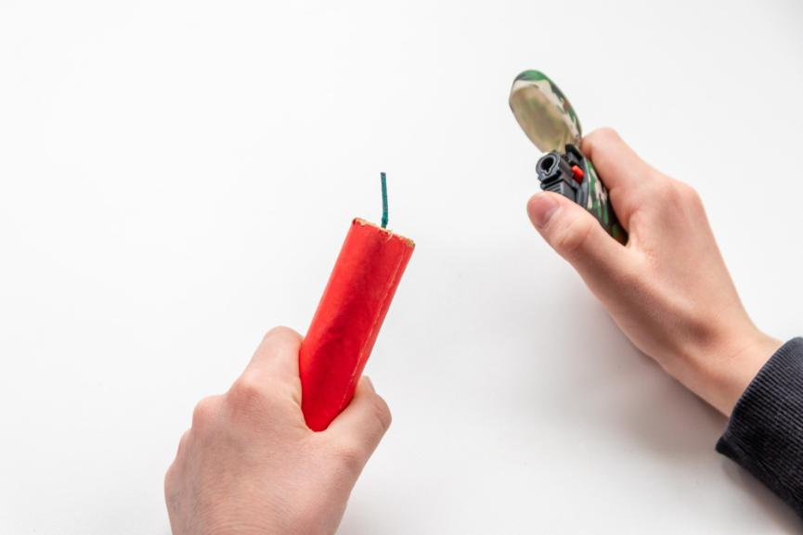
Fireworks Safety
Keep safe this summer, and especially during the 4th of July with these fireworks-related safety tips:
  Never use fireworks while impaired by alcohol or drugs
  Leave the fireworks to the professionals
  Keep a bucket of water or a garden hose handy, in case of fire or other mishap
  Consider attending a locally hosted fireworks show or use other festive alternatives
Notes:
Want to enjoy a safe and relaxing Fourth of July holiday? Keep these safety tips in mind, leave it up to the professionals or consider using other festive alternatives for a safe and mishap-free holiday.

Slide 7
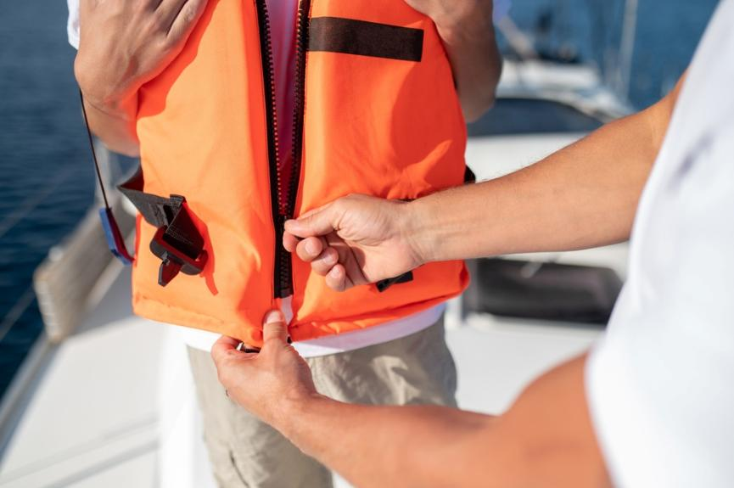
Boating Safety
The U.S. Coast Guard’s 2024 report on Recreational Boating Statistics notes 76% of boating deaths were due to drowning, 87% of victims were NOT wearing a life jacket and 2/3 of drowning victims were considered good swimmers. (https://safeboatingcampaign.com/get-the-facts/)
Life Jacket Wear Guidelines:
Life jackets for adults do not work for children
Make sure life jackets are properly fastened
Ensure all straps, buckles and zippers are secure
Ask a friend to help ensure you have a secure fit
Notes:
Boating Safety Advocates recommend all boaters and passengers always wear a life jacket while boating.
The best life jacket is the one you will wear. Modern life jackets are more comfortable, lightweight and stylish than the bulky orange style most boaters know. You don’t want your life jacket too large or too small. A snug fit is a proper fit. Hold your arms straight over your head. Ask a friend to grasp the tops of the arm openings and gently pull up.
All life jackets that are U.S. Coast Guard approved have an approval number. Look for it to ensure your life jacket meets the law requirements and is safe.

Slide 8

Rules of the Road
Always operate at a safe speed (especially in congested areas) and no wake zones; stay alert and steer clear of large vessels and watercraft that can be restricted in their ability to maneuver
Maintain a proper lookout and be mindful of buoys and other navigational aids, all of which have been placed there to ensure your safety and the safety of the boats around you.
To learn more, check out the USCG Navigation Rules Information page: https://www.dco.uscg.mil/NavRules/
Notes:
New boaters and experienced experts alike need to be familiar with the boating rules of the road. Boating safety courses are offered locally, inexpensive, and often completed in a day in-person or online. Make sure to stay alert and steer clear of large vessels and watercraft. Maintain a proper lookout and remember to be respectful of buoys and other navigational aids. They are there for your safety and the safety of other boats around you. To learn more, check out the USCG Navigation Rules Information page.

Slide 9
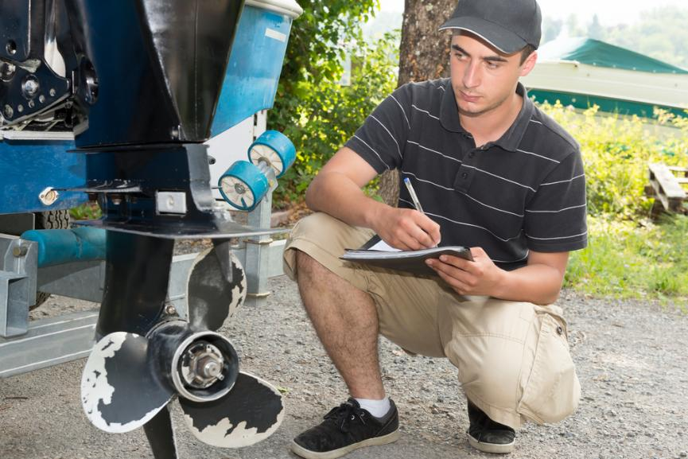
Prep and Good Judgment
Always check the local, route and destination weather and water conditions before departure
Have a float plan before heading out and ensure a reliable friend or family member has knowledge of your plan
The U.S. Coast Guard Auxiliary and U.S. Power Squadrons offer complimentary vessel safety checks and boat examinations.
https://wow.uscgaux.info/content.php?unit=013-04-06&category=1329844473
Notes:
1) GET FREE VESSEL SAFETY CHECKS
The U.S. Coast Guard Auxiliary and U.S. Power Squadrons offer complimentary boat examinations to verify the presence and condition of specific safety equipment required by state and federal regulations. Free of charge, they also offer virtual vessel exams.
https://wow.uscgaux.info/content.php?unit=013-04-06&category=1329844473
2) CHECK THE WEATHER
Always check local, route, and destination weather and water conditions before departure and ensure it is safe to go out.
3) HAVE A FLOAT PLAN
Just like pilots file a flight plan before takeoff, boaters should file a float plan before heading out on the water. It's one of the most important things you can do to prepare for an emergency and ensure a fast, effective response if you need assistance on your journey. Give your float plan to a family member, reliable friend, marina dock master, or anyone you trust to contact the US Coast Guard in an emergency. If your plans change due to weather, mechanical issues, or even personal preferences, reach out to your contact and update them.
When preparing your float plan, include the following details:
Vessel Description: Include the make, model, size, color, type, engine size (if applicable), and vessel identification number.
Number of Persons Onboard: List names, along with contact information and any special medical needs.
Departure Details: Include the name and location of the marina, launch ramp, or dock you'll be leaving from.
Tow Vehicle Info: Add your tow vehicle's location and license plate number.
Destination & Route: Provide your general route and specific stops or areas you plan to visit (e.g., anchor points, dive sites, fishing grounds).
Estimated Time of Return: Be specific about when you expect to return or check in.
Communication Equipment: List cell phone numbers, VHF radio channel(s), and even satellite devices, if available.

