Slide 1
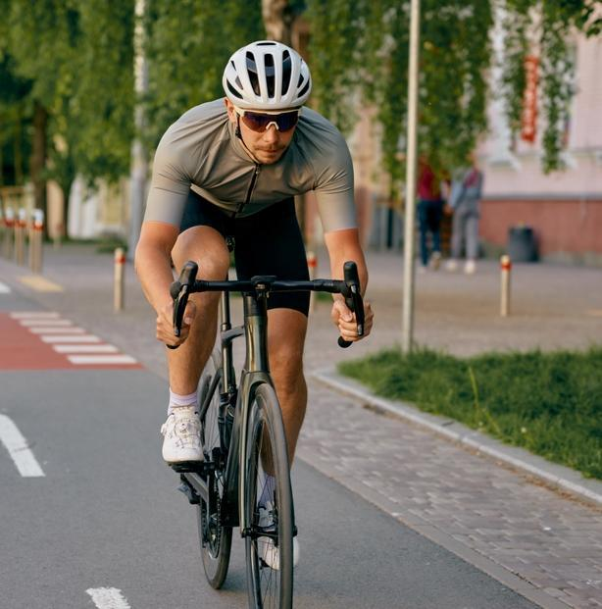
Bicycle Safety
Quick facts:
In the United States, over 1,000 cyclists are killed and 130,000+ injured in crashes each year​
Most fatal crashes involve motor vehicles, not just solo falls​
Head injuries are the leading cause of death in bicycle crashes
Wearing a helmet reduces the risk of serious head injury
The majority of fatal bicycle crashes occur in urban areas​
Dusk to nighttime is the highest risk period for fatal
cyclist crashes​
Alcohol is a factor in ~1/3 of fatal bicycle crashes (cyclist
or driver)
Notes:
​
Every year, we lose nearly a thousand cyclists on U.S. roads and see well over 100,000 injuries. Biking is a great way to stay active, although it has its risks. One of the things that surprises most people regarding bicycle incidents is that most fatal crashes don't occur from simple falls, but from collisions with motor vehicles. Both drivers and cyclists must maintain awareness. Keep in mind when you are commuting, riding with others or just out enjoying the summer fun, that bicyclists are out there and it can be difficult to spot them. On the flip side, if you are out enjoying a stroll on your bicycle, assume that drivers may not always notice you and proceed safely and accordingly.​
​
When crashes do happen, the largest danger remains head injuries which are the leading cause of death in bicycle crashes. The good news is that wearing a helmet can cut your risk of a head injury significantly by around 60%. Unfortunately, many riders still skip wearing a helmet. The risk climbs higher when alcohol is involved. The takeaway here is a simple one: stay visible, stay alert and protect yourself (including your head) every time you ride.​
​

Slide 2
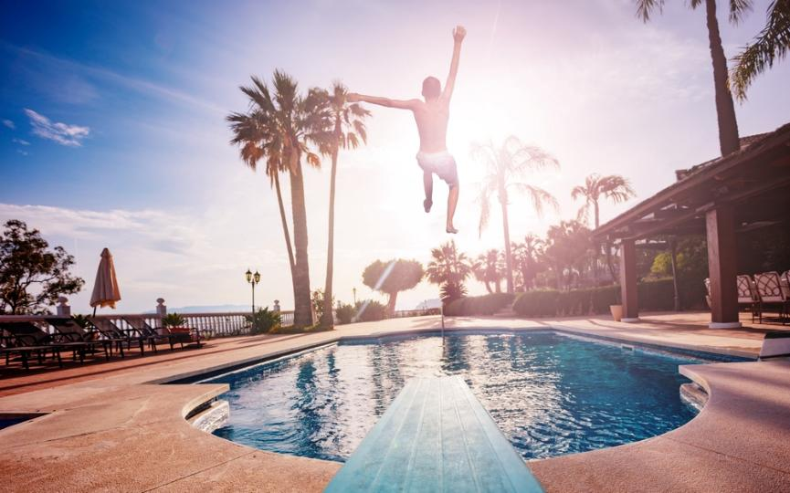
Water Activities
Drowning is a leading cause of unintentional injury/ death in the United States
Over 4,000 fatal unintentional drownings occur each year (~11 per day)​
For every fatal drowning, there are ~8 nonfatal drowning incidents requiring emergency care​
Rip currents account for ~80% of beach rescues​
Most drownings happen in open water (lakes, rivers, ocean), not pools
Notes:
When it comes to water activities, the risks are often underestimated. Drowning remains one of the leading causes of unintentional injury/deaths in the U.S. More than 4,000 lives are lost each year (about 11 people every day) from drowning. However, drowning is not always fatal. Fatal drowning happens when the drowning results in death. Nonfatal drowning happens when a person survives a drowning incident
Even more so, there are roughly 8 more incidents that require emergency care. These situations, appearing benign in nature can quickly turn serious. Natural water environments add an additional risk. For example, rip currents in our oceans can pull even the strongest swimmer away from shore. Lakes and rivers have hidden currents or drop-offs.

Slide 3
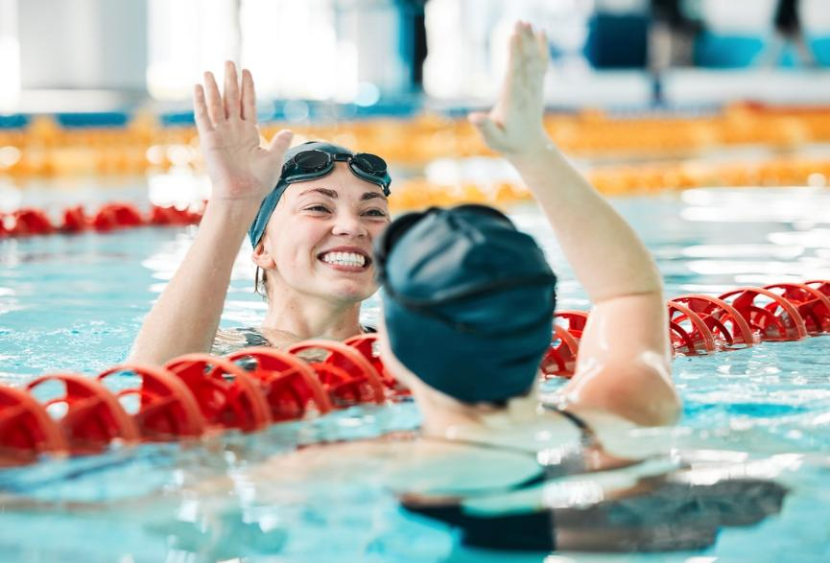
Tips to Swim Safely
Always swim with a buddy, never swim or go into any open body of water alone
If swimming indoors, always use the ladder to enter and exit the pool. Wear slip-resistant footwear around the pool area
Learn how to spot and escape rip currents.
Be cautious in natural waters such as lakes, rivers and the ocean.
Notes:
When you head out for a day on the water, respect it and stay aware of any changing conditions. Take notice of any hazards. Make smart decisions, such as:​
Even the best swimmers need company. Always swim with a buddy, never go into the open water alone​
Use caution when swimming indoors. Use the ladder in the pool to enter and exit, and be mindful that you are wearing slip-resistant footwear around the pool area.
Be aware of your surroundings. Look out for hazards. Learn how to spot and escape rip currents (check out our graphic here and swim parallel to shore, not against the current.)
Be cautious in natural waters such as lakes, rivers and even the ocean. Conditions can change quickly and hazards may not always be visible.​

Slide 4
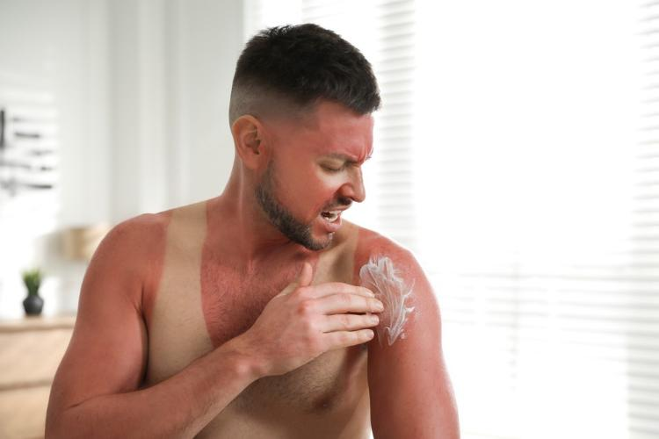


Sun Exposure
Here are some of the not so “cold” hard facts on sun exposure:
Sun exposure significantly increases the risk of dehydration, heat exhaustion and heat stroke
Sunburn is a radiation injury where severe burns can cause blistering, infection and systemic illness
UV exposure + heat = faster fatigue and reduced physical performance
Did you know?
Just one severe sunburn can lead to fever, chills and dehydration, also known as
“sun poisoning”
Certain medications can increase sun sensitivity and dehydration risks
Notes:
​
Sunburn isn't just a cosmetic issue. It is damage to the skin from the sun that can have serious health consequences. When people work or exercise outdoors in high heat, they face a dual threat: Injury from UV exposure and heatrelated illness. These injuries can cause blistering, infection and systemic illness. Furthermore, increased sun exposure increases your risk of dehydration and suffering from various heat illnesses. Remember, heat exhaustion and heat stroke are medical emergencies that require immediate attention.

Slide 5
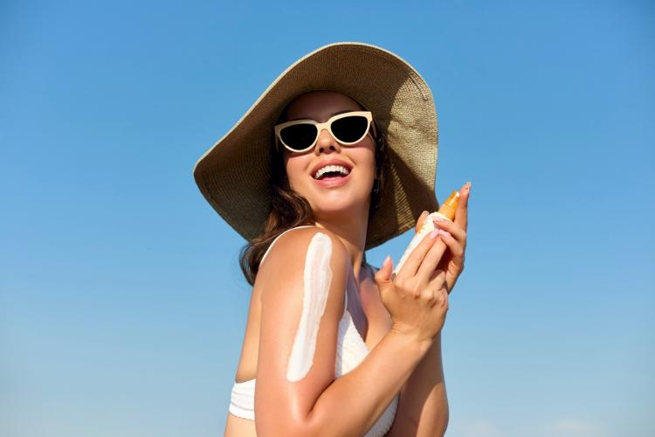
Staying Safe in the Sun
Here’s how you can protect yourself from sun exposure:
Apply sunscreen with an SPF rating of at least 30 or higher to all exposed skin
Reapply sunscreen every two hours or more after sweating or swimming
Stay in the shade as much as possible; Wear a hat or use an umbrella to reduce heat and sun exposure
Did you know?
Sunglasses aren’t there just to make you
look cool; they help block harmful UV radiation.
Wear sunglasses that will block out 99-100% UV-A and UV-B radiation
Notes:
Here are some prevention methods to keep you safe while enjoying the sun:​
Aim to drink at least one cup of water every 20 minutes while outside in the heat. Furthermore, apply sunscreen with an SPF rating of at least 30 or higher to all exposed skin. You'll want to reapply this every two hours, or even more so after sweating or swimming. Stay in the shade as much as possible. It isn't just for your comfort, it can reduce heat and sun exposure significantly. Pay attention to the clothes you wear. Ensure they are light-colored, loose-fitting that cover as much skin as possible. Sunglasses aren't just there to make you look cool. A good pair will block out 99-100% of UV-A and UV-B radiation. ​
​

Slide 6
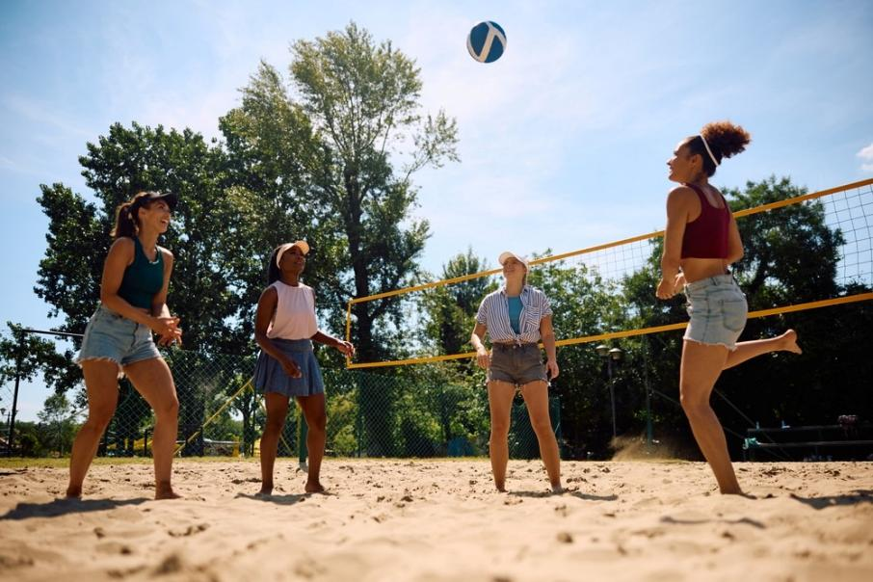
Sports Safety
What you should know:
Exertional heat illness is one of the leading causes of death during physical activity​
Runners can lose 1–3 liters of fluid per hour, even in moderate heat​
Starting activity already dehydrated significantly increases risk of heat injury​
Most heat-related incidents occur during sustained activity (30+ minutes)​
Lack of acclimatization (first 3–5 days of activity in heat) greatly increases risk
Notes:
Playing sports has both physical and psychological benefits. However, you can be at risk for sports injuries without proper planning. Exertional heat illness is one of the leading cases of preventable death during physical activity. Runners especially can lose up to three liters of fluid per hour, even in moderate heat. Drinking water is important, but especially when sports are part of your routine. If you start a physical activity already dehydrated, you significantly increase your risk of heat injury. Most heat-related incidents and injuries typically occur within the first 30 minutes of sustained activity. Exertional heat illness can increase the risk of muscle cramps, strains and overuse injuries. Furthermore, failure to acclimate during the first 3-5 days of activity in heat greatly increases the risk that you will get hurt.

Slide 7
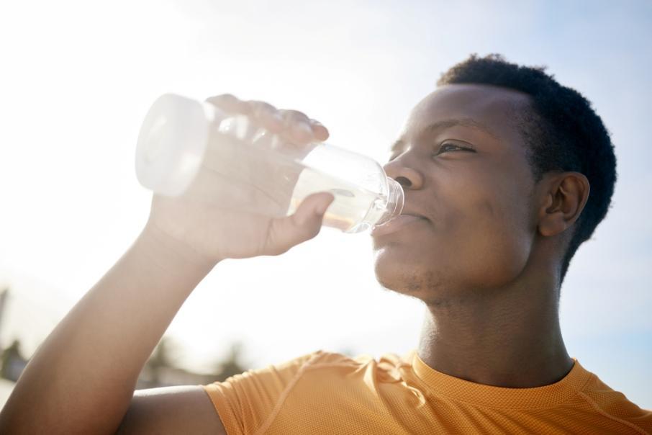
The Effects of Dehydration
Symptoms of Dehydration:
Muscle cramping​
Fatigue​
Lightheadedness​
Dizziness​
Confusion​
Dry mouth/mucous membranes​
Increased heart rate and breathing​
Notes:
Keep in mind the symptoms of dehydration, some of which include muscle cramping, dizziness or dry mouth. Water is the most basic form of hydration and the least expensive. Sports drinks and electrolyte beverages can also make a person feel better if they are experiencing dehydration. Exercise related heat exhaustion occurs when your body can no longer get rid of the extra heat made during exercise, and your body temperature rises more than what is healthy. Not drinking enough fluids can cause dehydration which can lead to collapse.

Slide 8
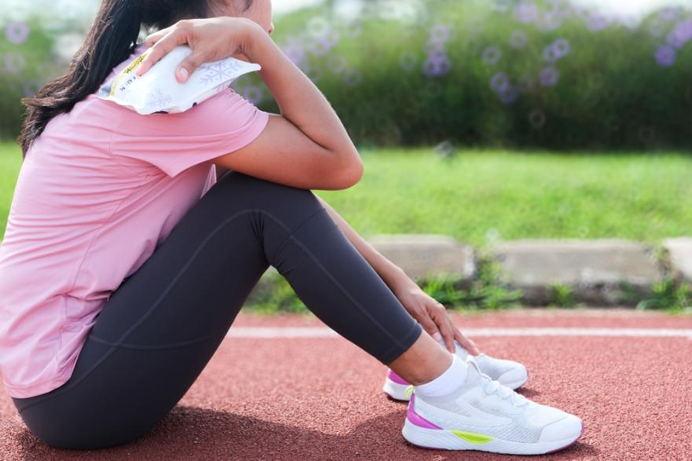
Playing It Safe
Tips for Sports Safety:
Hydrate before, during and after physical activity​
Wear lightweight, light-colored, loose-fitting clothes​
Listen to your body and take frequent breaks​
Check with your doctor before starting an exercise routine​
Avoid exercise outside in the early afternoon​
Work out or play sports with a friend, not alone​
Notes:
Here are some preventative measures that you can take to ensure that you don't get "winded" while enjoying sports:​
Hydrate even if you don't feel thirsty. Bring water and depending on the intensity, an electrolyte or sports beverage with you. Wear clothing that has moisture-wicking fabric. Furthermore, protect yourself from the sun with sunglasses, a hat and sunscreen. Take frequent breaks and drink water before you are thirsty. Allow yourself enough time to adapt to the heat. This can take between 3-5 days, or even as long as 14 days. Do not push yourself to have an intense workout when it is hot. Always check with your healthcare professional before starting any exercise routine or sport. Certain medications and health conditions can exaggerate your body's response to heat. Working out with a friend or partner can ensure that if something does happen, you can get assistance.

Slide 9
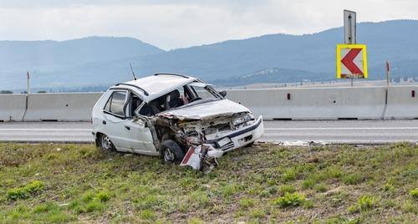
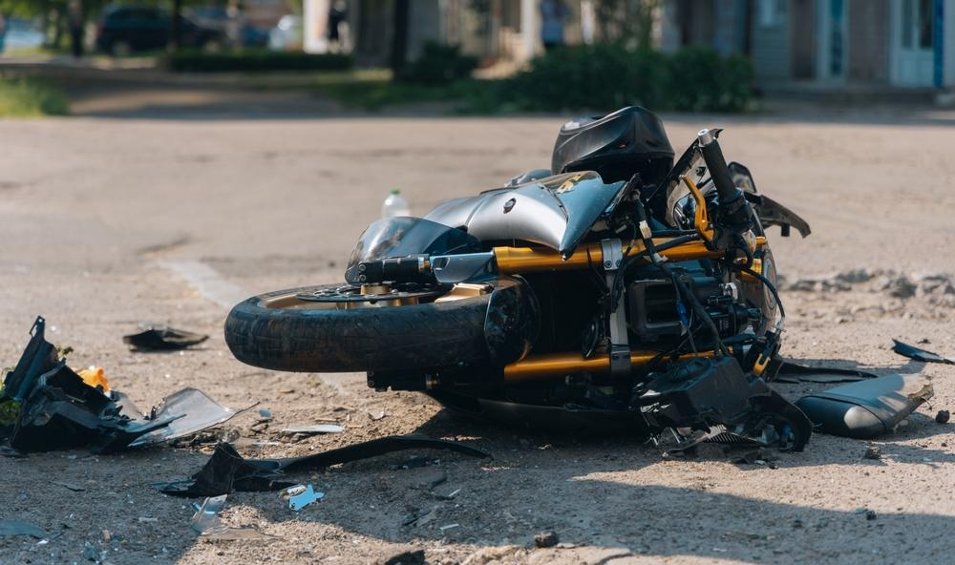
Safe Driving
Quick facts
According to the NHTSA, per vehicle miles traveled in 2023, motorcyclists were about 28 times more likely than passenger car occupants to die in a vehicle crash and were five times more likely to be injured. Motorcycle riders continue to be overrepresented in fatal traffic crashes. In 2023, there were 6,335 motorcyclists killed — 15% of all traffic fatalities.
Speed affects your safety even when you are driving at the speed limit; going too fast for road conditions -- such as bad weather or a road under repair.
Notes:
​
Summertime usually means vacations and summer road trips, with more people driving, walking, and biking. However, vehicle crashes remain a growing concern. Last year was a deadly year for motorcyclists in the Navy and Marine Corps, where 45 Sailors and Marines were killed due to motorcycle crashes. Speeding contributed to about one-third of all motor vehicle fatalities. In 2023, speeding was a factor in 29% of all traffic deaths, according to the National Highway and Traffic Safety Administration. Now is a good time to review these summer driving safety tips.

