Slide 1

Ride Right, Stay in the Fight
Before the Ride:
Check tire pressure and tread depth
Check your hand and foot brakes, as well as signal indicators and fluid levels
Check for gas or oil leaks
During the Ride:
Don’t take any unnecessary risks
Obey speed limits, traffic lights, signs and lane markings
Ride defensively and proceed with caution through intersections
Notes:
BEFORE THE RIDE Check your motorcycle’s tire pressure and tread depth, hand and foot brakes, head and brake light signal indicators, and fluid levels before you ride. You should also check under the motorcycle for signs of oil or gas leaks. If you're carrying cargo, you should secure and balance the load on the cycle; and adjust the suspension and tire pressure to accommodate the extra weight. If you're carrying a passenger, they should mount the motorcycle only after the engine has started; should sit as far forward as possible directly behind you; and should always keep both feet on the footrests, even when the motorcycle is stopped. Remind your passenger to keep his or her legs and feet away from the muffler. Tell your passenger to hold on firmly to your waist, hips, or belt; keep movement to a minimum; and lean at the same time and in the same direction as you do. Do not let your passenger dismount the motorcycle until you say it is safe.
Always wear a helmet that meets U.S. Department of Transportation (DOT) Federal Motor Vehicle Safety Standard (FMVSS) 218. Look for the DOT symbol on the outside back of the helmet. Snell and ANSI labels located inside the helmet also show the helmet meets the standards of those private, non-profit organizations.
DURING THE RIDE Experienced riders know local traffic laws - and they don't take risks. Obey traffic lights, signs, speed limits, and lane markings; ride with the flow of traffic and leave plenty of room between your bike and other vehicles; and always check behind you and signal before you change lanes. Remember to ride defensively. Most multi-vehicle motorcycle crashes generally are caused when other drivers simply don’t see the motorcyclist. Proceed cautiously at intersections and yield to pedestrians and other vehicles as appropriate. You can increase your visibility by applying reflective materials to your motorcycle and by always keeping your motorcycle’s headlights on, even using high beams during the day.
https://www.nhtsa.gov/road-safety/motorcycles

Slide 2
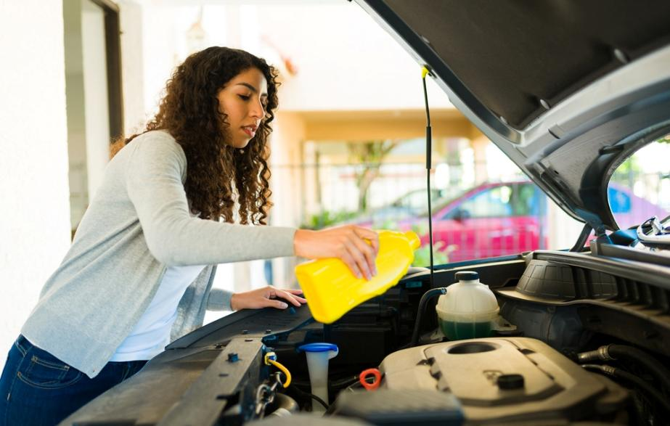
Motor Vehicles Too
Safety Planning Tips
Check the weather, road conditions and traffic as you plan your route.
Allow plenty of time to get to your destination safely.
Check your A/C performance and cabin air filter before the temperature rises
Check under your hood and inspect all belts and hoses to ensure good working order
NEVER LEAVE A CHILD UNATTENDED IN A PARKED/LOCKED VEHICLE.
Notes:
PLAN YOUR ROUTE
Before heading out, check the weather, road conditions, and traffic. Don’t rush through your trip; allow plenty of time to get to your destination safely. Always review directions and maps before you go, even if you use a navigation aid, and let others know your route and ETA.
SUMMER WEATHER TIPS
A/C
As the temperatures rise, your A/C works harder to keep your vehicle cool. Check A/C performance and cabin air filter before traveling. A lack of air conditioning on a hot summer day affects everyone, especially children and older adults sensitive to heat or in poor health.
BELTS AND HOSES
As summer temperatures rise, rubber belts and hoses degrade. Look under the hood and inspect all belts and hoses for bulges, blisters, cracks, or cuts in the rubber. It’s best to replace them now if they show signs of obvious wear. Also, make sure all hose connections are secure.
HEATSTROKE
Heatstroke in vehicles can happen when a child is left unattended in a parked vehicle or enters an unattended vehicle. Never leave children alone in a car. A child’s body temperature rises three to five times faster than an adult's. Even if it’s 60 degrees outside with the windows cracked, the temperature inside a vehicle can quickly reach deadly levels.

Slide 3
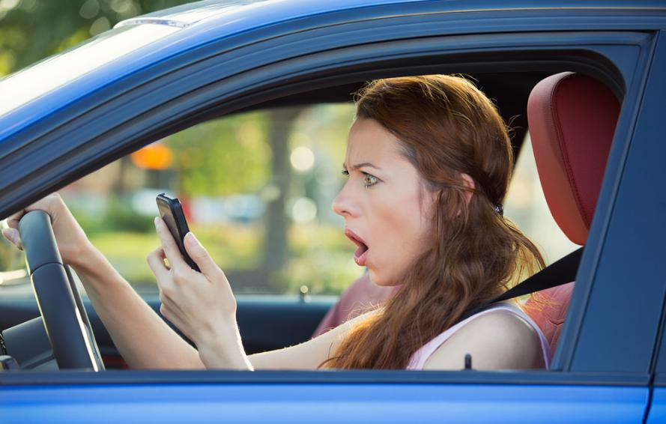
Distracted Driving
Distracted Driving Tips:
Do not text while driving
Obey posted speed limits
Encourage friends and family to drive phone-free
Put down your phone and focus on the road
Speak out as a passenger if the driver is distracted
Notes:
Here are AAA’s Top 10 Tips to Avoid Distractions While Driving
10. Fully focus on driving. Do not let anything divert your attention, actively scan the road, use your mirrors and watch out for pedestrians and cyclists.
9. Store loose gear, possessions and other distractions that could roll around in the car so you do not feel tempted to reach for them on the floor or the seat.
8. Make adjustments before you get underway. This includes adjusting your seat, mirrors and climate controls before hitting the road. Also, decide on your route and check traffic conditions ahead of time.
7. Finish getting ready at home – instead of once you get on the road.
6. Snack smart. If possible, eat meals or snacks before or after your trip, not while driving. On the road, avoid messy foods that can be difficult to manage.
5. Secure children and pets before getting underway. If they need your attention, pull off the road safely to care for them. Reaching into the backseat can cause you to lose control of the vehicle.
4. Put aside your cell phone. Never text, read email, play video games or scroll the internet or social media while driving.
3. If you have passengers, let them be your co-pilot or navigator so you can focus safely on driving.
2. If another activity demands your attention, instead of trying to attempt it while driving, pull off the road and stop your vehicle in a safe place
1. As a general rule, if you cannot devote your full attention to driving because of some other activity, it’s a distraction. Take care of it before or after your trip, not while behind the wheel.

Slide 4

Pedestrian Safety
Safety tips for Pedestrians:
Stay alert while in crosswalks
When driving, scan around your vehicle to check for children before backing out of a driveway or parking spot
As a pedestrian, walk on sidewalks whenever available
Make eye contact with drivers whenever possible and wait for a clear, complete stop before crossing
Obey signs and signals
Notes:
Stay alert and look out for pedestrians and cyclists. To prevent back overs, always walk around your vehicle to check for children running or playing before backing out of a driveway or parking spot. While backup cameras are helpful, they have limitations; kids, pets, and objects can still be in your path but out of the camera’s view. When children play, they are often oblivious to cars and trucks around them. Every vehicle has a blind zone.

Slide 5
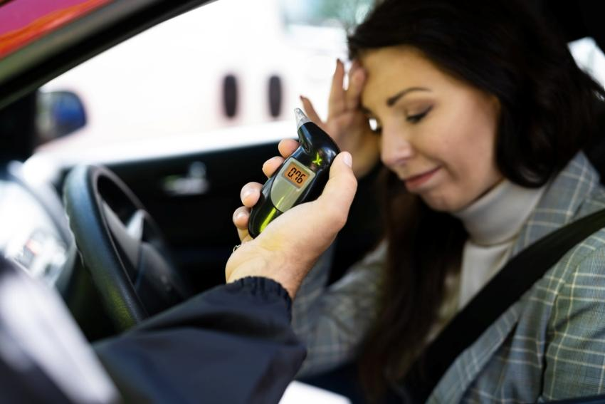
Alcohol Safety
Cold Hard Facts about Alcohol:
Alcohol involvement leads in water-related drowning deaths, typically peaking in the summer months​
Alcohol consumption is the leading cause of boating accidents involving property damage, injury and death.​
Drinking more while on vacation can lead to unforeseen issues​
Hot weather and alcohol are a dangerous risk combination for dehydration.
Do not drink and operate any motorized vehicles.​
Be smart this summer, think before you drink.
Notes:
Understand this: Alcohol use impairs judgment and increases risk taking. Did you know that alcohol is a leading contributor in water-related drowning deaths? Not only does alcohol impair your judgment and increase risk-taking, it is a dangerous combination for swimmers. People tend to become overconfident the more they drink and push beyond their natural ability at different sports or activities, increasing the risk of injury. ​
​
Keep in mind how much alcohol you consume when traveling or on vacation. Drinking often leads to higher blood alcohol concentrations and increases the risk for accidents and injuries. It can worsen certain health conditions as well, or interact with medications. Alcohol and heat can equal trouble. Heat can cause fluid loss through perspiration while alcohol intensifies this fluid loss through increased urination. Together, these two things can quickly lead to dehydration or heat stroke. Be smart this summer and think before you drink. ​
​
Avoid alcohol while piloting a boat, driving a car, exploring the great outdoors, swimming, surfing or any activity that requires concentration and can lead to severe injuries or death. Be a good host; if you are serving alcohol at a summer gathering, be sure to:​
-Provide a variety of healthy foods and snacks. Food can slow the absorption of alcohol and reduce the peak level of alcohol in the body by 1/3.​
-Offer alcohol-free beverages such as water, juice and sparkling sodas. This will help counteract the dehydrating effects of alcohol.​
-Have a plan for your guests to get home safely. Use designated drivers, ride-hailing services or taxis. Do not drive if you drink.​
​

Slide 6
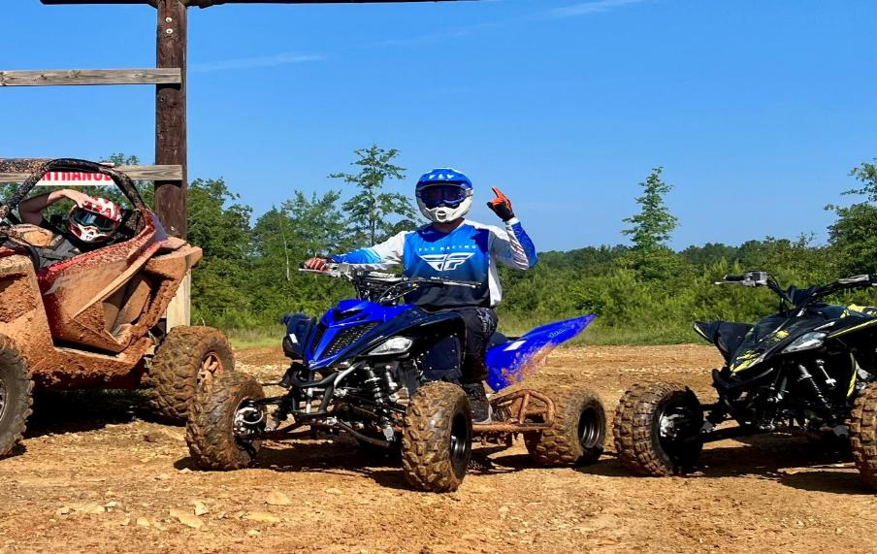
ATV Safety
Having a safe ATV Experience:
Before you hit the trails, it's essential to: ​
Get hands-on training from a qualified instructor.​
Always wear a helmet and other protective gear, such as eye protection, boots, gloves, long pants and a long-sleeved shirt.​
Never consume alcohol or drugs before or during your ride.​
Never ride with more passengers than there are seats.​
Stay off paved roads and stick to designated trails
Notes:
The U.S. Consumer Product Safety Commission (CPSC) urges all consumers using all-terrain vehicles (ATVs) to understand the risks and necessary safety measures of ATVs before riding them. Latest data shows that more than 800 deaths and an estimated 100,000 emergency department-treated injuries occur involving off-highway vehicles (OHVs). Over a five year period form 2018 to 2023, ATVs were the vehicle involved in 92% of OHV injuries. Before you hit the trails, keep the following tips in mind:​
-Get hands-on training from a qualified instructor. ​
-Always wear a helmet and other protective gear and ensure that they are in good condition and working order. Don’t consume alcohol before or after you ride. Use common sense and don't ride with more passengers than there are seats available. Use designated trails, stay off of paved roads. Exercise overall caution when riding an ATV.

Slide 7
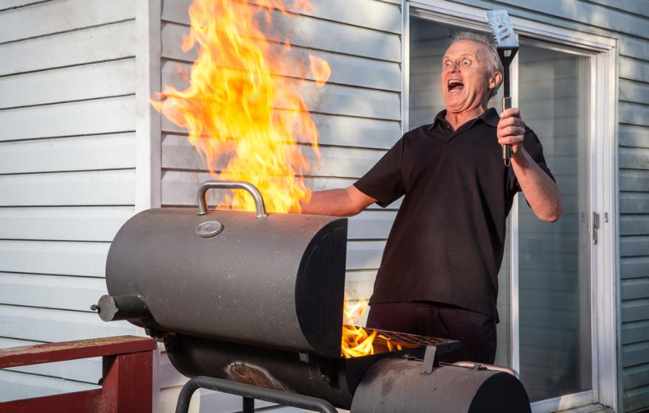
Grilling/Open Fire Safety
Safe Tips while Grilling:
As the warmer weather approaches and you fire up the grill, be mindful of these tips for a safe grilling experience:​
Never leave your grill unattended when in use.​
Check your gas tank for leaks.​
Grill away from your home and anything flammable.​
Remove grease or fat build up before use.​
Keep children and pets at least three feet away.
Notes:
Before you fire up your grills in celebration of warm weather, hear this: Based on annual averages from 2019-2023, July was the peak month for grill fires, followed by June, May and then August. Gas grills were involved in an average of 9,287 home fires per year, including 4,682 structure fires and 4,605 outdoor fires. From 2020-2024, an average of 21,682 patients per year went to the emergency room because of injuries involving grills.​
Keep the following safety tips in mind to keep your BBQ weekend plan from going up in smoke:​
Never leave your grill unattended when in use. Before use, check your gas tank for leaks. Push your grill away from your home or anything flammable. Clean your grill before and after each use. Ensure you remove grease or fat build up from the grill and trays below your grill. Keep children and pets at least three feet away from the grill.​
With these simple tips, you will be on your way to safe grilling.

Slide 8

Conclusion
Keep in mind that:
Toward the end of the 101 CDOS last year, 69 servicemembers had been killed in vehicle-related crashes, resulting in a 20% increase over the previous year's total. ​
From the most junior Sailor/Marine to the highest ranking leader, help us keep YOU from being one of these numbers. ​
See the risks, get the information out so that your personnel can avoid the same fate.
Notes:
We have reached the end of the presentation. But, we have to remind all servicemembers of these important facts. FACT: Towards the end of the 101 CDOS last year, 69 servicemembers had been killed in vehicle-related mishaps, resulting in a 20% increase from the previous year's total. Furthermore, we lost 30 Sailors and 15 Marines during FY 2025 from motorcycle accidents. From the most junior person to the highest ranking leader, help us keep YOU from being part of these unfortunate statistics.​
​
See the risk, get the information out so that your personnel can avoid the same fate. We at the Naval Safety Command Risk Management Directorate - Safety Division want you to enjoy your summer—safely. YOU are valuable to our team, and we need to keep all players on the field and focused on the mission.

Slide 9


Contact Us!
NAVSAFECOM_CODE04_PAO@US.NAVY.MIL
https://www.navalsafetycommand.navy.mil
https://www.safety.marines.mil/
Notes:
Have any questions? Send an email or visit the website on the slide.

