Slide 1
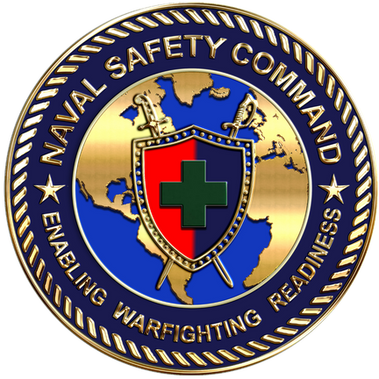
2023
101 CRITICAL DAYS OF SUMMER
1

Slide 2
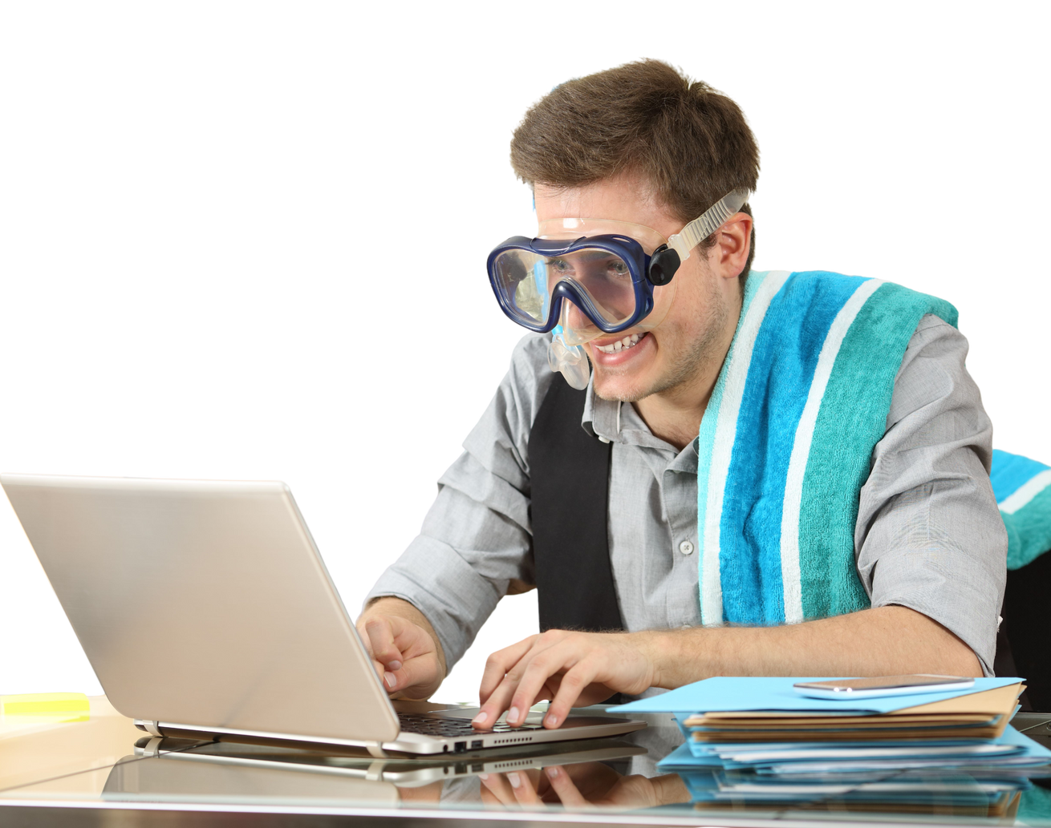
The 101 Critical Days of Summer is the longest vacation period of the year for military members, beginning Memorial Day weekend and ending Labor Day weekend. Summer also includes four holidays, which are frequently approved as long weekends for uniformed personnel.
Introduction
Manage Your Risk
Potential lapses in judgment while engaging in summer activities can impact the readiness of Sailors and Marines. A general lack of situational awareness and complacency are root causes in numerous off-duty mishaps every summer.
This presentation provides general summer safety information to help you – and your team – maintain an active risk management mindset to help ensure an enjoyable and safe summer.
ID numbers of off-duty mishaps reported during the last two summer seasons in Risk Management Information (RMI) are included as well. The next slide addresses how safety professionals with access to RMI can share redacted versions of these examples to protect safety privileged information (PSI) and personally identifiable information (PII).
2

Slide 3
PSI and PII Protection of Mishap Examples
The last two slides of this presentation offer limited factual information regarding the RMI mishap examples noted throughout. Safety professionals with access to RMI can research the examples with one caution: while helpful for general background information for use by safety professionals, avoid going beyond factual information by releasing privileged safety information (PSI) or personally identifiable information (PII).
Note: Commander, Naval Safety Command is custodian of and sole release authority for PSI. The Safety Privilege is meant to encourage candor from witnesses and board members to identify root causes of mishaps and take corrective actions to prevent future mishaps.
Please contact NAVSAFECOM with any questions.
3

Slide 4
Last Summer Fatalities
During the 101 Critical Days of Summer in 2022, the Department of the Navy lost 29 Sailors and Marines to preventable off-duty mishaps. Motor vehicle and motorcycle mishaps were the leading causes.
One off-duty death is one too many.
4

Slide 5
Top Activities that Hurt Us Last Summer
PMV-4 (automobiles) - Two fatalities were pedestrians.
PMV-2 (motorcycles) - For perspective, only 10% of service members are motorcycle riders.
Team sports - Basketball incurred the most, followed by softball.
In the home - Cuts, trips, falls, cooking and lifting/moving objects.
Outdoors - Hiking, walking, swimming, camping, diving and boating.
Individual physical training (PT) - Mainly while running and weightlifting.
Bicycles, stairs and dogs.
5

Slide 6
We Know What You Did Last Summer
Opening frozen ice cream container with knife.
Chopping wood, then hatchet bounces.
Jumps while playing basketball, lands on another player's foot.
While camping, drops hot fire log on feet.
While riding motorcycle, brakes lock.
Attempts to remove feral cat from dumpster, then bitten by cat.
Slips off boat onto engine.
While hosting social gathering, slips on deck.
Weed eater motor explodes during start up.
Slips while hiking, falls 20 feet.
Tumbles over mountain bike handlebars.
Riding E-scooter off road, falls when front wheel embeds in loose sand.
Wrestling while drinking, dislocated shoulder.
Dirt bike riding, thrown from bike.
Driving ATV, attempts to avoid puddle, uses brakes and flies over handlebar.
Surfer at shoreline startles unknown sea creature who punctures foot.
Events reported as
hazards in RMI.
Luck is not a superpower. Make consideration of risks and hazards
an ingrained part of your life, on and off duty.
6

Slide 7
The Navy’s Get Real, Get Better (GRBG) call to action empowers us to self-assess and self-correct risk both on and off duty.
We must adopt a learning mindset and commit to work collaboratively to educate, inform and hold each other accountable for decisions we make.
The majority of off-duty recreational mishaps are entirely preventable and avoidable, provided we assess risks and comply with laws, procedures and recommended best practices for a given activity.
get real
get better
An active risk management mindset contributes to readiness.
7

Slide 8
Water-Related
Activities
The Department of the Navy lost 1 Sailor during the 2022 Critical Days of Summer due to drowning.
4 Sailors sustained injuries that resulted in loss of time from work.
Boating example: RMI ID# 181548
Swimming example: RMI ID# 836439
8

Slide 9
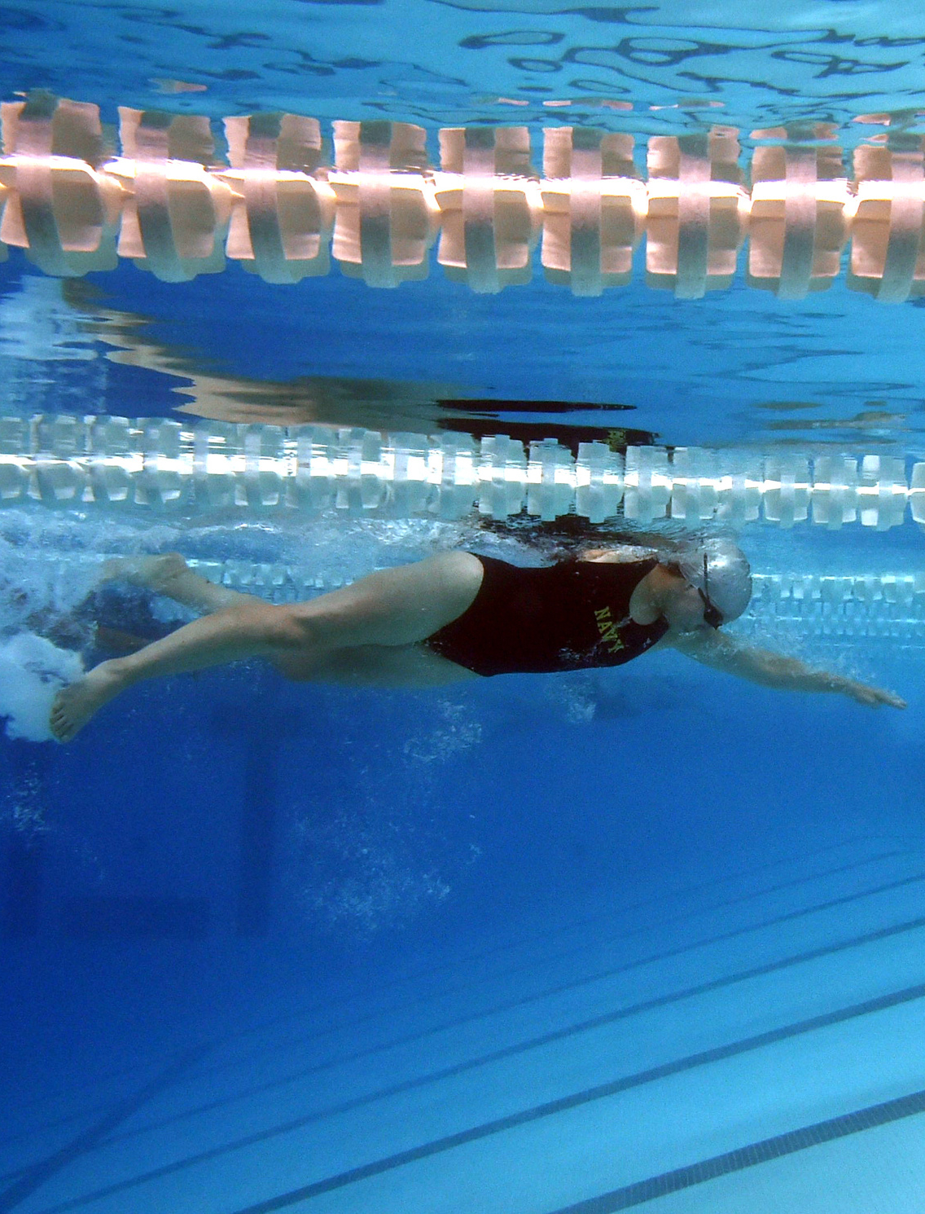
Adult Swimming Safety
Don't swim alone. Always swim with a partner.
Never swim under the influence of alcohol, drugs or medication.
Know and observe your swimming limitations and capabilities.
Avoid swift-moving water. If caught in a current, swim with it and angle toward shore or the edge of the current. (Rip currents are powerful currents of water moving away from shore that can sweep even the strongest swimmer out to sea.)
Stay out of the water during thunderstorms and severe weather.
Don't get too tired, too cold, too far from safety, too much sun exposure or experience too much strenuous activity.
Maintain self-awareness of swimming skills.
9

Slide 10
Adult Swimming Safety
The American Canoe Association estimates almost 70% of drownings involving canoes, kayaks and rafts could have been avoided if a personal flotation device (PFD) was worn.
Label gear with contact info. Labeling gear with your name and two contact numbers could help the U.S. Coast Guard identify your equipment in case of an emergency.
The U.S. Coast Guard offers a nationwide program called Paddle Smart to encourage people to label their equipment. You can get a free, reflective waterproof sticker for your gear at local boating supply stores, canoe clubs and harbor masters.
Have a way to call for help. Ensure cell phone is charged and in a waterproof case or take a two-way radio with you. For serious adventurers, consider purchasing a personal location beacon, outfitted with a flotation sleeve.
Anyone can drown, even the most experienced.
10

