Slide 1
Heat-related Illness
Heat-Related Illnesses:
Sunburn
Heat Cramps
Heat Exhaustion
Heat Stroke
Definition:
Heat-related illness, or hyperthermia, is a condition resulting from exposure to extreme heat where the body becomes unable to properly cool, resulting in a rapid rise in body temperature.
The evaporation of sweat is the normal way to remove body heat, but, when the humidity is high, sweat does not evaporate as quickly. This, in turn, prevents the body from releasing heat quickly.
Prompt treatment of heat-related illnesses with aggressive fluid replacement and cooling of core body temperature is critical to reducing illness and preventing death.
Heat exhaustion and heat stroke can escalate quickly.
21

Slide 2
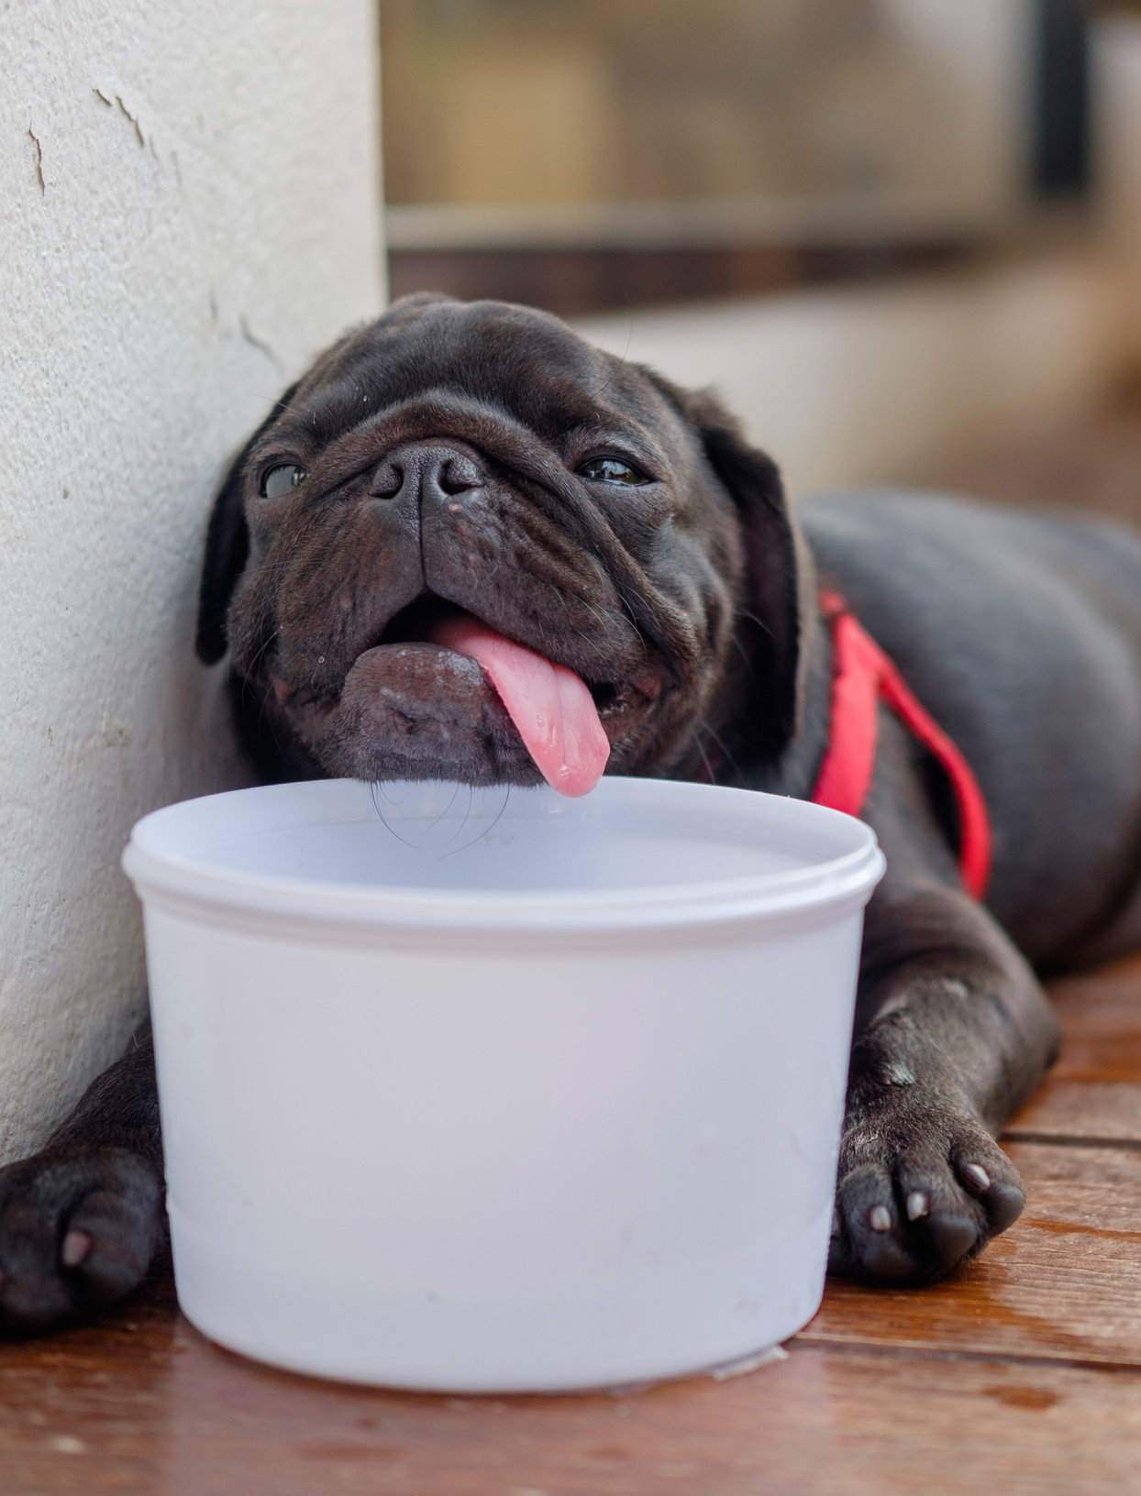
Heat Safety Tips
WHAT YOU CAN DO:
During heat waves, frequently check on people at risk for heat-related death, such as the elderly and disabled or homebound people.
Never leave children alone in cars and ensure children cannot lock themselves in an enclosed space, such as a car trunk.
Limit sun exposure during midday hours and in places of potential severe exposure, such as beaches.
Drink plenty of nonalcoholic fluids and replace the body’s salts and minerals, which sweating can release. Do not take salt tablets unless under medical supervision.
Dress infants and children in cool, loose clothing and shade their heads and faces from the sun with hats or an umbrella.
Provide plenty of fresh water for pets and leave the water in a shady area.
Surviving the hot weather.
22

Slide 3
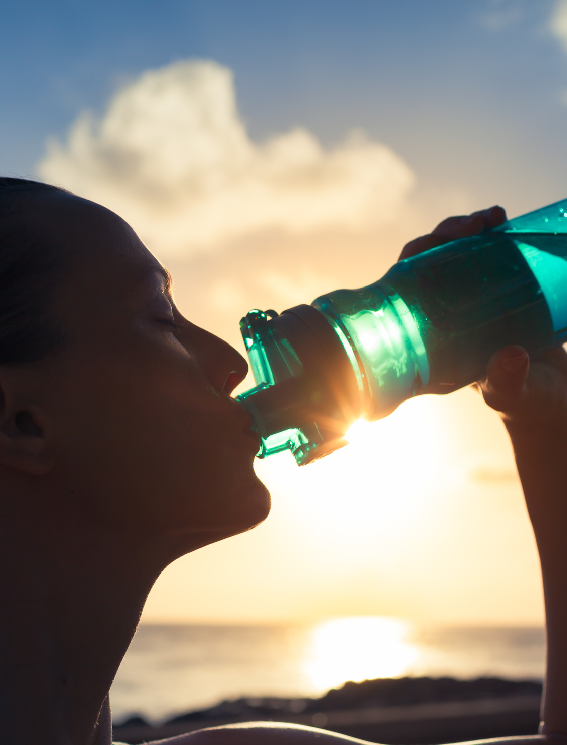
Heat Safety Tips
TREATMENT:
Reduce body temperature by cooling the body.
Remove unnecessary clothing.
Apply water, cool air, wet sheets, or ice on the neck, groin and armpits to accelerate cooling.
Seek professional medical attention immediately!
PREVENTION:
Stop physical activity and move to a cool place.
Drink water or a sports drink.
Wait for cramps to go away before you do any more physical activity.
GET MEDICAL HELP RIGHT AWAY IF:
Cramps last longer than one hour.
You’re on a low-sodium diet.
You have heart problems.
Surviving the hot weather.
23

Slide 4
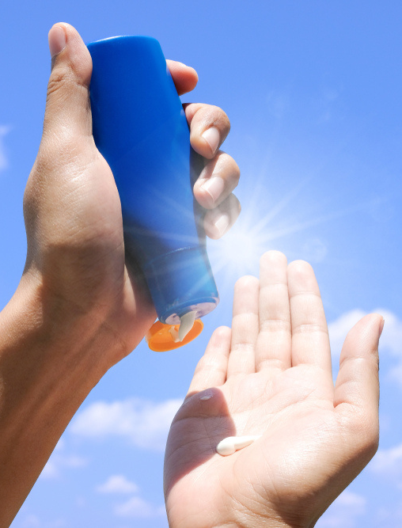
Sun Safety
Use broad spectrum sunscreen with sun protection factor (SPF) 15 or higher before you go outside, even on slightly cloudy or cool days. Don’t forget to put a thick layer on all parts of exposed skin. Get help for hard-to-reach places like your back. And remember, sunscreen works best when combined with other options to prevent UV damage.
Reapply. Sunscreen wears off if you stay out in the sun for more than two hours and after swimming, sweating or toweling off.
Expiration date. Check the sunscreen’s expiration date. Sunscreen without an expiration date has a shelf life of no more than three years, but its shelf life is shorter if it is exposed to high temperatures.
Cosmetics. Some makeup and lip balms contain some of the same sun-protective ingredients used in sunscreens. If they do not have SPF 15 or higher, be sure to use other forms of protection as well, such as sunscreen and a wide-brimmed hat.
Sun's UV rays can damage skin in 15 minutes.
24

Slide 5
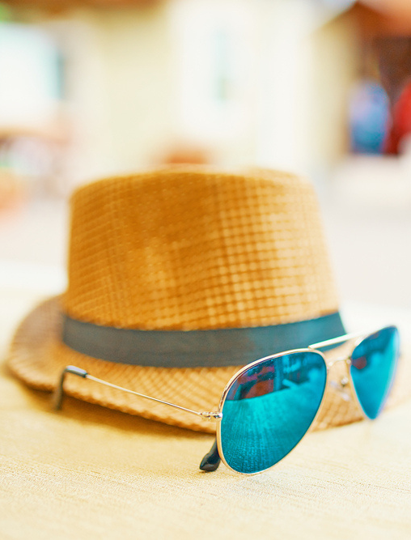
Sun Safety
Shade, Clothing, Hat and Sunglasses
You can reduce your risk of skin damage and skin cancer by seeking shade under an umbrella, tree or other shelter before you need relief from the sun.
When possible, long-sleeved shirts and long pants and skirts can provide protection from UV rays. For the most protection, wear a hat with a brim all the way around that shades your face, ears and the back of your neck. A tightly woven fabric, such as canvas, works best to protect your skin from UV rays. Avoid straw hats with holes that let sunlight through. A darker hat may offer more UV protection.
Sunglasses protect your eyes from UV rays and reduce the risk of cataracts. They also protect the delicate skin around your eyes from sun exposure.
Sun's UV rays can damage skin in 15 minutes.
25

Slide 6
Fireworks
Safety
The National Safety Council recommends enjoying fireworks at public displays conducted by professionals and not use any fireworks at home. They may be legal where you reside, but they are not safe. Know the laws pertaining to fireworks in your state.
Example: RMI ID# 662583
26

Slide 7
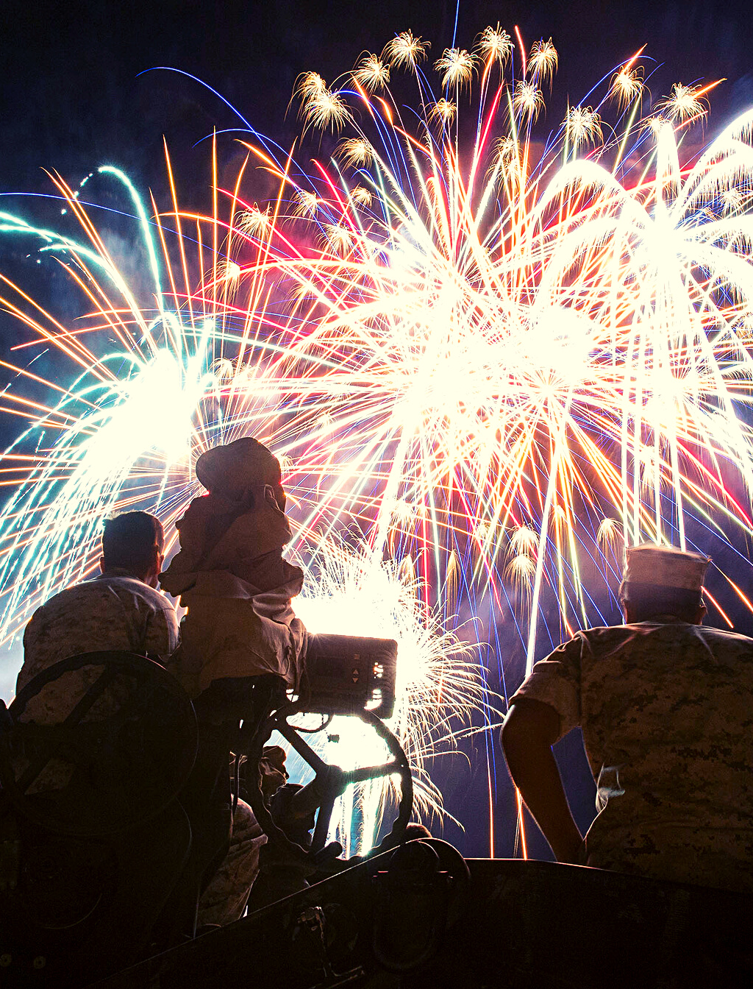
General Fireworks Rules
Never use fireworks while impaired by drugs or alcohol.
Anyone using fireworks or standing nearby should wear protective eyewear.
Never hold lighted fireworks in your hands.
Never light them indoors.
Only use them away from people, houses and flammable material.
Never point or throw fireworks at another person.
Only light one device at a time and maintain a safe distance after lighting.
Never ignite devices in a container.
Do not try to re-light or handle malfunctioning fireworks.
Soak both spent and unused fireworks in water for a few hours before discarding.
Keep bucket of water nearby to extinguish fireworks that don't go off or in case of fire.
Never allow young children to handle fireworks.
Older children should use them only under close adult supervision.
Never use illegal fireworks.
If fireworks are legal where you live, use caution!
27

Slide 8
Sports & Fitness
Activities
Team sports ranked third in activities that hurt us the most last summer. Basketball incurred the most, followed by softball.
Basketball example: RMI ID# 996895
PT example: RMI ID# 944006
28

Slide 9
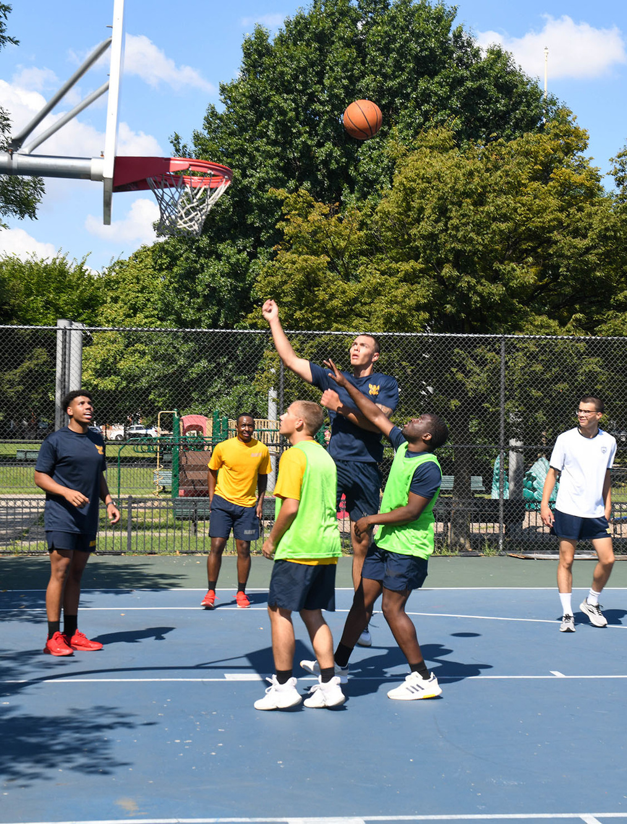
Sports Injury Prevention
Warm up and stretch before playing any sport.
Ensure you are physically able to play – see your physician for periodic physicals. Don’t participate in a sporting event without a physician’s release if you’ve had a sports injury that required medical attention.
Wear all proper protective equipment required for the sport: Shoulder pads, elbow pads, knee pads and helmet for football; batting helmets with faceguards; catcher’s face mask, throat guard, chest protector and shin guards for baseball.
Be sure sports protective equipment is in good condition, fits appropriately and is worn correctly at all times. Avoid missing or broken buckles or compressed or worn padding. Poorly fitting equipment may be uncomfortable and may not offer the best protection.
Ensure you are physically able.
29

Slide 10
Cardio Activities
Follow our tips to ensure your walks, jogs or runs are rewarding and safe:
Execute warm up exercise before walking, jogging or running.
Choose shoes for walking, jogging or running.
Drink plenty of fluids (water or sports drinks) before, during and after.
Watch for signs of heat cramps, heat exhaustion or heat stroke.
Allow a cool down period.
Jog, run or walk on sidewalks facing traffic. Exercise caution when jogging, running or walking near roadways.
Wear bright-colored clothing to improve your visibility.
Be safe while being fit.
30

