Slide 1
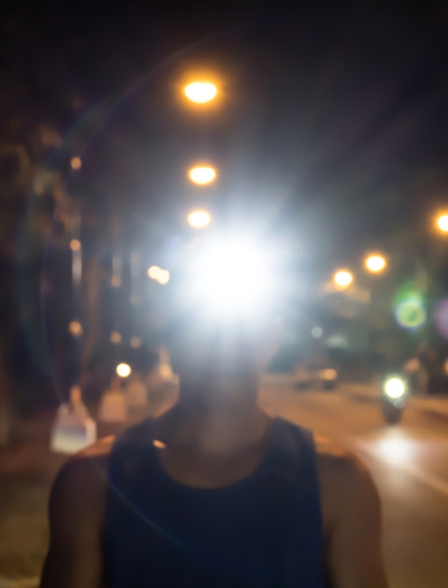
Cardio Activities
Walking, jogging and exercising safely for security:
Jog in a familiar area but vary your routes. Changing the route you take will prevent someone from noting your schedule or movements.
Jog in open spaces, away from bushes or alcoves where someone could hide.
Carry your ID. If you suspect you’re being followed, call the police immediately and find a safe place to wait for them to arrive.
Carry a whistle or shrill alarm to summon help if needed.
Take a key with you. Don’t leave your house unlocked.
Do not run with your phone or other valuables in sight.
Avoid jogging in secluded areas or at night. If you do run after dark, do so in well-lit and populated areas and consider buying reflective running gear or a runner’s light so you’re highly visible to traffic.
Recruit a friend. Runners in pairs or groups are less appealing targets.
Ensure your security while exercising.
31

Slide 2
Bicycling
When a crash occurs between a vehicle and a bike, it’s the cyclist who is most likely to be injured. A large percentage of crashes can be avoided if motorists and cyclists follow the rules of the road and watch out for each other.
Wear equipment to protect you and make you more visible to others, like an approved bike helmet, bright clothing (during the day), reflective gear, and a white front light and red rear light and reflectors on your bike (at night or when visibility is poor).
Remember to use arm and hand signals.
Ride with traffic, not against it.
Avoid riding at night, if possible. If you must ride at night, install front and rear lights on your bicycle and wear reflective clothing. It’s the law! Regardless of the season, bicyclist deaths occurred most often between 6 p.m. and 9 p.m.
Bike safely.
32

Slide 3
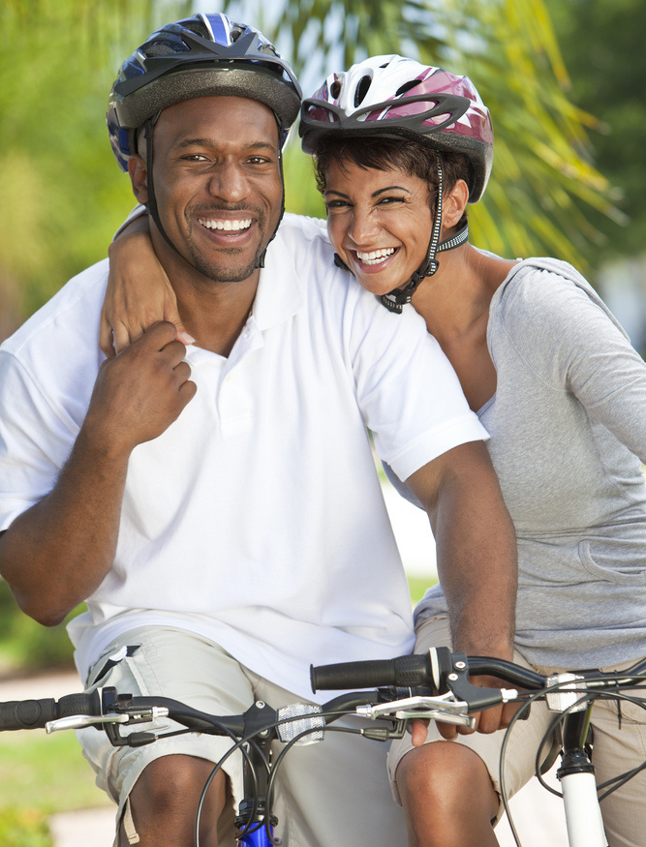
Bicycling
Of the 1,260 bicyclist deaths in 2020, 806 died in motor-vehicle traffic crashes and 454 in other non-traffic incidents, according to National Center for Health Statistics mortality data. Males accounted for 89% of all bicycle deaths, over eight times the fatalities for females.
Bicycle-related deaths peak in the summer months, starting in June and they remain high through September.
Ride a bike that fits you. If it’s too big, it’s harder to control the bike.
Carry all items in a backpack or strapped to the back of the bike.
Tuck and tie your shoelaces and pant legs so they don’t get caught in your bike chain.
Plan your route, choose routes with less traffic and slower speeds. Your safest route may be away from traffic altogether, in a bike lane or on a bike path.
Bike safely.
33

Slide 4
Firearms
Safety
In the past five 101 Critical Days of Summer, an average of two Sailors and Marines were involved in Class A-D mishaps involving negligent discharge while off duty.
Example: RMI ID# 788395
34

Slide 5
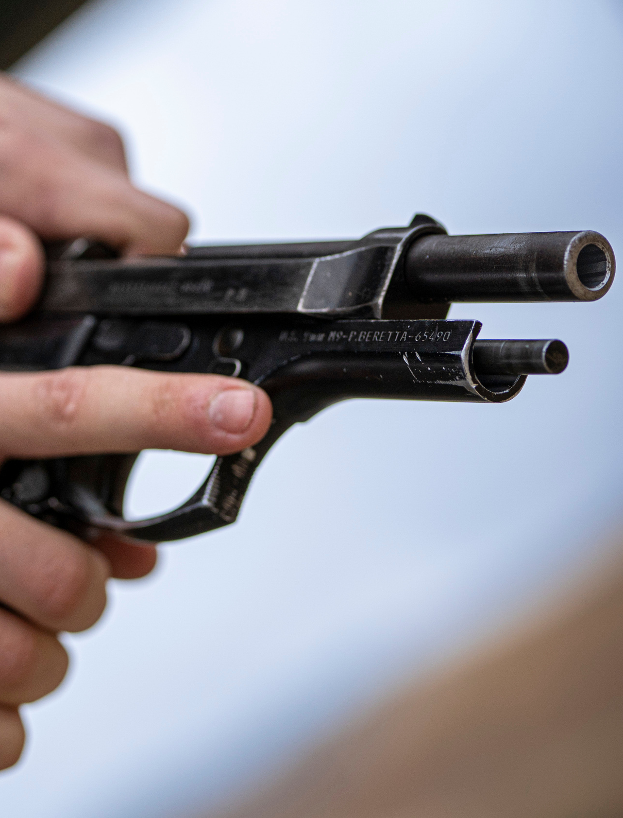
Handle Firearms Safely
Handle every firearm as if loaded.
Never point the muzzle at anything you don’t intend to shoot.
Alcohol and firearms don’t mix: Do not handle firearms while, or after, consuming alcohol.
Know your firearm.
Make sure you read the owner’s manual and take a class.
Everyone is a safety officer.
Intervene when you see someone handling a firearm improperly.
Handle every firearm with care.
Identify the target before you fire.
Avoid complacency with privately owned firearms.
35

Slide 6
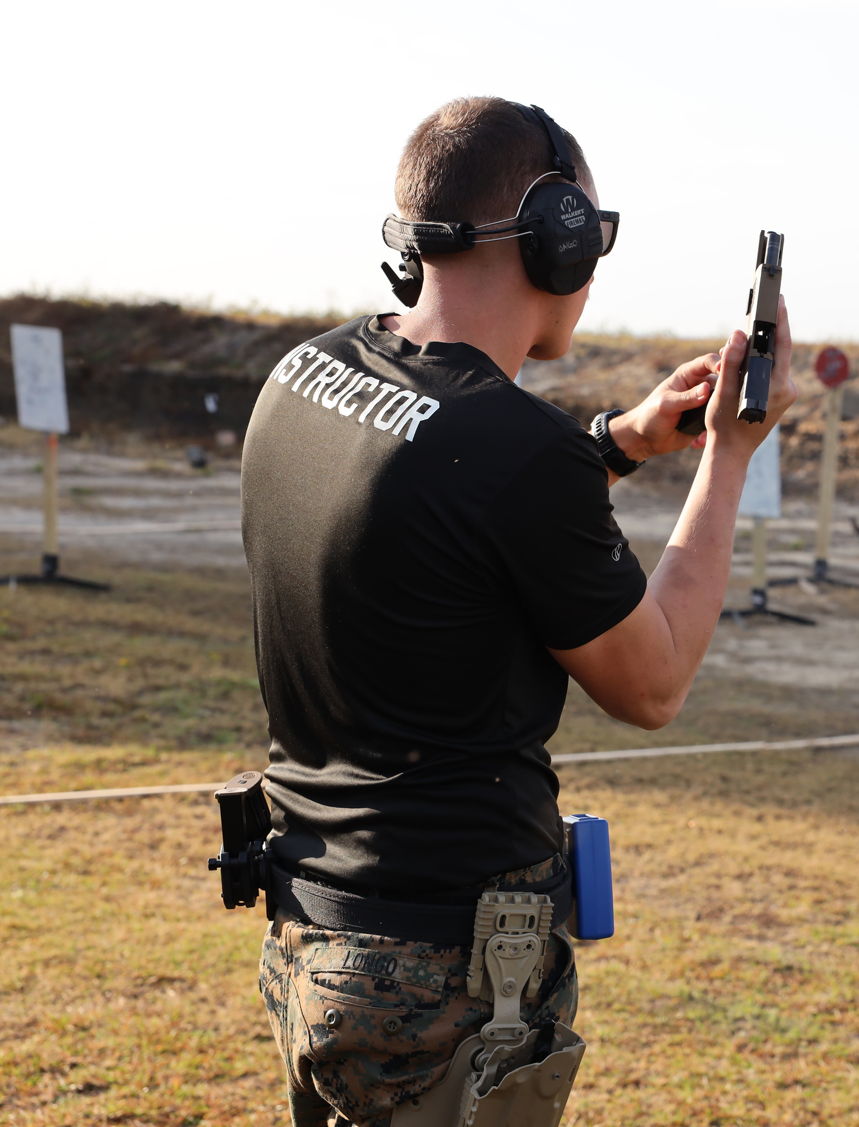
Range Safety
Know and follow all the rules of the shooting range.
Listen and do what the range master tells you to do.
Uncase and case your firearm at the shooting bench, never behind the safety line.
Always keep the barrel pointed down range.
Always keep the firearm on safe until you intend to shoot.
Always wear eye and ear protection when shooting.
Never shoot at water or hard surfaces.
Apply range safety procedures even when shooting off-range.
Handle firearms safely on the range.
36

Slide 7
Driving
Safety
In 2022 during the 101 Critical Days of Summer, the Department of the Navy lost 19 Sailors and Marines as a result of vehicle (PMV-4) and motorcycle (PMV-2) mishaps.
Overall, there were 46 PMV-4 and 73 PMV-2 Class A-D mishaps.
PMV-4 example: RMI ID# 844767
PMV-2 example: RMI ID# 540792
37

Slide 8
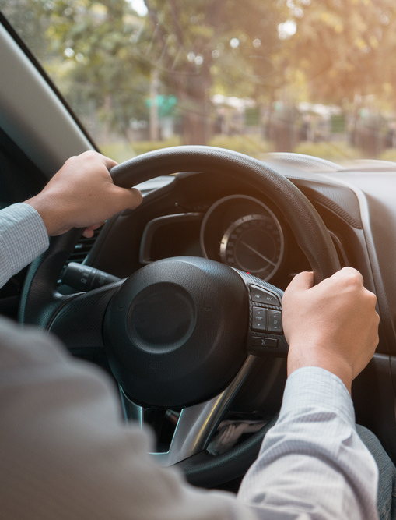
Safe Driving
When you’re behind the wheel of a car – whether alone or with passengers – driving safely is paramount.
We’re more distracted than ever, so it’s crucial to know the basics of safe driving and practice them every time you’re on the road. Ensure you and your vehicle are in the right condition before you get behind the wheel. Dangerous driving behaviors like speeding, distraction and impairment are the greatest threats to pedestrians.
Avoid distracted driving.
Don't drink and drive.
Follow the rules of the road and don't speed.*
Use caution when changing lanes. Cutting in front of someone, changing lanes too fast or not using your signals may cause an accident or upset other drivers.
*Note: Naval Safety Command data indicates excessive speed was a primary factor after midnight for PMV4 and PMV2 mishaps.
Driving safely should always be your top priority.
38

Slide 9
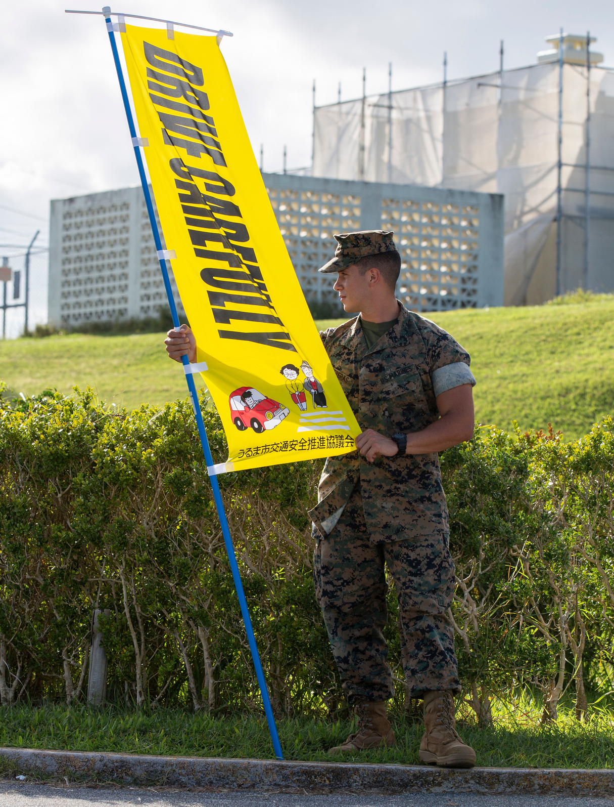
Driving Fatality Trends
The Naval Safety Command suspects that driving fatality trends tracked by the Virginia Department of Motor Vehicles are a tell-tale sign of other regions in the United States.
The Virginia DMV released a report in April 2022 showing the number of fatalities due to people not wearing seat belts, alcohol use and distracted driving is down. Unfortunately, there are surges in driving fatalities involving teenagers (up 55.6%), bicycles (up 100%), motorcycle fatalities (up 17.2%) and speed-related fatalities (up 9.6%).
Slow down.
Keep plenty of distance between you and the car or motorcycle in front.
Share the road.
Trends backed by data.
39

Slide 10
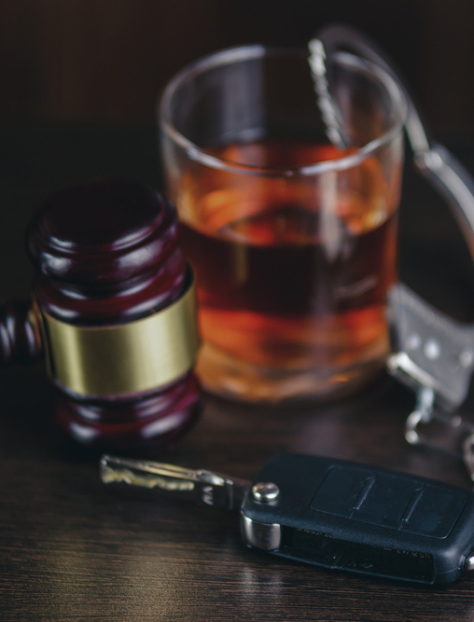
Drinking and Driving
Plan your safe ride home before you start the party, choose a non-drinking friend as a designated driver.
If someone you know has been drinking, do not let that person get behind the wheel. Take their keys and help them arrange a sober ride home.
If you drink, do not drive for any reason. Call a taxi, a ride-hailing service or a sober friend.
If you’re hosting a party where alcohol will be served, make sure all guests leave with a sober driver.
Always wear your seat belt — it’s your best defense against impaired drivers.
Every day, 32 people die in drunk-driving crashes – that's one person every 45 minutes. That means you, your family or friends could be innocent victims. (Source: National Highway Transportation Safety Administration (NHTSA))
All 50 states, the District of Columbia and Puerto Rico have by law set a threshold making it illegal to drive with a BAC of .08 g/dL or higher.
According to the NHTSA, in 2020, 11,654 people died in alcohol-impaired driving traffic deaths — a 14% increase from 2019. These deaths were all preventable. Alcohol-impaired crash fatalities accounted for 30% of all crash fatalities.
Don't drink and drive.
40

