Slide 1
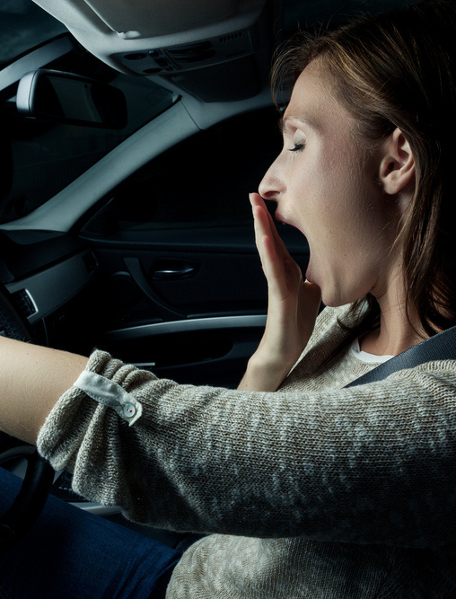
Drowsy Driving
WHO IS MOST AT RISK:
Sleep-deprived.
Driving long distances after working a full shift.
Driving through the night, the early afternoon or at other times when normally asleep.
Drinking alcohol or taking medication that increases drowsiness.
Driving alone for long distances without rest breaks or much change in scenery.
Drowsing driving occurs most frequently between midnight and 6 a.m., says the NHTSA.
KNOW THE SIGNS OF DROWSY DRIVING:
Can’t remember the last few miles driven.
Drifting from lane or hitting a rumble strip.
Yawning repeatedly.
Difficulty focusing or keeping eyes open.
Tailgating or missing traffic signs.
Trouble keeping head up.
41

Slide 2
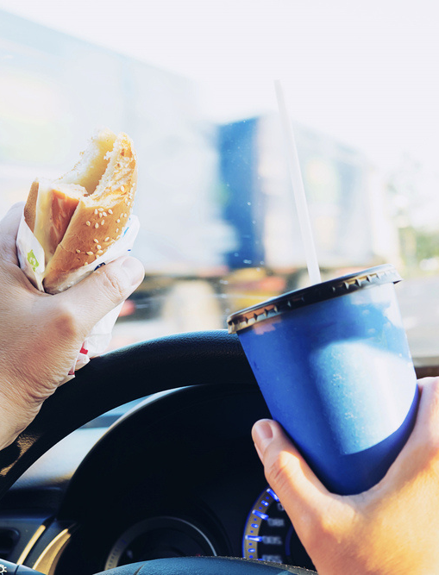
Distracted Driving
We’re more distracted than ever, so it’s crucial to know the basics of safe driving and practice them every time you’re on the road.
At any given daylight moment across America, approximately 660,000 drivers are using cell phones or manipulating electronic devices while driving, according to the NHTSA. Using a cell phone while driving creates enormous potential for deaths and injuries on U.S. roads. In 2020, 3,142 people were killed in motor vehicle crashes involving distracted drivers.
Don't allow children to fight or climb around in your car – they should be buckled in their seats at all times. Too much noise can easily distract you from focusing on the road.
You're not multi-tasking, you're distracted.
Thousands die in crashes involving cell phone use.
42

Slide 3
ATV and ROV Safety
ATVs and ROVs are not toys - get training.
There are about 650 deaths and 100,000 injuries every year involving ATVs, according to the Consumer Product Safety Commission.
Read the owner's manual carefully and ensure the ATV or ROV is in good working condition.
Always wear an approved helmet.
Never drive an ATV while under the influence of drugs or alcohol.
Never drive an ATV on paved roads. Never operate ATVs or ROVs on streets, highways or paved roads, except to cross at safe, designated areas. Understand the terrain BEFORE you ride.
Familiarize yourself with the local laws.
Never ride alone, and always tell someone where you are going and when you will return.
Always supervise young operators. Never carry extra riders.
Remember ATGATT: "All the gear, all the time."
43

Slide 4
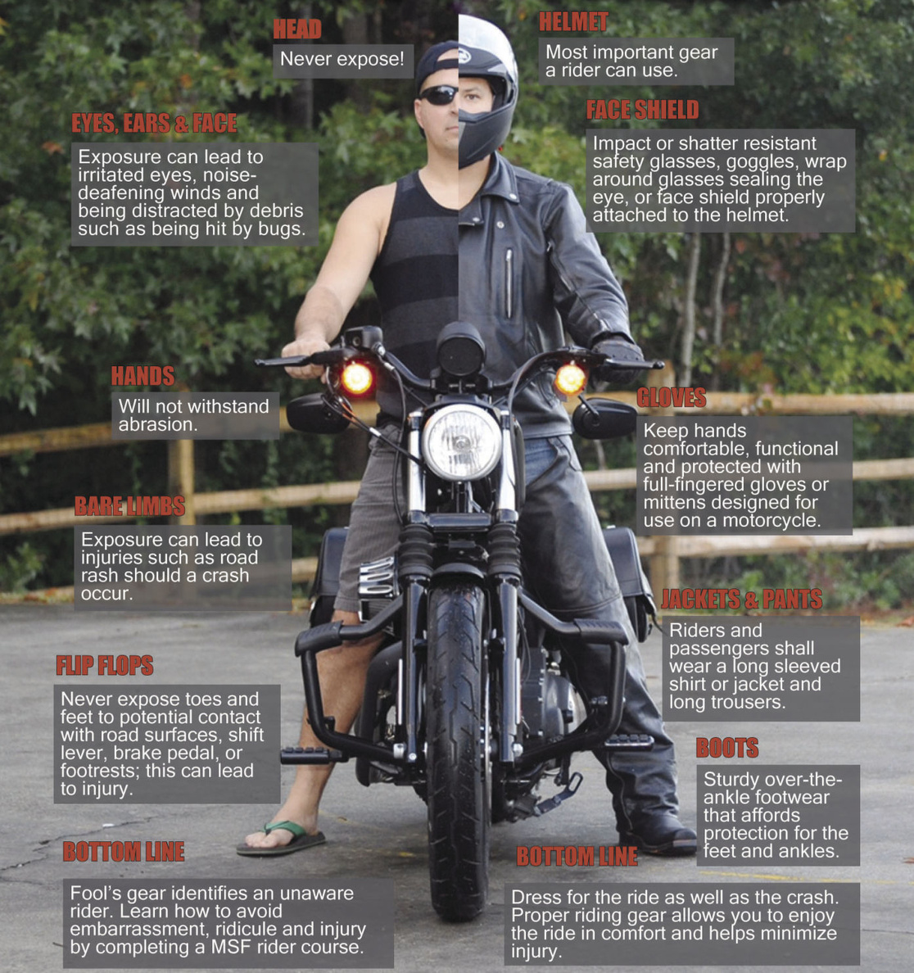
Motorcycle
Safety
In 2022 during the 101 Critical Days of Summer, the Department of the Navy lost 8 Sailors and Marines as a result of motorcycle (PMV-2) mishaps.
Overall, there were 73 PMV-2 Class A-D mishaps.
44

Slide 5
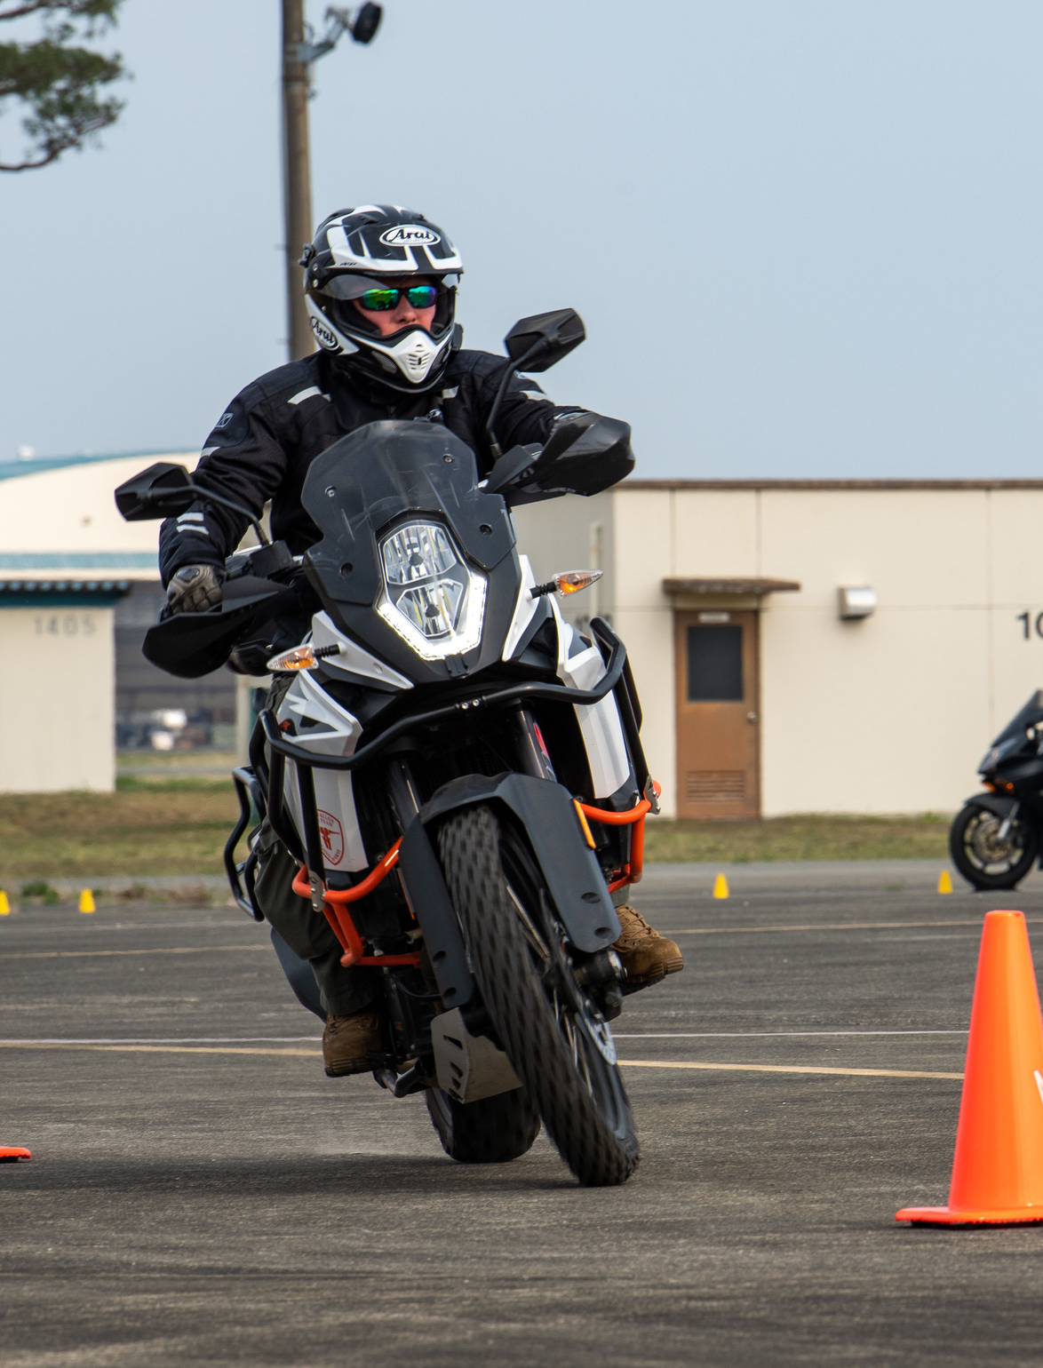
Motorcycle Riding Safety
SEARCH around you for potential hazards.
EVALUATE any possible hazards such as turning hazard.
EXECUTE the proper action to avoid the hazard.
A sound street strategy can help prevent a dangerous situation.
Training Requirements
All Sailors must complete LEVEL I training before operating a motorcycle and then must complete LEVEL II training within 60 days to one year of LEVEL I.
All Sailors must complete either LEVEL II or LEVEL III refresher training every five years.
Take riding courses periodically to improve riding techniques and sharpen your street-riding strategies.
Seeing is the best way to avoid dangerous situations.
45

Slide 6
Motorcycle Safety Tips
Complete a formal riding education program, get licensed and take riding courses periodically to improve riding techniques and sharpen your street-riding strategies.
Obey the speed limit; the faster you go the longer it will take you to stop. Know and follow local traffic laws and rules of the road.
Don’t drink and ride!
Make sure your bike is fit and ready to ride. Perform all recommended checks and inspections before you hit the road.
Always wear a helmet with a face shield or protective eye wear. A motorcycle rider not wearing a helmet is five times more likely to sustain a critical head injury.
Wear leather clothing, boots with nonskid soles and gloves to protect your body from severe injuries in the event of an accident or skid. Attach reflective tape to your clothing to help other drivers to see you.
Ride defensively. Nearly two-thirds of all motorcycle accidents occur from a driver violating a rider’s right of way. Ride with headlights on; stay out of a driver’s blind spot; signal well in advance of any change in direction and watch for turning vehicles.
Fatigue and drowsiness impair your ability to react. Make sure you are well-rested when you hit the road.
Make motorcycle riding safety your top priority.
46

Slide 7
Pedestrian
Safety
In 2022 during the 101 Critical Days of Summer, the Department of the Navy lost 2 Sailors and Marines as a result
of pedestrian-related mishaps.
Overall, there were 5 Class A-D mishaps.
Example: RMI ID# 907620
47

Slide 8
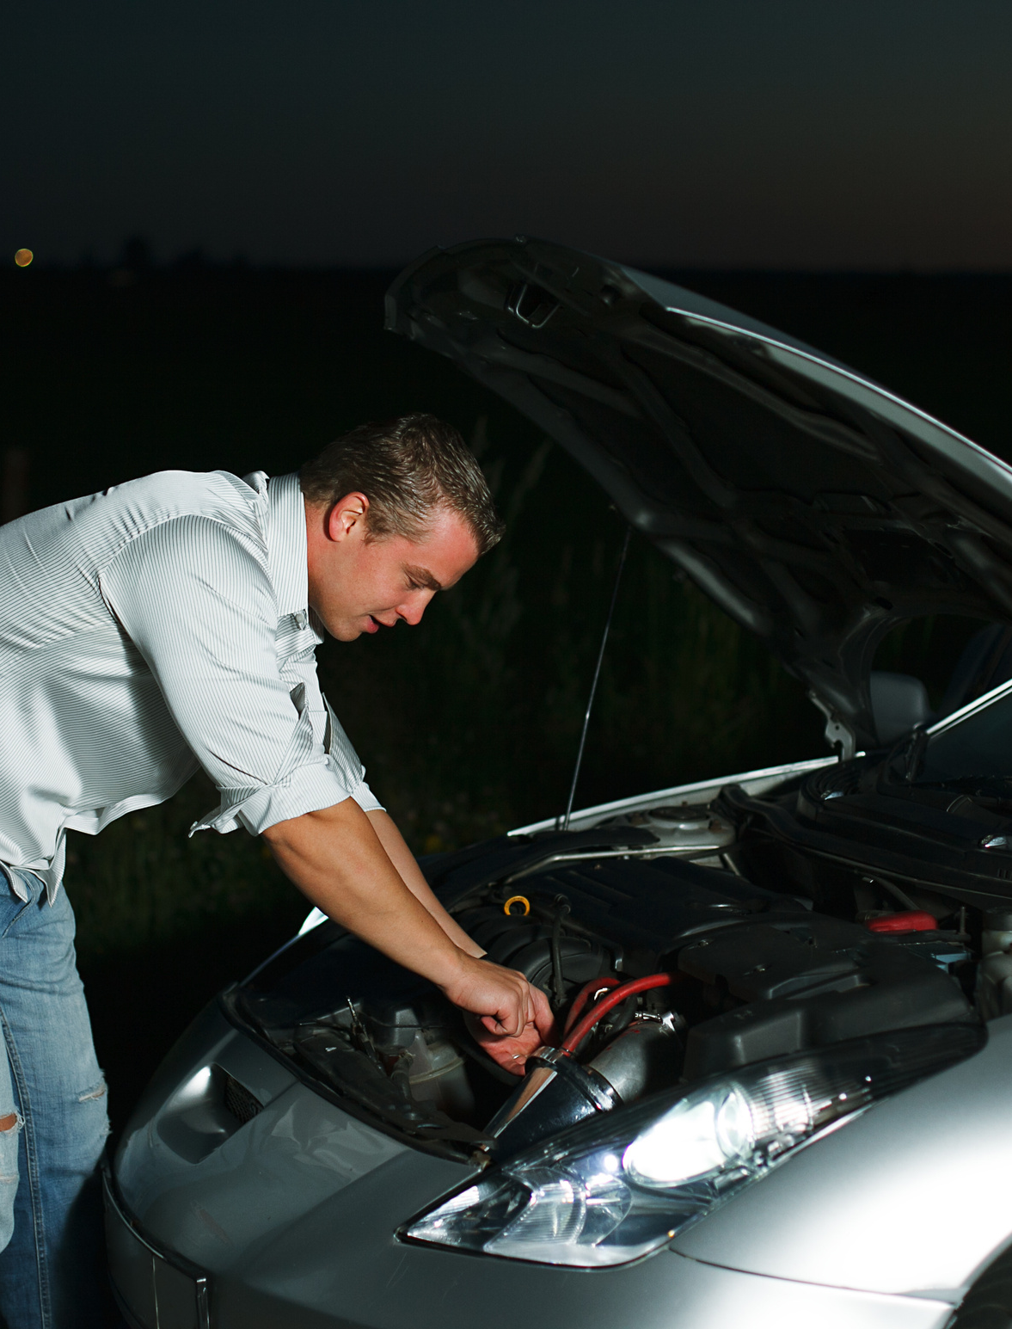
Pedestrian Safety
The Governors Highway Safety Association reported an estimated 3,441 pedestrians were killed in the first six months of 2021, up from 2,934 (17.3%) over the same period in 2020. Dangerous driving behaviors were a major factor contributing to the trend.
We urge drivers to look out for pedestrians everywhere, at all times, to include those stopped on road shoulders with disabled vehicles.
See and be seen.
Use crosswalks and look left, right and then left again before crossing the street.
Avoid distractions such as texting or watching videos on your phone while walking.
Avoid walking when impaired by alcohol.
Be visible at all times. Wear bright clothing during the day and wear reflective materials or use a flashlight at night.
Use all your senses when near an area with moving vehicles.
Never assume a driver sees you. Make eye contact with drivers as they approach to make sure you are seen.
Walk on sidewalks. If no sidewalk, walk facing traffic and as far from traffic as possible.
Pedestrians and drivers share the responsibility.
48

Slide 9
Home
Safety
One person in 10 experienced a medically consulted home injury in 2020, says the National Safety Council.* This number is greater than the total number of medically consulted injuries that occurred in public places, the workplace and motor vehicle crashes combined.
*Note: This is a rise compared to earlier years due to more people at home in 2020 because of the COVID pandemic. This statistic does NOT negate our responsibility today to exercise risk management at home.
Home safety example: RMI ID# 833657
Cooking example: RMI ID# 530375
49

Slide 10
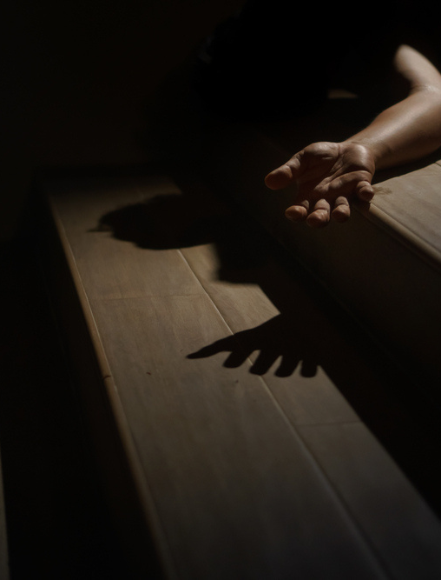
Slips, Trips and Falls
More than 6.8 million people were treated in emergency rooms for fall-related injuries in 2019, according to the National Safety Council. Wet floors, slippery stairs and scattered toys all create the potential for falls. Make sure to do the following:
Install handrails on staircases.
Clear outdoor steps.
Cover slippery surfaces in bathrooms.
Install grab rails in shower and bathtub.
Secure toys, skateboards, bikes and other mobile toys in a safe area where family members and visitors won’t trip on them.
When working from a ladder assess risk and use the right equipment.
Make sure you have level ground and never lean the ladder against an unstable surface.
Ensure stepladders have a locking device to hold the front and back open.
Always keep two hands and one foot, or two feet and one hand on the ladder.
Wear slip-resistant shoes and don't stand higher than the third rung from the top.
Don't lean or reach while on a ladder and have someone support the bottom.
Assess risk and use the right equipment.
50

