Slide 1
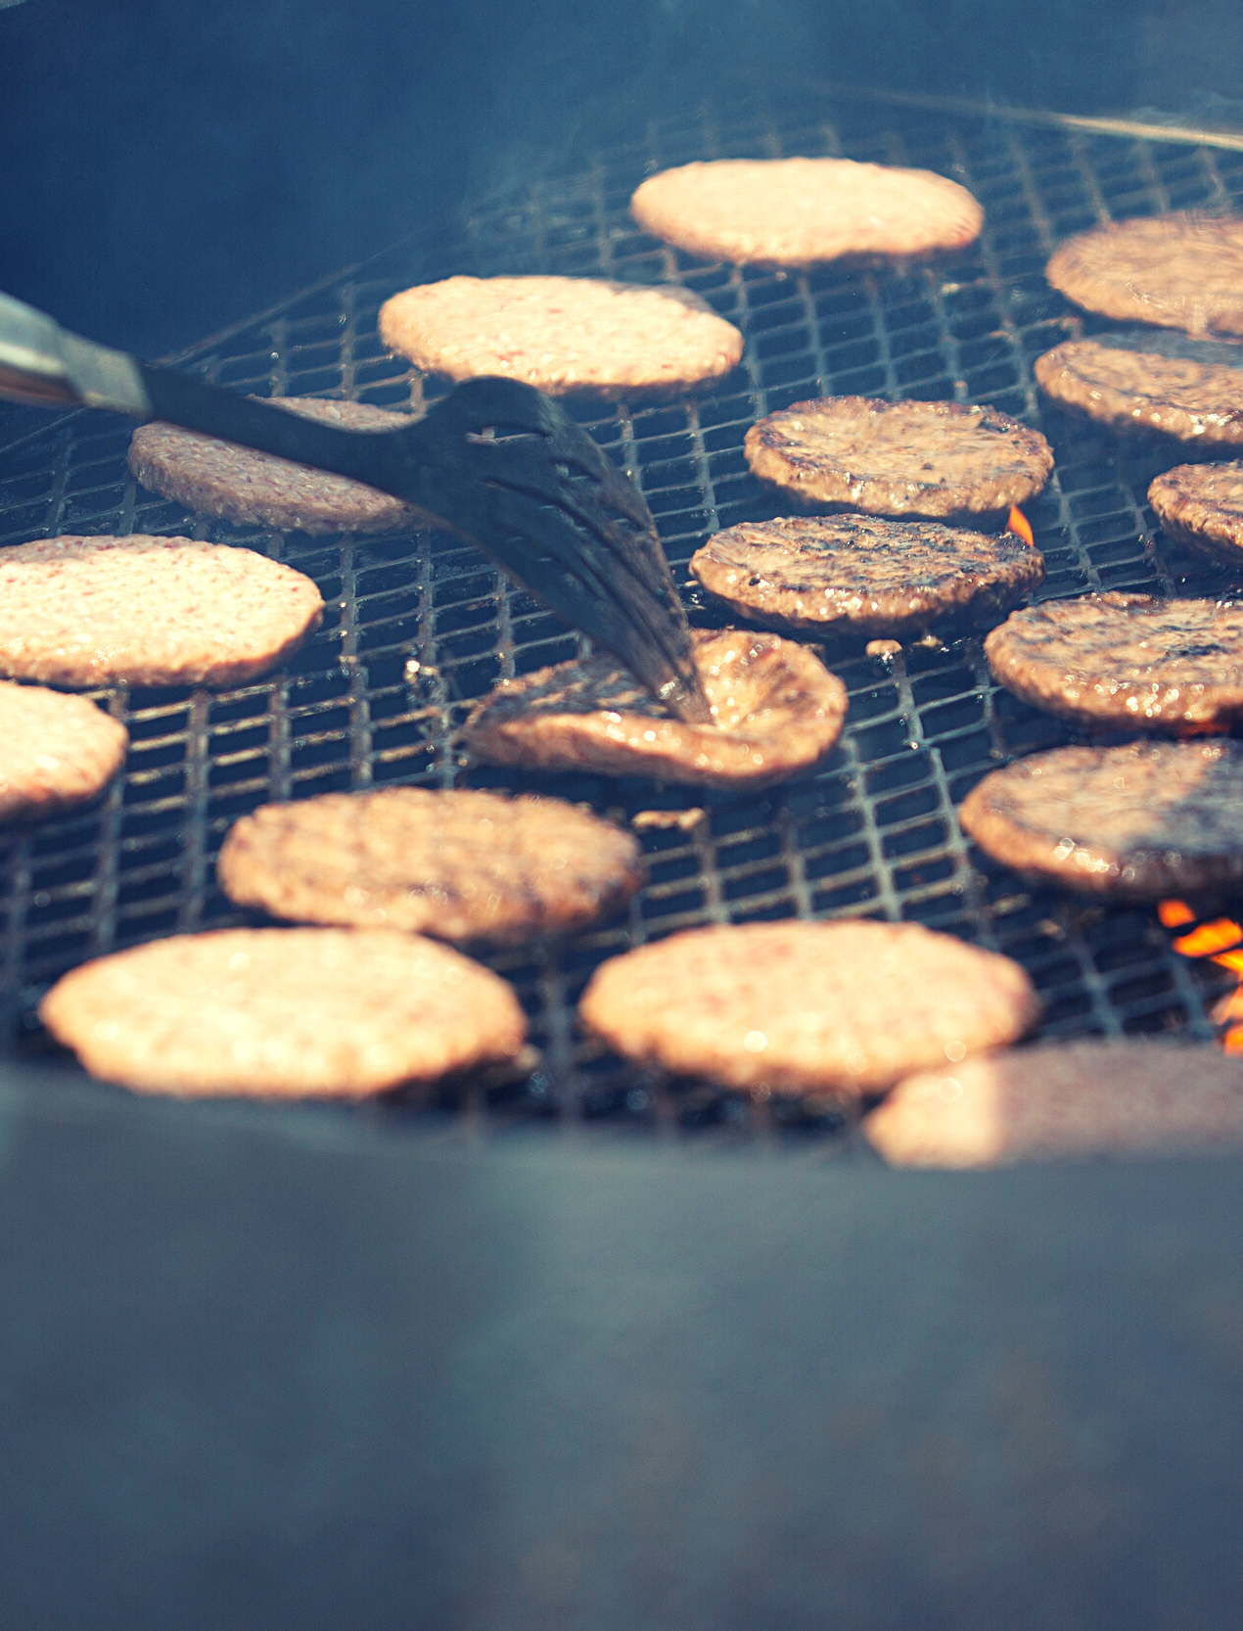
Grilling Safety
According to the U.S. Fire Administration, over half (57%) of grill fires on residential properties occur in the months of May, June, July and August. Grill fires on residential properties result in an estimated average of 10 deaths, 100 injuries and $37 million in property loss each year.
Use grill outside only, away from siding, deck rails and overhanging branches.
Clean grills regularly to remove grease buildup.
Never add charcoal starter fluid to fire.
Never use gasoline or any flammable liquids other than starter fluid.
Check the gas cylinder hose for leaks.
Smell the food grilling, not the grill on fire.
51

Slide 2
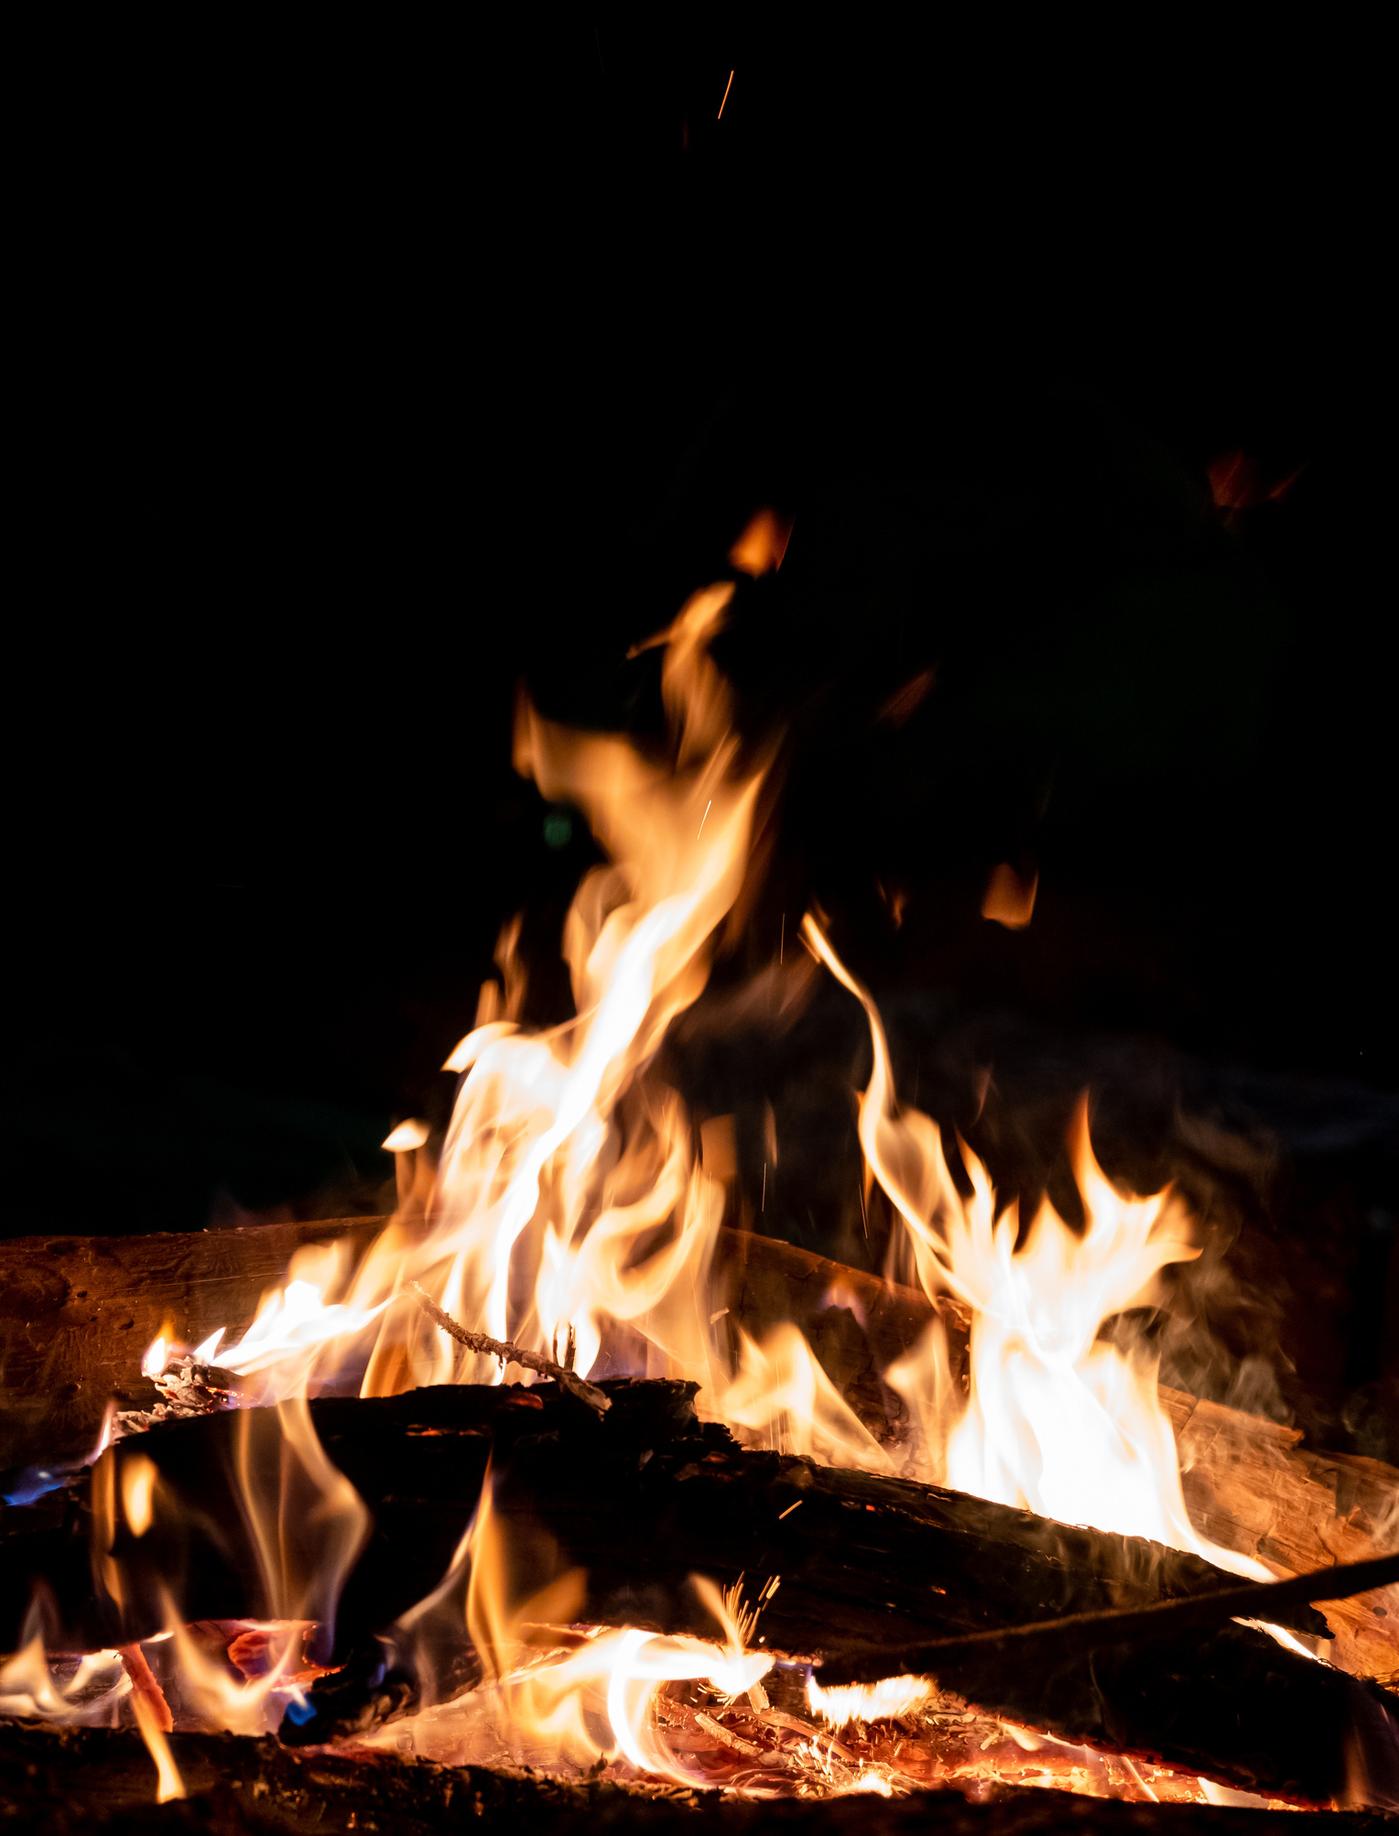
Open Fire Safety
Many off duty, outdoor fire burns sustained by Sailors and Marines are caused by someone, either the service member or another person, pouring or shooting a flammable liquid into or near a fire; while burning yard debris or by tripping and falling into the fire. Many incidents result in second-degree burns to the person’s face and torso.
Do not pour, aim or shoot gasoline, alcohol, lighter fluid or any other flammable liquid into or near a fire.
Keep the area around designated fire pits, campfires or bonfires free of trip hazards.
Make sure the fire pit is at least three feet away from structures and anything that can burn.
Pay attention to where you’re walking and don’t run in the vicinity of an open fire.
Keep a hose or water source nearby to extinguish the fire quickly if needed.
Ensure fires are completely out.
Prevent burn injuries.
52

Slide 3
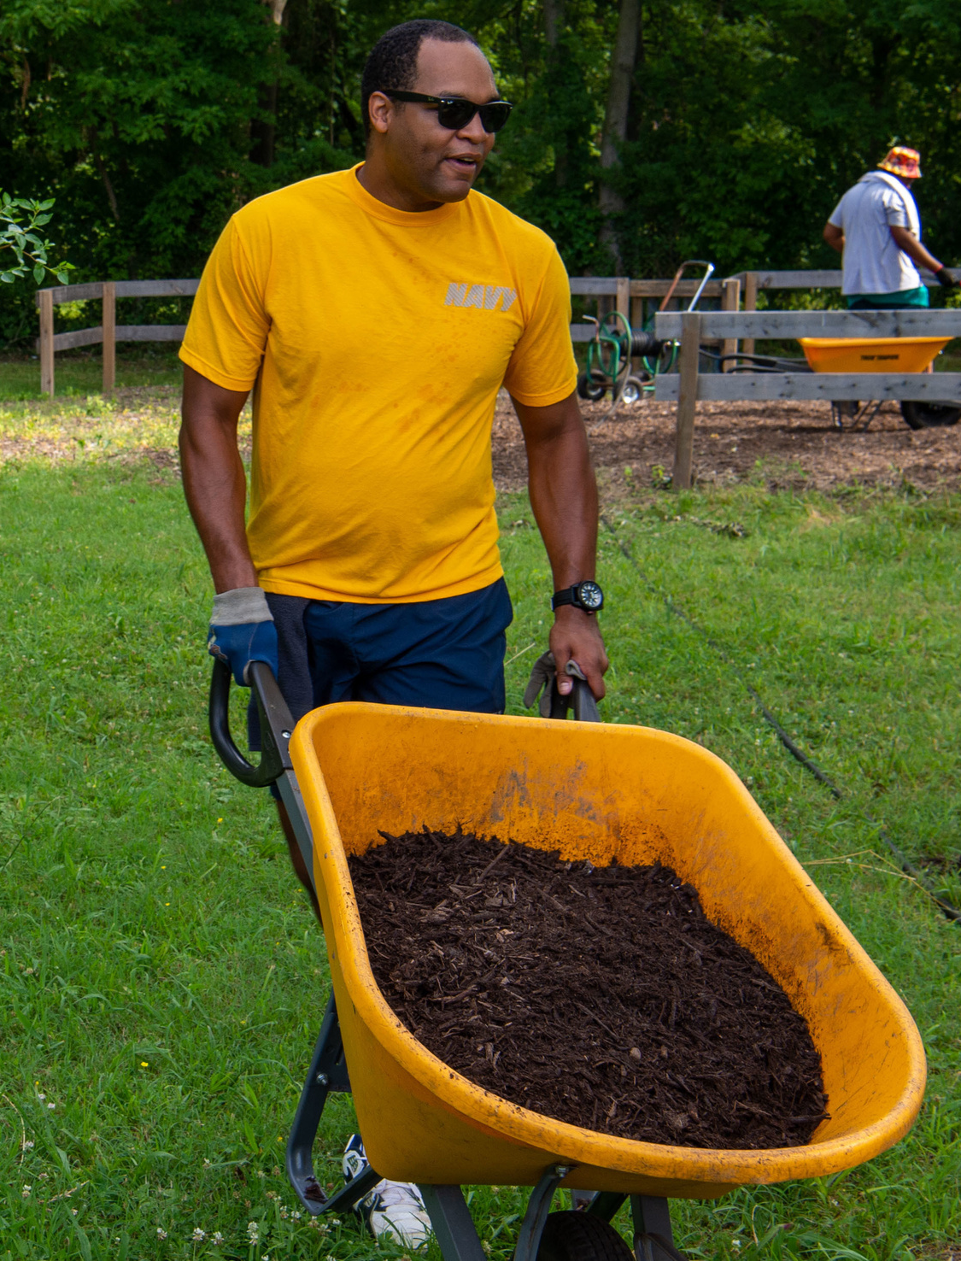
Gardening Safety
Emergency rooms treat more than 400,000 injuries each year related to outdoor garden tools, says the U.S. Consumer Product Safety Commission.
Put away yard tools. Lawn tools, including rakes, saws and lawnmowers, can cause harm if not used and stored properly.
Stay alert when using power tools and never rush while mowing the lawn or using the weed whacker. Never leave tools lying around. Always keep them locked in a shed or garage where kids can’t access them.
Wear safety gear whenever operating power equipment, including hedge trimmers (safety glasses, hearing protection, non-slip closed-toe shoes or boots, long pants or chaps, long sleeves and work gloves).
Store poisonous chemicals safely. There were over 2 million poisoning incidents reported to poison control centers nationwide in 2020. Several household items present poisoning hazards, including gardening and home maintenance supplies.
Wear gloves. Garden gloves will help protect you from blisters, fertilizers, pesticides, bacteria, fungi and sharp tools.
Gardening may seem safe, but it has its hazards.
53

Slide 4
Gardening Safety
Warm up. Just like an athlete does before a game, you should warm up before digging in the garden. Walk around your garden for a few minutes and do some pre-gardening stretches.
Avoid repetitive motion. Prolonged and repetitive motions, such as digging, raking, trimming, pruning and planting, might irritate your skin, tendons or nerves. To avoid this, switch up your tasks every 15 minutes and take breaks between tasks.
Banish bending. Kneeling instead of bending will put less strain on your back. For extra comfort, consider wearing kneepads.
Check your lifting. When lifting objects, especially heavy ones, engage your legs and not your back. When you’re carrying heavy objects, hold objects close to your body to reduce strain.
Look for pests. Check your clothes and body for ticks, which can cause several diseases. Better yet, help prevent tick bites by applying repellent.
Block the sun and stay hydrated.
Gardening may seem safe, but it has its hazards.
54

Slide 5
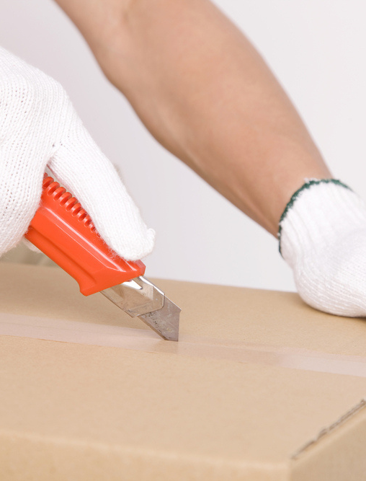
Bladed Tool Safety
The most common concern when using sharp blades or edges is an injury, such as a cut (laceration, puncture) or an amputation. Tools or equipment with sharp blades or edges can include box cutters, utility knives, safety cutters and equipment with blades or moving parts such as hedge trimmers. To prevent cuts:
Use the right tool for the job it was designed for.
Make sure the blade is sharp. Dull blades require more force, increasing the chance of injury.
Carry one tool at a time, tip and blade pointed down at your side.
Work in a well-lit space so you can see what you are doing.
Cut on a stable surface.
Use protective clothing such as cut resistant or mesh gloves, and safety glasses to protect eyes if the blade shatters or breaks.
Cut away from your body. Make sure no body parts are in the cutting path, or in the path the blade might take if it slips.
If the tool has a retractable blade, retract it immediately after use, and retract it fully. Similarly, close scissors or snips when not in use.
Be aware of sharp blades and edges.
55

Slide 6
Bladed Tool Safety
Follow the manufacturer's instruction manual when you operate, clean, and maintain the equipment.
Make sure that all guards and safety devices are in place and functioning properly.
Make sure cutting blades are sharp.
Keep your hands away from the edges of cutting blades – make sure you can see both your hands (and all your fingers) as well as the cutting blades. Keep your eyes on the item you are cutting and know where your fingers are in relation to the blade.
Keep your hands away from all moving parts and avoid cleaning or brushing off moving parts such as cutting blades.
Turn off and unplug the equipment before trying to dislodge items and before disassembling and cleaning.
Put all guards and safety devices back in place after cleaning.
If there are moving parts, cover or tie back your hair, tuck in loose or frayed clothing and remove your gloves and jewelry.
Do not bypass any guards or safety devices.
Do not operate the equipment if you feel tired or unwell.
Safely use power tools with sharp blades.
56

Slide 7
Mishap Reporting Reminder
Off-duty mishaps
by uniformed service members
are required reports in the Risk Management Information (RMI) mishap reporting system: https://afsas.safety.af.mil
Without accurate data, honest analysis cannot be made.
57

Slide 8
Conclusion
No matter where you are or what activity you are engaging in, make sure you know and understand the inherent environmental risks of that region, especially if you are new to or unfamiliar with the region. Threats vary depending on the locale.
Familiarize yourself with climate, local wildlife and any potential threats or dangerous situations specific to that activity and location. Make sure you have identified avenues for medical treatment (nearby hospitals) and always prepare for the unexpected.
If you get hurt, seek medical attention as soon as possible, even if the injury appears mild. Let a medical professional assess the likelihood of additional symptoms that may not be experienced or develop. For example, a head injury may have unseen symptoms at onset or appear later.
Understand inherent environmental risks.
58

Slide 9
Sample RMI Mishap Examples
Boating, Class C, RMI ID #181548: Rides jet ski and falls off, hit in head by following jet ski and knocked unconscious. Admitted to hospital emergency room. Suffered a fractured skull.
Swimming, Class C, RMI ID #836439: Dives headfirst into swimming pool during a holiday celebration after consuming alcohol. While in hospital, undergoes emergency surgery for fractured vertebrae and receives treatment for a head laceration.
Alcohol, Class A, RMI ID #839950: Consumes excessive alcohol in a social setting, found unconscious by others who performed CPR. Transported to hospital and pronounced dead upon arrival.
Weather, Hazard, RMI ID #661964: While making popcorn on a stove, lightning strikes residence. The stove was not wired properly, and the pan had a metal handle, both of which caused the lightning to arc. Experiences tingling on left side of body and goes to hospital to ensure no unseen injuries. Undergoes several tests, to include an EKG. Admitted overnight due to abnormal pattern indicated by EKG. EKG ran again following morning and was in normal range. Released with no limitations. Note: Full details of this mishap are provided due to hazards not falling under safety privilege.
Heat, Class C, RMI ID #257883: Embarks on a 12.5-mile walk, and experiences nausea and dizziness before completing the last 200 meters. Cold compresses applied and taken by ambulance to local hospital. Admitted and treated for heat exhaustion and dehydration.
Fireworks, Class C, RMI ID #662583: Lights firework at a private residence gathering. While leaning over firework, it fires and strikes face. Spends 10 hours under observation and treatment at emergency room.
Sports, Class C, RMI ID #578302: Attempts to perform a layup while playing basketball, fellow player jumps and lands on subject. Taken to hospital and undergoes emergency knee surgery.
59

Slide 10
Sample RMI Mishap Examples
PT, Class C, RMI ID #944006: Experiences extreme overexertion of muscles while weightlifting. Goes to medical following day and treated for rhabdomyolysis (breakdown of muscle tissue that releases a damaging protein into the blood).
Firearms, Class C, RMI ID #788395: Removes privately owned pistol from holster and ejects magazine. Without recollection of a round in the chamber, inadvertently squeezes trigger when replacing pistol in holster. Discharged round wounds leg. Admitted to hospital for sutures to close wound and discharged three days later.
PMV-4, Class C, RMI ID #844767: Overcorrects vehicle while making a turn and vehicle rolls over. Suffers concussion.
PMV-2, Class A, RMI ID #540792: Hits curb with motorcycle, ejects into a parked car. Declared deceased on scene.
Pedestrian, Class A, RMI ID #907620: Vehicle struck by another from behind. Driver exits vehicle to review damage, who is struck by another vehicle. Transported to hospital with life-threatening injuries, then passes away from multiple internal injuries.
Home Safety, Class C, RMI ID #292556: While using crutches for a sprained left ankle, slipped on uneven bathroom floor. Admitted to hospital for surgery of fractured right ankle.
Home Safety (Cooking), Class C, RMI ID #530375: Microwaves egg with water and salt. Turns over egg with fork and egg explodes. Boiling water from explosion splashes onto arm and face. Goes to emergency room and treated for third-degree burns to arm and second-degree burns to face.
60

Slide 11
navalsafetycommand.navy.mil
Scan codes to follow us on social media.
61

