Slide 1
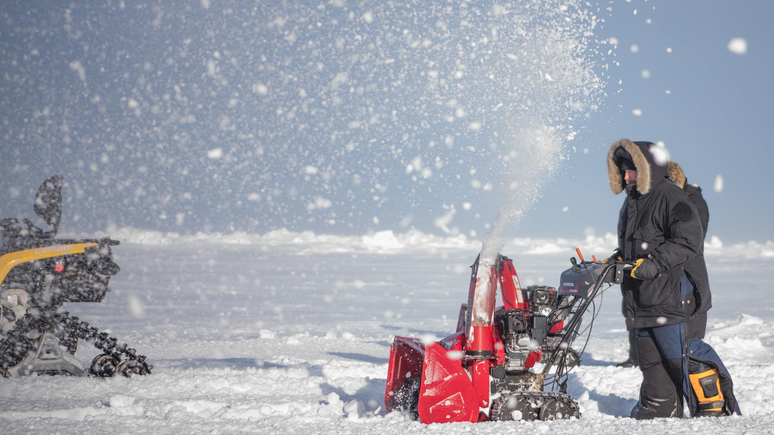
Snow and Ice Safety
Proper Snow and Ice Removal Techniques
Shoveling Techniques
  Use an ergonomic shovel with a curved handle to reduce strain.
  Bend your knees and lift with your legs, not your back.
  Take breaks and avoid overexertion.
De-Icing Preparations
  Apply de-icing materials (salt, sand or other alternatives) to walkways and driveways.
  Follow instructions on de-icing products for safe and effective usage.
  Clear ice before applying de-icing agents.
Snow Blowers
  Read and follow the manufacturer's instructions carefully.
  Keep hands, feet and clothing away from moving parts.
  Do not attempt to clear clogs with your hands when the machine is running.

Slide 2
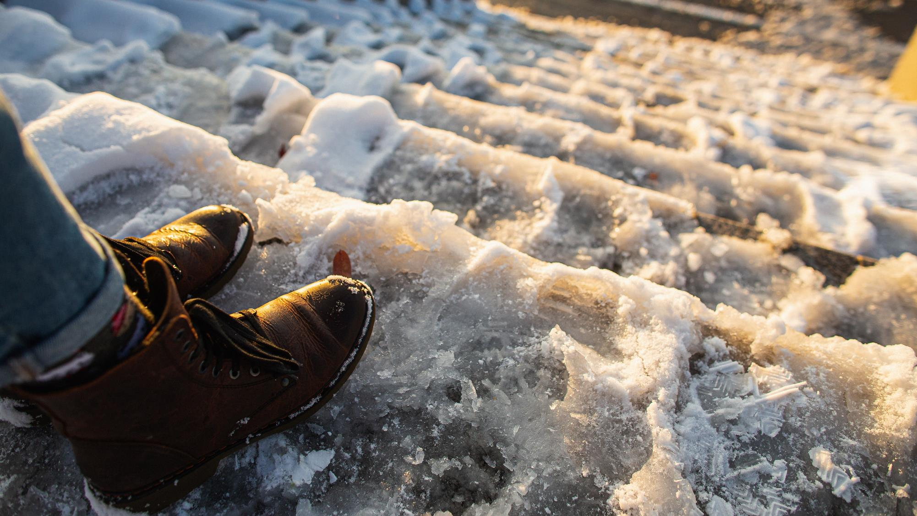
Snow and Ice Safety
Movement in Icy Conditions
Walk Safely on Icy Surfaces
  Footwear Recommendations
    Wear shoes or boots with good traction soles.
    Consider using ice cleats or traction aids for added stability.
    Take small, slow steps to maintain balance.
Identify Black Ice
  Black ice is transparent ice that forms on roadways and sidewalks.
  It can be difficult to see, so exercise extreme caution.
  Watch for shiny or glossy patches on surfaces, especially in shaded areas.

Slide 3
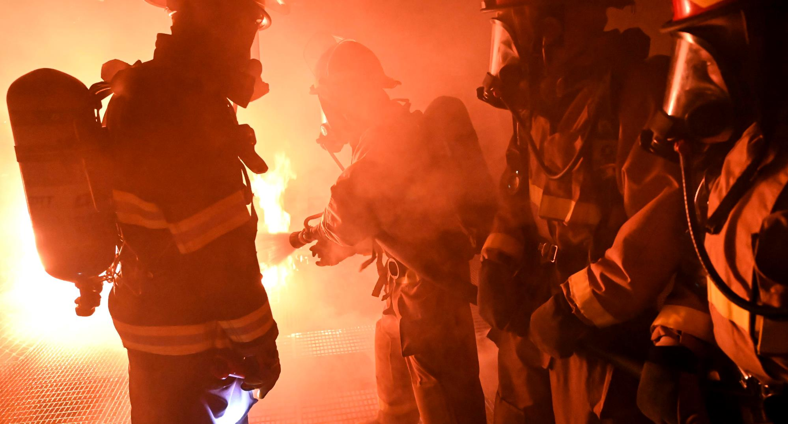
Heating and fire safety
There were 56 Sailors and Marines injured in off-duty incidents involving fires during the FY19-FY23 fall and winter seasons.
25 were burned during cooking fires and house fire injuries
31 fell into an “other” category.
Of the remaining incidents, 11 involved a campfire.
6 members “fell into a fire.” Of the latter, alcohol was involved in nearly every incident.

Slide 4
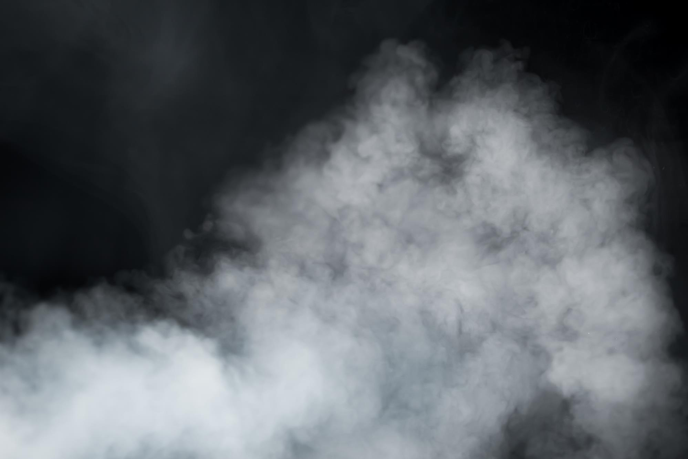
Heating and fire safety
The majority of off-duty, outdoor fire burns sustained by Sailors and Marines were caused by someone pouring or shooting a flammable liquid into or near a fire, while burning yard debris or by tripping and falling into the fire. Many incidents resulted in 2nd degree burns to the service member’s face and torso. BE CAREFUL.
Fall
Winter
Do not pour, aim or shoot gasoline, alcohol, lighter fluid or any other flammable liquid into or near a fire.
Keep the area around designated fire pits, campfires or bonfires free of trip hazards.
Pay attention to where you’re walking and don’t run in the vicinity of an open fire.
Keep a hose or water source nearby to extinguish the fire quickly if needed.
From 2015-2019, an average of 790 home structure fires per year began with decorations, excluding holiday trees.
  More than two of every five of these fires occurred because the decorations were too close to a heat source, such as a candle or hot equipment.
  Teach children to stay away from open flames, including jack-o-lanterns with candles in them.
  Dried flowers, cornstalks and crepe paper catch fire easily. Keep all decorations away from open flames and other heat sources like light bulbs and heaters.
  Keep exits clear of decorations so nothing blocks escape routes. Ensure all smoke alarms are working.
Safely Use Heaters and Fireplaces
  Keep flammable items at a safe distance from heaters and fireplaces.
  Test smoke alarms and carbon monoxide detectors regularly.
  Ensure proper ventilation in rooms with fuel-burning appliances.
Prevent Carbon Monoxide Poisoning
  Install carbon monoxide detectors near sleeping areas and on every level of the building.
  Never use portable generators or fuel-burning equipment indoors.
  Regularly inspect heating systems, chimneys and vents for blockages.
Avoid Fire Hazards in Living and Working Spaces
  Never leave space heaters unattended; turn them off when leaving the room.
  Use sturdy, stable surfaces to place heaters and avoid tipping accidents.
  Follow manufacturer guidelines for proper maintenance of heating appliances.

Slide 5
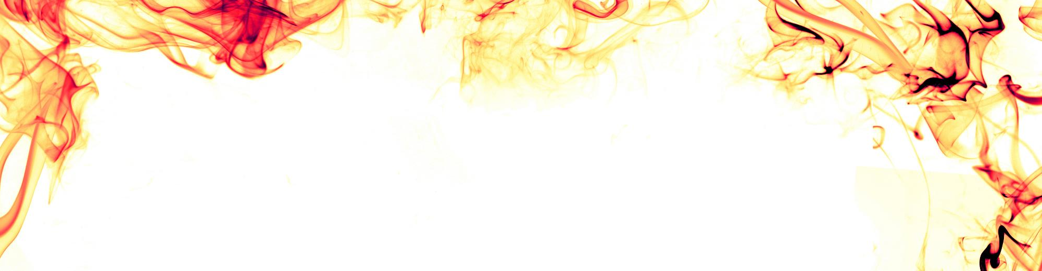
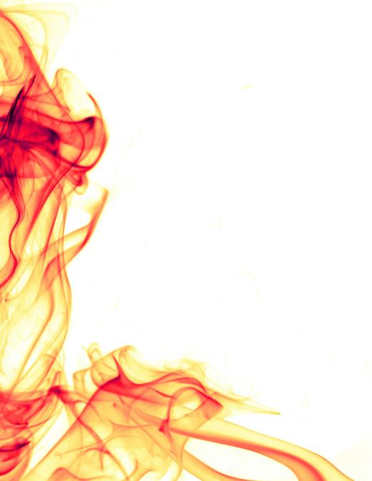
Home fires
Home fires are more common in the cooler months. The chart on the right from the National Fire Protection Association shows the leading causes of home fires from 2016-2020.
Remember:
Do not leave candles unattended or near flammable material and keep them out of reach from children or pets.
If you use a fireplace, have it inspected annually and clean it regularly. Do not hang flammable materials such as stockings near the flame.
Place space heaters on the smoothest floor surface possible.
DO NOT LEAVE HEAT SOURCES UNATTENDED!

Slide 6
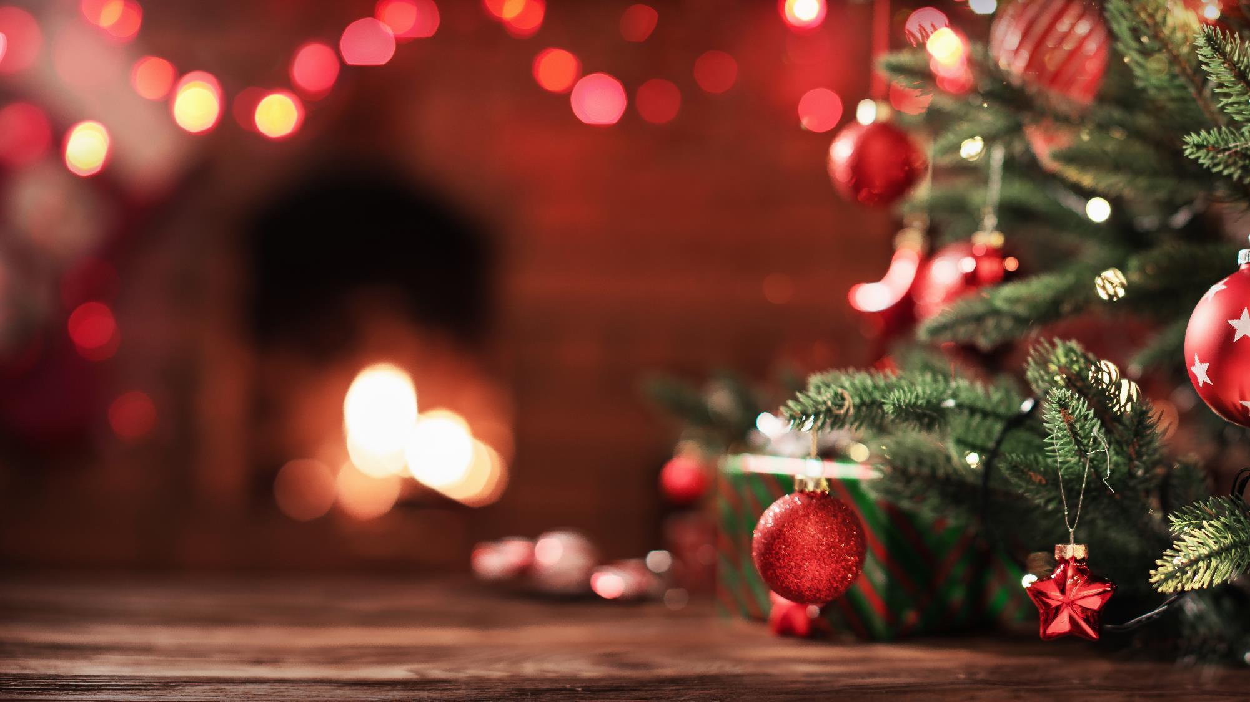
Holiday trees
An estimated 160 home fires started from holiday trees. This resulted in an average of two deaths, 12 injuries and $10 million in direct property damage per year.
Water live trees regularly. Do not let them dry out. Keep an eye out for browning or drying needles.
Keep live and artificial trees at least three feet away from heat or flame sources such as heating vents, fireplaces, candles and portable heaters. Do not block doorways.
Follow instructions on holiday lights and do not overload outlets, power strips or circuits.
Remove live trees as soon as they start to dry out and stop retaining water.
FALL AND WINTER 6

Slide 7

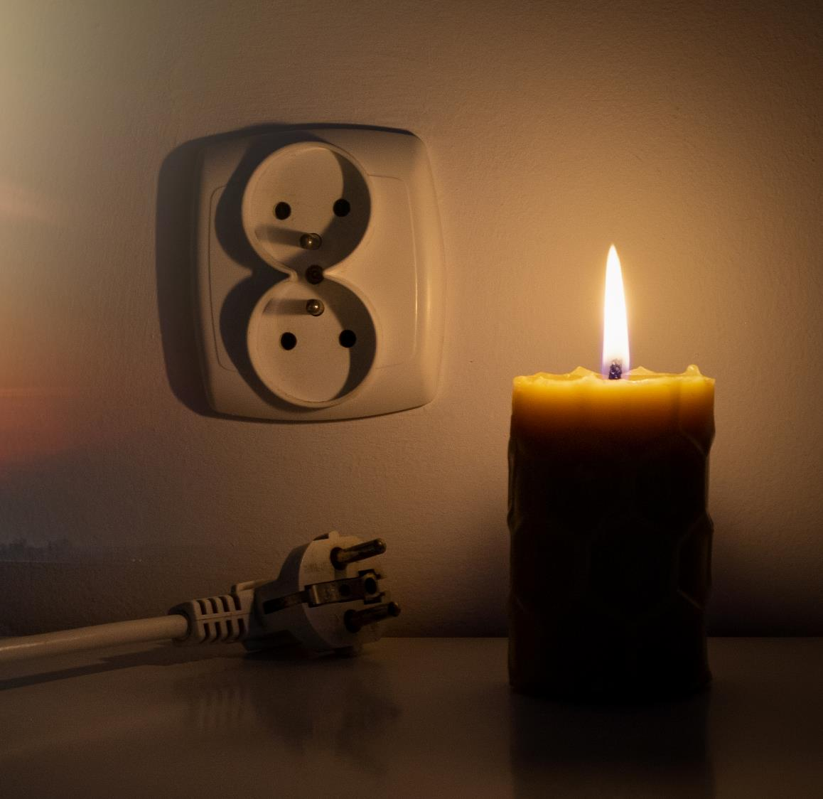
RMI Report:
Candle fire
RMI ID #213612: Service member was in their room at night when they lit a candle with a lighter. They had an open bottle of nail polish remover in the vicinity of the candle and the vapor ignited. The fire grew rapidly as the service member attempted to put out the flame. The sprinkler system in their room activated, which extinguished the fire. The sprinkler’s activation caused water damage to their room and several other rooms in the barracks. Total damage estimated at $16,000.

Slide 8
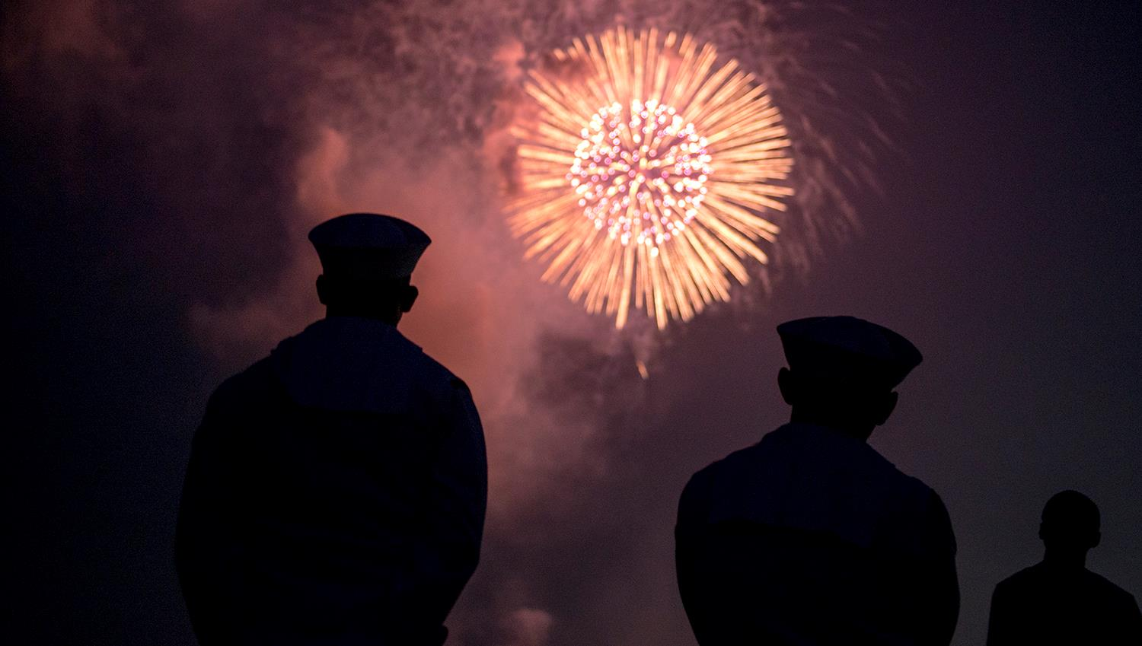
Holiday safety
Safe Decorating Practices
  Use only lights and decorations that are labeled and certified for safety.
  Check for damaged sockets, frayed wires or loose connections before use.
  Avoid overloading electrical outlets and extension cords.
  Keep flammable materials away from heat sources and open flames.
Handling and Disposing of Holiday Lights
  Turn off holiday lights before going to bed or leaving the house.
  Unplug lights by grasping the plug, not pulling the cord.
  Avoid using damaged or broken lights and replace them promptly.
  Store lights properly to prevent damage and tangling.
Fireworks and Celebration Safety
  Follow local laws and regulations regarding the use of fireworks.
  Keep a safe distance from fireworks and sparklers when in use.
  Never try to relight or handle malfunctioning fireworks.
  Have a bucket of water or a hose nearby when using fireworks.
Pet Safety during the Holidays
  Keep holiday plants, decorations and foods that are toxic to pets out of reach.
  Secure holiday trees to prevent tipping, especially in households with pets.
  Provide a safe and quiet space for pets during holiday gatherings.

Slide 9
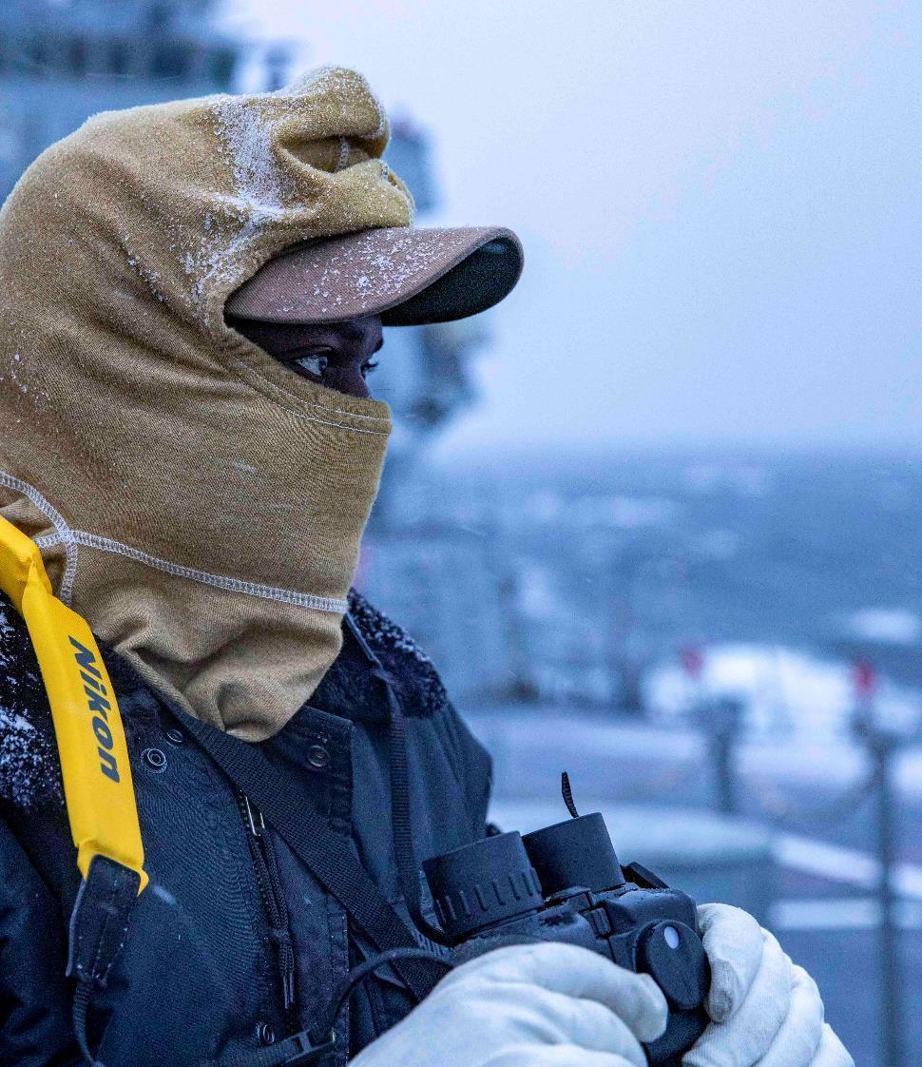
Conclusion
Fall and winter safety are critical for ensuring the well-being of all personnel.
Proper weather preparations are essential to mitigate risks during adverse conditions.
Preventing slips, trips, and falls should be a priority in all settings.
Vehicle safety measures must be observed to navigate challenging weather and road conditions.
Outdoor activities require specific precautions to ensure everyone's safety.
FALL AND WINTER 9

Slide 10
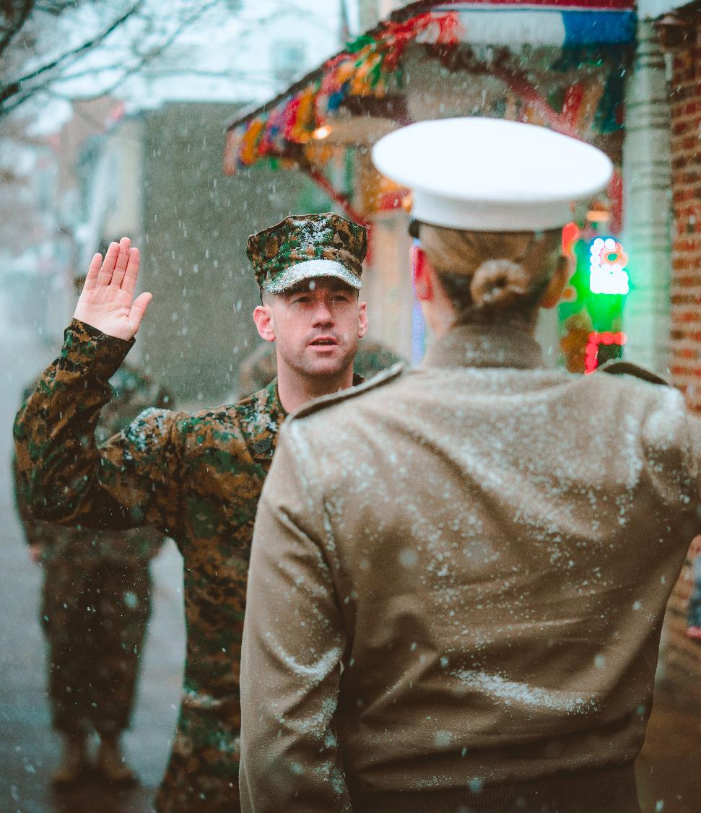





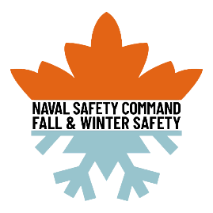
Fall and winter
Safety Awareness Presentation
2023
WWW.NAVALSAFETYCOMMAND.NAVY.MIL

