Slide 1
PRESENTATION

Slide 2
Manage Your Risk
The 101 Critical Days of Summer is the longest vacation period of the year for military members, beginning Memorial Day weekend and ending Labor Day weekend. Summer also includes four holidays, which are frequently approved as long weekends for uniformed personnel.
Potential lapses in judgment while engaging in summer activities can impact the readiness of Sailors and Marines. A general lack of situational awareness and complacency are root causes in numerous off-duty mishaps every summer.
This presentation provides general summer safety information to help you – and your team – maintain
an active risk management mindset to help ensure
an enjoyable and safe summer.
ID numbers of off-duty mishaps reported during the last summer season in Risk Management Information (RMI) are included as well. The next slide addresses how safety professionals with access to RMI can share redacted versions of these examples to protect safety privileged information (PSI) and personally identifiable information (PII).
Presentations are tools that can be used as lectures, speeches

Slide 3
PSI and PII Protection of
Mishap Examples
The presentation offers limited factual information regarding RMI mishap examples. Safety professionals with access to RMI can research the examples with one caution: while helpful for general background information for use by safety professionals, avoid going beyond factual information by releasing privileged safety information (PSI) or personally identifiable information (PII).
Note: Commander, Naval Safety Command is custodian of and sole release authority for PSI. The Safety Privilege is meant to encourage candor from witnesses and board members to identify root causes of mishaps and take corrective actions to prevent future mishaps.
Please contact NAVSAFECOM with any questions.

Slide 4
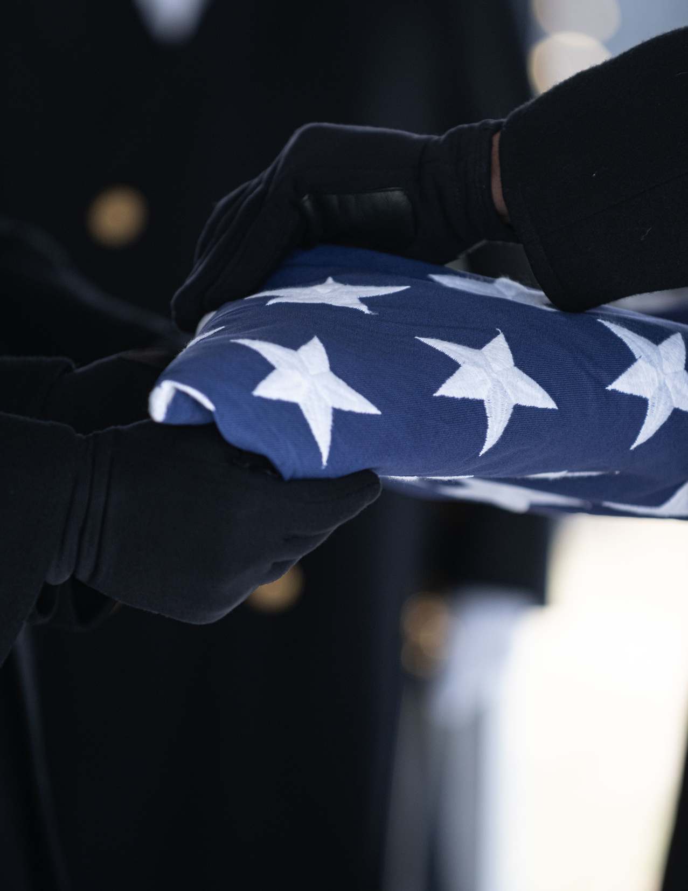
Last Summer
Fatalities
During the 101 Critical Days of Summer in 2023, the Department of the Navy lost 27 Sailors and Marines to preventable off-duty mishaps. Motor vehicle and motorcycle crashes were the leading causes.
One off-duty mishap is one too many.

Slide 5
Top Activities That
Hurt Us Last Summer
PMV-4 (automobiles) - One fatality was pedestrian-related.
PMV-2 (motorcycles) - For perspective, roughly 10% of service members are motorcycle riders.
Team sports - Basketball, soccer, football, kickball, rugby, and volleyball
Swimming
Bicycling

Slide 6
We Know What You Did
Last Summer
Roller skating; lost balance and fell; wrist fractured
Fell playing basketball; broke arm; 14 days convalescent
Motorcross, didn’t clear triple jump, multiple injuries, surgery
Stepped into a hole while playing frisbee, sprained ankle
Fell 40 feet while rock climbing, hospitalized with multiple injuries
Playing basketball; Player fell on them; split lip; 7 stitches
Crashed ATV, cracked pelvis and AC tendon separation, surgery
Riding bicycle, slip/fall, abdomen punctured by handlebar
Dirt bike crashed after hitting rut, hospitalized with multiple injuries
Riding a scooter, fell off fracturing
tibia, required surgery
Tripped on concrete curb while running, multiple head injuries
Burned arm, leg, face and
neck while grilling
Horse training, thrown from horse, head injury and concussion
Tripped on ball in soccer, ligament injuries to shoulder

Slide 7
GET REAL
GET BETTER
The Navy’s Get Real, Get Better (GRBG) call to action empowers us to self-assess and self-correct risk
both on and off duty.
We must adopt a learning mindset and commit to work collaboratively to educate, inform and hold each other accountable for decisions we make.
The majority of off-duty recreational mishaps are entirely preventable and avoidable, provided we assess risks and comply with laws, procedures and recommended best practices for a given activity.

Slide 8
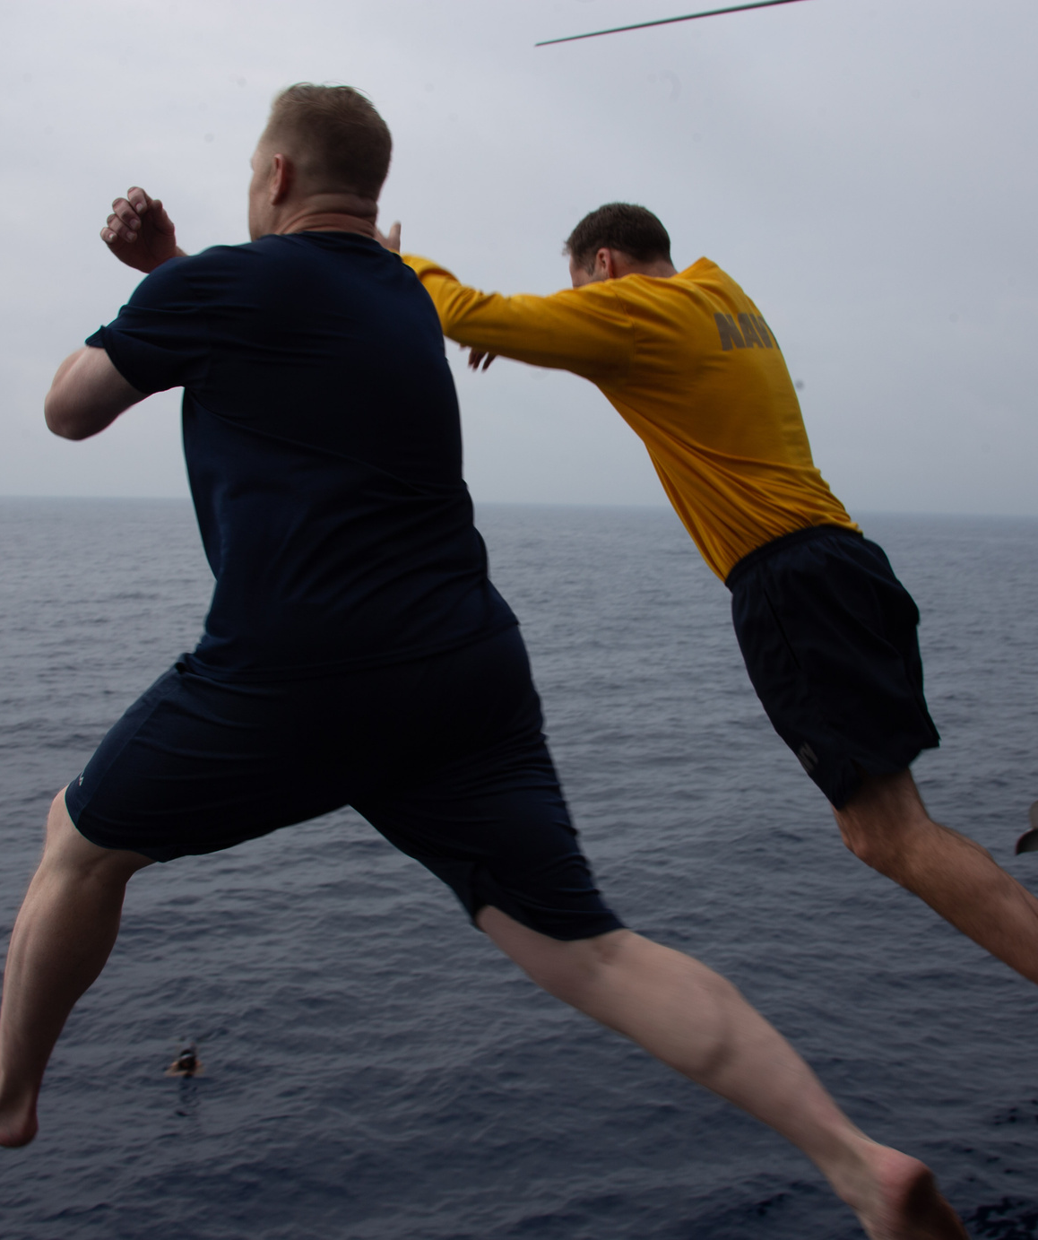
Water-Related
Activities
The Department of the Navy saw 7 Sailors sustain injuries while participating in water-related activities that resulted in loss of time from work.

Slide 9
Adult Swimming
Safety
Don’t swim alone. Always swim with a partner.
Never swim under the influence of alcohol, drugs or medication.
Know and observe your swimming limitations and capabilities.
Don’t get too tired, too far from safety, too much sun exposure or experience too much strenuous activity.
Maintain self-awareness of
swimming skills.

Slide 10
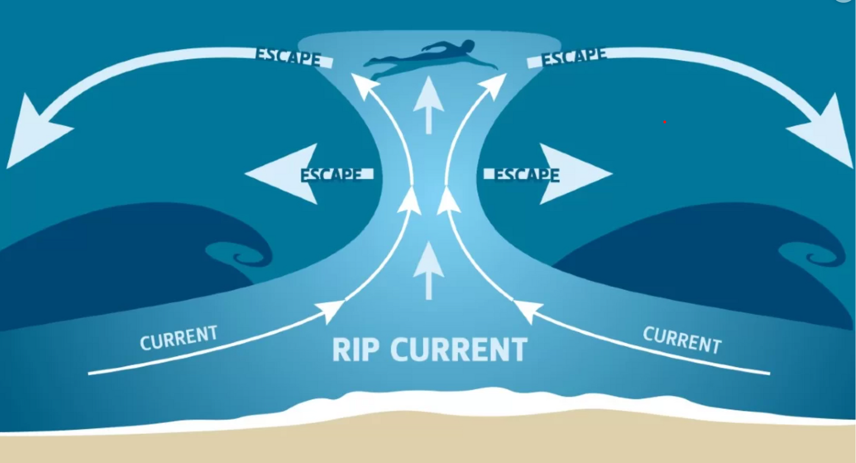
Adult Swimming
Safety
Avoid swift-moving water. If caught in a current, swim with it and angle toward shore or the edge of the current. (Rip currents are powerful currents of water moving away from shore that can sweep even the strongest swimmer out to sea.)
Stay out of the water during thunderstorms and severe weather.

