Slide 1
Adult Swimming
Safety
The American Canoe Association estimates almost 70% of drownings
involving canoes, kayaks and rafts could have been avoided if a personal
flotation device (PFD) was worn.
Label gear with contact info. Labeling gear with your name and two contact numbers could help the U.S. Coast Guard identify your equipment in case of an emergency.
The U.S. Coast Guard offers a nationwide program called Paddle Smart to encourage people to label their equipment. You can get a free, reflective waterproof sticker for your gear at local boating supply stores, canoe clubs and harbor masters.
Have a way to call for help. Ensure cell phone is charged and in a waterproof case or take a two-way radio with you. For serious adventurers, consider purchasing a personal location beacon, outfitted with a flotation sleeve.

Slide 2
Boating
Safety
Follow a pre-departure checklist. Using a pre-departure checklist is a helpful way to check the boat and ensure the proper gear is aboard.
Be weather-wise. Always check local, route and destination weather and water conditions before departure and ensure it is safe to go out.
Use common sense. Operate at a safe speed
at all times, especially in crowded areas; stay alert and steer clear of large vessels and watercraft that can be restricted in their
ability to stop or turn.

Slide 3
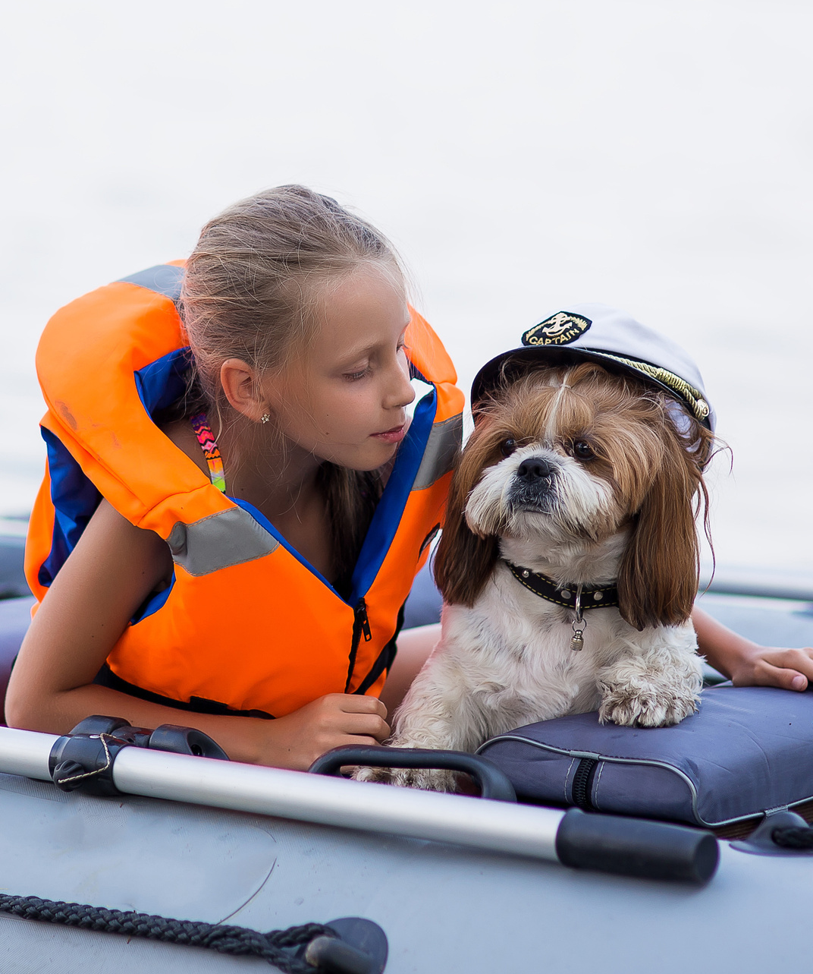
Boating
Safety
Know the nautical rules of the seas. Maintain
a proper lookout and respect buoys and other navigational aids, all of which are in place to ensure your safety and the safety of the
boats around you.
Remain sober if you are the skipper. A boat operator is likely to become impaired quicker
than a driver. Operating a boat while
intoxicated is illegal. Nearly half of all boating accidents involve alcohol.
Designate an assistant skipper. Make sure more than one person aboard is familiar with boat handling, operations and general boating safety,
in case the primary operator is incapacitated and someone else needs to get the boat back to shore.

Slide 4
Boating
Safety
Develop a float plan. Let someone else know where you’re going and your estimated time of return. A float plan can include the following information: name, address and phone number of trip leader and passengers; boat type and registration information; trip itinerary; types of communication and signal equipment aboard, such as an Emergency Position Indicating Radio Beacon (EPIRB) or Personal Locator Beacon.
Have life jackets on hand. Assign and fit each passenger and crew member with a life jacket before departure.
Be aware of carbon monoxide. Maintain fresh air circulation throughout the boat. Educate all passengers about the symptoms of CO poisoning and where CO may accumulate.
Skip swimming in a marina. Never swim in a marina or in other areas where boats are connected to shore power. Stray power in the water can create an electric shock hazard.
Stay clear of the engine. Drivers should wear the boat engine's cut-off switch lanyard at all times. Keep watch around the propeller area when people are in the water. Never allow passengers to board or exit your boat from the water when engines are on or idling. Take extra precautions near boats towing skiers or tubers.

Slide 5
Boating
Safety: Man Overboard
Shout – “Man overboard!”
Spot – Locate the person in the water and keep an eye on them at all times. With waves and the boat’s movement, it’s easy to lose track of your victim.
Throw – Toss a flotation device into the water for
the victim to latch onto.
Boat Turn Around* – Turn back toward the victim
to pick them up.
Pull or Climb – Return to the victim’s side, toss a lifeline, and tow them in. Or you can pull the victim by the life vest into the boat. If they’re strong enough, they may be able to climb aboard via the swim ladder.

Slide 6
Boaters
Hypnosis
BoatUS Foundation: "Stressors, such as exposure to noise, vibration, sun, glare, wind, and the motion of the water, affect boat operators and passengers, thus drinking while boating is even more dangerous than drinking and driving."
"Research shows that hours of exposure to boating stressors produces a kind of fatigue or ‘boater’s hypnosis,’ which slows reaction time almost as much as if you were legally drunk. Adding alcohol or drugs to boating stress factors intensifies their effects; each drink multiplies your accident risk."
That’s why boaters should never drink when operating a boat. Every state has strict drinking and boating laws – you can be arrested on the water. Yes, you can get a Boating Under the Influence (BUI) punishable with the same criteria for Driving Under the Influence (DUI).

Slide 7
Diving
Safety
Always test water depth before diving. If unable to see below water surface, don’t dive.
Never dive into rivers or other moving bodies of water. Keep your arms extended above your head when diving.
Don’t drink. Drinking before a dive entails a number of risks, including nitrogen narcosis, heat loss and impaired judgment that affects reaction time, attention span and visual tracking, among others.
Don’t smoke. It’s advisable to abstain from smoking at least 12 hours before your dive.
Get medically assessed. Some medical conditions are not compatible with diving. Even a common cold or sinus infection can prevent you from going under.
Double-check your gear. Whether you own your gear or rent it, always do a safety check. Inspect the gear for wear and tear; look for faulty zippers, cracked buckles, straps or frayed areas that could lead to leaks. Your regulator and tank should also get checked regularly for functional issues.
Observing warning signs.

Slide 8
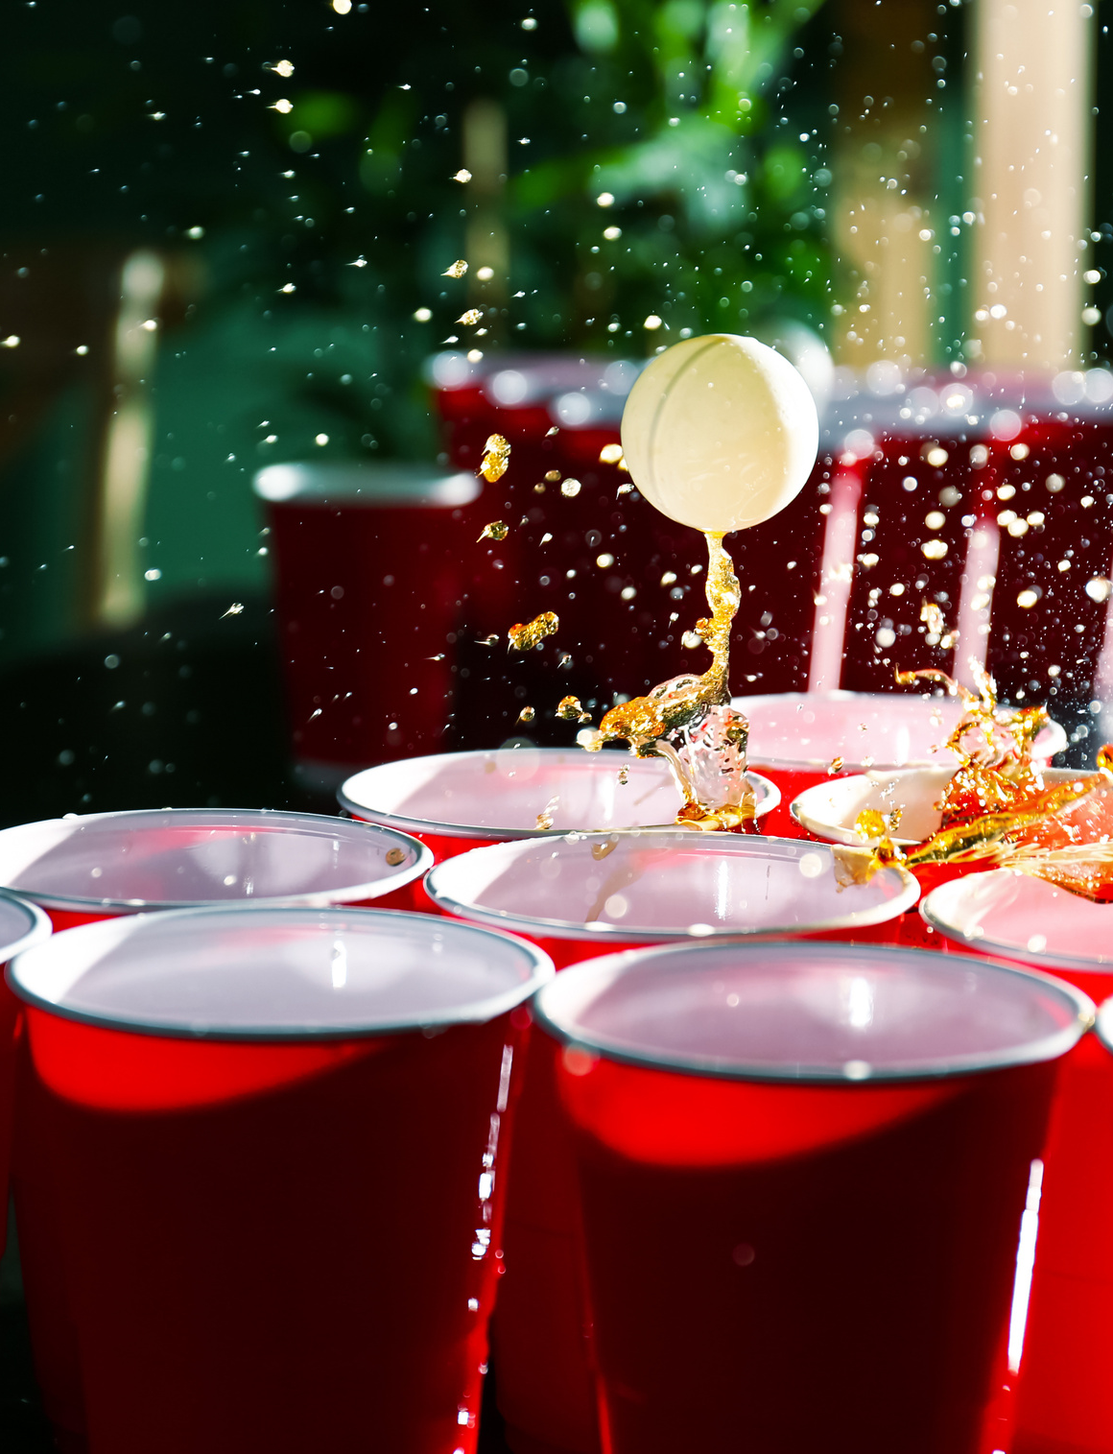
Alcohol
Safety
For some, summer activities may include alcohol, but risky drinking
can put a chill on summer fun, says
the National Institute on Alcohol
Abuse and Alcoholism.
For more information on preventing problems with alcohol this summer and tips on cutting back, visit: https://www.rethinkingdrinking.
niaaa.nih.gov

Slide 9
Mixing Sun
and Alcohol
The sun causes your body to sweat to stay cool and if those fluids aren’t replaced, your body will undergo adverse reactions. You may feel extremely thirsty, dizzy or fatigued.
When people drink alcohol, they may become lackadaisical and reckless, which can have dangerous implications when water is involved.
If you are drinking in or near a body of water be aware that you may lack the dexterity needed to stay afloat, which can increase your risk of drowning (the third leading cause of unintentional injury and death worldwide and fifth in the United States). Sun and heat exposure only amplifies this risk.
The physical exertion of swimming on a hot day paired with alcohol consumption
can lead to overheating, a risk factor for heat syncope (fainting), which can
have deadly consequences.

Slide 10
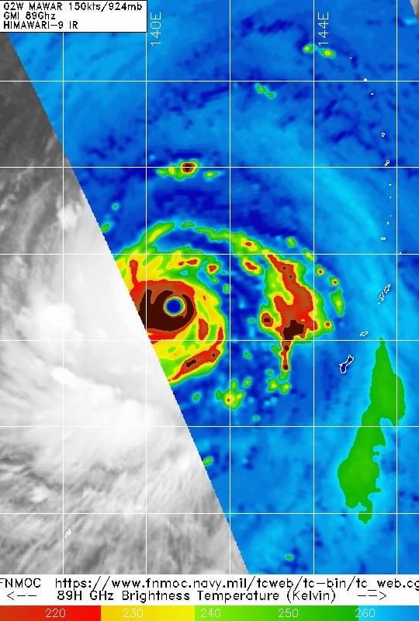
Weather Safety
In 2022, the following
weather events caused
the most deaths:
Heat, 383
Hurricanes, 116
Floods, 93
The following weather events caused
the most injuries:
Tornados
Winter weather
High winds/thunderstorm winds

