Slide 1
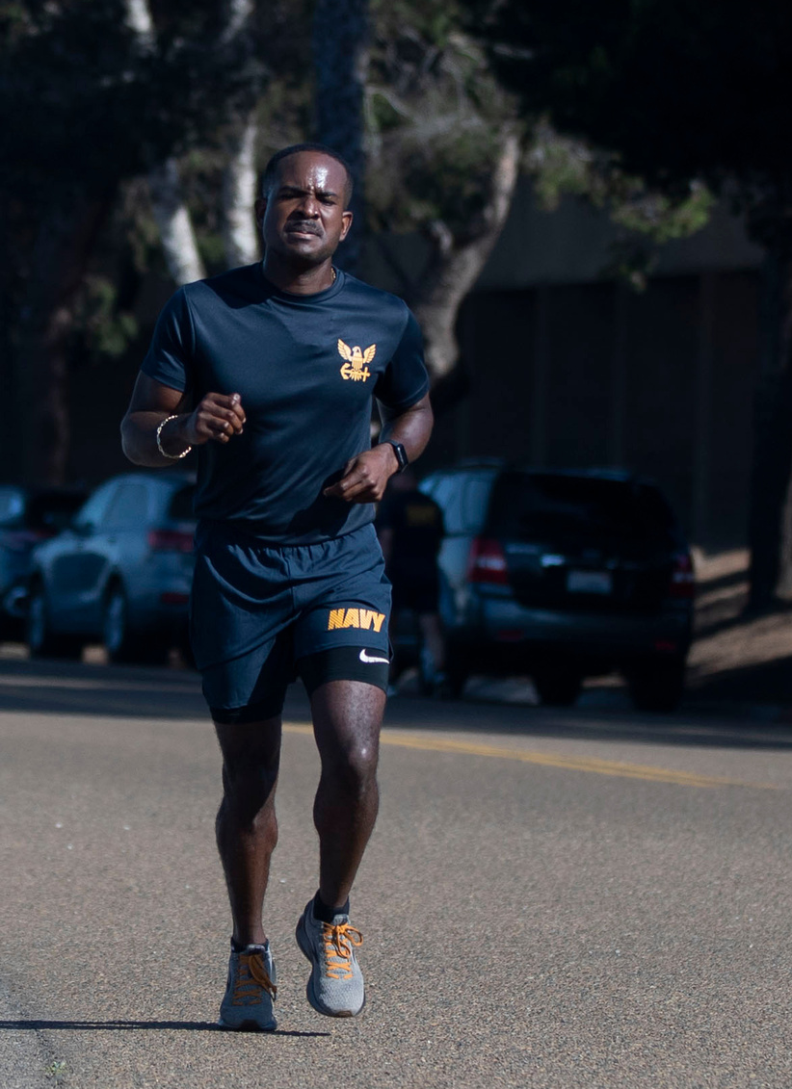
Cardio
Activities
Walking, jogging and exercising safely for security:
Jog in a familiar area but vary your routes. Changing your route could prevent someone from noting your schedule or movements.
Jog in open spaces, away from bushes or alcoves where someone could hide.
Carry your ID. If you suspect you’re being followed, call the police immediately and find a safe place to wait for them to arrive.
Carry a whistle or shrill alarm to summon help if needed.
Do not run with your phone or other valuables in sight.
Avoid jogging in secluded areas or at night. If you do run after dark, do so in well-lit and populated areas and consider buying reflective running gear or a runner’s light so you’re highly visible to traffic.
Recruit a friend. Runners in pairs or groups are less appealing targets.

Slide 2
Bicycling
When a crash occurs between a vehicle and a bike, it’s the cyclist who is most likely to be injured. A large percentage of crashes can be avoided if motorists and cyclists follow the rules of the road and watch out for each other.
Wear equipment to protect you and make you more visible to others, like an approved bike helmet, bright clothing (during the day), reflective gear, a white front light and red rear light and reflectors on your bike (at night or when visibility is poor).
Remember to use arm and hand signals.
Ride with traffic, not against it.
Avoid riding at night, if possible. If you must ride at night, install front and rear lights on your bicycle and wear reflective clothing. It’s the law! Regardless of the season, bicyclist deaths occurred most often between 6 p.m. and 9 p.m.

Slide 3
Bicycling
In 2023, 857 cyclists were killed in traffic accidents in the United States, representing a 10% increase from the previous year, according to www.cyclepedal.com
Bicycle-related deaths peak in the summer months, starting in June and they remain high through September.
Ride a bike that fits you. If it’s too big, it’s harder to control the bike.
Carry all items in a backpack or strapped to the back of the bike.
Tuck and tie your shoelaces and pant legs so they don’t get caught in your bike chain.
Plan your route, choose routes with less traffic and slower speeds. Your safest route may be away from traffic altogether, in a bike lane or on a bike path.
Example: R﻿MI ID #714805

Slide 4
FIREARMS
SAFETY
According to the CDC, in 2022, there were more than 48,000 firearm-related deaths in the U.S., an average of 132 people dying each day.
Notes:
Source: https://www.cdc.gov/violenceprevention/firearms/fastfact.html

Slide 5
Handle Firearms
Safely
Handle every firearm as if loaded.
Never point the muzzle at anything you don’t intend to shoot.
Do not handle firearms while, or after, consuming alcohol.
Know your firearm.
Make sure you read the owner’s manual and take a class.
Everyone is a safety officer.
Intervene when you see someone handling a firearm improperly.
Handle every firearm with care.
Identify the target before you fire.

Slide 6
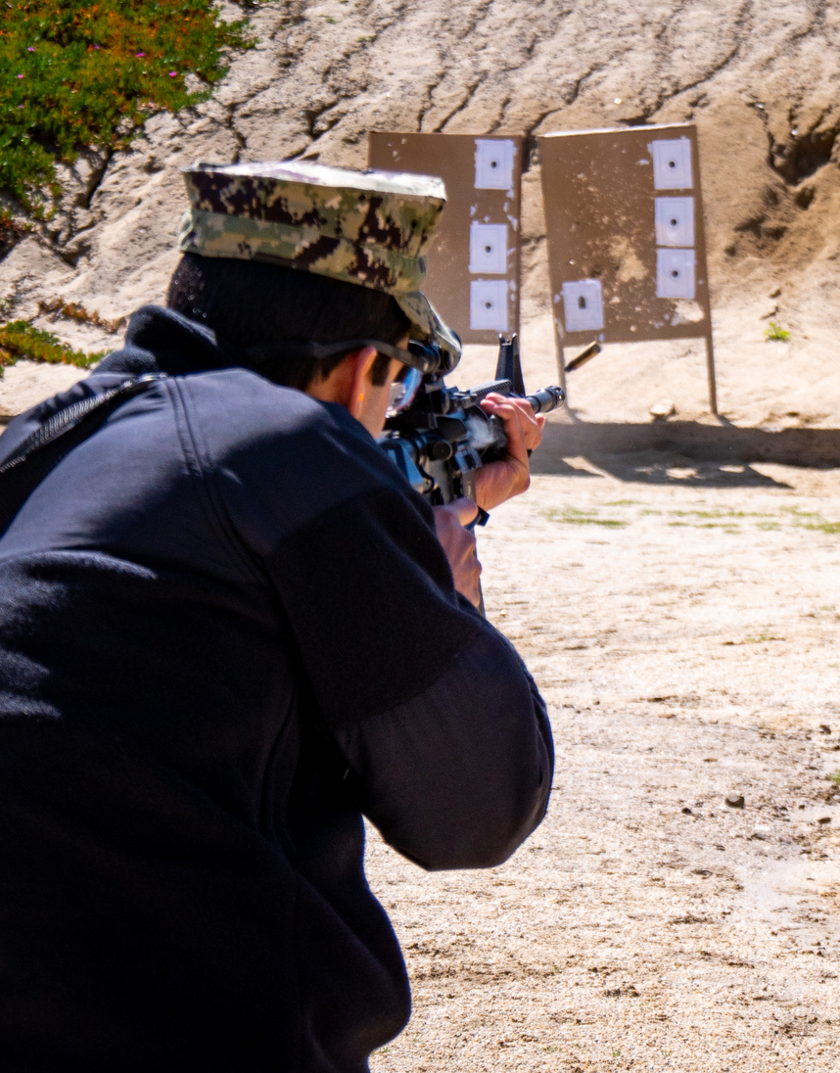
Range Safety
Know and follow all the rules of the shooting range.
Listen and do what the range master tells you to do.
Uncase and case your firearm at the shooting bench, never behind the safety line.
Always keep the barrel pointed down range.
Always keep the firearm on safe until you intend to shoot.
Always wear eye and ear protection when shooting.
Never shoot at water or hard surfaces.
Apply range safety procedures even when shooting off-range.

Slide 7
DRIVING
SAFETY
In 2023 during the 101 Critical Days of Summer, the Department of the Navy lost 27 Sailors and Marines as a result of vehicle (PMV-4) and motorcycle (PMV-2) crashes.
Overall, there were 32 PMV-4 and 67 PMV-2 Class A-E mishaps.
PMV-4 Example RMI ID#928166
PMV-2 Example: RMI ID#:4410726

Slide 8
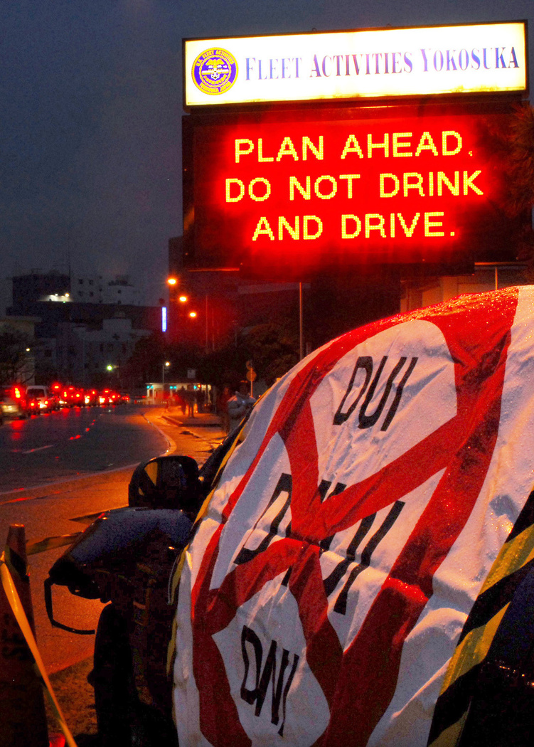
Safe Driving
When you’re behind the wheel of a car – whether alone or with passengers – driving safely is paramount.
We’re more distracted than ever, so it’s crucial to know the basics of safe driving and practice them every time you’re on the road. Ensure you and your vehicle are in the right condition before you get behind the wheel. Dangerous driving behaviors like speeding, distraction and impairment are the greatest threats to pedestrians.
Avoid distracted driving.
Don't drink and drive.
Follow the rules of the road and don't speed.*
Use caution when changing lanes. Cutting in front of someone, changing lanes too fast or not using your signals may cause an accident or upset other drivers.
*Note: Between fiscal 2013 and 2023, excessive speed was the reported leading causal factor of PMV fatalities across the naval services, followed by improper maneuvering.

Slide 9
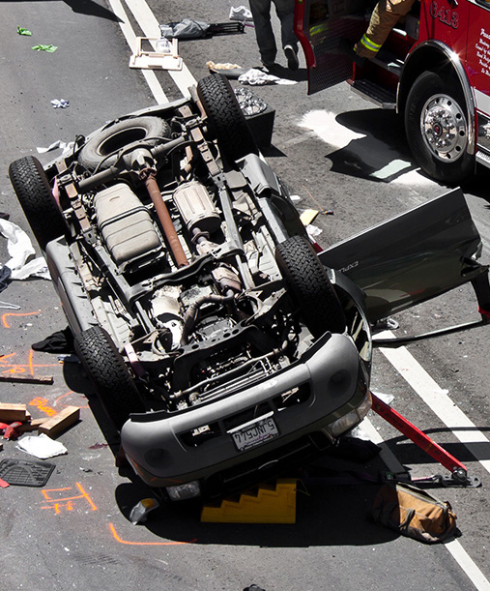
Driving Fatality
Trends
The National Highway Traffic Safety Administration estimates that 42,795 people died in motor vehicle traffic crashes in 2022. For more information on regional overview, visit:
https://crashstats.nhtsa.dot.gov/Api/Public/ViewPublication/813428
2020 had an average of 107 fatal car accidents per day. 2021 had the highest daily average of car accident fatalities: 118 a day. 2022 saw an average of 117 fatal accidents per day.
Slow down.
Keep plenty of distance between you and the car or motorcycle in front.
Share the road.

Slide 10
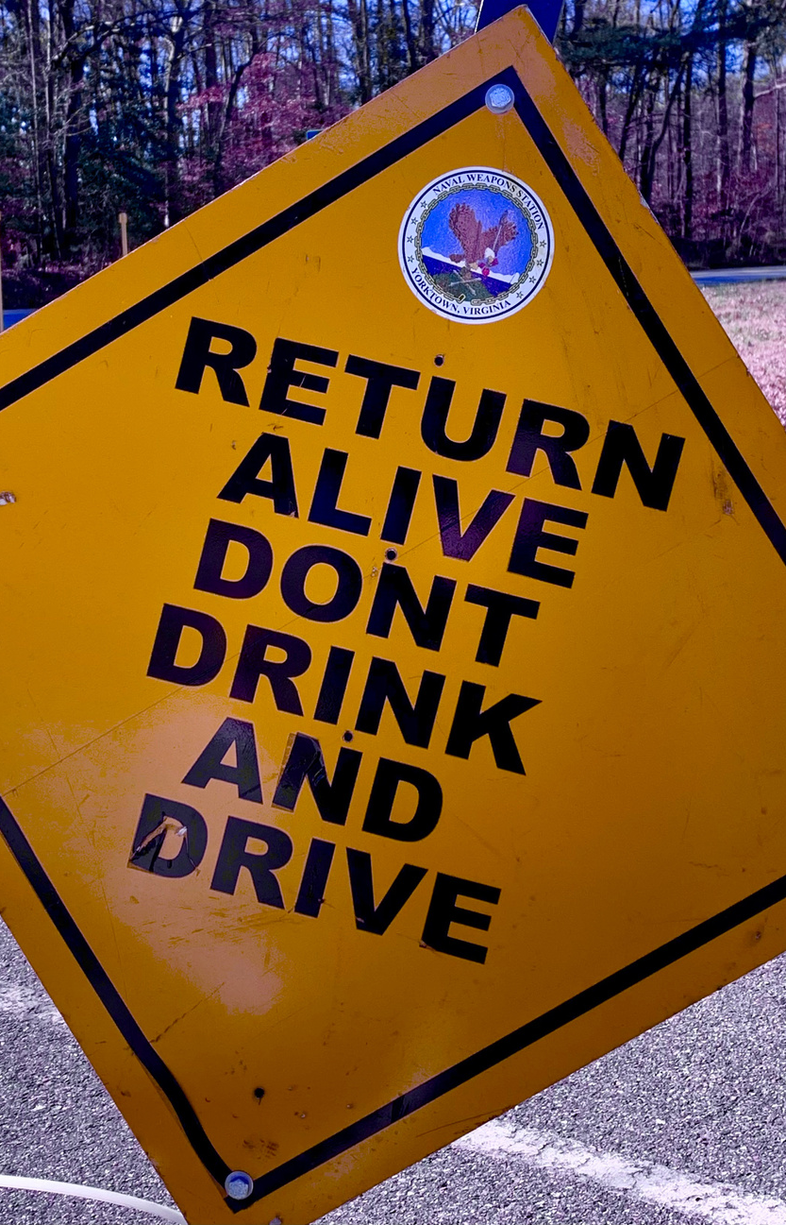
Drinking
and Driving
Plan your safe ride home before you start the party, choose a non-drinking friend as a designated driver.
If someone you know has been drinking, do not let that person get behind the wheel. Take their keys and help them arrange a sober ride home.
If you drink, do not drive for any reason. Call a taxi, a ride-hailing service or a sober friend.
If you’re hosting a party where alcohol will be served, make sure all guests leave with a sober driver.
Always wear your seat belt — it’s your best defense against impaired drivers.
Every day, 32 people die in drunk-driving crashes – that's one person every 45 minutes. That means you, your family or friends could be innocent victims. (Source: National Highway Transportation Safety Administration)
All 50 states, the District of Columbia and Puerto Rico have by law set a threshold making it illegal to drive with a BAC of .08 g/dL or higher.

