Slide 1




Drowsy Driving
WHO IS MOST AT RISK:
  Sleep-deprived drivers.
  Driving long distances after working a full shift.
  Driving through the night, the early afternoon or at other times when normally asleep.
  Drinking alcohol or taking medication that increases drowsiness.
  Driving alone for long distances without rest breaks or much change in scenery.
KNOW THE SIGNS OF DROWSY DRIVING:
  Can’t remember the last few miles driven.
  Drifting from lane or hitting a rumble strip.
  Difficulty focusing or keeping eyes open.
  Tailgating or missing traffic signs.
  Trouble keeping head up.
  Yawning repeatedly.
Example: RMI ID #5562867

Slide 2
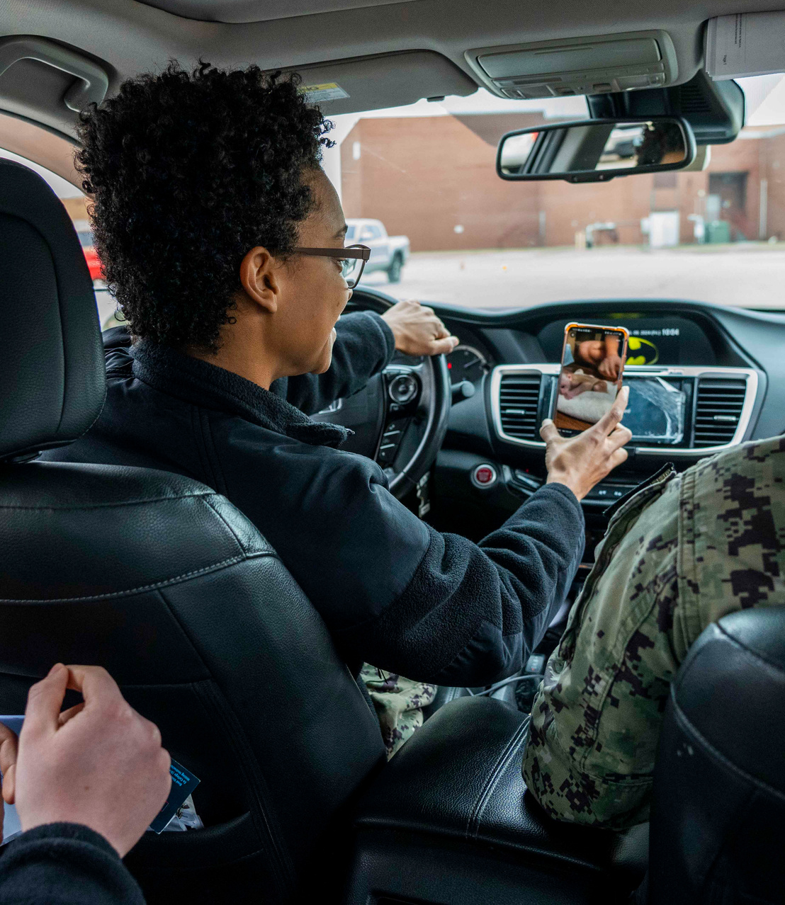
We’re more distracted than ever, so it’s crucial to know the basics of safe driving and practice them every time you’re on the road.
At any given daylight moment across America, approximately 660,000 drivers are using cell phones or manipulating electronic devices while driving, according to the NHTSA.
Using a cell phone while driving creates enormous potential for deaths and injuries on U.S. roads. In 2020, 3,142 people were killed in motor vehicle crashes involving distracted drivers.
Don't allow children to fight or climb around in your car; they should be buckled in their seats at all times. Too much noise can easily distract you from focusing on the road.
You're not multi-tasking, you're distracted.
Distracted
Driving

Slide 3

ATV and ROV
There are about 650 deaths and 100,000 injuries every year involving ATVs, according to the Consumer Product Safety Commission.
  Read the owner's manual carefully and ensure the ATV or ROV is in good working condition.
  Always wear an approved helmet.
  Never drive an ATV while under the influence of drugs or alcohol.
  Never drive an ATV on paved roads. Never operate ATVs or ROVs on streets, highways or paved roads, except to cross at safe, designated areas. Understand the terrain BEFORE you ride.
  Familiarize yourself with the local laws.
  Never ride alone, and always tell someone where you are going and when you will return.
  Always supervise young operators. Never carry extra riders.
Safety

Slide 4




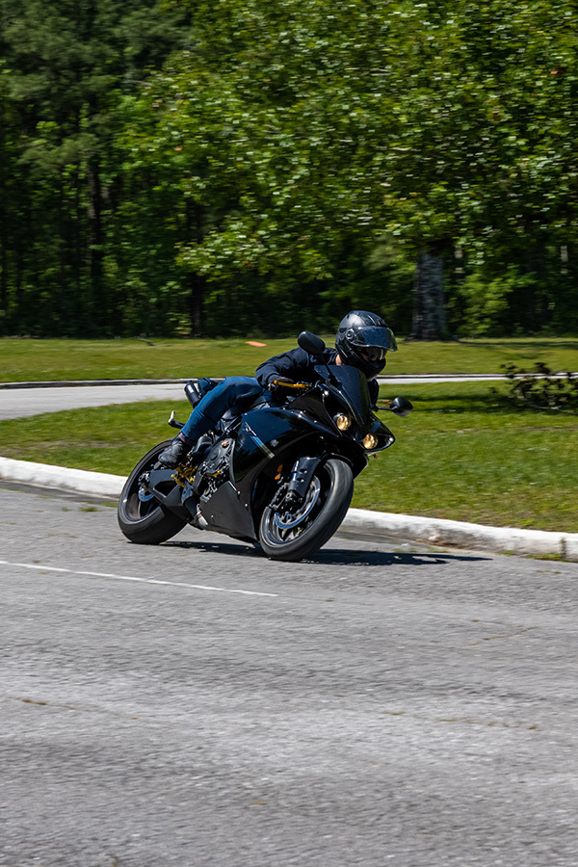


MOTORCYCLE
SAFETY
In 2023 during the 101 Critical Days of Summer, the Department of the Navy lost 14 Sailors and Marines as a result of motorcycle (PMV-2) mishaps.

Slide 5
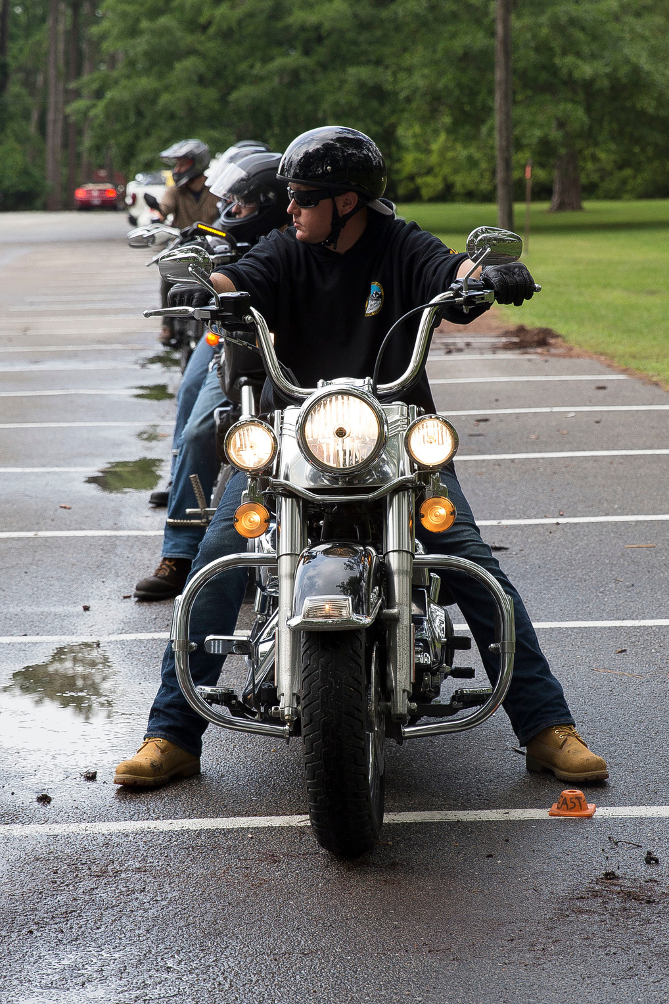
Motorcycle Riding
Safety
SEARCH around you for potential hazards.
EVALUATE any possible hazards such as turning hazard.
EXECUTE the proper action to avoid the hazard.
A sound street strategy can help prevent a dangerous situation.
Training Requirements:
  All Sailors must complete LEVEL I training before operating a motorcycle and then must complete LEVEL II training within 60 days to one year of LEVEL I.
  All Sailors must complete either LEVEL II or LEVEL III refresher training every five years.
Take riding courses periodically to improve riding techniques and sharpen your street-riding strategies.

Slide 6

Motorcycle
  Complete a formal riding education program, get licensed and take riding courses periodically to improve riding techniques and sharpen your street-riding strategies.
  Obey the speed limit; the faster you go the longer it will take you to stop. Know and follow local traffic laws and rules of the road.
  Make sure your bike is fit and ready to ride. Perform all recommended checks and inspections before you hit the road.
  Always wear a helmet with a face shield or protective eye wear. A motorcycle rider not wearing a helmet is five times more likely to sustain a critical head injury.
Safety Tips

Slide 7

Motorcycle
  Wear leather clothing, boots with nonskid soles and gloves to protect your body from severe injuries in the event of an accident or skid. Attach reflective tape to your clothing to help other drivers to see you.
  Ride defensively. Nearly two-thirds of all motorcycle accidents occur from a driver violating a rider’s right of way. Ride with headlights on; stay out of a driver’s blind spot; signal well in advance of any change in direction and watch for turning vehicles.
  Fatigue and drowsiness impair your ability to react. Make sure you are well-rested when you hit the road.
  Don’t drink and ride!
Safety Tips

Slide 8
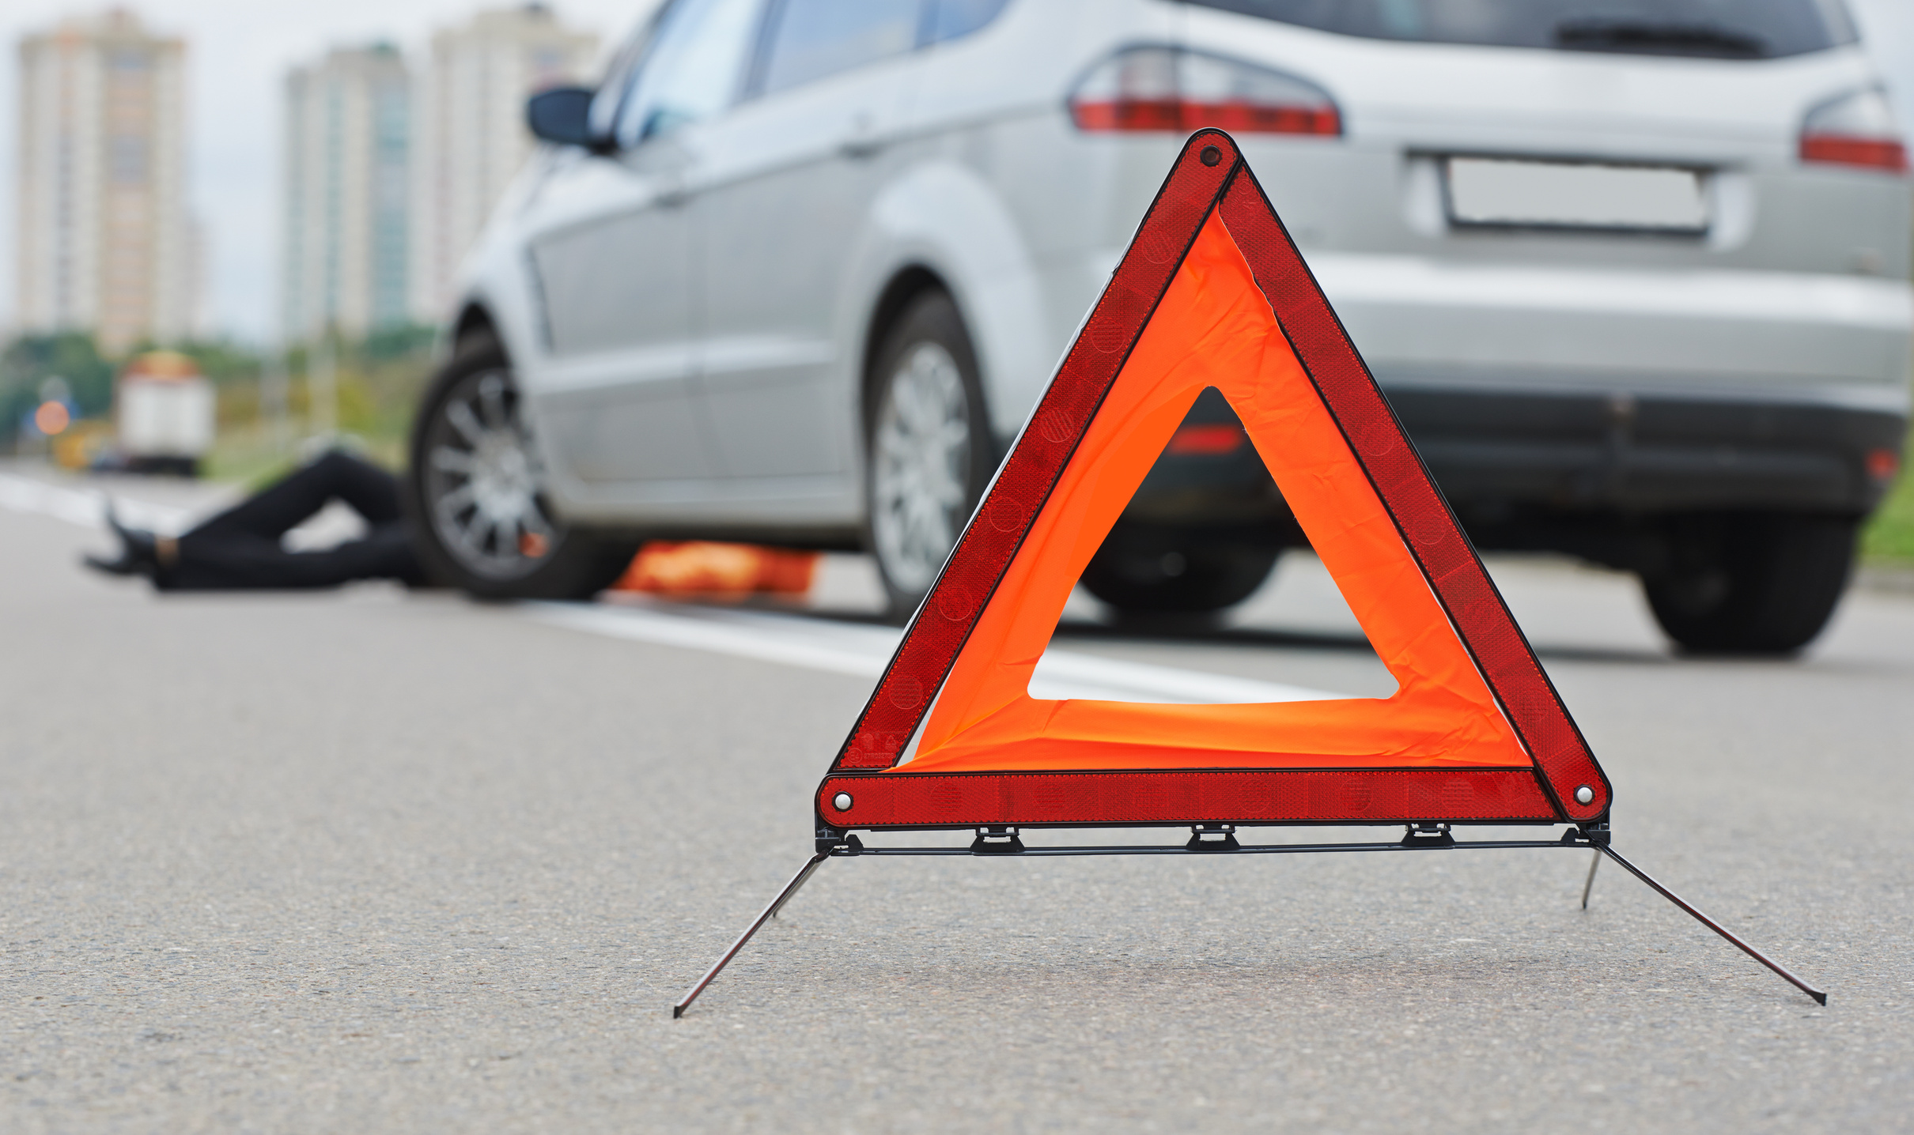
PEDESTRIAN
SAFETY
Over the past five years, during the 101 Critical Days of Summer timeframe, the Department of the Navy lost 9 Sailors and Marines as a result of pedestrian-related mishaps.

Slide 9

Pedestrian
Safety
The Governors Highway Safety Association reported an estimated 3,441 pedestrians were killed in the first six months of 2021, up from 2,934 (17.3%) over the same period in 2020.
  Look for pedestrians everywhere, at all times, to include those stopped on road shoulders with disabled vehicles.
  Use crosswalks and look left, right and then left again before crossing the street.
  Avoid distractions such as texting on your phone while walking.
  Avoid walking when impaired by alcohol.
  Be visible at all times. Wear bright clothing during the day and wear reflective materials or use a flashlight at night.
  Use all your senses when near an area with moving vehicles.
  Never assume a driver sees you. Make eye contact with drivers as they approach to make sure you are seen.
  Walk on sidewalks. If no sidewalk, walk facing traffic and as far from traffic as possible.

Slide 10
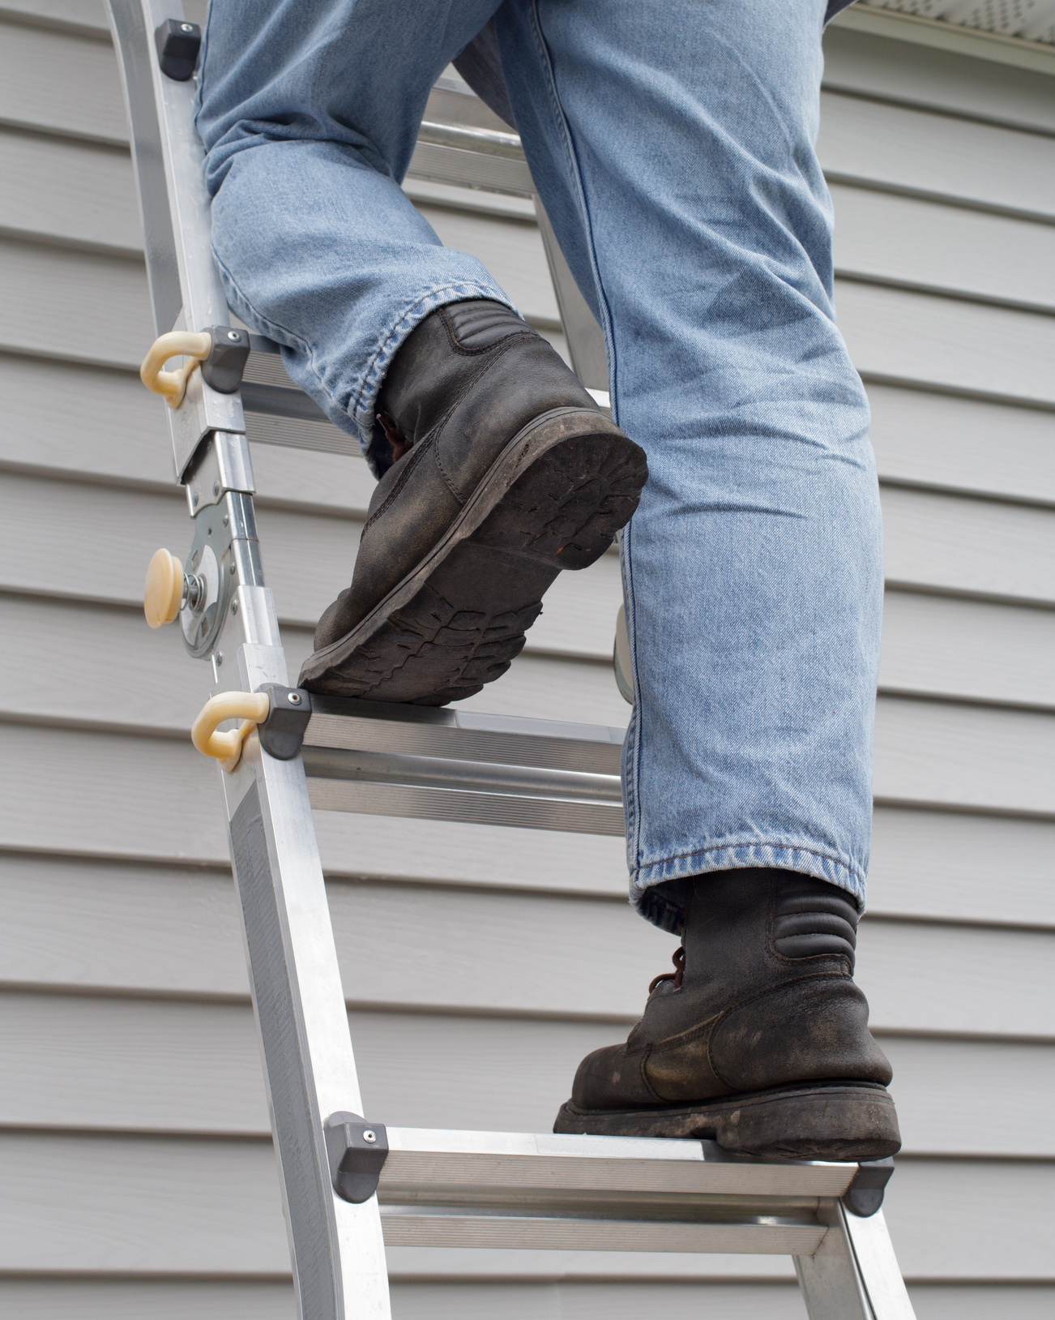

Home
Safety
According to the National Safety Council, an estimated 128,200 preventable injury-related deaths occurred in homes and communities in 2021. The majority of deaths is tied to unintentional poisonings and falls.
Notes:
Source: National Safety Council Home Safety Page. https://injuryfacts.nsc.org/home-and-community/home-and-community-overview/introduction/

