Slide 1
Slips, Trips
Wet floors, slippery stairs and scattered toys all create the potential for falls. Make sure to do the following:
Install handrails on staircases.
Clear outdoor steps.
Cover slippery surfaces in bathrooms.
Install grab rails in shower and bathtub.
Secure toys, skateboards, bikes and other mobile toys in a safe area where family members and visitors won’t trip on them.
When working from a ladder assess risk and use the right equipment.
Make sure you have level ground and never lean the ladder against an unstable surface.
Ensure stepladders have a locking device to hold the front and back open.
Always keep two hands and one foot, or two feet and one hand on the ladder.
Wear slip-resistant shoes and don't stand higher than the third rung from the top.
Don't lean or reach while on a ladder and have someone support the bottom.
and Falls

Slide 2
Grill Safety
According to the U.S. Fire Administration, over half (57%) of grill fires on residential properties occur in the months of May, June, July and August. Grill fires on residential properties result in an estimated average of 10 deaths, 100 injuries and $37 million
in property loss each year.
Use grill outside only, away from siding, deck rails and overhanging branches.
Clean grills regularly to remove grease buildup.
Never add charcoal starter fluid to fire.
Never use gasoline or any flammable liquids other than starter fluid.
Check the gas cylinder hose for leaks.

Slide 3
Open Fire Safety
Many off duty, outdoor fire burns sustained by Sailors and Marines are caused by someone, either the service member or another person, pouring or shooting a flammable liquid into or near a fire; while burning yard debris or by tripping and falling into the fire. Many incidents result in second-degree burns to the person’s face and torso.
Do not pour, aim or shoot gasoline, alcohol, lighter fluid or any other flammable liquid into or near a fire.
Keep the area around designated fire pits, campfires or bonfires free of trip hazards.
Make sure the fire pit is at least three feet away from structures and anything that can burn.
Pay attention to where you’re walking and don’t run in the vicinity of an open fire.
Keep a hose or water source nearby to extinguish the fire quickly if needed.
Ensure fires are completely out.

Slide 4
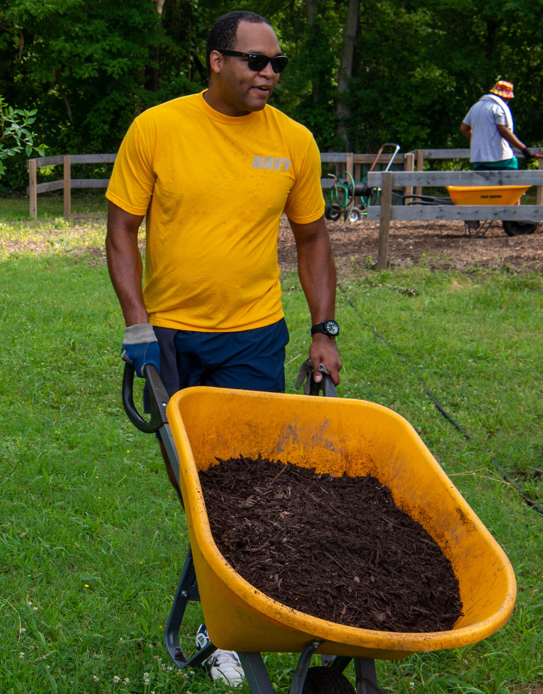
Gardening
Emergency rooms treat more than 400,000 injuries each year related to outdoor garden tools, says the U.S. Consumer Product Safety Commission.
Put away yard tools. Lawn tools, including rakes, saws and lawnmowers, can cause harm if not used and stored properly.
Stay alert when using power tools and never rush while mowing the lawn or using the weed whacker. Never leave tools lying around. Always keep them locked in a shed or garage where kids can’t access them.
Wear safety gear whenever operating power equipment, including hedge trimmers (safety glasses, hearing protection, non-slip closed-toe shoes or boots, long pants or chaps, long sleeves and work gloves).
Store poisonous chemicals safely. There were over 2 million poisoning incidents reported to poison control centers nationwide in 2020. Several household items present poisoning hazards, including gardening and home maintenance supplies.
Wear gloves. Garden gloves will help protect you from blisters, fertilizers, pesticides, bacteria, fungi and sharp tools.
Safety

Slide 5
Gardening
Safety
Warm up. Just like an athlete does before a game, you should warm up before digging in the garden. Walk around your garden for a few minutes and do some pre-gardening stretches.
Avoid repetitive motion. Prolonged and repetitive motions, such as digging, raking, trimming, pruning and planting, might irritate your skin, tendons or nerves. To avoid this, switch up your tasks every 15 minutes and take breaks between tasks.
Banish bending. Kneeling instead of bending will put less strain on your back. For extra comfort, consider wearing kneepads.
Check your lifting. When lifting objects, especially heavy ones, engage your legs and not your back. When you’re carrying heavy objects, hold objects close to your body to reduce strain.
Look for pests. Check your clothes and body for ticks, which can cause several diseases. Better yet, help prevent tick bites by applying repellent.
Block the sun and stay hydrated.

Slide 6
Bladed Tool
Safety
The most common concern when using sharp blades or edges is an injury, such as a cut (laceration, puncture) or an amputation. Tools or equipment with sharp blades or edges can include box cutters, utility knives, safety cutters and equipment with blades or moving parts such as hedge trimmers. To prevent cuts:
Use the right tool for the job it was designed for.
Make sure the blade is sharp. Dull blades require more force, increasing the chance of injury.
Carry one tool at a time, tip and blade pointed down at your side.
Work in a well-lit space so you can see what you are doing.
Cut on a stable surface.
Use protective clothing such as cut resistant or mesh gloves, and safety glasses to protect eyes if the blade shatters or breaks.
Cut away from your body. Make sure no body parts are in the cutting path, or in the path the blade might take if it slips.
If the tool has a retractable blade, retract it immediately after use, and retract it fully. Similarly, close scissors or snips when not in use.

Slide 7
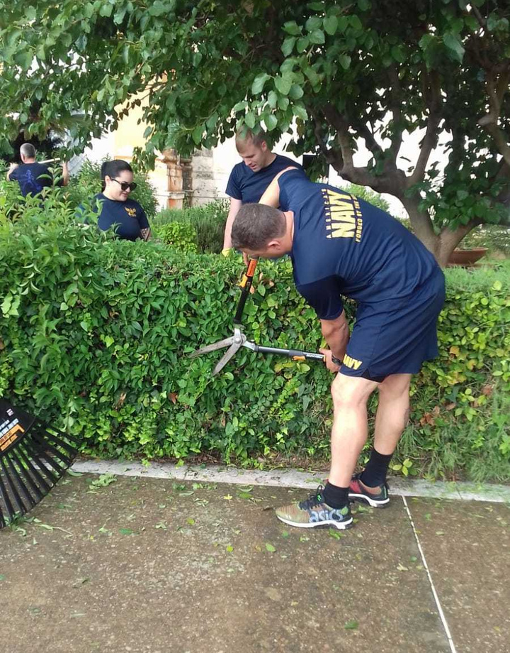
Bladed Tool
Follow the manufacturer's instruction manual when you operate, clean and maintain the equipment.
Make sure that all guards and safety devices are in place and functioning properly.
Make sure cutting blades are sharp.
Keep your hands away from the edges of cutting blades – make sure you can see both your hands (and all your fingers) as well as the cutting blades. Keep your eyes on the item you are cutting and know where your fingers are in relation to the blade.
Keep your hands away from all moving parts and avoid cleaning or brushing off moving parts such as cutting blades.
Turn off and unplug the equipment before trying to dislodge items and before disassembling and cleaning.
Put all guards and safety devices back in place after cleaning.
If there are moving parts, cover or tie back your hair, tuck in loose or frayed clothing and remove your gloves and jewelry.
Do not bypass any guards or safety devices.
Do not operate the equipment if you feel tired or unwell.
Safety

Slide 8
Off-duty mishaps by uniformed service members are
required reports in the Risk Management Information (RMI)
mishap reporting system: https://afsas.safety.af.mil
Without accurate data, honest analysis cannot be made.

Slide 9
Conclusion
No matter where
you are or what activity you are engaging in, make sure you know and understand
the inherent environmental risks of that region, especially if you are new to or unfamiliar with the region. Threats vary depending on
the locale.
Familiarize yourself with climate, local wildlife and any potential threats or dangerous situations specific to that activity and location. Make sure you have identified avenues for medical treatment (nearby hospitals) and always prepare for the unexpected.
If you get hurt, seek medical attention as soon as possible, even if the injury appears mild. Let a medical professional assess the likelihood of additional symptoms that may not be experienced or develop. For example, a head injury may have unseen symptoms at onset or appear later.
Understand inherent environmental risks.

Slide 10
RMI Mishap
Examples
Sport, Class C, RMI ID #598153: Playing tennis and jumped to hit the ball in the air. Landed on the side of their right foot and fractured right ankle.
Bicycling, Class C, RMI ID #714805: Riding bicycle from work to barracks. Fell off bicycle and punctured abdomen with left handlebar. Another individual discovered the injured person laying in the middle of the road. Treated at hospital and released the following day, 4 lost workdays.
PMV-4, Class C, RMI ID #5562867: Fell asleep at wheel. Single car crash. Car destroyed. Fractured finger and lacerations to forehead; 14 days SIQ.
Rock Climbing, C, RMI ID #140562: Fell 40 feet at indoor rock-climbing facility; multiple injuries; 12 days hospitalized, 10 weeks limited light duty.
Swimming, Class C, RMI ID #906097: Swimming and hit head on the wall of the pool;
head injury, Concussion protocol.
Running, C, RMI ID #295705: While running; tripped over concrete curb, fell and hit head on concrete bollard; concussion, cuts to forehead, received sutures and 30 days LLD.

Slide 11
Have you connected with our NAVSAFECOM Phone App?
The Naval Safety Command mobile app delivers valuable guidance and tools to assist naval safety personnel in assessing, managing and reducing risk on and off duty. Users have access to four portals, each with warfare community-specific content including: safety program information, checklists, guides, templates, announcements, assessments
and much more.

Slide 12
Follow
NavalSafetyCommand.Navy.mil
Us

