Slide 1
Recreational Activities
and Off-Duty Mishaps
Naval Safety Center

Slide 2
Safety Recommendations
Consult a medical professional before starting a new activity
Do not participate while in pain or with an injury
Warm up before any activity
Participate within your limits
Drink plenty of water
Do not participate in an activity while intoxicated
Always wear protective gear

Slide 3
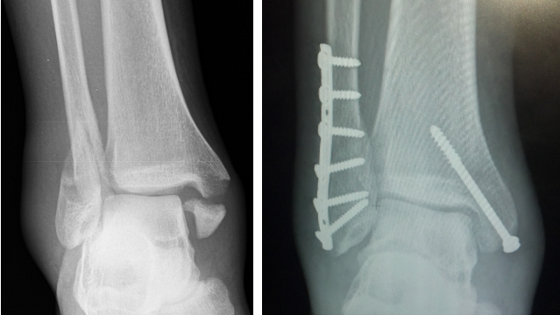
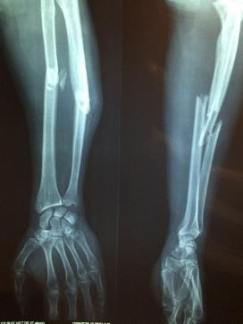
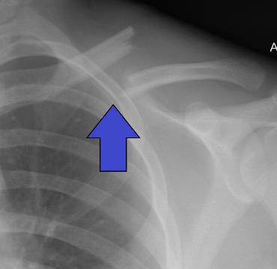
Breaking a bone was the number one off-duty injury
One in three injuries was a fracture

Slide 5
The Top 25 Mishap Categories:
Basketball
Miscellaneous Walking
Football
Physical training, exercise/weight lifting
Bicycling
Ascending or Descending Stairs
Soccer
Softball
Other
Skateboarding
Snowboarding
Glass or Knife handling
Running (non-PT)
Running (for PT)
Motorized Dirt Bike
Weight Lifting
Recreational Outdoor Activities
Handling Pets, Animals, or Insects
Attending Social Event
Volleyball
Hiking
Jumping
Swimming
Horseplay
Showering or Bathing

Slide 6
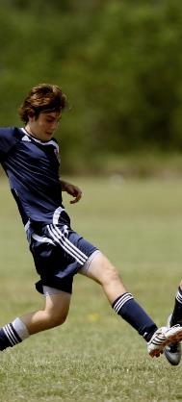
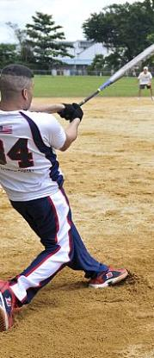
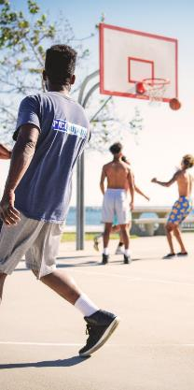
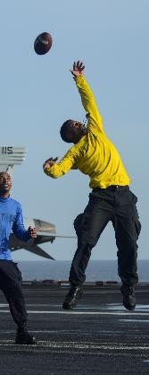
Team Sports

Slide 7
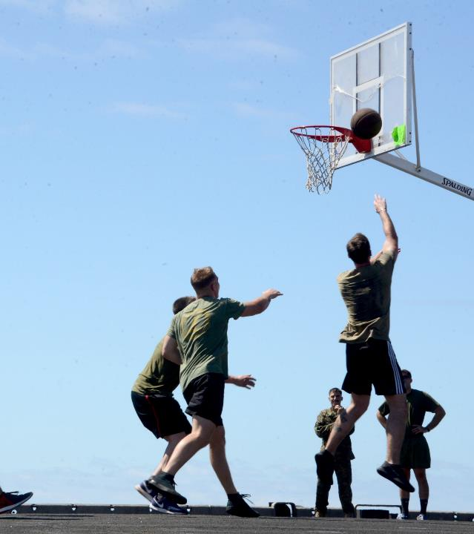
Play Safe
Basketball, Football, Soccer, and Softball made it on the top of the injury list for the past three years.
Follow the rules of the game
Take frequent breaks
Stop often to rehydrate
Prepare to make contact when playing contact sports

Slide 8
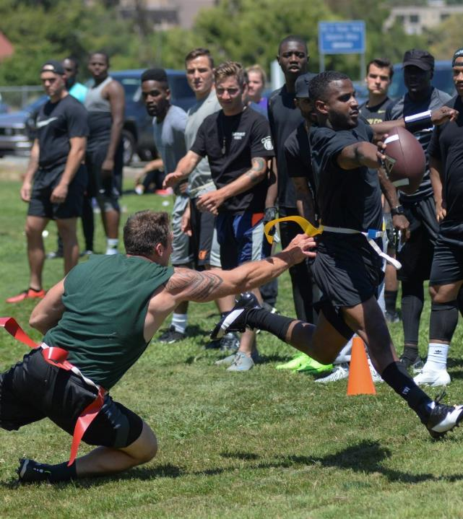
Being Competitive vs. Being Aggressive
Remember, the goal is to have fun
Emotions can run high and create room for error
Only you can only control your actions
Avoid players who stir up emotions
Do not antagonize other players

Slide 9
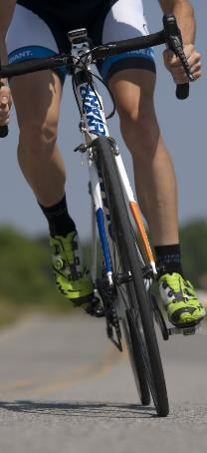
Races, Weights, and Obstacles

Slide 10
Weight Lifting
There are several types of strength training: total body circuit, push-pull, power lifting, explosive dynamic and muscular isolation training
Strength training can improve your body’s metabolism, build stronger bone density as well as aid in managing a balanced weight
You don’t have to “go-all-out” to see results. Most people see physical improvement with short, 30 minute sessions 2-3 times a week

Slide 11
Always warm up before any lift session
Proper form is always more important than counting repetitions (If you notice a peer practicing improper form, politely help them out)
Always lift with a buddy or spotter
Never lift while in pain or experiencing fatigue
When in doubt, ask for help
Lift Safely
There were 141 reported mishaps involving weight lifting activities 2016 through 2019.
Injuries range from pulled back to popped knees and shoulders to other forms of strain on joints and muscles.

Slide 12
Running for leisure or PT
Running injuries happen regardless of whether jogging for PT, racing, or moving from point A to B
You are more likely to injure yourself running from point A to B than in a competitive race
Most running injuries occur when you lose balance, trip, or run into something
Ankle injuries are common running injuries

Slide 13
Bicycling in urban environments or on the road
Safe tips for the Road:
Keep your head up and your eyes on the path ahead of you
If in a group, ride in a single file
Always ride on the right side of the road (with traffic, not against it)
Know and practice hand signals
Obey traffic signs and rules
Avoid riding during hazardous weather conditions
Pay attention to vehicles and pedestrians
Avoid peak traffic times
Choose bike paths or trails when possible

Slide 14
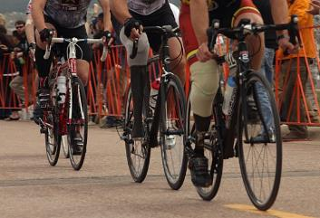
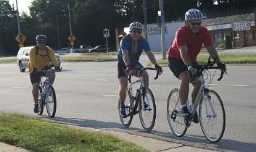
More cycling tips:
Always wear a properly fitting helmet
Adjust the bicycle to fit your size
Wear bright colored or reflective gear at night and during low visibility conditions
Keep your bicycle on a regular maintenance schedule
Make sure your bicycle is equipped with reflectors
A bell or horn, rear-view mirror, and headlights are recommended for additional safety

Slide 15
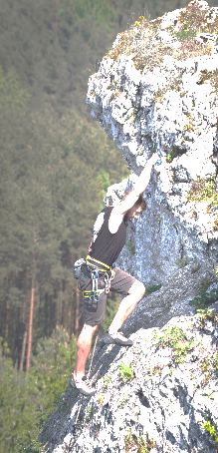
Outdoor Adventures

Slide 16
Dirt Bike- 56
Miscellaneous Outdoor Activities- 46
Hiking- 41
All-Terrain Vehicle- 25
Rock Climbing-13
Horseback Riding- 9
Chopping Wood- 8
Hunting- 7
Paintball- 5
Driving Off-Road- 2
Number of Mishaps Reported

Slide 17
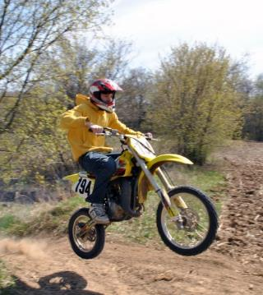
Dirt Bike guidelines and regulations can be found within the OPNAVINST 5100.12J
Dirt-bike riders must attend training if riding on or off a government installation.
If the dirt-bike is licensed and registered to operate on public roads or highways, it's classified as a motorcycle, and rider must attend Levels I, II, and refresher training.
Off-road only dirt bikes don't require license or insurance to attend training on government installation.
It is highly recommended riders complete specialized motorcycle training or the Level I course to satisfy the dirt bike training requirement.
For rider training location nearest you call: 877.228.7093
or visit: www.dirtbikeschool.com

Slide 18
Examining the “Miscellaneous, Other” Category
Off- duty incidents vary from simple mistakes to elaborate flops. Practice risk management in all facets of life.
Examples of actual activities that lead to a mishap:
Clearing shrubs with a machete and suffering an injury from the machete
Grabbing a burning piece of wood with bare hands to adjust a fire
Getting tangled in a tent when attempting to set it up
Falling off a trampoline
Getting hit in the face with a swinging golf club
Receiving stitches after a being bitten by a parrot
Wrestling with dogs, falling off the bed getting a concussion
Tripping over furniture to capture a runaway pet, breaking a bone

Slide 19
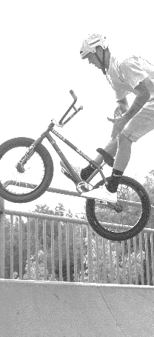
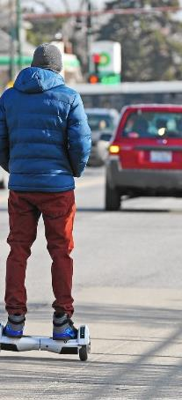
Extreme Sports

Slide 20
Number of Mishaps Reported
Skate Boarding- 97
Rollerblading- 16
Extreme Sports Other- 11
Scooter- 2
Sky Diving- 1

Slide 21
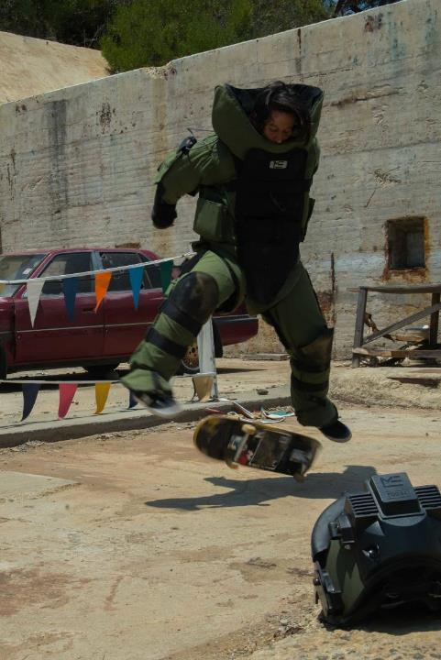
Extreme Sports
Wear proper PPE
Helmet
Knee Pads
Elbow Pads
Mouth and Wrist Guards
Prepare to fall – a lot. So learn how to fall to minimize the hurt:
Roll into a fall
Crouch down to lessen the falling distance
Try to land on meaty parts of the body
Practice near soft surfaces, like grass

Slide 22
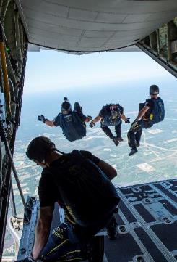
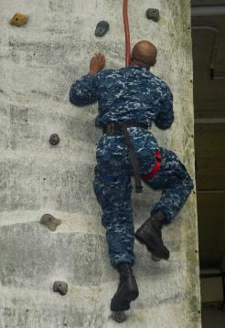
Is the risk worth the reward?
Cuts, scrapes, sprains, broken bones, and concussions are on the extreme sports injury list.
Implement ORM
Ask yourself “what if?”
Can you afford to miss several weeks if you’re limited duty with a serious injury?
Always do a thorough inspection of the gear needed to support your activity. When was the rock climbing harness last tested? Has it been awhile since your BMX bike has a tune-up?
Make risk decisions

Slide 23
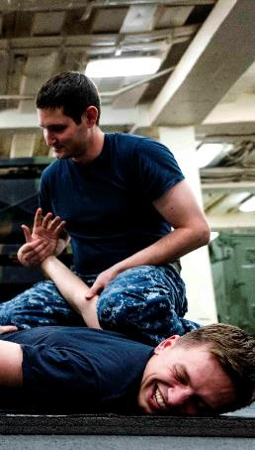
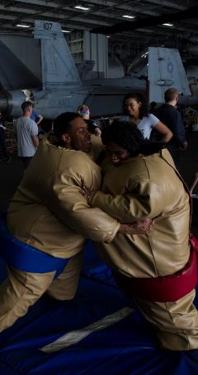
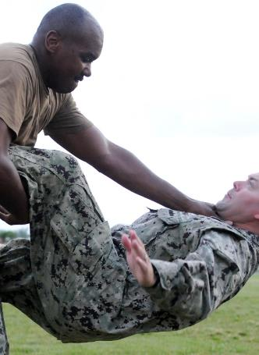
Martial Arts and Sparring

Slide 24
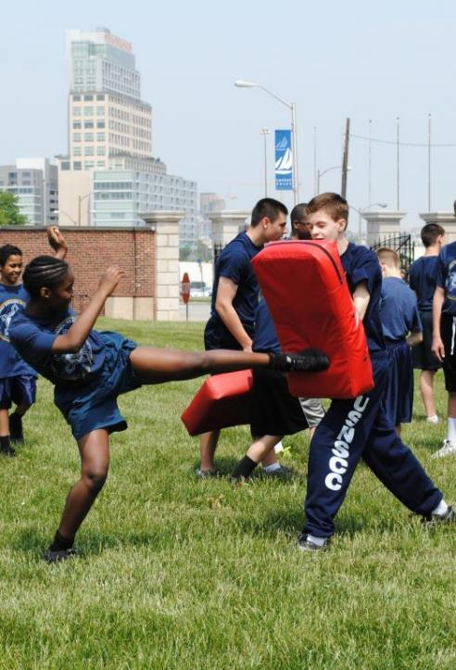
Number of Mishaps Reported
Martial arts- 29
Boxing- 14
Wrestling- 13
Kickboxing- 6
Sparring- 2
Other- 2
No two styles are the same. Some forms focus on grappling, others on leg work such as kicking. Do some research before starting, to find the best style for you.

Slide 25
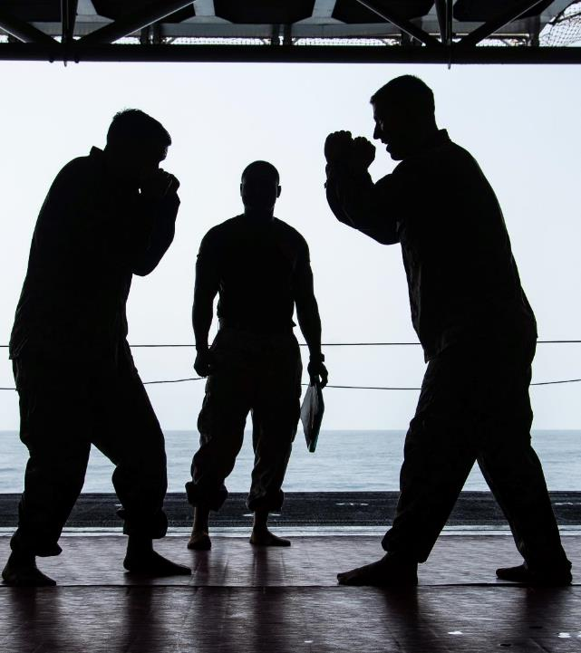
Be honest with yourself and recognize your limitations
Don’t practice when it hurts
Always warm up
Wear clothing or attire that fits properly
Invest in protective gear

Slide 26
Off-Duty Mishaps

Slide 27
In the Kitchen
Grilling- 23
Handling- 17
Slicing- 15
Other- 10
Opening package- 3
Opening Can, Bottle or Jar- 2
Number of Mishaps at Home
Around the House
Walking- 345
Showering or Bathing- 35
Sleeping- 29
Getting Dressed- 5
Sitting in a Chair- 4

Slide 28
Miscellaneous Events
Child Care- 176
Cleaning-36
Supply and Materials Handling- 13
Construction- 5
Electric Work- 5
Equipment Repair- 4
Social Events
House or Private Party- 33
Socializing at a Bar or Blub- 17
Attending a Concert- 9

Slide 29
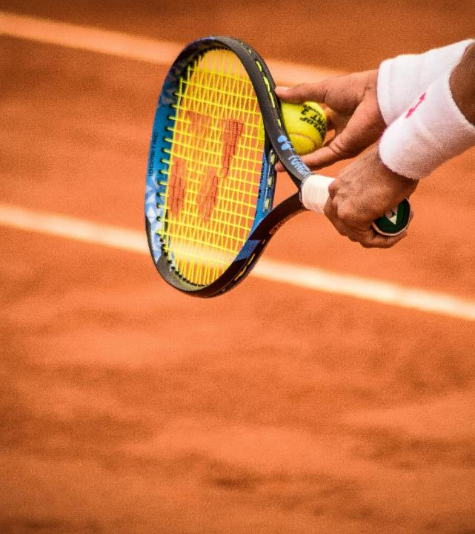
Recreational activities with the least amount of mishap reports:
Golfing- 4
Video games- 3
Tennis- 2
Bowling- 1
Painting- 1
Lacrosse- 1

Slide 30
Zero mishaps were reported involving yoga, pilates, tai chi, or billiard games.

Slide 31
For More Information on Safety follow us or find us at:
Twitter: @NSC_Updates
https://www.facebook.com/NavalSafetyCenter
https://www.safetycenter.navy.mil/

