Slide 1
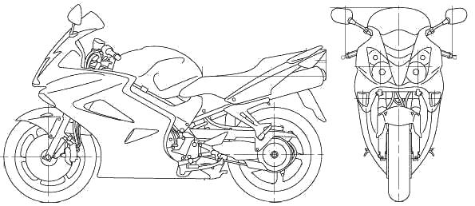
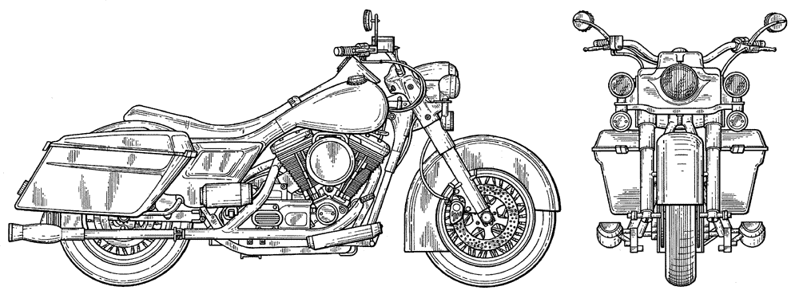
Navy Motorcycle Leadership Guide
READINESS
2/3 of Navy Fatalities and Injuries occur in Personal Motor Vehicles (PMV)
1/2 of the PMV Fatalities and Injuries occur on Motorcycles (PMV-2)
Most motorcycle crashes involve Sport Bikes
TRAINING is very effective at preventing Fatalities and Injuries
EVERY FATALITY AND INJURY AFFECTS READINESS
Riders are responsible for completing required training.
Commands are responsible for providing the opportunity for training.
BEST PRACTICES / KEYS TO SUCCESS
Assign and support your Motorcycle Safety Representative (MSR)
Include MSR on Check-in/out routing – Keep Roster Current!
Recommend all personnel complete a Pg13 stating they are aware of the reporting requirement if they ride or own a motorcycle (example available on the NSC Motorcycle web page)
Engage Divisions and Chief’s mess to know their riders and set the tone to support motorcycle training and mentoring opportunities
Monitor Readiness Posture using ESAMS Reports provided by MSR
Enforce Training Attendance and Motorcycle Rider Policy compliance
Report Training needs or inadequacies to the local supporting Installation safety manager and command ISIC
Encourage Mentorship and Personal Risk Management
SUPPORT
POLICY: Naval Safety Center (NSC)
www.safetycenter.navy.mil TAB: Ashore/Motor Vehicle/Motorcycle
DELIVERY: Commander Naval Installations Command (CNIC)
www.cnic.navy.mil BUTTON: Find Your Region or Installation
ESAMS: https://esams.cnic.navy.mil/esams_gen_2/loginesams.aspx
Help Desk: CONUS: 866-249-7314 OCONUS: 809-463-3376
ESAMS Registration and Scheduling: www.navymotorcyclerider.com
(accessible on Navy and personal computers)
3-E’s
Engineering: Best method to eliminate or reduce risk
(i.e. ABS Brakes, Stability Control, Tire Construction, Mirrors etc.)
Education: Best method to reduce risk when engineering is not feasible
Enforcement: Mandate and Enforce compliance with Engineering and Education policies and equipment designed to mitigate risk
Collateral Duty MSRs Have More Ability To Reduce Fatalities and Injuries Than Anyone Else In The Navy!
Actions that focus on enforcement without opportunities to learn have driven riders “underground”. Success = leadership enables training attendance, supports mentorship and expects compliance and personal risk management.
Improving Navy motorcycle culture will have a positive affect
on readiness and will foster safety conscious attitudes.
REFERENCES
DODI 6055.04 DoD Traffic Safety Program
OPNAVINST 5100.12 Navy Traffic Safety Program
Sportbike
Performance machine, engineered for the track but authorized on the road
Non-Sportbike
Engineered road bikes

Slide 2
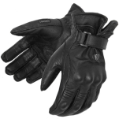
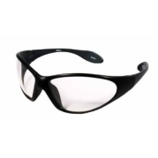
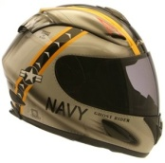
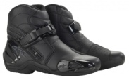
TRAINING REQUIREMENTS
LEVEL I BASIC
Initial class required within 30 days
No license or permit required if Trainer Bikes are available
Curriculum: BASIC RIDER COURSE (BRC)
LEVEL II INTERMEDIATE
Initial class required within 60 days of Initial BRC
Student must provide his/her own bike.
Permit or License, and Insurance Required
Students on cost orders may use Trainer Bike of correct type
Curriculum: ADVANCED RIDER COURSE (ARC) – All bike types
MILITARY SPORTBIKE RIDER COURSE (MSRC)- All Sportbikes
BASIC RIDER COURSE LEVEL II (BRC-2)- All Non-Sportbikes
LEVEL III REFRESHER AND ADVANCED
Required every THREE years
Curriculum: ANY LEVEL I OR II TRAINING COURSE
AUTHORIZED ALTERNATE TRAINING (See NSC Website)
Note1: Training Requirements apply to Military riders on or off duty and Government Civilians in the line of their duty
Note 2: Level I training may be required for civilians to ride on military installations
Note 3: Leave should not be charged for personnel taking courses.
Note 4: Classes are available to Retirees, Dependents, and Govt. Civilians on a space available basis.
MOTORCYCLE SAFETY REPRESENTATIVE (MSR)
Collateral or Full Time MSR(s) manage the Motorcycle Program, and provide status to the CO/OIC/ISIC as necessary.
At least one MSR shall be assigned for the command
Rider(s) preferred for the MSR position, but not required
If more than one MSR is assigned, appoint a “Senior” MSR
MSR(s) may support more than one UIC/Command
Add MSR to command check-in/check-out sheet
Ensure MSR’s are trained to use ESAMS (ESAMS website)
ENTERPRISE SAFETY APPLICATION MANAGEMENT SYSTEM (ESAMS)
ESAMS shall be used to manage the Navy Motorcycle Program. ESAMS provides rider inventory, training compliance, demographic information and reports
ESAMS is also the Navy Safety and Occupational Health (SOH) Program tool. Your MSR and Safety Manager can assist one another with the program or may be the same individual.
MSR(s) Duties Include:
Monthly: Verify training and deficiency report, frequency may change depending on command population
Quarterly: Review and counsel planned owners for change
Quarterly: Review and update reports
Quarterly: Provide COC with the dashboard
Quarterly: Hold a motorcycle rider safety meeting to remind and update riders on safety requirements and training. Have plan-to-own riders attend so that they can meet their peers and can pair up with experienced riders as mentors
CO SUPPORT OPPORTUNITIES
Motorcycle Mentorship Meetings are encouraged within the command and are available at most regional safety offices
Command Organized Rides are valuable to encourage positive peer pressure and informal program oversight
Season Opening and Closing Fairs/Rides are encouraged to provide an opportunity to inspect vehicles, check training, check licensing and discuss personal risk management
Stand-Down Presentations, Data, and GMT are available on the NSC web site and at many installation safety offices
Contract Trainers are available as PMV-2 Subject Matter Experts (SME) to provide special request training and Stand-Downs
PMV-2 PPE to/from parking in uniform-refer to local policy
REQUIRED PERSONAL PROTECTIVE EQUIPMENT (PPE)
Department of Transportation approved (DOT) Helmet
Impact Resistant Goggles, Face-shield or Wrap Glasses
Full Fingered Gloves
Sturdy over the ankle footwear
Long sleeve shirt below the elbows & Long pants below the knees
Motorcycle specific Jackets and Pants with armor is highly encouraged to provide ultimate crash protection

