Slide 1
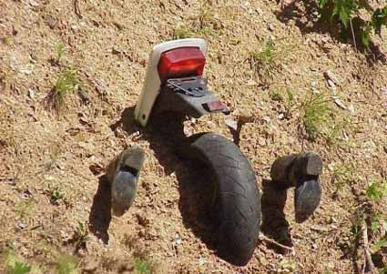
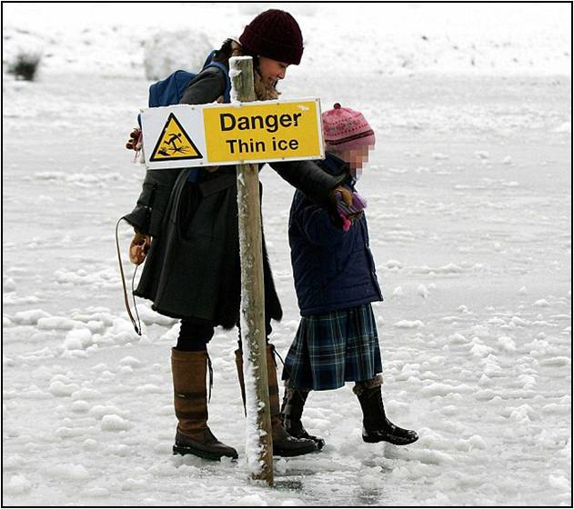
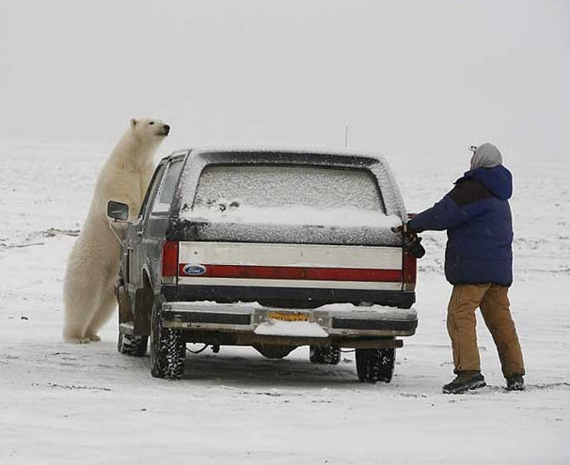
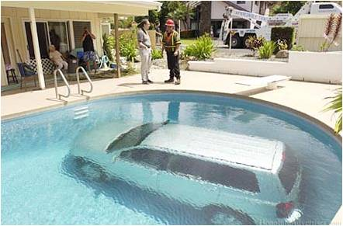
Marketing Safety
Do’s, Don’ts, and Lessons Learned

Slide 2
Topics
What exactly is “safety”?
The importance of communicating
Types of messages
Opportunities and what works
Challenges and what doesn’t work
Setting priorities

Slide 3
What exactly is “safety”?
Effectively accomplishing the mission
&
Avoiding losses that diminish readiness

Slide 4
What safety isn’t
Careless and unprofessional actions
Increased risk of avoidable mishaps
Unreliability
Cutting corners
Accepting unnecessary risk
Hoping you’ll get lucky

Slide 5
Safety messages
Risk management (on- and off-duty)
Rules and precautions (do’s and don’ts)
Mishaps and close calls
Inspection and enforcement

Slide 6
Communicating is crucial
Ignoring hazards and risks makes them seem permanent or acceptable
Preventable mishaps appear unavoidable
Junior personnel adopt bad habits as the way things are done
Not communicating sends the message that you don’t care

Slide 7
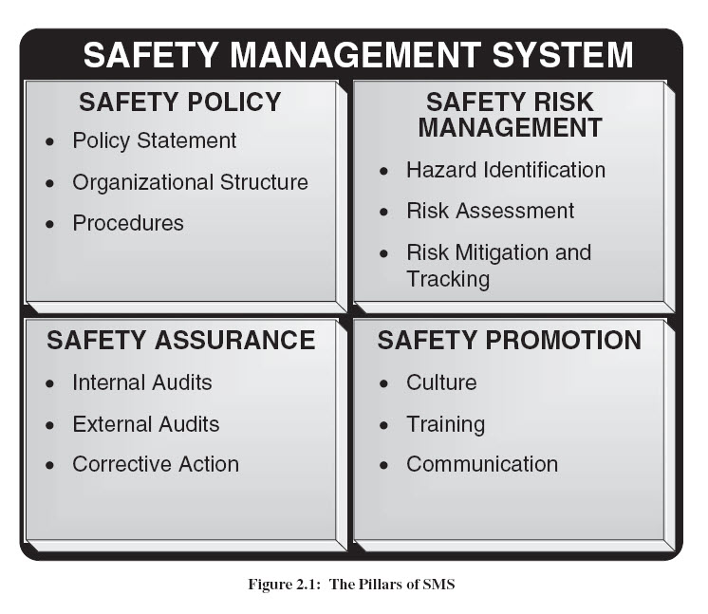
Key part of the system
Policy is useless if people don’t read it
Why identify hazards if you don’t publicize them?
Why do internal audits if you don’t share results?
Appears last on this list, but is key to many other items

Slide 8
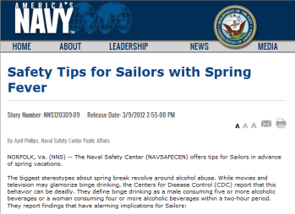
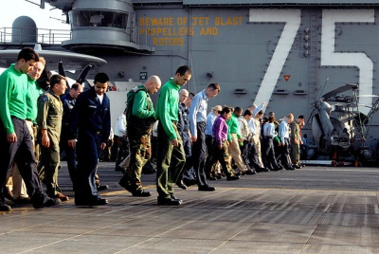
Types of messages
Print (newsletters, articles)
Email
Posters
Briefs, lectures, discussions (talking the talk)
Walking the walk

Slide 9
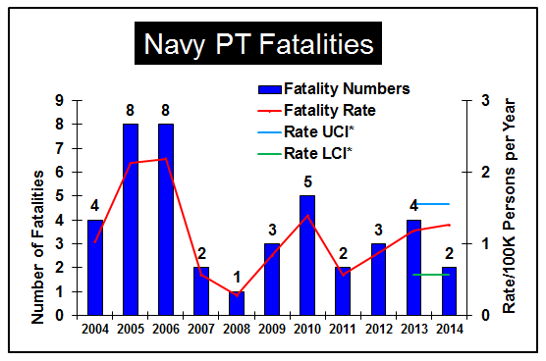
Content of communications
Mishaps, near-mishaps (and how to avoid them)
Trends, data
Hazard alerts
Rules, policy
Anecdotes
Advice
Notes:
Mishaps: Information about causes, how to prevent and other lessons learned. Complicated by delay in information about causes, especially for complex mishaps. Near-mishaps also meaningful, possibly more meaningful.
Trends: We keep track of mishap-free streaks and downward trends. However, safety “news” is usually bad because the latest fatality if always of immediate interest. For aviation Class A mishaps, we launch an investigator, brief the admiral, and recalculate the mishap rate. Data helps establish the existence of an issue. Assuming the data are accurate (problems: under-reporting, “statistically significant”)
Rules and policy: These are necessary, but they don’t necessarily reflect reality. They can, at worst, be wish lists or nice theories.
Anecdotes – Not data, but people like and respond to stories. Why reporters always find someone who is personally involved in an issue.
Advice – Telling people what they ought to do. Only becomes an issue when it is something a lot easier said than done. Which is, unfortunately, most of the time.

Slide 10
Why communicate?
Provide information
Raise awareness of the importance of an issue
Motivate audience to change behavior

Slide 11
For example
Information
The BAC for a DUI is 0.08.
I’m planning to bar-hop this weekend.
Awareness
I’m bar-hopping right now.
I’ve had 5 drinks in two hours and my BAC is in the danger zone.
Motivation: If I get a DUI, my career goes down the crapper.

Slide 12
For example
Information: Gun owners fire their weapons by mistake occasionally.
Awareness:
This pistol in my hand was loaded recently.
“Thinking” it’s unloaded isn’t good enough.
Motivation: Firing it by mistake can be painful and expensive.

Slide 13
Typical products: Pros
Print-media articles – Large potential audience, informative
Status reports, “how’s it going” – Awareness, accomplishments
Bulletin boards, banners, billboards – Quick, easy, fast, flexible
Posters – Attention-getting
Warning signs, placards – Important, precise
Notes:
Status reports – Can highlight achievements and problem areas
Articles – Can theoretically include elements of all of the above, be informative, alter behaviors, increase awareness
Bulletin boards, banners, billboards – Useful collection of interesting items, easy way to spread news and information. Banners, like posters, can be attention-getting
Posters – Quick, attention-getting, can have impact
Warning signs, placards – Extremely important, actionable

Slide 14
What works
Direct, specific information that applies to audience needs/concerns
Facts and realism
Humor
Messages tailored to audience
Messages that stress successful completion of an activity/task

Slide 15
Five good rules
1. Have a specific purpose.
2. Have a clear target audience.
3. Get to the point.
4. Create communication products to meet a current need.
5. Use different products for different audiences.

Slide 16
Typical products: Cons
Print media articles – Dull, not actionable
Status reports – Misleading
Bulletin boards, banners, billboards – Cluttered, distracting, overly simple
Posters – Dumb, stale
Warning signs, placards – Hidden, defaced, ignored
Notes:
Bulletin boards – Must be updated or they become ineffective. Banners and billboards can be distracting, or may not give people something specific and tangible to do.
Posters
Status reports – Must use data accurately. One month doesn’t make a trend. Is reporting complete and accurate? Does anyone understand the concept of “statistical significance”?
Articles – Must be interesting and well-written to have a remote chance someone will read them. Newsletters are great if they actually contain news, which can sometimes be hard to come by.
– Popular, but are they clever or stupid? Example of those Simpson posters that were just dumb.

Slide 17
It’s getting easier to communicate, isn’t it?
Email
Cell phones
Texting
Wi-Fi, internet almost everywhere
Explosion of social media

Slide 18
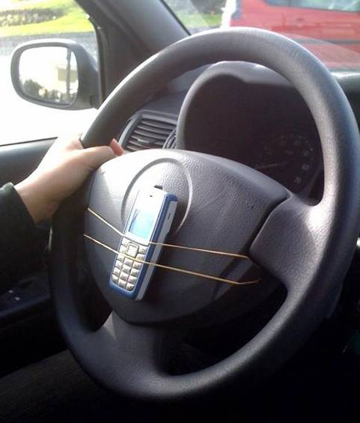
No, it isn’t
People swamped with input and messages
Overload and clutter
Email = spam
Texting = distracted driving
Notes:
People swamped with input: News, advertisements, “awareness” pieces (disease of the month, hurricane season)
Data re verbal communication: 60% is about as good as it gets
New York Times article (6/8/10): “our ability to focus is being undermined by bursts of information”
“In 2008, people consumed three times as much information each day as they did in 1960” [of course, that depends on what you mean by “consumed”—”glanced at”?]
Unless you're distributing information about a hot issue, a crisis, or issuing a work-related task, most of your audience will be indifferent or only mildly interested in what you're trying to tell them.
Some research shows that we are subjected to more than 1,500 competing messages every day.

Slide 19
Challenges
Clarity always hard to achieve, even verbally, face-to-face
Loss of person-to-person skills
Less time spent reading
Easy to opt out of what you don’t want

Slide 20
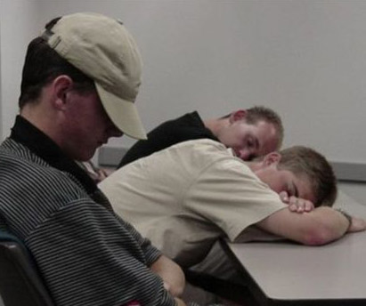
Why safety is a tough sell
Audience has heard some messages 100 times
Precautions make jobs harder, not easier
Buzzkill for off-duty recreation
Turns into lecture or harangue
Puts you to sleep
Doesn’t apply
Obviously lip service

Slide 21
Messages that don’t work
Contain platitudes
Are boring or depressing
Wordy
Lack focus
Fail to make it clear what the reader or listener should do

Slide 22
Five bad habits
1. Imagining you have a captive audience.
2. Assuming everyone else cares about what you care about.
3. Offering unrealistic advice.
4. Not treating communication as a process.
5. Failing to “sell” the issue or document the risk.

Slide 23
High-risk areas and trends
PMV, especially motorcycles (56% of all mishap fatalities in FY13)
Off-duty/rec – produces significant # of injuries
Human error – factor in vast majority of mishaps

Slide 24
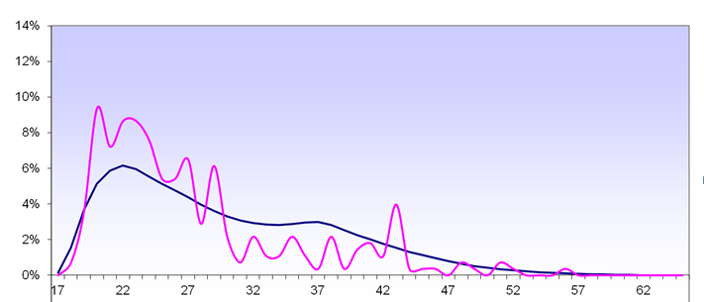
Age-related danger zone
Percentage of PMV/ROD mishaps involving each age
Percentage of Navy population of each age
Percentage of fatal mishaps
Age of mishap victims
For example: 20-year-olds = 5% of population, 10% of mishaps
Data based on 5-year averages
Notes:
Where do we focus?
This chart shows combined PMV-2, PMV-4, and Recreation/Off-Duty (ROD)
Sailors aged 30 and below died at a higher rate than Sailors over 30 in motorcycle mishaps during the last 5 fiscal years.
Sailors aged 25 and below died at a higher rate than Sailors over 25 in 4-wheel mishaps during the last 5 fiscal years.
In general, Sailors aged 29 and below died at a higher rate than Sailors over 29 in RODS mishaps during the last 5 fiscal years.

Slide 25
Resources on NSC web site
At www.public.navy.mil/comnavsafecen:
“Safe Tips” on numerous topics
Presentations, posters, videos
Humor (Photo of the Week, Friday Funnies, presentations)
Data and statistical studies
Information about safety surveys and climate assessments
Notes:
Our website is a treasure trove of materials you can use in your communications efforts. Steal them! That’s what they’re there for.

Slide 26
Contact us
Call: 757-444-3520 (Public Affairs Officer’s extension is 7312)
Email: safe-mediafdbk@navy.mil
Feedback links on our main web page
Staff directory at www.public.navy.mil/comnavsafecen/Documents/staff/Website_Directory.doc

