Slide 1
water sports and activities
Naval Safety Center

Slide 2
Water mishap statistics
Only Two mishap reports involved a shark attack
Of the 78 mishaps reported, none of them involved alcohol
5 fatalities were reported over the past 3 years
The top five most reported mishaps involved the following activities:
1. Swimming 2. Boating 3. Surfing 4. Jet skiing 5. Snorkeling
Mishap statistics are generated from submitted reports to the Naval Safety Center

Slide 3
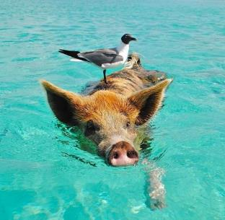
Swimming basics
Recognize your limitations
Swim in safe areas
Learn how to handle common water hazards
When required, wear a life jacket
Learn how to swim, float, or tread water
Take a course to learn CPR
Do not participate in water activities while using alcohol or drugs
According to the CDC, the main factors associated with drowning are:
Lack of swimming ability
Lack of barriers
Lack of supervision
Location
Failure to wear life preservers
Alcohol use
Seizure disorders

Slide 4
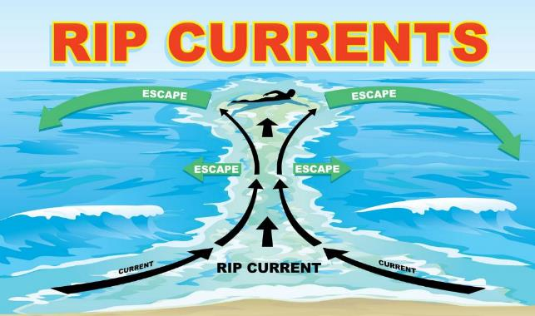
Tips to get out of a rip current
Remain calm to conserve energy and think clearly
Never fight against the current
Think of it like a treadmill that cannot be turned off, which you need to step to the side of
Swim out of the current in a direction following the shoreline. When out of the current, swim at an angle--away from the current--towards shore
If you are unable to swim out of the rip current, float or calmly tread water. When out of the current, swim towards shore
If you are still unable to reach shore, draw attention to yourself by waving your arm and yelling for help
Rip currents are powerful, channeled currents of water flowing away from shore. They typically extend from the shoreline, through the surf zone, and past the line of breaking waves. Rip currents can occur at any beach with breaking waves.
Check for current rip current conditions at the National Weather Service website, or local weather forecast report

Slide 5
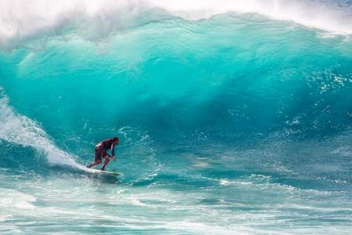
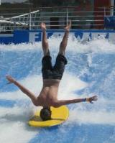
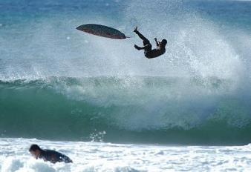
Surfing safety
Plan for A GOOD TIME…
Surfing is inherently dangerous. The very nature of surfing involves its fair share of wipe-outs!
Take lessons before attempting on your own
Never surf alone
Avoid surfing in adverse weather conditions
Ensure your leg rope is attached to your ankle and board
Check to make sure your fins are properly secured
Observe water conditions before entering to ensure it is safe
Maintain a high level of situational awareness because waves are relentless
Pick a point along the beach to line up with and stay in that general area
Always hold on to your board, to prevent it from become a projectile object hurting you or someone else
…BUT PREPARE FOR ANYTHING TO HAPPEN

Slide 6
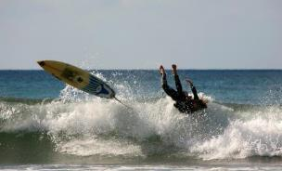
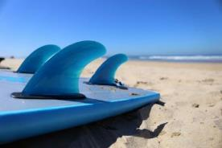
Surfing mishaps
A variety of mishaps were reported for injuries ranging from shark bites, and other run-ins with sea creatures, to severe cuts, bruises, and fractures.
The most common trend was hand and wrist injuries. Surfers hurt themselves most when trying to brace for a hard landing.
A service member wiped-out and cut their foot on the surfboard fin. The surfer checked into the emergency room where they received stitches.

Slide 7
How you think your jet ski experience is going to be…
Jet Ski safety
Jet Skis are categorized as Class A vessels by the Coast Guard. Therefore all rules and regulations for craft under 16 feet long apply.
Take an operator course before use
Obey the Rules of the Road
Everyone riding on a jet ski should wear a life preserver
Drive defensively, resist dangerous stunts or maneuvers
Key the ignition safety switch lanyard on your wrist or jacket
How it turns out when you don’t make safe decisions

Slide 8
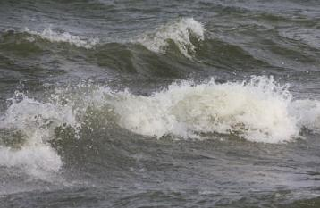
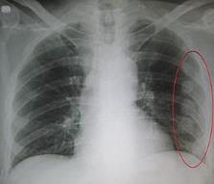
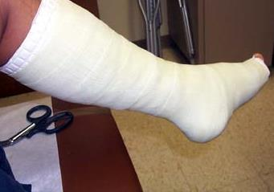
Jet ski mishaps in 2018
Service member fell off a jet ski while riding as a passenger. As a result, they broke several ribs and suffered a partial collapsed lung.
While riding on a lake, A Sailor suffered non life threatening injuries when they fell off a jet ski. The sailor drove through choppy water which caused them to lose control of the craft. Fortunately, they were wearing a live vest.
A service member suffered broken bones in their foot when they fell off of a jet ski, mid turn.

Slide 9
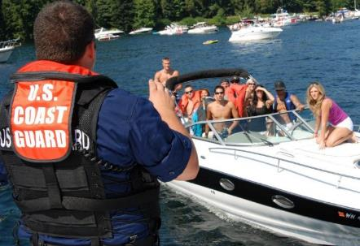
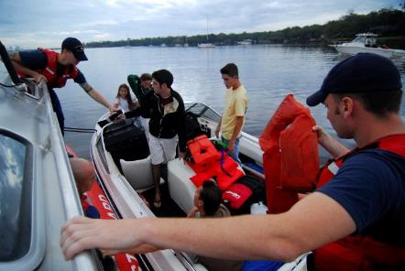
Boating Safety
Each boat operator must abide by federal and state laws governing vessel operation and safety equipment onboard
Each vessel must be registered within the state, and federally documented by the U.S. Coast Guard
As a passenger, ensure that certain safety equipment is available such as: Life preservers, visual and auditory distress signalers, fire extinguishers, proper ventilation, and navigation lights
Always follow the Rules of the Road
Know that negligent operation is punishable by law, to include: accidents, driving while intoxicated, and failure to comply with navigation rules
Ensure the boat or vessel is tidy and up-to-date on operational maintenance
Always stay alert and keep your eye on the water while on, or operating a boat
Always wear a life preserver while onboard

Slide 10
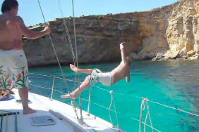
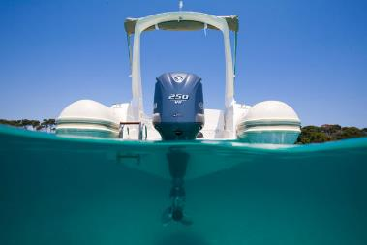
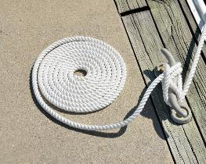
Boating Mishaps
The most common Boating mishaps include injuries sustained during slips, trips, and falls
A number of mishaps involved injuries sustained while departing a boat: either jumping off, walking off, or falling.
While assisting other boaters, a service member injured their knee while securing a line to a cleat.
A service member received stitches and tetanus shot when they slipped off of a platform and cut their arm on a boat propeller.

Slide 11
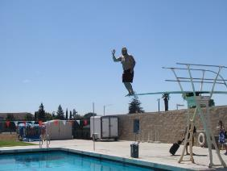
Diving and jumping
High Diving is the act of diving into water from great heights
Always jump feet first to avoid injury to head, neck, and arms
Use caution when jumping into unclear water as there could be obstructions that could cause injury
Never dive into shallow water
Jumping or diving from great heights creates a risk of injuring muscles, bones, and joints

Slide 12
Scuba diving
Take a diving course, and always refresh yourself before each dive
“Plan your dive, dive your plan”
Never dive alone, use the buddy system
Always check your gear before each dive
Always dive in your comfort zone or skill level
Holding your breath underwater can result in serious injury or even death
Take time to establish positive buoyancy first
Practice safe ascents to avoid “the bends”
Pay attention to other divers

Slide 13
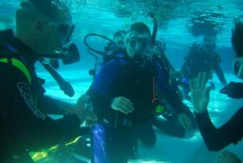
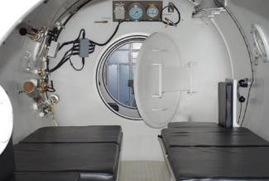
Scuba diving Mishaps
A service member suffered a laceration from a nylon rope while participating in a dive training course.
diving can be dangerous, or even deadly if you are not careful
A service member suffered delayed symptoms of decompression sickness. Several hours after a deep dive, the service member was admitted to the emergency room where dive related complications were confirmed and treated.

Slide 14
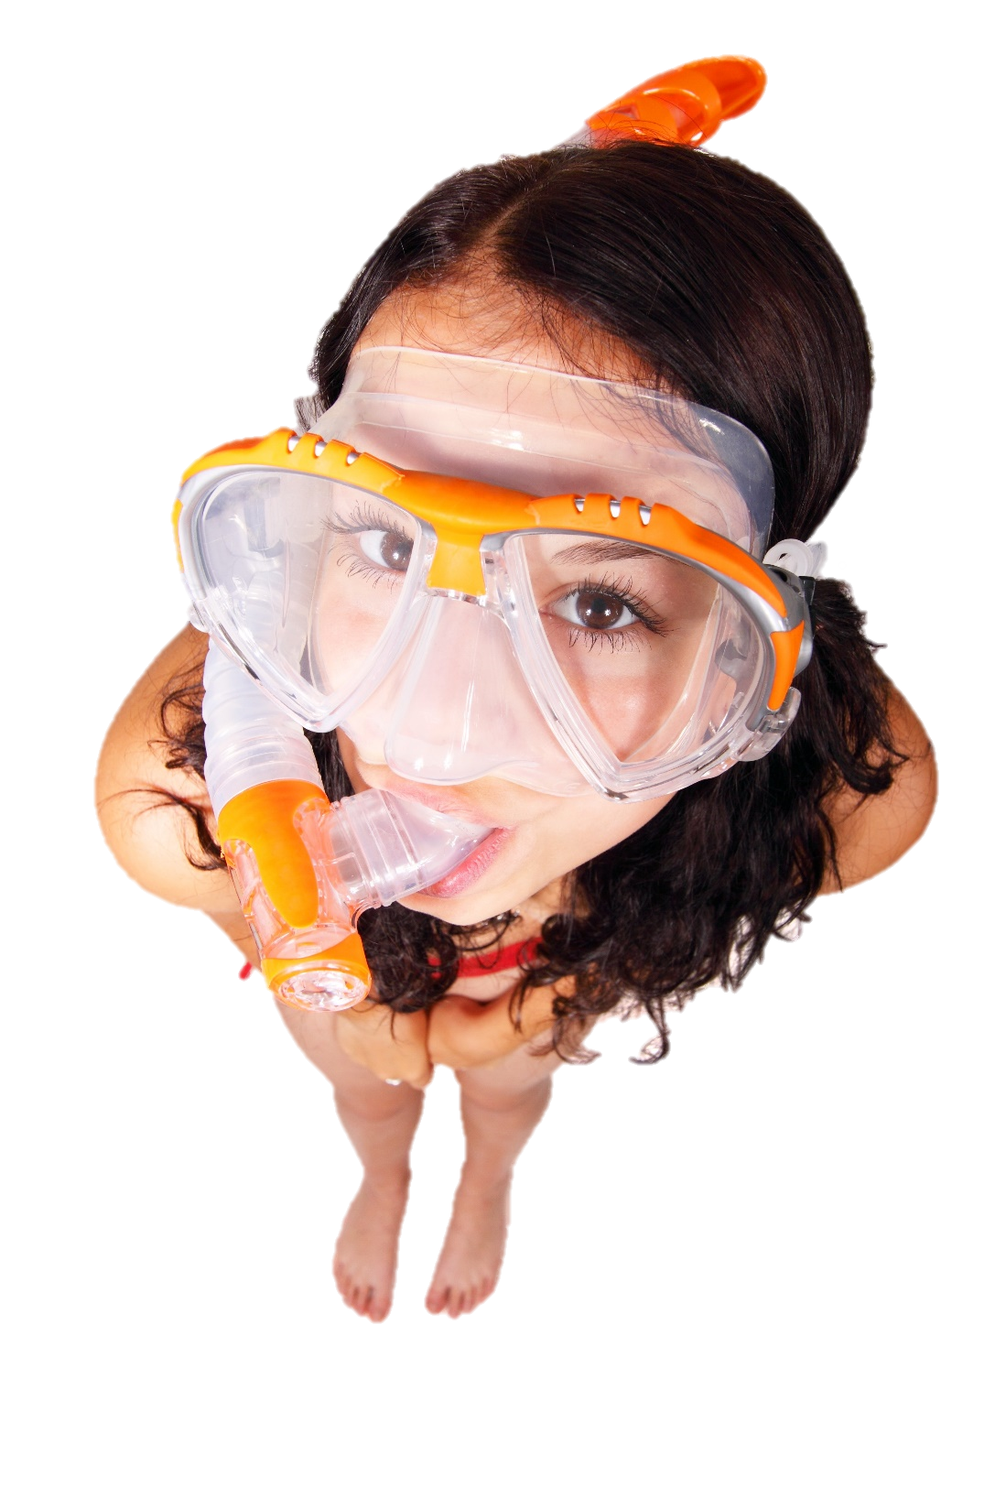
Snorkel Safety
Never snorkel alone
Know how to clear your mask and snorkel of water
Ensure your face mask and flippers are properly fitted
Stay fit, snorkeling requires the ability to swim and float. Stamina and endurance is a main component to a positive experience
Stay close to the shoreline identify entry and exit points to the water, in case you become too tired to swim back
Always check the weather forecast and sea conditions before entering the surf
Remember to apply (and reapply) sun screen

Slide 15
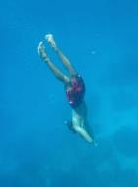
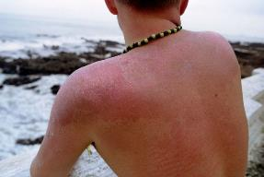
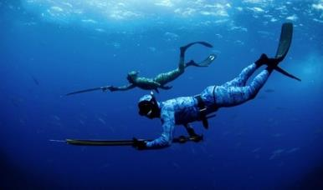
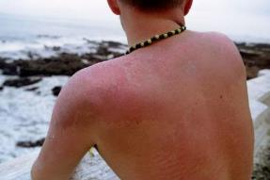
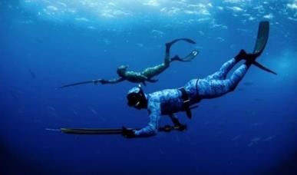
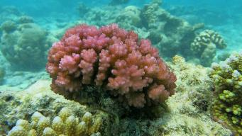
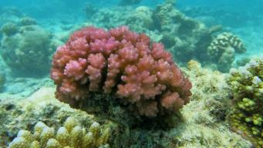
Snorkeling mishaps in 2018
Service member suffered from a perforated eardrum while snorkeling at depths of 15 feet
A Sailor suffered second degree burns on their back while snorkeling. Blisters developed on their shoulders, back and neck. The Sailor had initially applied skin protectant but failed to reapply after the recommended amount of time passed.
A Sailor suffered second degree burns on their back while snorkeling. Blisters developed on their shoulders, back and neck. The Sailor had initially applied skin protectant but failed to reapply after the recommended amount of time passed.
Service member went on a snorkeling spearfishing adventure and was struck in the head by a spear thrown by another snorkeler. The Service member was then transported to the hospital where surgery was performed to remove the lodge spear.
Service member went on a snorkeling spearfishing adventure and was struck in the head by a spear thrown by another snorkeler. The service member was then transported to the hospital where surgery was performed to remove the lodged spear.
A service member cut their foot on a cluster of coral while snorkeling
A service member cut their foot on a cluster of coral while snorkeling

Slide 16
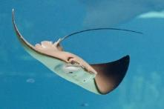
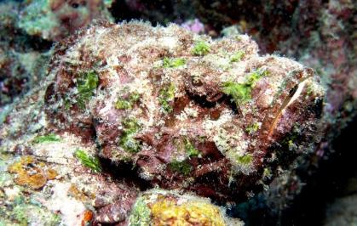
Toxic threats
Certain Sea life can create risk of infectious wounds:
Sea Urchin
Sting Ray
Jelly fish
Stone Fish
Keep in mind that you will be swimming with live animals who have evolved with survivalist defense mechanisms
A jelly fish sting may only burn for a while, but stepping on a sea urchin can lead to infections if the barbs stay embedded in your skin
To avoid injury, practice: look but don’t touch
Do some research and find out what threating sea life exist in your region
Stay close to the shore line, for a quick exit
Never swim alone
In the summer of 2018, a service member was snorkeling. While underwater, they reached for what they though was a stone, however quickly realized that the stone was actually a venomous fish. The service member was quickly rushed to the ER and dosed with anti-venom serum. Fortunately they were released after an overnight stay at the hospital.

Slide 17
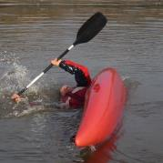
Paddle sports
Have a picturesque moment…
Whether it’s kayaking, rafting, canoeing, or paddle-boarding, each paddle sport carries its own risk
Paddle in groups or with a buddy
Train, prepare and use caution on the water
Natural bodies of water are unpredictable and vary in level of risk depending on the weather
Recognize natural obstacles and learn how to navigate them
Always wear a life preserver
Use a paddle or an oar that is sized specifically for you
Dress in breathable layers and wear shoes
…not a MEME

Slide 18
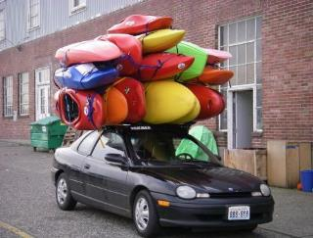
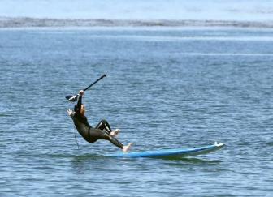
Paddle sport mishaps
Service member was struck in the head by paddle from another kayaker.
Service member hurt their hand while loading kayaks onto a travel holder. The kayak crushed their hand, breaking several bones.
A paddle boarder fell off their board and cut their foot on a chunk of coral.

Slide 19
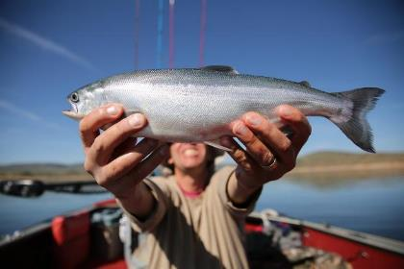
fishing
Make certain you have the correct fishing license
Only fish in safe or designated areas
Obey catch-and-release rules
Check what is in season
Practice situational awareness
Don’t put your hand or fingers inside a fish’s mouth to retrieve hook
Learn fishing first aid, such as removing a hook from your skin
There are so many ways to fish!
Spear fishing
Deep sea
From a kayak, canoe, or boat
Fly fishing
Ice fishing
Off a bridge or pier
On the beach
From a river bank
Fresh water, brackish water or sea
Crabbing
Noodling

Slide 20
Pool, water park, and fountain Safety
Learn how to swim before participating
Know CPR, and signs for a person drowning
Always walk, never run
Familiarize yourself with how deep the water is as well as when and where the depth changes
Identify where life saving equipment is around the attraction: a pole, rope, or life rings
Ensure all coverings are removed before swimming in a pool or fountain
Never swim alone or without someone else knowing
Read the instructions on the posted signs at pools and waterparks
Stay hydrated with regular drinking water

Slide 21
Recreational Water Illness
Norovirus
RWI’s are most commonly acquired from water based activities involving pools, water parks, interactive fountains, lakes rivers, and oceans
Naegleria Foweri ameba
Common RWI infections include:
Diarrhea
Rash
Ear Infection
Respiratory infection
Chemical irritation of the eyes and lungs
chryptosporidium
e. Coli
Rare cases of a brain tissue eating amoeba called “naegleria foweri” can be found in fresh water bodies. The amoeba enters the body through the nose. You cannot get infected from drinking contaminated water.
“Chrypto” can stay alive for days in a chlorine environment and has become the leading cause for pool-related outbreaks (according to the Center for Disease Control)
Diarrhea is the most common symptom of a RWI, which is caused from germs such as:
Norovirus
Giardia
Shigella
E-coli
Chryptosporidium

Slide 22
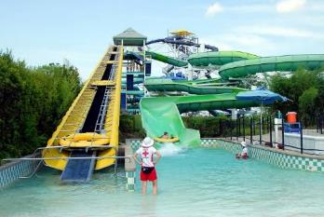
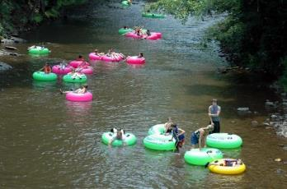
Recreational Water Illness
Avoid contracting an RWI:
Check the pool, fountain, or activity area for current inspection results
Ensure the drain is visible from the surface and clear of debris
Check waters pH levels with pool test strips
Natural bodies of water are susceptible to water pollution
Check bacterial levels of the water (ocean or freshwater body) before getting in, levels can be found on the EPA website and local news sources
All Water play areas or interactive fountains such as wet deck, splash pad, pray pad, or spray par— recycle their water through a filtration system, the water spray that drips off your body ends up being sprayed out again
Stay out of the water if you have recently been sick or have open wounds
Rinse off before entering the water
Do not go to the bathroom yourself in the water
Do not swallow the water
Rinse and/or wash yourself after exiting the water
Dry your ears after swimming

Slide 23
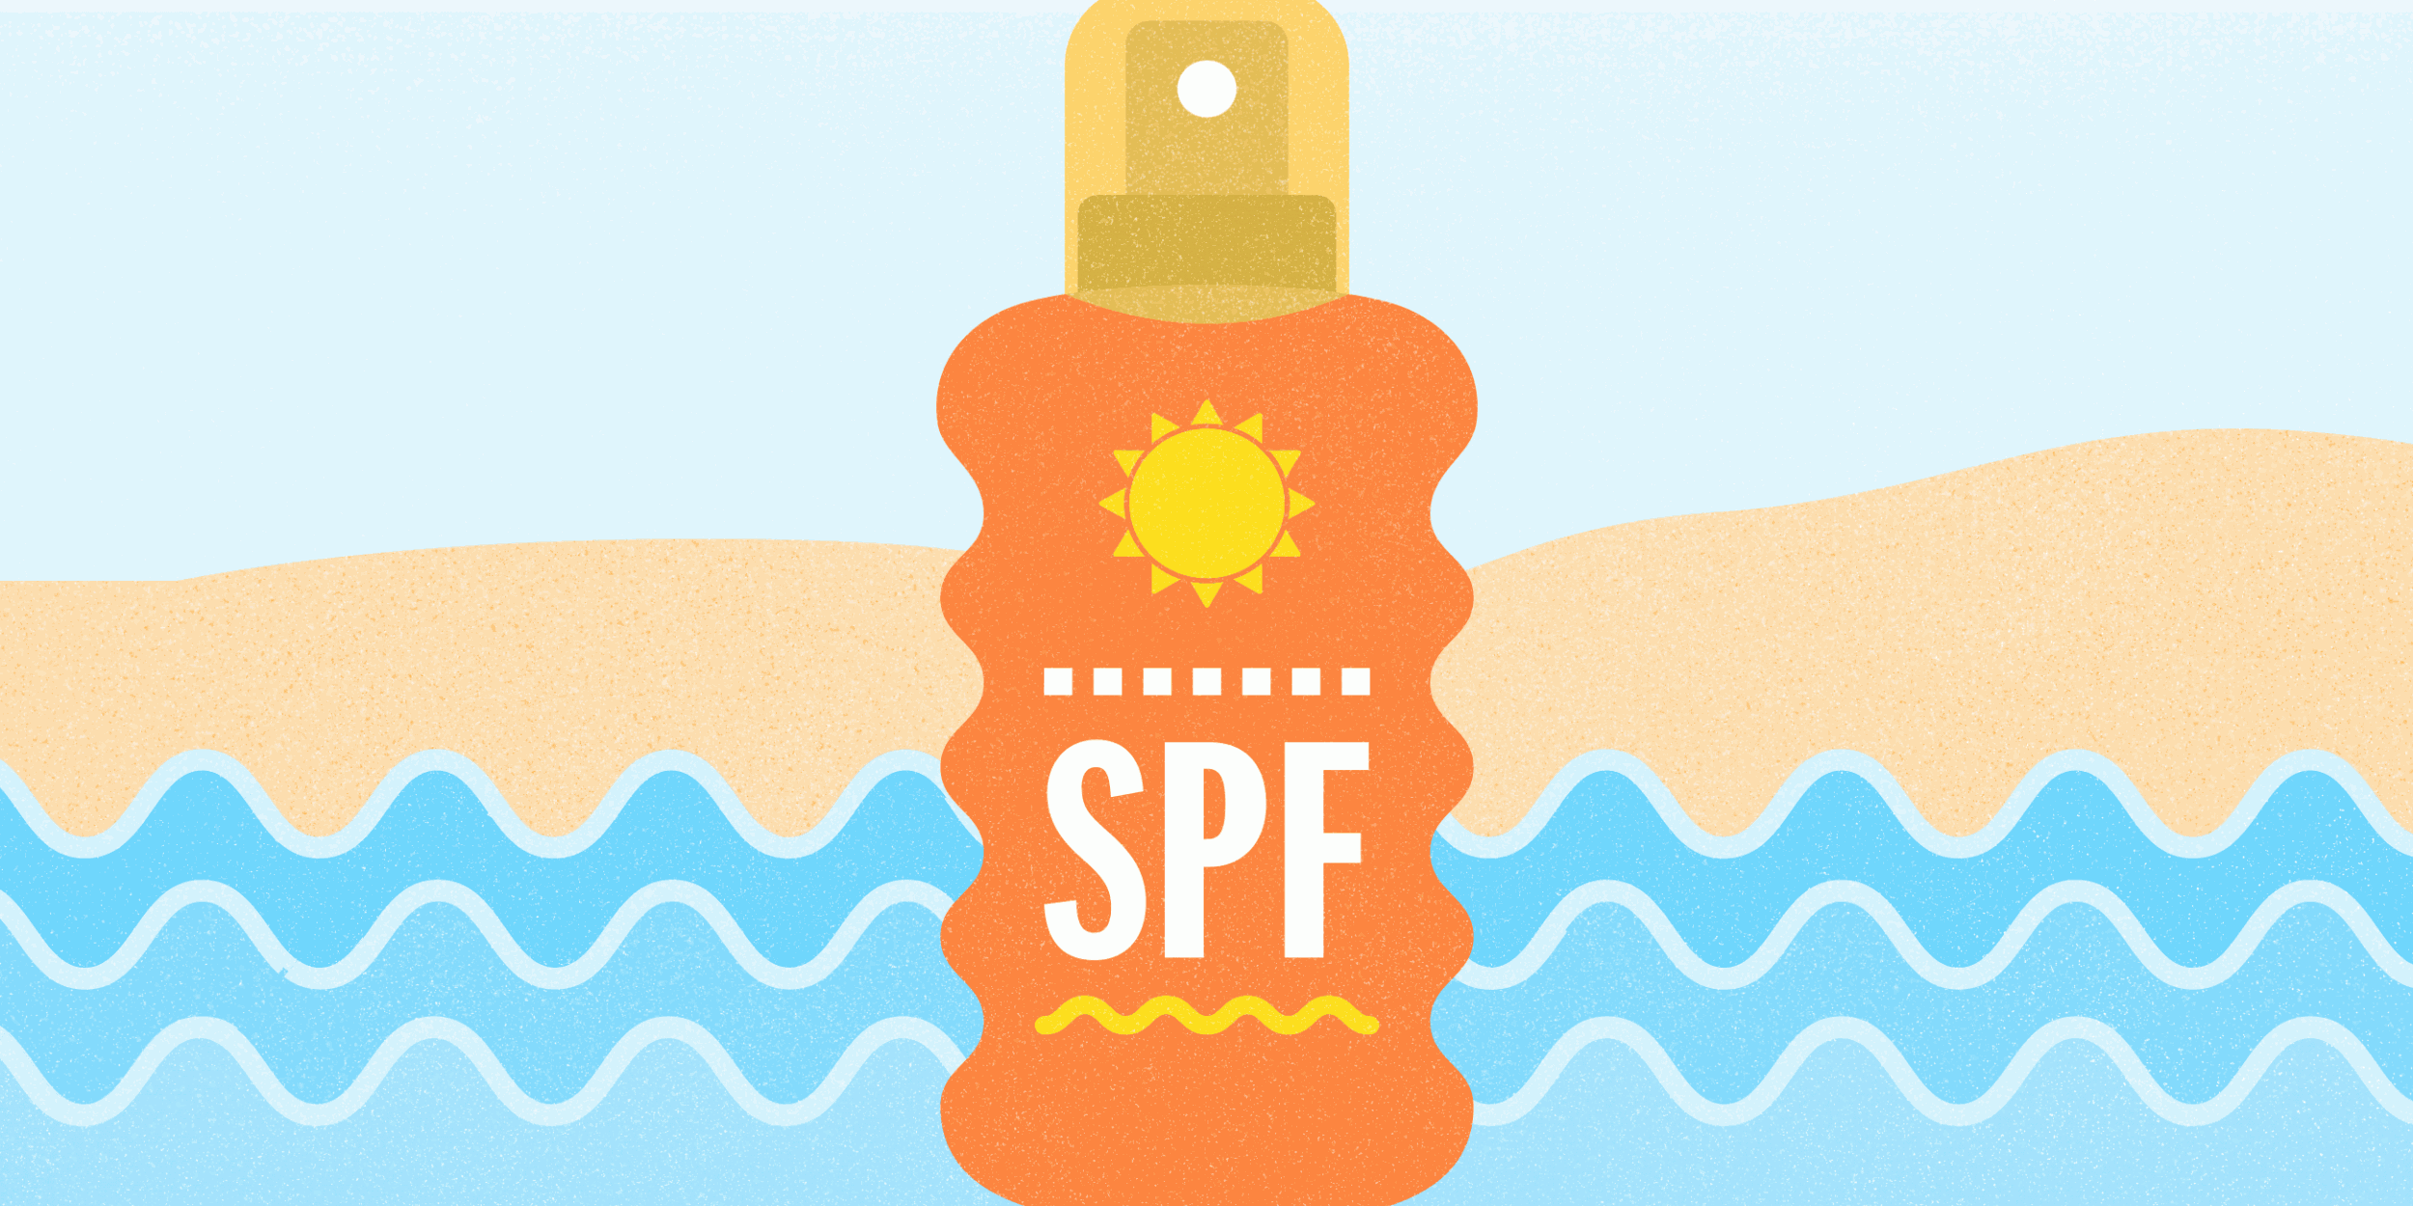
use these methods to Avoid damaging ultraviolet rays:
Skin Protection
Stay in the shade
Wear long sleeves or pants; rash guards are useful for water activities
Wear a hat to protect your head, neck, ears, and face
Wear sunglasses to protect your eyes, as well as areas around your eyes
Lather on broad spectrum sun screen with a minimum SPF of 15
Always reapply sun screen

Slide 24
For more information on safety follow us or find us at:
Twitter: @NSC_Updates
https://www.facebook.com/NavalSafetyCenter
https://www.safetycenter.navy.mil/

