Slide 1
Motorcycle Group Ride 101
NAVAL SAFETY COMMAND

Slide 2
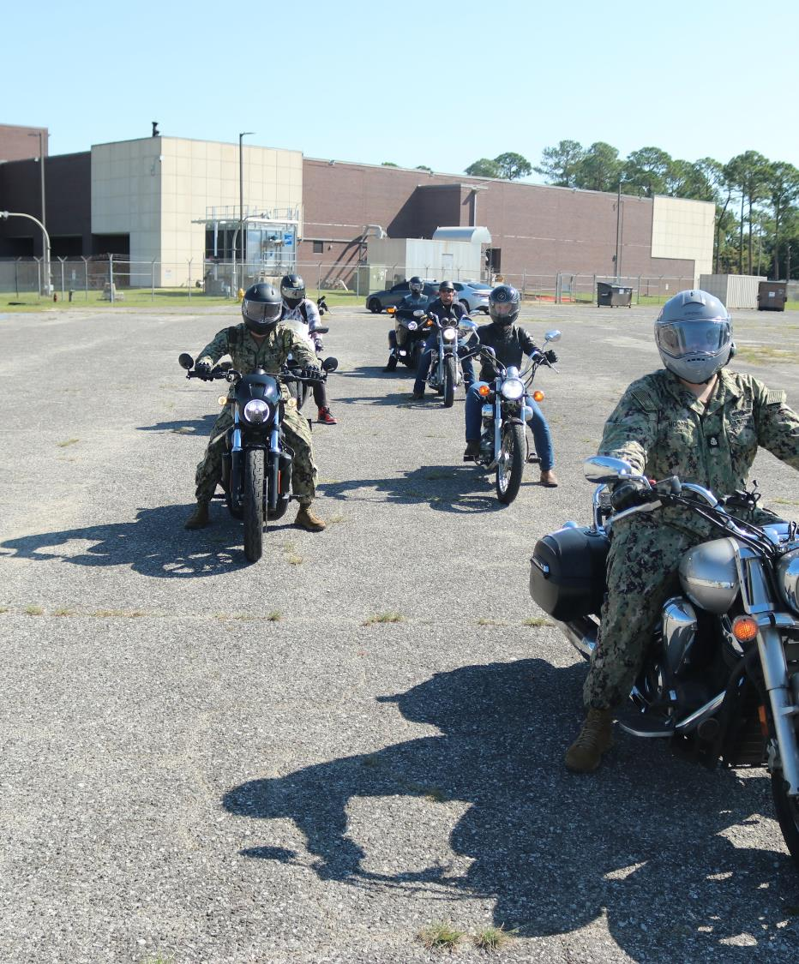
Enforcement of Policy
Command leadership must ensure compliance with all motorcycle safety requirements including the safe planning and execution of command sponsored group rides.
Familiarize yourself with all applicable instructions
DoD Instruction 6055.04
OPNAVINST 5100.23H, CH 36
MCO 5100.29C
Receive chain of command approval and keep command duty office informed of the ride progress for official group rides.
Consider developing a Personnel Qualification Standards (PQS) for Road Captain Certification.
Identify your most at-risk Sailors and lean in.

Slide 3
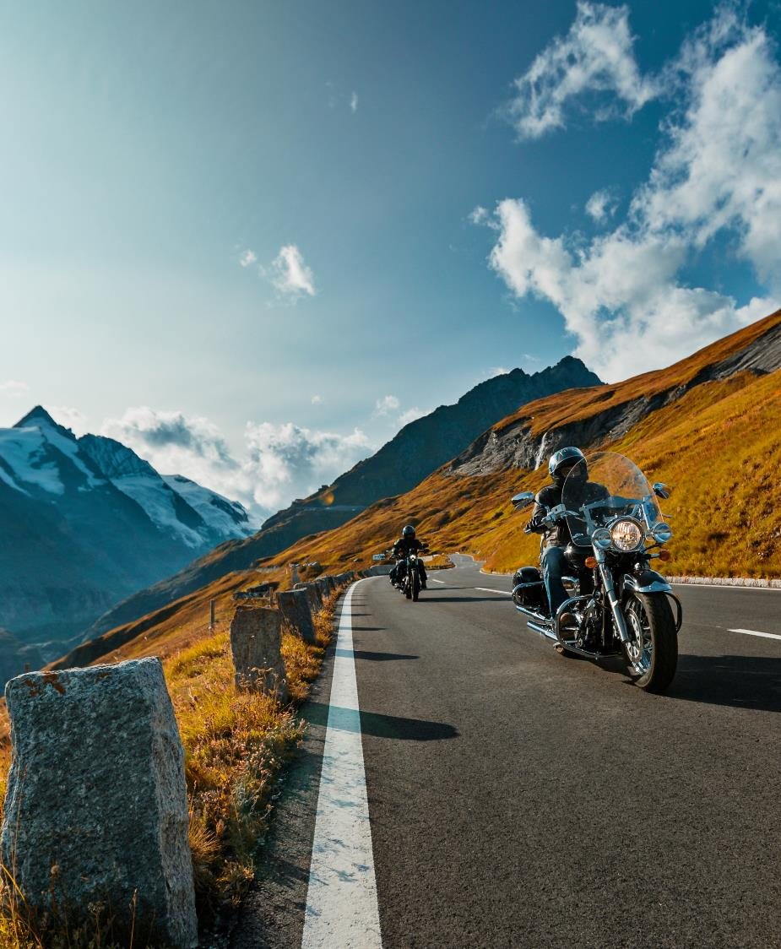
Ride Tips
Group rides are a great way to connect and enjoy the open road together, however safety must always come first.
Use the following tips when planning a group ride:
Communication is vital on and off the road.
Conduct pre and post ride briefs.
Divide large groups into packs of five or less.
Have a lead and sweep rider for every group and pack.
Stay together as much as possible.
Plan for separation at signal lights or in traffic.
Every rider should know the re-group plan.
Respect each other and participate in group decisions.
Always be aware of your surroundings and the location of your fellow riders.

Slide 4
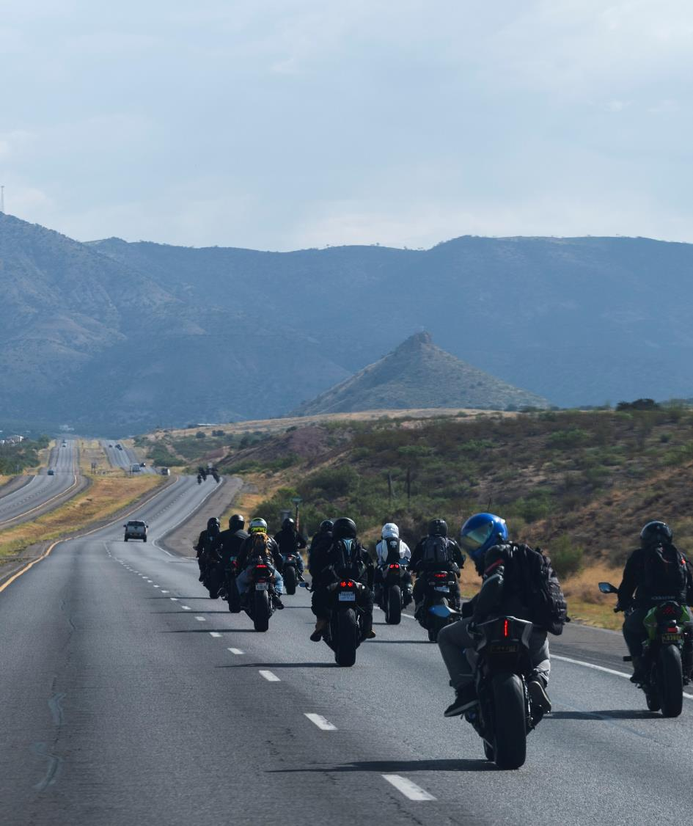
Ride Planning
You must receive command approval and provide feedback on all command rides regardless of the length.
Assign enough lead and sweep riders to accommodate the number of riders signed up for each ride.
Hold training to identify ride responsibilities, hand signals, maneuvers, group ride etiquette, etc.
Provide a contact information sheet to all participants to include rider and passenger names, cell phone numbers and emergency contact information.
Set ride speed to the slowest rider.
Plan the start of the group ride to avoid rush hour and be mindful of fatigue.

Slide 5
Ride Planning
Routes must be pre-planned and denote tolls, construction and detour options. Include planned pit-stops, overnight stays, events, shopping, gas, etc.
Provide a copy of the route to all riders.
Discuss and plan for weather, cancellation, emergencies, mishaps or mechanical failures.
Conduct bike T-CLOCS* and PPE checks prior to each group rides.
*T-CLOCS
T- Tires & wheels
C- Controls
L –Lights & electrics
O- Oil and other fluids
C- Chassis
S-Sidestand

Slide 6
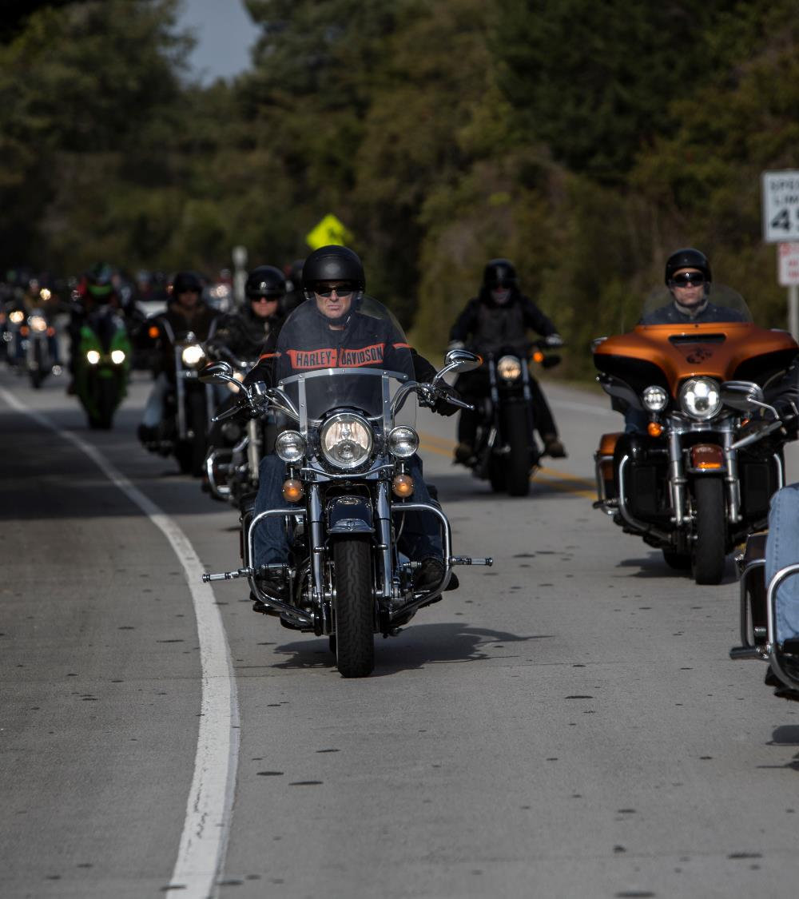
Road Captain Responsibilities
Road Captains (R-CAPS) are experienced riders who understand the dynamics of group rides and assist with leading and managing the ride.
Give riding instructions to all riders prior to the start of a ride, coach riders during the ride, and conduct post ride debriefs.
Enforce the rules of group riding.
R-CAPS do not assume responsibility for individual riders. Each rider shall assume their own risk and make their own decisions while operating their motorcycle.

Slide 7
Lead & Sweep Responsibilities
Lead (First Rider)
Be experienced
Able to make safe decisions
Sweep (Last Rider)
Be experienced
Follow the route or alternate
Follow the plan
Maintains the tone and speed
Identifies hazards, traffic, weather, etc.
Communicates changes early
Listens to team members
Maintains ride etiquette
Secures lanes for the team
Leaves formation to aid team members
Prevents drifting
Keeps lead informed

Slide 8
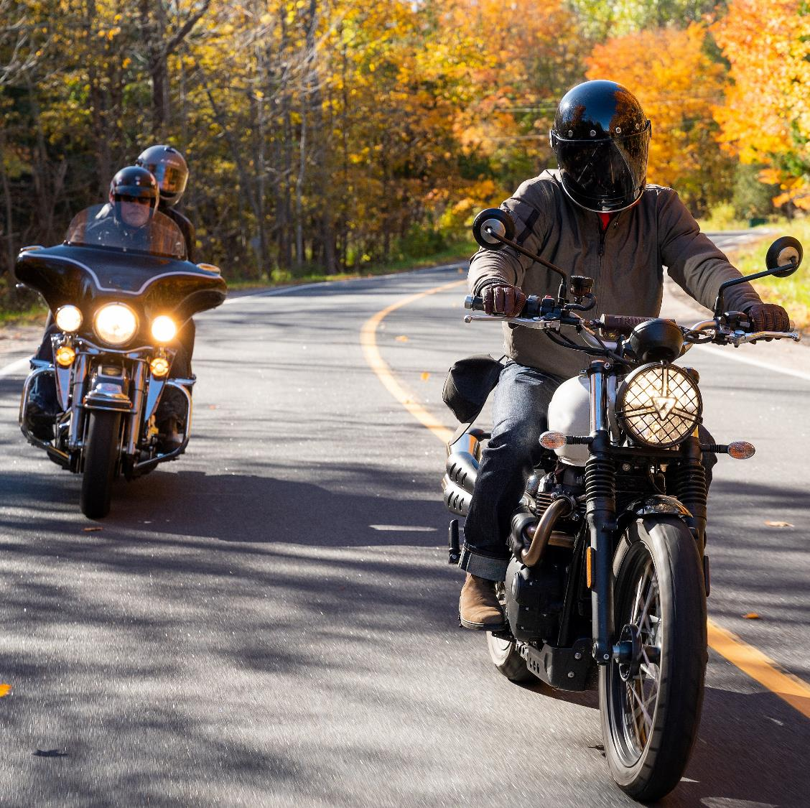
Wingman Responsibilities
Every rider should have a wing man.
Help your partner with mechanical or medical issues.
Help your partner catch up with the group.
Two riders are more visible than one. Staying in groups of two or more improves safety dramatically.
If separated, wingman can get help while partner waits in a safe location.

Slide 9
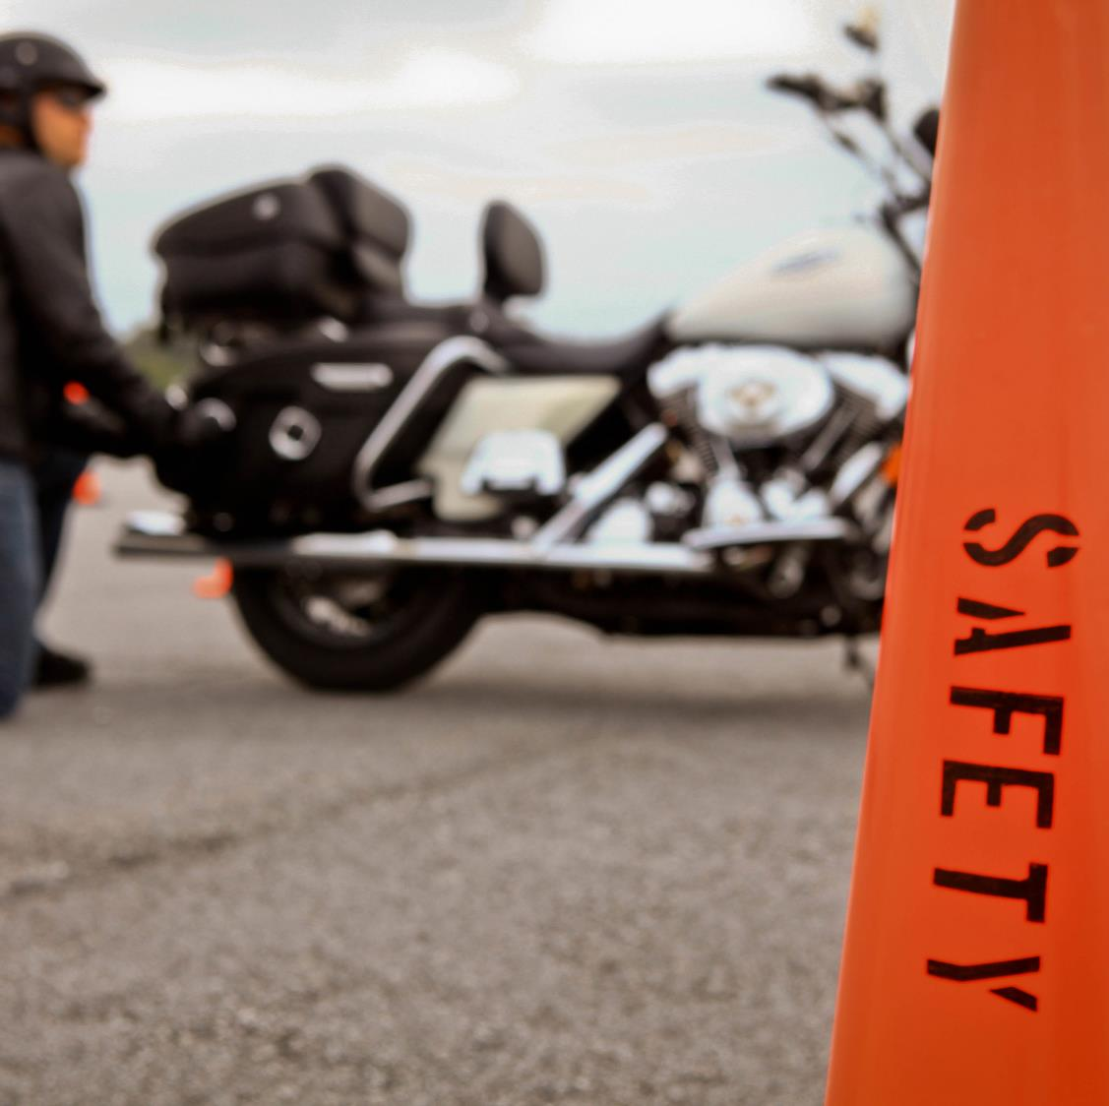
Rider Responsibilities
Be responsible for your own riding first.
Follow group etiquette.
Support your wingman.
Attend and contribute to meetings, training and inspections.
Be courteous to other vehicles on the road.
Never assume the right-of-way.
Know your escape route.
Practice safe riding techniques.

Slide 10
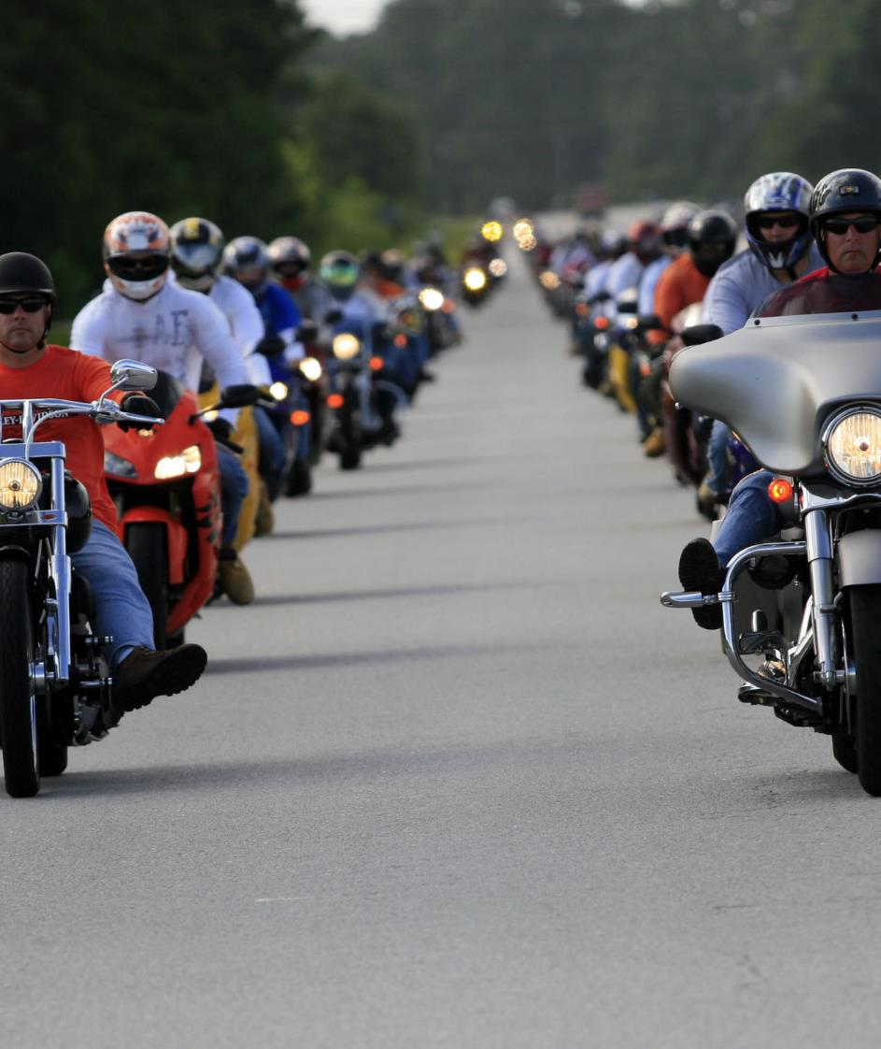
Pack Responsibilities
If packs are separated from the group by a traffic signal, or heavy traffic:
Group continues at a slower pace to allow packs to catch up or meet at the next scheduled rest.
In the event of a break down or unplanned stop:
Only the pack with the affected rider should pull over to render assistance.
If some packs need to separate, they should discuss this at a rest or stop and should always re-assemble at the end of the day.

Slide 11
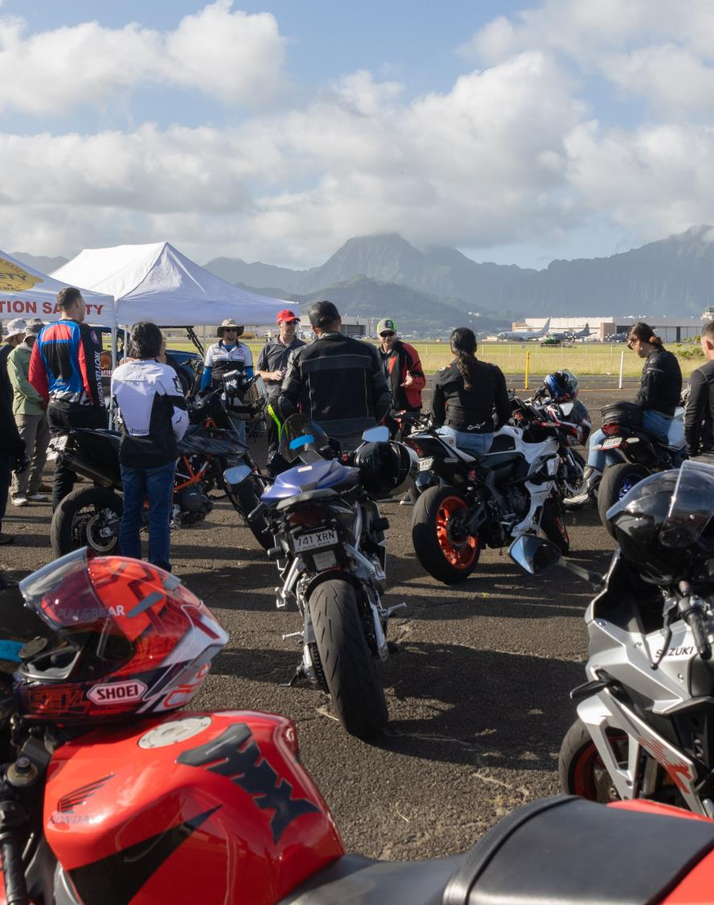
Support Vehicle Responsibilities
Some rides may require a support vehicle.
Follow a safe distance behind the sweep.
If passing the pack for any reason, use flashers and tap horn to warn riders and always pass on the left.
If stopping for a rider:
Pull behind the rider if possible.
Stop while you can still see some road between you and their rear tire.
Angle your tires to the side of the road.
Always keep flashers on.
Notify Emergency Services, road-side assistance, or the riding group as needed.

Slide 12
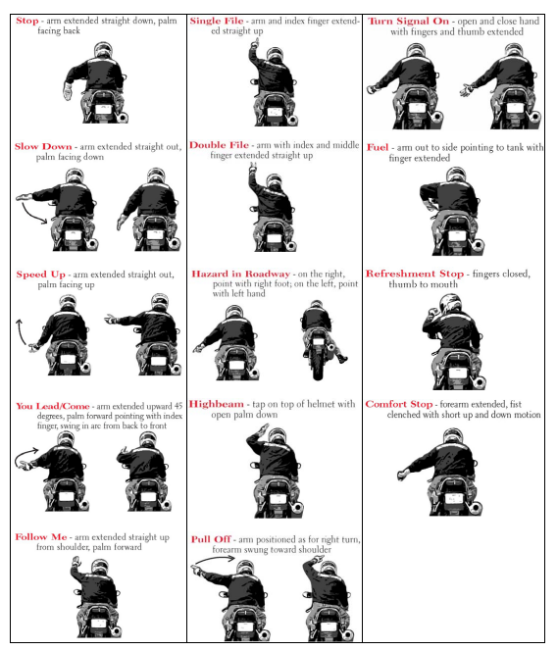
Communication
Rules
Know and use hand signals and always pass signals back.
Riders behind are responsible for staying clear of bikes in front of them.
Horn Signals
1 Short: I’m OK/YES
1 Long: Watch Out! Emergency! May pull over/swerve
2 Short: No/Can’t Comply
3 Short: Need Fuel/Stop

Slide 13
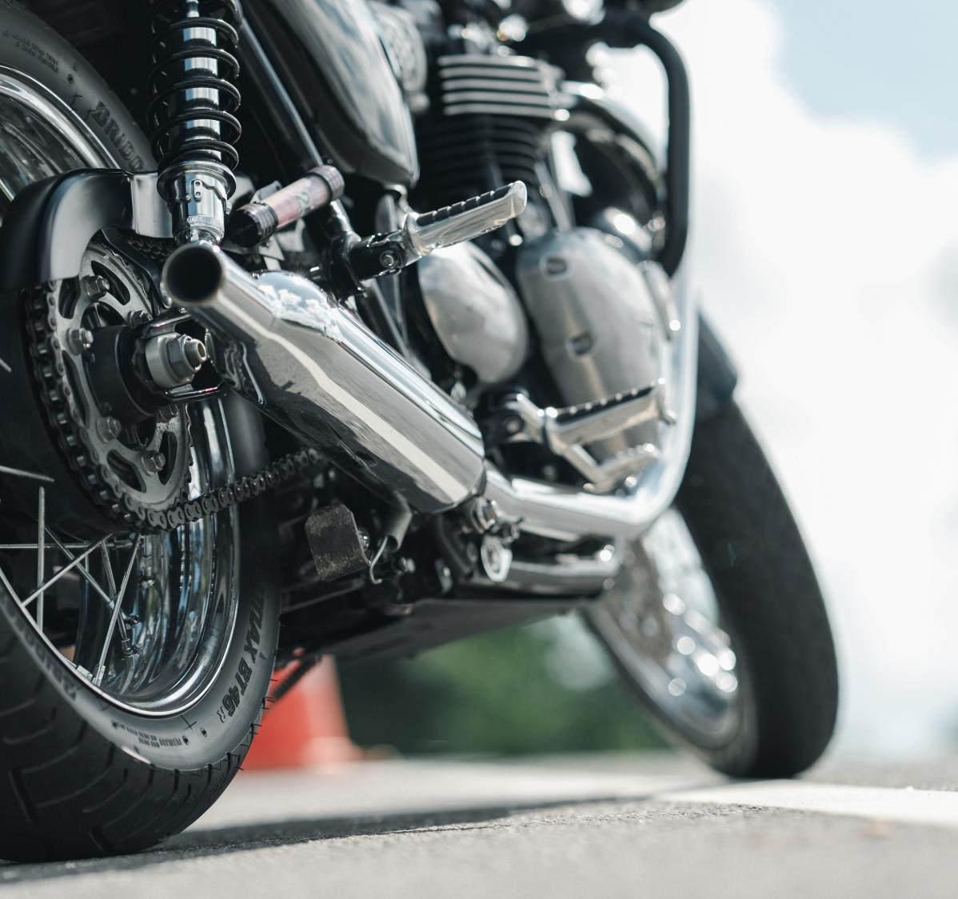
Group Ride Etiquette
Do not violate traffic lights, signs and follow the traffic laws of your state.
Group should stay to the right unless passing or allowing traffic entry from access ramps.
Allow other vehicles on the road to pass through the group (preferably between packs).
Remain in ranks unless you must pull over or pass to communicate with the Road Captain or lead rider.
Do not crowd riders near you.
Do not drift back, just to accelerate back to the group.
Do not use high beams or fog lights behind the lead riders.

Slide 14
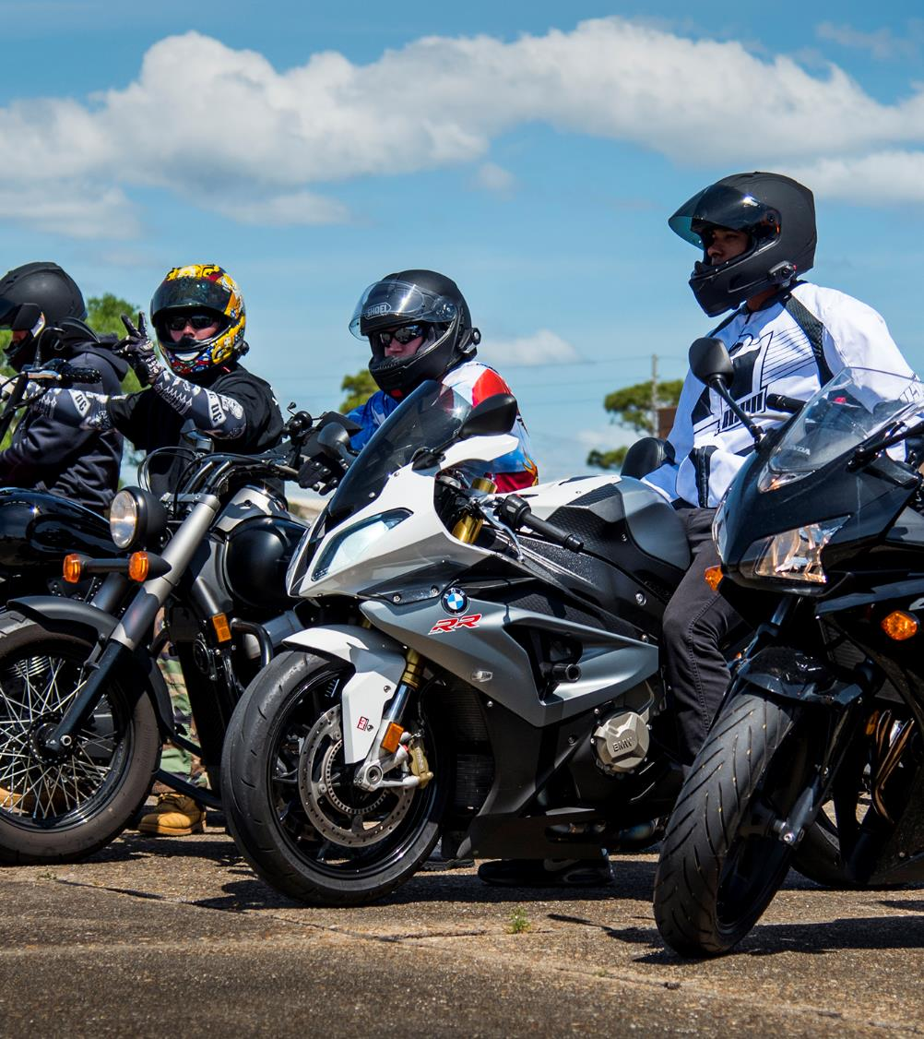
Post Ride Debrief
The post-ride debrief is just as important as the pre-ride brief and the ride itself. Ensure you share your lessons learned with command leadership.
Don’t get complacent on the return trip.
Debrief immediately following the group ride.
Discuss post-ride lessons learned.
Share post-ride lessons learned for the next ride.

Slide 15
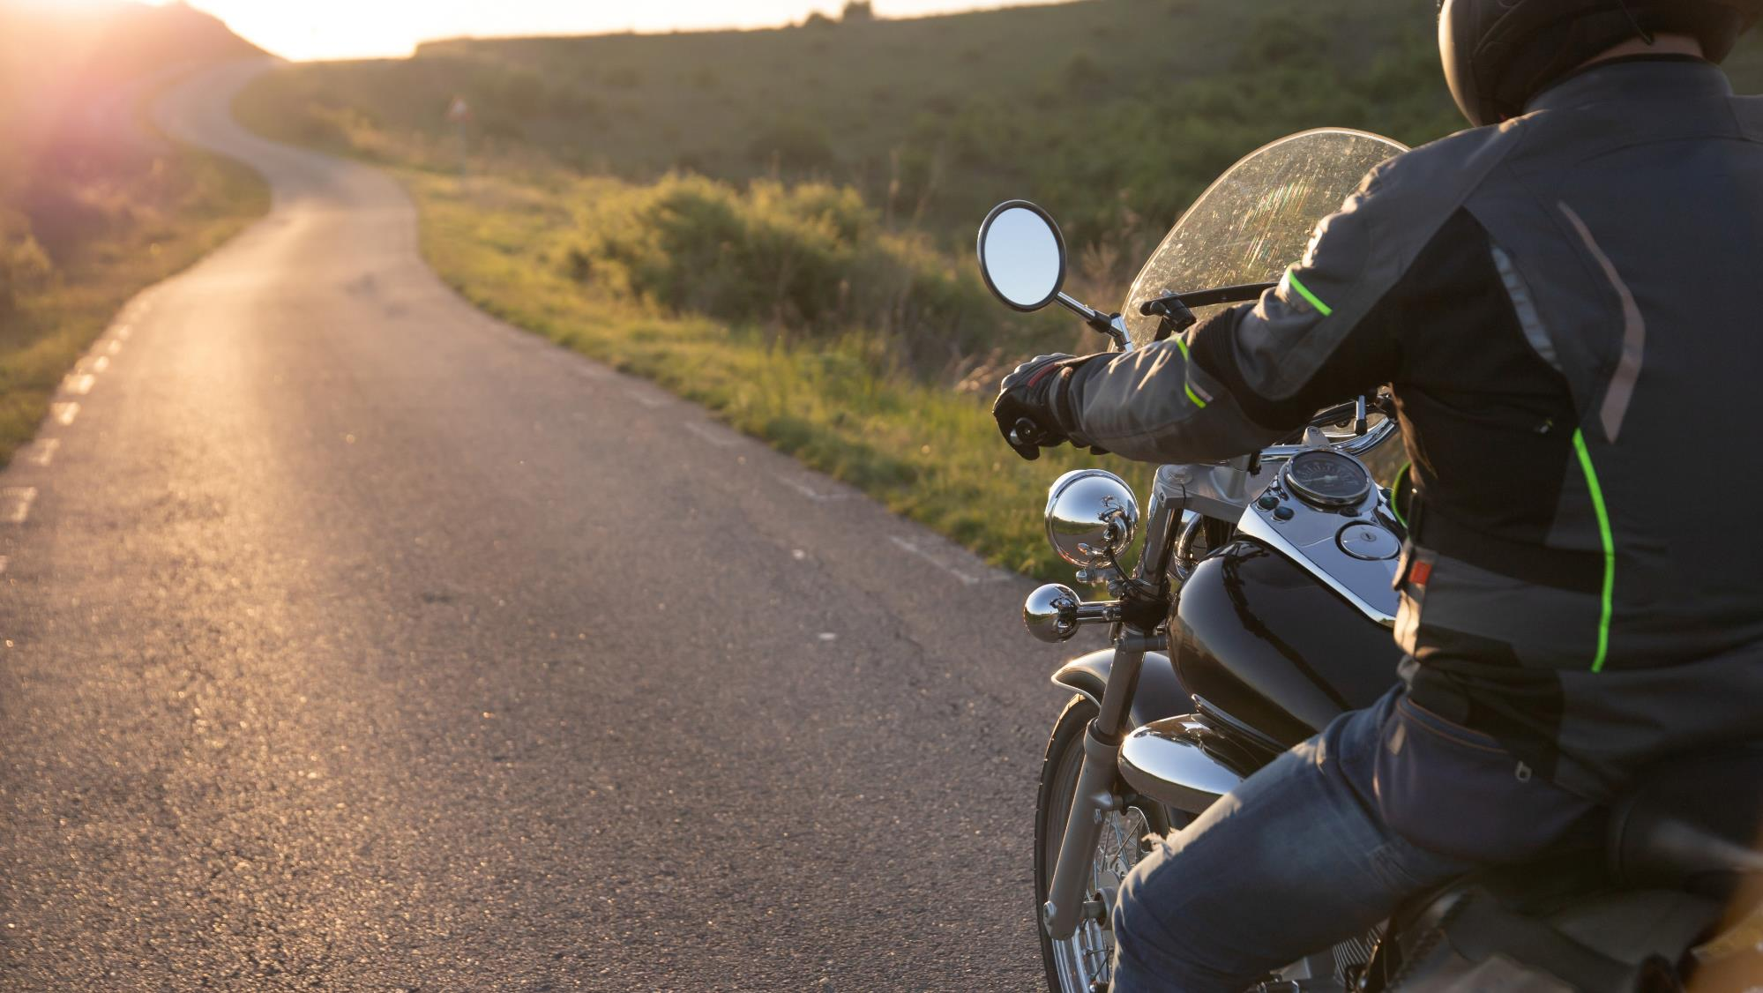
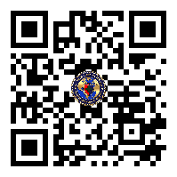
Ride Right. Stay in the Fight.

