Slide 1
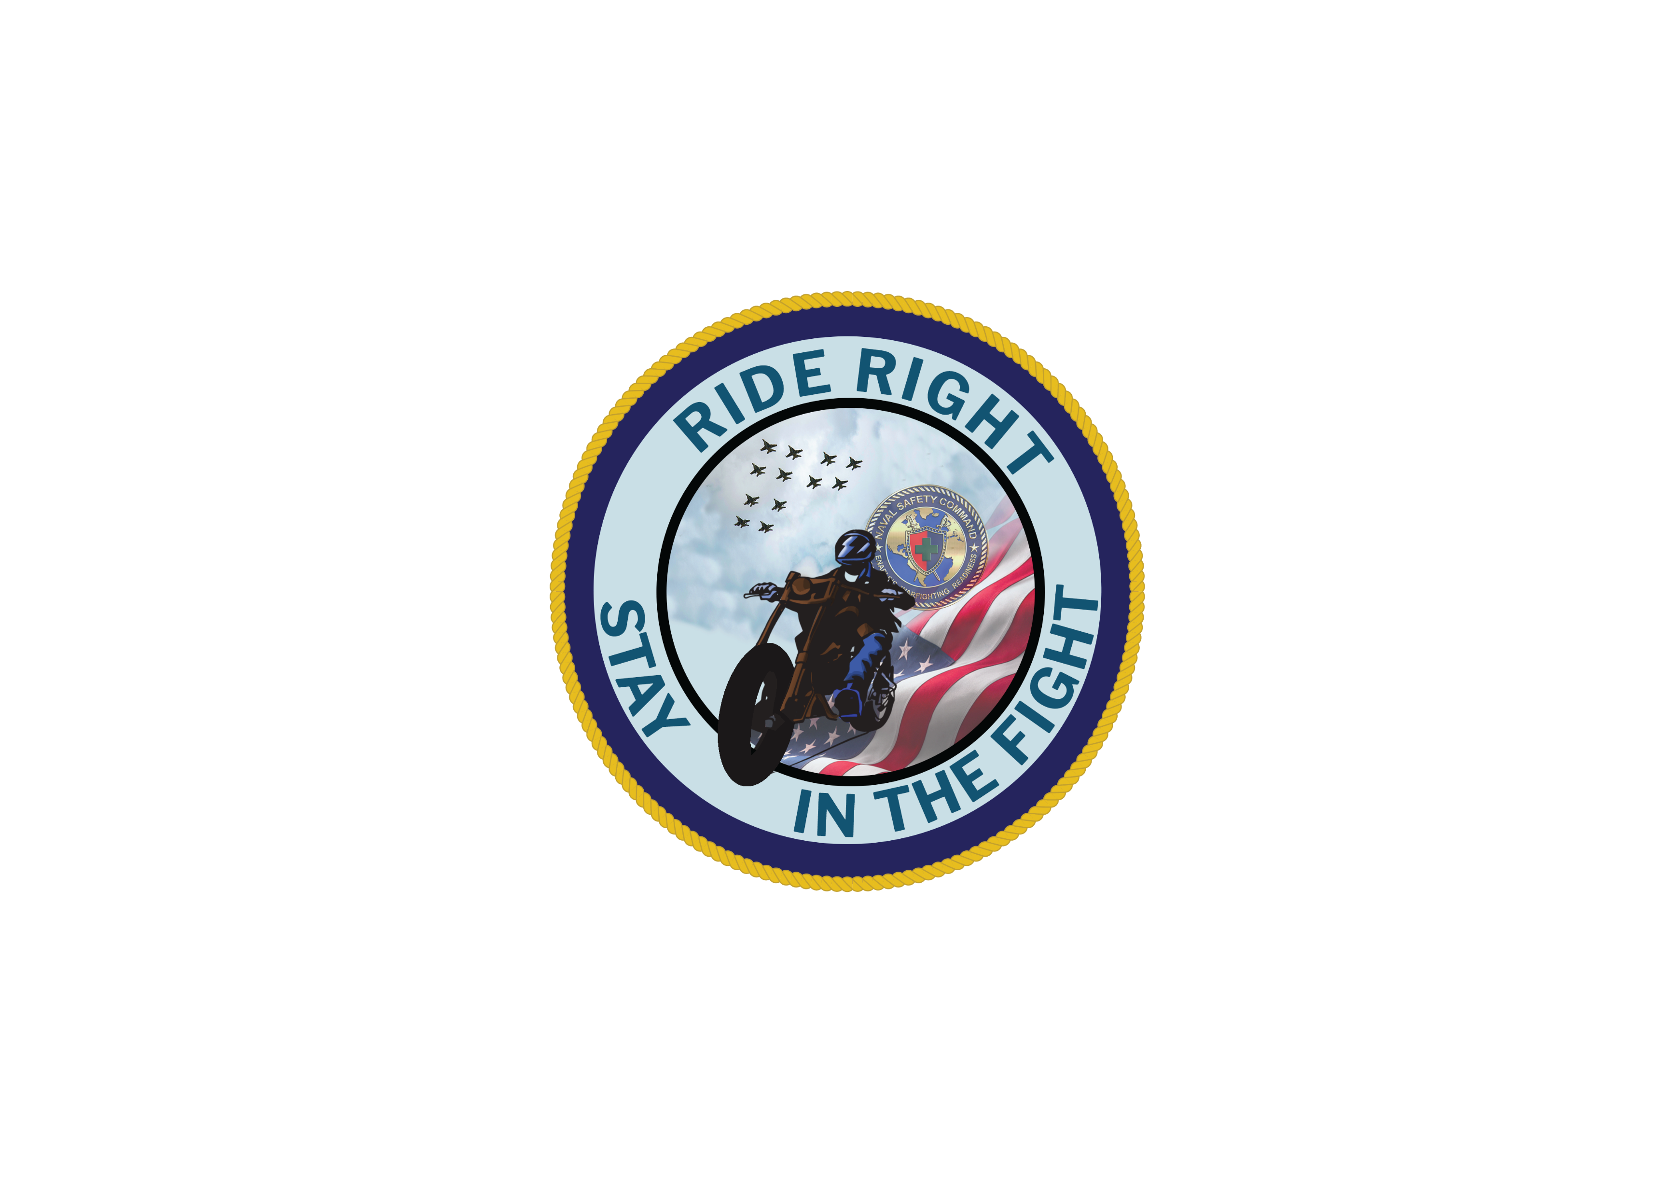
Motorcycle Safety Stand-down
NAVAL SAFETY COMMAND
Notes:
Hello, thanks for being here to discuss a top area of concern for us.
Every loss due to a motorcycle crash affects the overall health of the enterprise and negatively impacts mission readiness.
While motorcycles make up a small percentage of vehicles on the road, they account for many active-duty fatalities, the majority of which are preventable.

Slide 2
“We’re here to help the Navy and the Marine Corps get better through learning. Our objective is to keep everyone safe by having real discussions about risk assessment and management so that we can eliminate easily avoidable self-inflicted wounds that take players off the field.”
Rear Adm. Dan “Dino” Martin,
Commander, Naval Safety Command
Notes:
I'll let you read this statement here from the Commander of the Naval Safety Command, Admiral Martin. [PAUSE]
These mishaps can be easily avoided, and that's what we really want to get after.
We've got to make sure everyone is safe so we can keep you – our warfighters -- mission-capable. How can we accomplish this? By ensuring our motorcycle riders are trained to the highest standards, including how they identify and deal with risk.

Slide 3
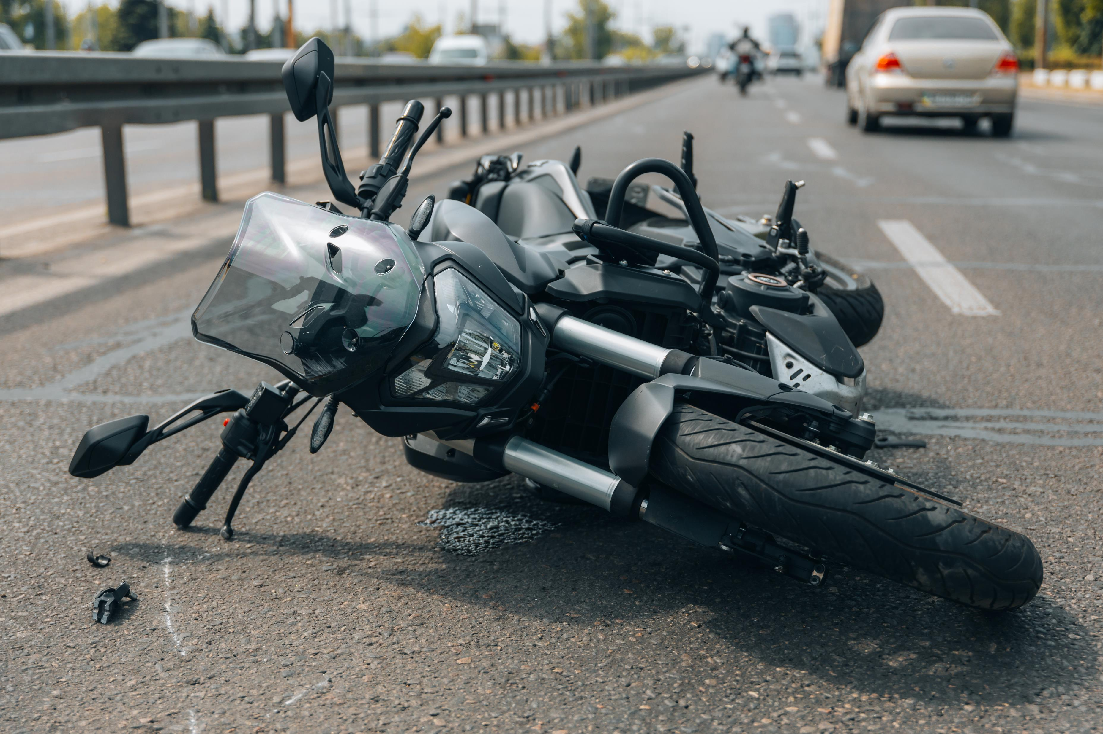
In FY 2024, the Department of the Navy lost 23 Sailors and Marines to motorcycle crashes.
Notes:
The Naval Safety Command reported in fiscal year 2024, the Navy and Marine Corps lost 23 Sailors and Marines to motorcycle crashes.
As of today, since 1 October, the naval enterprise has already lost 12 Sailors and 7 Marines to motorcycle crashes. [note to speaker: before beginning, check the motorcycle fatality tracker at the top of the Motorcycle Safety page (https://navalsafetycommand.navy.mil/Off-Duty/Motorcycle-Safety/) for updated numbers]
This is not acceptable. So, what can we do to change this trend? Let's go over what we know, and what we can do.

Slide 4
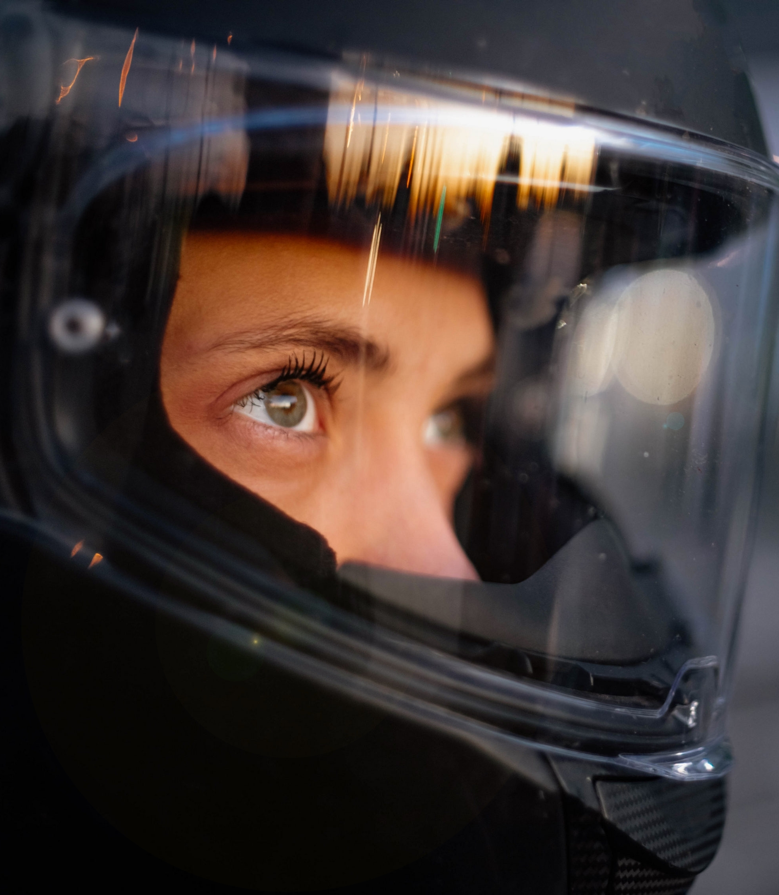
What We Know.
You are important - to your family, your friends and your command.
Motorcycle crashes account for many active-duty fatalities and serious injuries.
The health and well-being of our Sailors and Marines is essential to the mission.
Notes:
OK, so this is what we know. We continue losing Sailors and Marines to motorcycle crashes – many, if not all, are preventable.
Some of the disturbing factors, identified by the NAVSAFECOM analysts include excessive speed, lack of training and inadequate safety gear, to name a few.

Slide 5
What We Can Do.
SEARCH for hazards around you.
EVALUATE those hazards and decide what actions to take.
EXECUTE maneuvers by avoiding the hazard.
Notes:
Now, let's take it a step further and talk about what we can do to prevent motorcycles crashes. Please, stop me at any point to ask questions or to share a personal experience.
Search – Evaluate – Execute or SEE. Let's talk about: SEARCH
It’s always important to keep your head on a swivel. Always maintain situational awareness. Doing so avoids distractions and allows riders to make informed and safer decisions, reducing their exposure to risk, contributing to a safer riding environment.
Next, let's evaluate the hazards riders may encounter on the road. What kind of hazards exist on the road? [ask participants for suggestions Be prepared to discuss the hazards]
[Hazards include black ice, snow, constructions, other drivers, low visibility, etc.]
Lastly, let's discuss how we can avoid crashes.
Again, maintaining situational awareness is a top priority. The goal is to ensure all of our riders return home safely. [Discuss ways to maneuver around hazards, i.e. approaching construction zones, black ice, vehicle suddenly veers into your lane, vehicles exiting driveways, etc.]
Next, we're going to discuss what to wear....

Slide 6
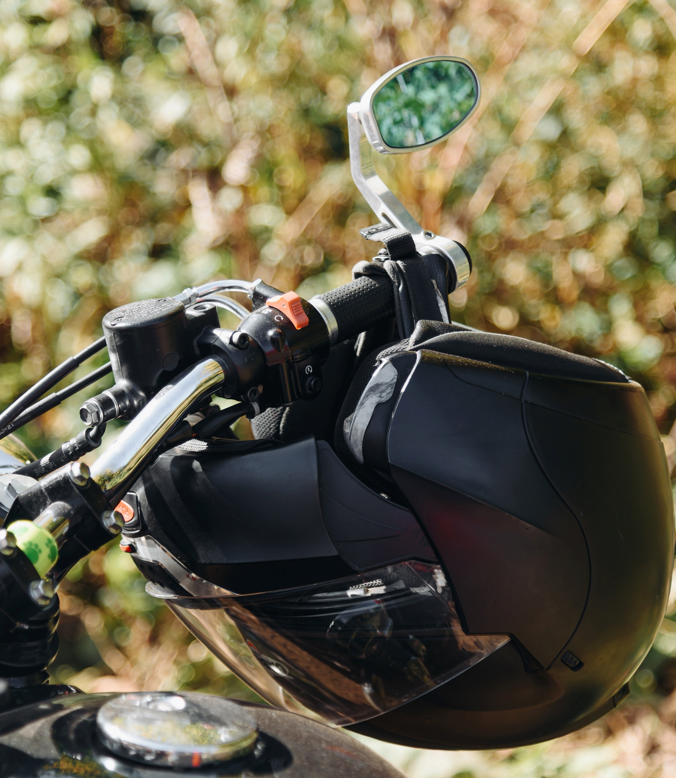
What to Wear.
Wear leather clothing, boots with non-skid soles and gloves to protect your body from severe injuries in case of a crash or skid.
Always wear a Department of Transportation approved helmet with a face shield or protective eye wear.
Dress for a crash as well as for the ride.
Notes:
Wearing the right clothing can minimize potential injuries and possibly death.
Wearing a helmet and protective eye wear seems like a no-brainer, but some folks are still resistant to putting them on, particularly if the state they're in doesn't require one. It's important to note ALL military installations require their riders to wear a Department of Transportation-approved helmet while on the base.
A few additional points:
Wear leather or other sturdy, protective clothing - like a jacket and pants.
Over-the-ankle boots and sturdy gloves provide increased protection and ease in handling the throttle and brake controls.
Remember, dress for a crash as well as for the ride. We don’t want you involved in a mishap or crash; however, we need you to be prepared and dressed appropriately to minimize your risk as much as possible.
Next slide, we'll discuss the importance of maintaining your ride.

Slide 7
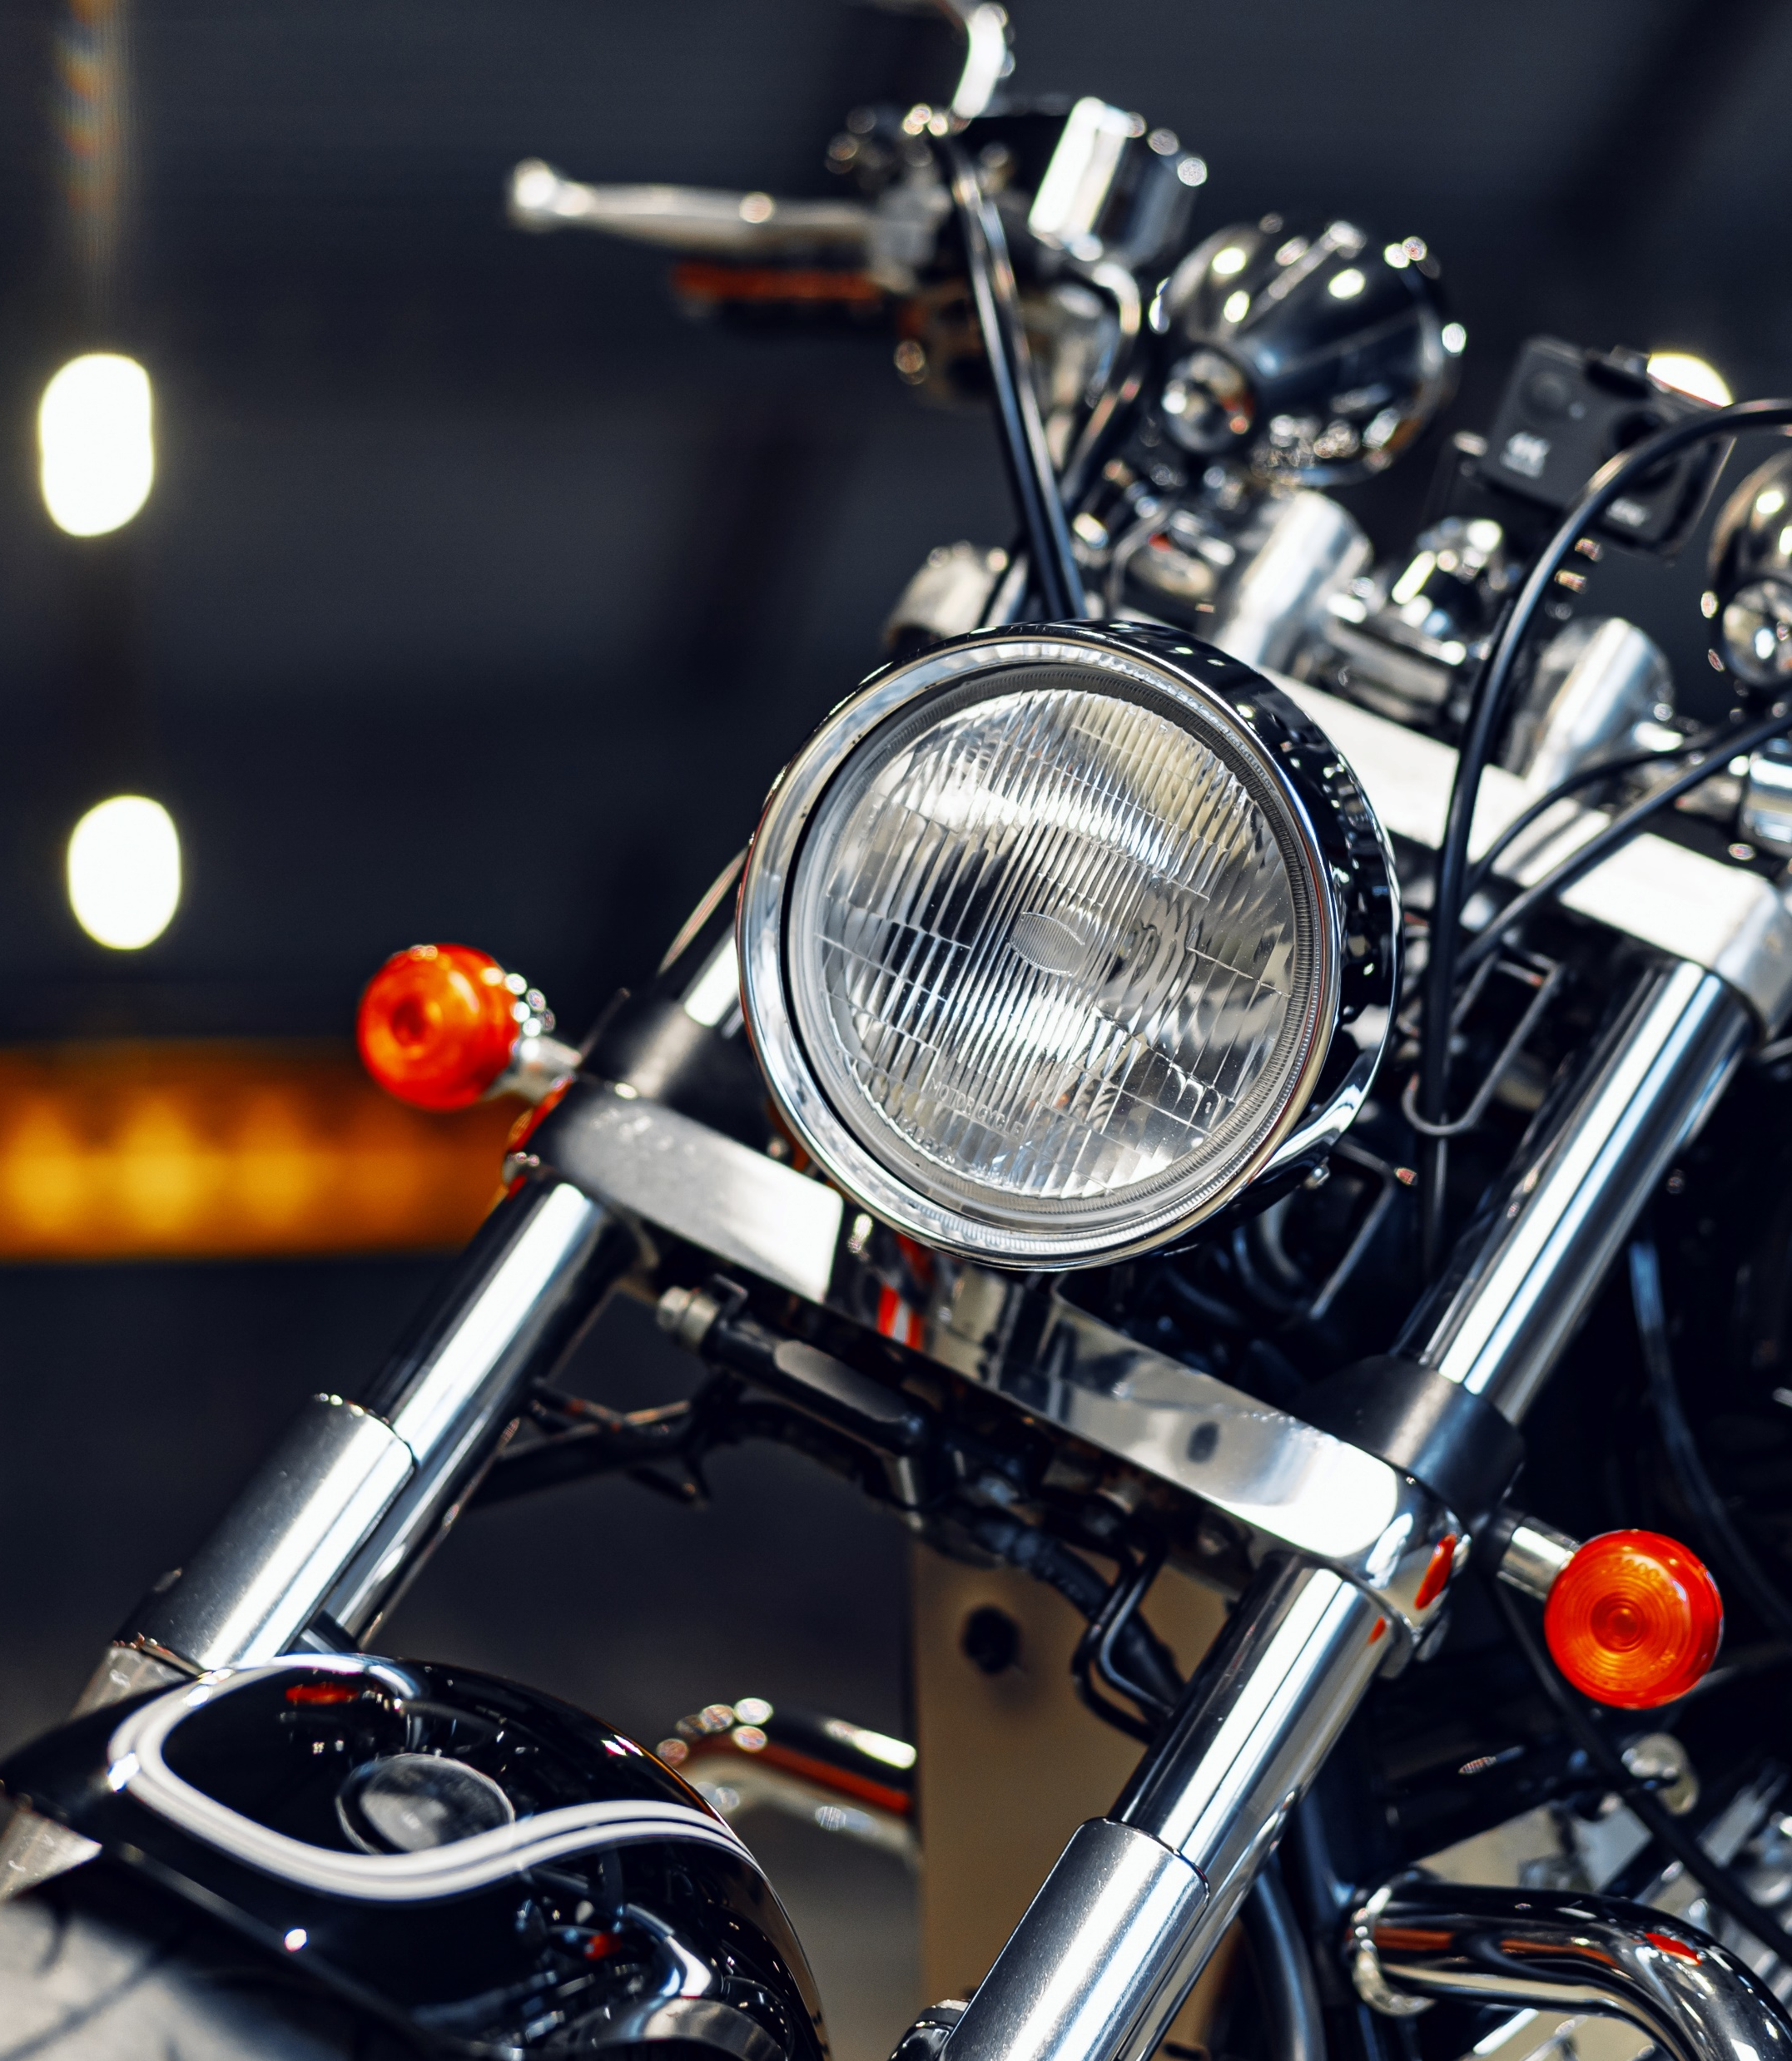
Know Your Bike and How to Use It.
Complete a formal riding education program, get licensed and take riding courses periodically to improve riding skills.
Ensure your bike is ready to ride by performing all recommended checks and inspections before you hit the road. Think T-CLOCS!
Obey the speed limit - the faster you go the longer it will take you to stop.
Know and follow local traffic laws and rules of the road, particularly when they pertain to motorcycle riding.
Notes:
Ok, so for the motorcycle riders out here, you’re likely familiar with T-CLOCS, right? [Tires and wheels, Controls, Lights and electric, Oil and other fluids, Chassis and chain, and stands]
Study your motorcycle's owner's manual and make a habit of doing a pre-ride check.
Remember, motorcycle safety courses are mandatory for all active-duty riders. These courses teach skills that can help prevent crashes, improve reaction times and reduce the risk of serious injury.
Also, riders should become familiar with their state’s riding laws and keep in mind these laws can change when moving to a new assignment.
It’s important to develop your riding techniques before venturing into traffic, especially emergency braking and swerving maneuvers. Practice often to keep your skills sharp.
Ensure your bike is ready to ride by performing all recommended checks and inspections before you hit the road. Remember T-CLOCS.

Slide 8
Be Visible.
Attaching reflective tape to your clothing helps other drivers see you, especially at night.
Ride with headlights on, stay out of a driver’s blind spot, signal well in advance of any change in direction and watch for turning vehicles.
Flash your brake lights when you are slowing down and before stopping.
Plan an escape route in case a motorist doesn’t see you and violates your right of way.
Notes:
Let’s go over a topic that resonates with both drivers and riders – visibility.
• Remember, most motorists often have trouble seeing motorcycles, so make sure your headlight works and is on day and night.
• Use reflective strips or decals on your clothing and on your motorcycle. Also, bright clothing and a light-colored helmet increases the chances of being seen. Being visible is key!
• Avoid riding in cars and trucks blind spots. Assume they cannot see you and ride accordingly.
• If possible, flash your brake light when you’re slowing down and before stopping.
• Have an escape route in case a motorist doesn’t see you and violates your right-of-way. This is particularly important when you are making turns. Remember to keep your situational awareness high.
Next, we are going to discuss your mental mindset.

Slide 9
Drinking & Driving
Plan your safe ride home by choosing a non-drinking friend, a taxi or ride-hailing service as your designated driver.
If you are drinking, do not drive for any reason.
If someone you know has been drinking, do not let them get behind the wheel.
Driving with a blood alcohol content of 0.08 g/dL or higher is illegal in all 50 states, the District of Columbia and Puerto Rico.
Notes:
You’ve all been through training on avoiding drinking and driving, but I want to remind you it applies to all vehicles and is an important part of your personal safety.
By riding only when fully alert and sober, riders eliminate a significant risk factor as impaired riders are far more likely to be involved in fatal crashes; riders also significantly reduce their exposure to risk and contribute to a safer riding environment for themselves and others on the road.
Motorcycle riding requires a person's full attention, skill and coordination. Be smart by not combining riding with drinking alcohol or using other impairing drugs.

Slide 10
Mental Strategies
Constantly scan the road for any hazards.
Give other motorists time and space to respond to you.
Fatigue and drowsiness impair your ability to react. Make sure you are well rested when you hit the road.
Ride as if you’re invisible. By using lane positioning, you allow yourself to see and be seen.
Notes:
OK, we're pretty much done. Some final take aways to remember.
So, here are some ways to prepare yourself on the road.
• Constantly search ahead for changing conditions. Use the Search-Evaluate-Execute strategy (SEE) to assess and respond to hazards before you have to react to an emergency.
• Give yourself space and time as you search for hazards and consider potential escape routes.
• Give other motorists time and space to respond to you. This is where your clothing choices can be a major factor.
• Use lane positioning to see and be seen.
• Search for vehicles that may turn across your path, especially at intersections.
• Use your turn signals for all turns and lane changes.
• Again, don't ride when you are tired or under the influence of alcohol or other drugs.
• Know and follow the rules of the road.
• Ride as if you're invisible.

Slide 11
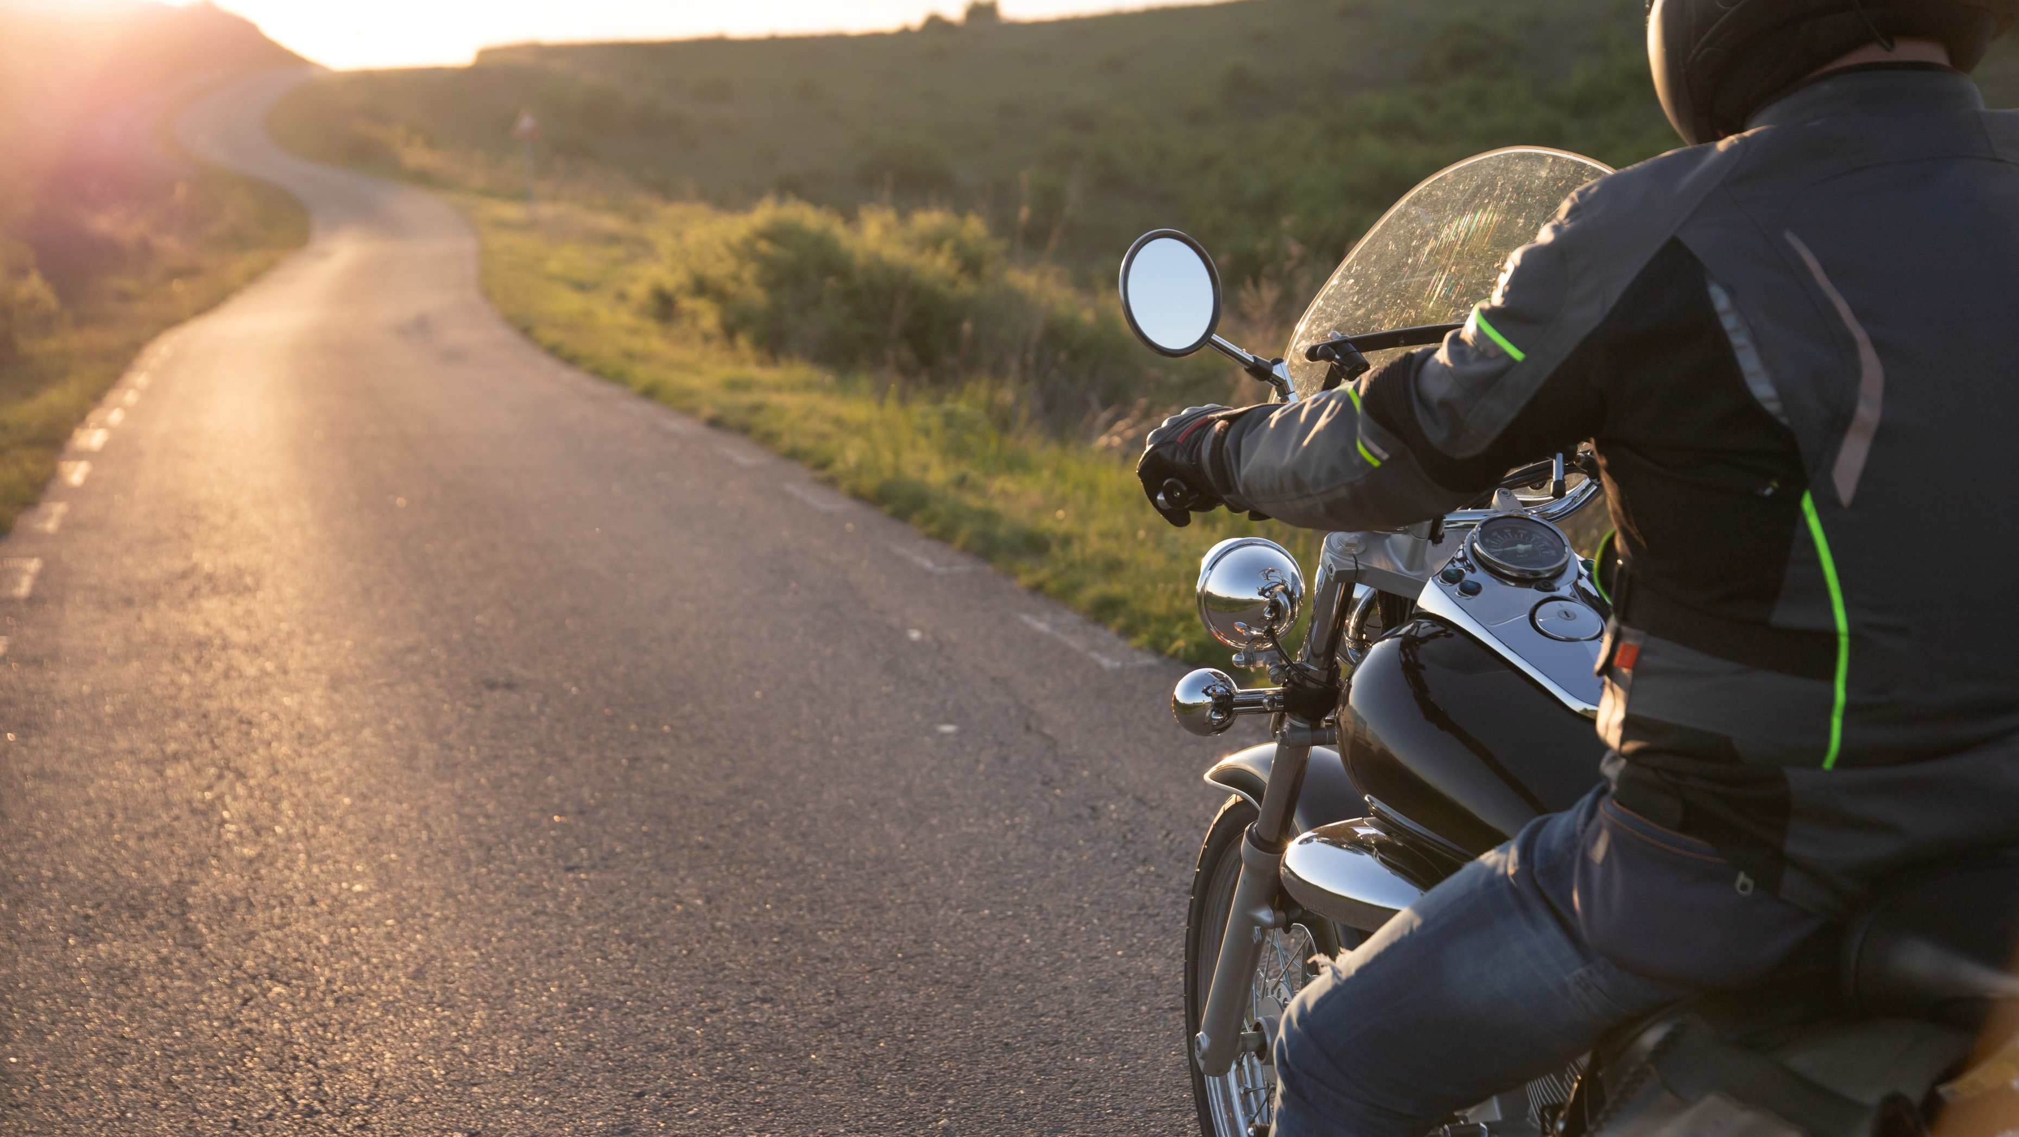
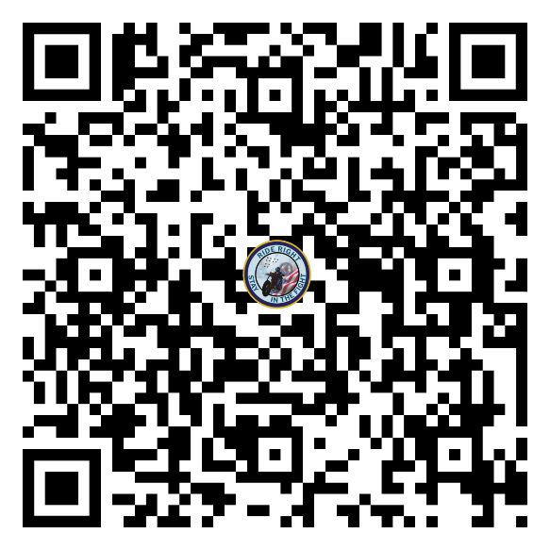
Ride Right. Stay in the Fight.
Notes:
Thank you so much for your participation in today’s presentation. If you’re looking for more information or have any further questions, please contact your command Motorcycle Safety Representative.
Additional resources are available on the Naval Safety Command website, [QR code in the slide]. Thank you again and remember - Ride right to stay in the fight!

