Slide 1
How to Build
Safety Briefings

Slide 2
Risk and reward
The good news: effective safety briefings can help prevent mishaps and change people’s behavior
The bad news: ineffective safety briefings can alienate the audience or put them to sleep
It is hard to throw together a good presentation on the spur of the moment

Slide 3
Five Do’s
Have a specific purpose for the briefing.
Have a clear audience for your information.
Get to the point.
Create communication products to meet a current need.
Use different products for different audiences.

Slide 4
Five Don’ts
Don’t imagine that you have a captive audience.
Don’t assume everyone cares about what you care about.
Don’t offer unrealistic advice.
Don’t settle for what is trite and expected.
Don’t be boring*.
*This is easier said than done, sorry.

Slide 5
Typical content
Mishaps
Trends, data
Hazard alerts
Rules, policy
Anecdotes
Notes:
Mishaps: Try to include clear, succinct information about causes, how to prevent and other lessons learned. Near-mishaps also meaningful.
Trends: Mishap-free streaks and downward trends are always good. However, safety “news” is usually bad because the latest fatality if always of immediate interest. Data help establish the existence of an issue.
Hazard Alerts: These are a staple of safety briefings when new and/or unexpected hazards appear in the workplace or the local environment.
Rules and policy: These are necessary, but tend to be dull.
Anecdotes – People like and respond to stories. This is why reporters always find someone who is personally involved in an issue that the reporter is writing about.

Slide 6
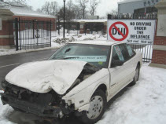
Mishaps
Talk about actual events – especially local/recent ones
Don’t just pay attention to Class A and Class B mishaps
Look at your local statistics for lost days
Describe and discuss near-misses – prevention techniques are identical

Slide 7
Lessons from Mishaps
Fight the urge to blame mishaps on the person who got hurt or who did the damage
Many human errors are the result of systemic issues, including
Insufficient training
Lack of supervision
Conflicting guidance

Slide 8
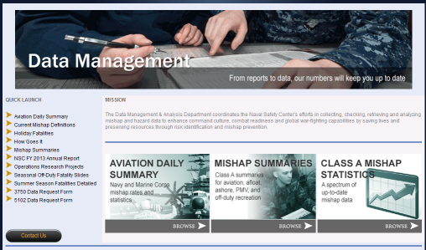
Trends and data
Service-wide data and trends for serious mishaps is available on the Naval Safety Center website at http://www.public.navy.mil/comnavsafecen/Pages/statistics/index.aspx

Slide 9
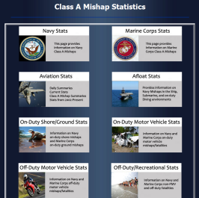
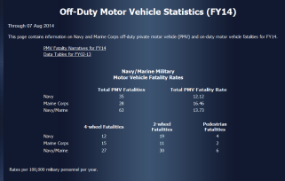
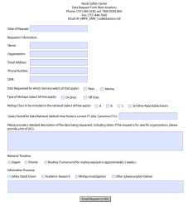
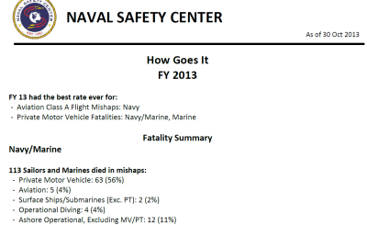
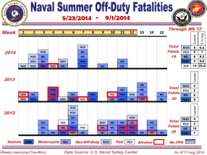
On the NSC statistics pages
Class A summaries and statistics, data-request forms, seasonal snapshot, trends

Slide 10
Hazard alerts
Remember the ORM saying: “Change is the mother of all risks.”
Are there any new hazards in your locality and environment?
New pieces of equipment, unfamiliar tasks and new work processes all bring risks

Slide 11
Rules and policy
Are new safety-related policies taking effect?
Do mishaps, near-mishaps, safety surveys or inspections show that personnel aren’t following guidance?
People are more likely to follow the rules if:
They understand the reason behind the rule, and
They know what happens when people break the rule.

Slide 12
Anecdotes
Personal stories from people who caused a mishap or who were affected by a mishap are invaluable
People like to hear stories, because examples are more interesting than general statements

Slide 13
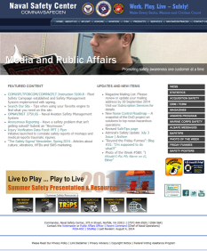
Learn your way around the Naval Safety Center web site
Information
Topical and seasonal presentations
POCs
Training resources
Media products
Guidance
http://www.public.navy.mil/comnavsafecen/Pages/index.aspx

