Slide 1
Risk Management Information (RMI) Account Registration
Controlled by: SPAWAR Office of Congressional and Public Affairs (SPAWAR OOP); Controlled by: PMW 250; CUI Category: CTI; Distribution Statement B: Distribution authorized to U.S. Government agencies only (Administrative or Operation Use; 31 August 2020). Other requests for this document shall be referred to SPAWAR OOP or PMW 250. POC: RMI Help Desk, rmitestteam@chenega.onmicrosoft.com
CONTROLLED UNCLASSIFIED INFORMATION (CUI)
Notes:
Welcome to Risk Management Information Training Course.

Slide 2
Welcome and Agenda
Introduction
Training Course Goals
Housekeeping
RMI Getting Started
RMI Overview
RMI-My Account Overview
Notes:
This course will be covering basic functions, features and navigation of RMI

Slide 3
Module 1: RMI Getting Started
This module will walk users through:
Accessing RMI
Register for an account
Request roles
Basic system navigation
Hands-on practice
Notes:
First things first, you need an RMI account!

Slide 4
Important Notes
RMI-SIR is a shared application with Air Force Safety Automated system
To access RMI (Production Site aka PROD)
Navigate via the AFSAS URL: https://afsas.safety.af.mil
To access the RMI Training/Testing Site (Simulation aka SIM)
Navigate via the Simulator URL: https://sim.afsas.safety.af.mil
This site contains fictious data and is for training purposes only.
RMI Production Site and RMI Training/Testing Site (SIM) are NOT linked and are independent of each other.
Users will be required to complete the self-registration process for each site, and roles will need to be assigned as required for each account. Be sure to verify the URL as these sites look identical! The RMI logo will display “Simulator” when logged into the Simulation URL.
Notes:
RMI-SIR is a shared application with Air Force Safety Automated system meaning they share a platform. You will see some Air Force centric terminology and features because of this. For example, the URLs are AF.MIL. There are 2 URLs in use: The RMI Production Site (PROD) where live real data is processed and the RMI Simulation Site (SIM) which is for training/testing purposes only and contains fictitious data.
The Production and Simulation sites are not linked and are independent of each other. This means that users will be required to complete the registration process for each site. Be sure to verify the URL as Production and SIM look identical!

Slide 5
RMI Module
Streamlined Incident Reporting (SIR)
SIR is a module within RMI utilized to create, finalize, and search event investigations as well as access analytics regarding event investigations
Roles granted by User Administrators assigned at each UIC
Access SIR via SAFETY on the RMI Homepage left-hand menu
Echelon II Administrators will authorize roles
RMI requires an elevated account.
Users will request roles during self-registration; however, roles will not appear until the User Administrator grants approval for the requested roles.
Justification is required for all elevated accounts.
Users must provide a detailed and meaningful justification addressing “why” they require access to RMI, and the roles requested. The more detailed the explanation the faster your User Administrator can process the role requests.
Notes:
It is important to understand the structure of RMI. In order to access Streamlined Incident Reporting (SIR), you will first need an account in RMI. SIR is a module located in RMI and your roles and permissions will be managed via your RMI “My Account”
Users will need to request an elevated for RMI
And justification will be required addressing why they require access to RMI.

Slide 6
RMI Roles and Permissions
RMI is a role-based application.
The roles assigned will define access to modules, actions available and functions assigned in the workflow.
RMI
Must create an account to access SIR
SIR
Must be assigned roles in RMI to be able to access Safety Module options. Options available will vary based on roles assigned to the user.
Notes:
RMI is a roles-based application. This means the options you see and functions/features you have access to will vary depending on the roles you are assigned.

Slide 7
Available Roles
EVENT INVESTIGATOR
This role grants you the ability to enter data for events for which you are assigned as an investigator
SAFETY INVESTIGATOR SUPERVISOR
This role grants you the ability to enter data for event investigations for which the convening authority is below your organization and in your chain of command
MESSAGE APPROVER
This role grants you the ability to review, approve, and release all messages for their organization and subordinate commands
RECOMMENDATIONS APPROVER
This role grants you the ability to approve closure of recommendations. The recommendation must have your organization assigned as an approval authority
QUALITY CONTROL: EVENT
This role grants you the ability to perform Quality Control functions such as accepting or rejecting an event message, and editing any open or closed event (Currently resides at NSC)
MOFE
This role grants you the ability to prepare and release a Memorandum of Final Evaluation (Currently resides at NSC)
Notes:
RMI-SIR is role based and the roles available for SIR are listed

Slide 8
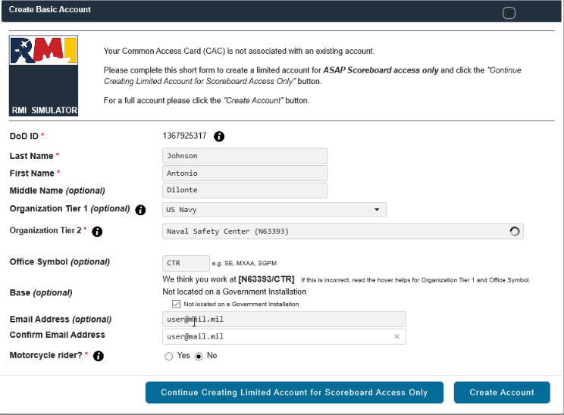
Requesting an Account
STEP 1: Access RMI-SIM via https://afsas.safety.af.mil for RMI Production (Live & Real Data)
STEP 2: Accept the US Department of Defense Warning Statement
STEP 3: Click “Create Account”
RMI shares a platform with the Air Force (AFSAS), therefore, you will see Air Force centered items in RMI. Not all features are leverage for Naval purposes currently. Office symbol, Motorcycle Rider, Job Functions, & ASAP scoreboard are examples of USAF centered items not leveraged for Naval purposes and do not have an impact on your RMI accts.
123456789
DoD ID will populate
Step 4: Enter Last Name, First Name, MI
Step 5: Select your branch of service
Step 6: Enter your command information here (predictive text will help locate options). For Office Symbol use “SAFE”
For Office Symbol use SAFE
SAFE
Step 7: Provide a valid email address
Step 8: Mark “Yes” or ‘No” as applicable
Step 9: Click “Create Account” to continue
Notes:
We are now going to register for RMI accounts.
Please navigate to https://sim.afsas.safety.af.mil
Read and accept the DoD Warning Statement.
You should see a screen that says Create Basic Account
You will notice your DoD Id is automatically populated
Enter your last name and first name in the provided boxes
For Organization tier 1 you will select your branch of service
For Organization Tier 2 you will enter your organization. You will notice that predicative text will assist you in making your selection.
For Office symbol use “SAFE”
Mark “Not located on a government installation”
Enter a valid email address. It is highly recommended you use a professional or work email address
Mark “No” for motorcycle rider. This is an AF leveraged featured and not presently used for Naval purposes. The AF manages their MC Safety program via AFSAS.
Let me know when you’ve all entered the requested information
Click the “Create Account” Button

Slide 9
Requesting an Account (Cont.)
STEP 10: Complete contact information on the populated screen
STEP 11: Mark the Job Functions for position(s) held.
Job Functions will not impact what you have access to do in RMI.
Common functions for RMI-SIR are highlighted.
Notes:
Personal Information page will display. Continue completing the requested information.
Scroll to Contact information. You must enter a phone number, but it does not have to be a DSN
Verify your email address
Scroll to Job Functions in Current Position
For our purposes, select SIB Member, Event Investigator and Unit Safety Representative.

Slide 10
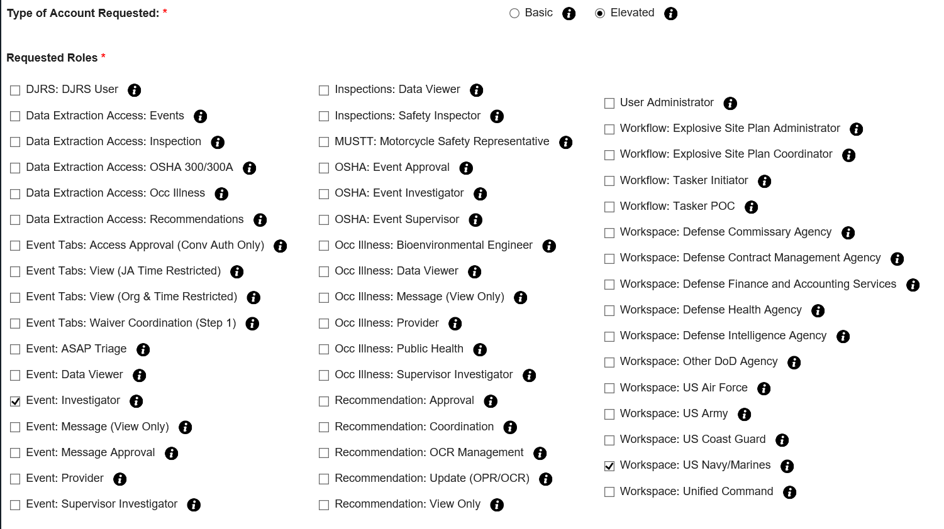
Requesting an Account (Cont.)
NOTE: If a user selects “Basic” they will not be prompted to select roles. A “Basic” account is simply an account without roles
Step 12: Select “Elevated” Account Type: This is required for roles to be granted in RMI
Step 13: Select For DJRS Users You will be assigned roles once your DJRS profile is created
NOTE: Elevated Role Approval is NOT automatic and may take up to 24 hours to process
You must select a workspace. Select your Branch of Service/Agency. For Navy/Marine Corps SIR select Workspace: US NAVY/MARINES
Step 13: Select for SIR Users Select role(s) to be performed (most common role is “Event: Investigator”)
Notes:
Scroll to Type of Account Requested
Select “Elevated”
Requested Roles will appear
Mark “Event Investigator” for SIR
Mark Workspace “US NAVY/MARINES”
Please note that Elevated Role approval is not automatic and may take up to 24 hours to process

Slide 11
Requesting an Account (Cont.)
NOTE: RMI is a role-based application. Your User Administrator will grant/remove roles based on your assigned duties. The RMI account will not create with roles automatically assigned. Roles will appear when approved.
Step 14: Type Justification
Step 15: Click “Submit Application”
Notes:
Enter justification for roles requested. Roles requested per assigned duties
Click the “Submit Application” button to proceed.

Slide 12
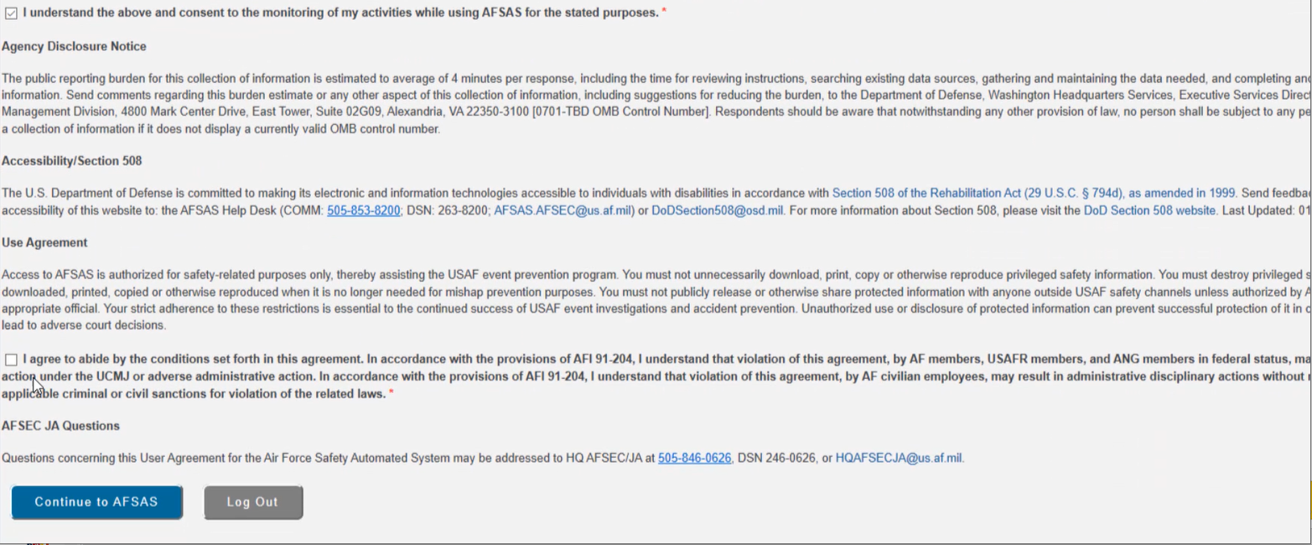
User Agreement
User Agreement will populate when the user clicks “Submit Application”
User Agreement covers: Types of information contained in RMI, Restrictions on their reproduction and distribution, Notification and consent to monitoring, User agreement statement and concurrence
NOTE: Only a portion of the user agreement is displayed for informational purposes. There are several boxes to mark total.
Step 16: Check all boxes confirming you have read and understand the statement
Step 17: Click “Continue to AFSAS”
Notes:
User Agreement will display. Check all the boxes confirming you have read and understand the terms and conditions.
After you’ve checked all of the boxes click the “continue to AFSAS” button

Slide 13
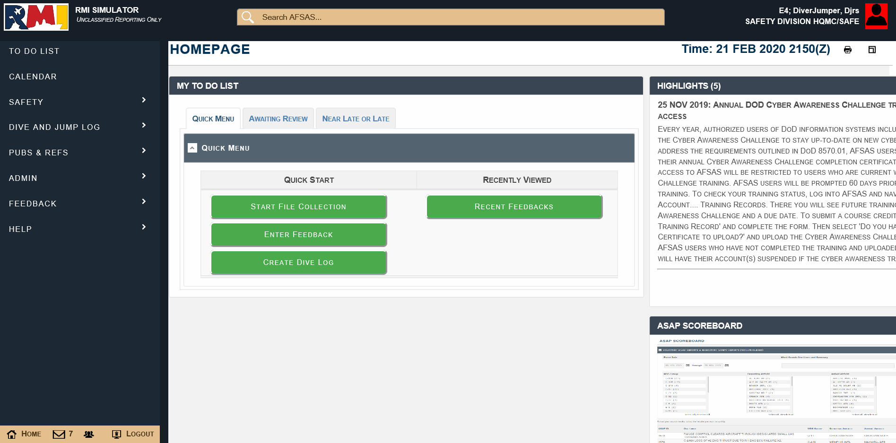
Risk Management Information(RMI)Homepage
Click RMI Logo to Hide or Show left-hand menu
Left-hand menu navigation
Search Feedbacks ID & Event ID
Access to SIR
User logon information. You can also click on your name for quick access to your account management
NOTE: Left-hand menu options are role dependent.
Your User Administrator must approve requested roles for those menu options to appear
Quick Menu Navigation
Quick Access to create Feedback
Notes:
RMI Homepage will display. Please note, elevated role requests take up to 24 hours to approve which means you will not see those options available to you until they are approved. Please look at the accounts created. You will notice under safety all you can access is OSHA References. This is because those roles are not yet approved. Please familiarize yourselves with the RMI Homepage

Slide 14
To view a demonstration of Creating an RMI Account, please reference Video 1_ Getting Started Video by navigating to:
Help→ Help Files and User Guides →Scroll to SIR Help Files and User Guides → Click the magnifying glass of the video you wish to view
Notes:
To view a demonstration of Creating an RMI Account, please reference the Getting Started Video.

Slide 15
Account Registration
Register for accounts in SIM (https://sim.afsas.safety.af.mil) for training purposes. If users do not have a production account, you can have them register for this as well
Notes:
Pause, have users register for accounts in PROD and SIM if they do not already have them.

