Slide 1





STAY SAFE THIS FALL
SIMPLE STEPS FOR A SAFER AUTUMN

Slide 2
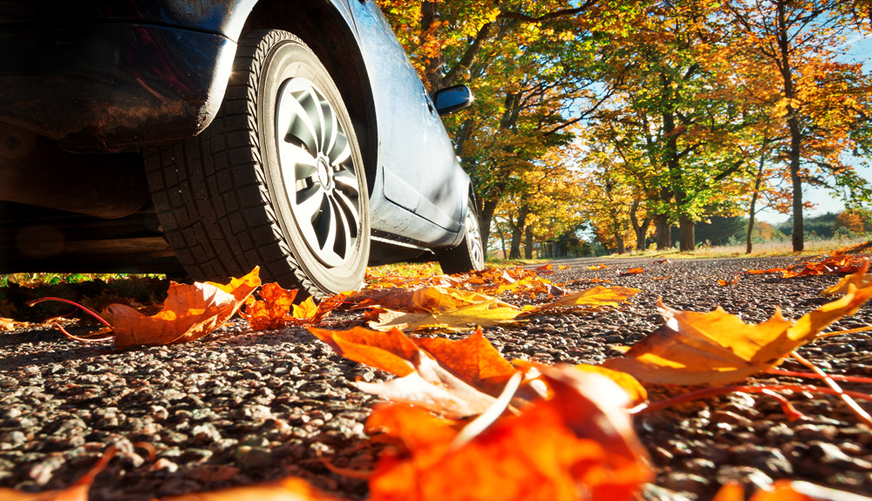
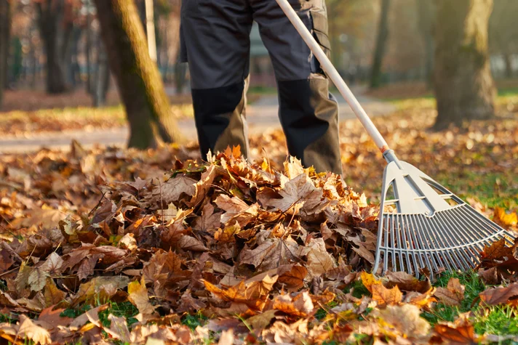
FALL SEASON RISKS
  As the seasons change, so do the risks we face both on and off duty. Fall brings unique safety challenges, such as slippery conditions, reduced daylight, drowsy driving, and increased holiday activities.
  By recognizing these potential hazards and taking preventive measures, we can protect ourselves, our families, and our shipmates. Most importantly, staying safe keeps us warfighter-ready and ensures we can continue to successfully carry out the mission.

Slide 3
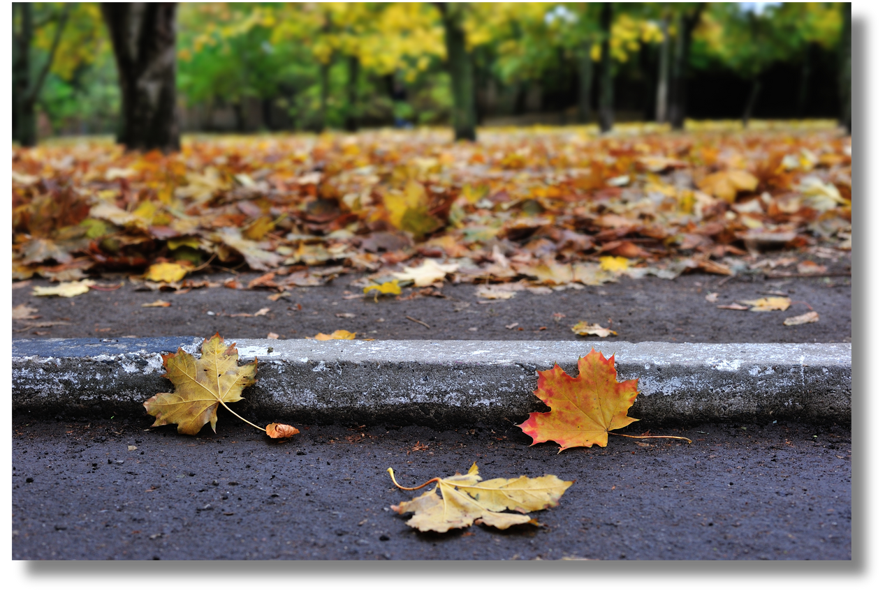
SLIPS, TRIPS AND FALLS
  Wet leaves, rain and frost create slippery walkways. Wear slip-resistant shoes and keep paths clear.
  Keep outdoor extension cords for decorations away from walkways to prevent tripping hazards. Mark any cords that must cross paths.
  Use handrails on stairs and ramps, especially in wet or icy conditions, to reduce the risk of falls.
  It may seem minor, walking on leaves or navigating stairs, but these everyday actions contributed to 36 slips, trips and falls reported in just three fall seasons (2022-2024), resulting in real impacts to manpower and force readiness.

Slide 4
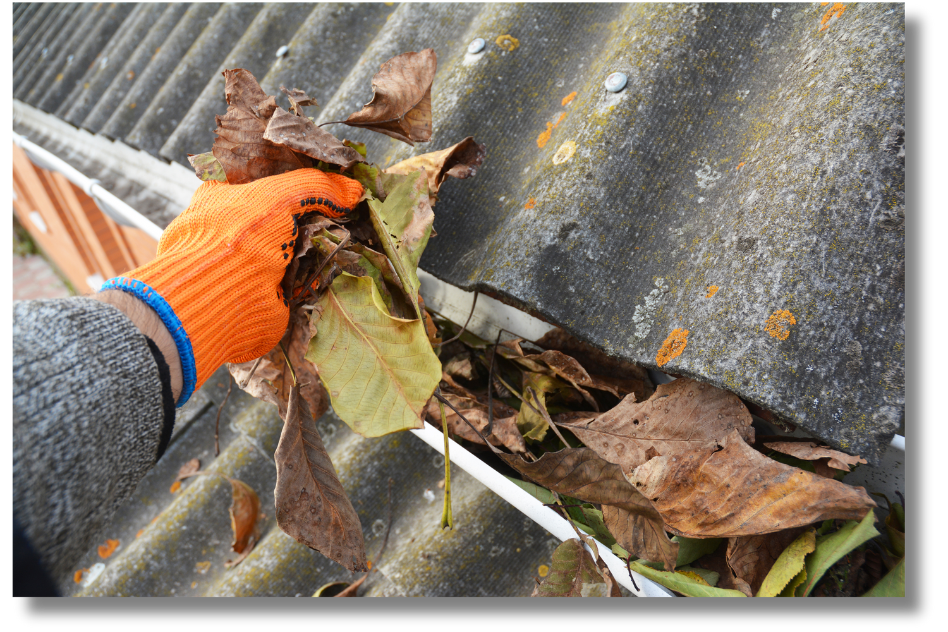

LADDER SAFETY
  Always maintain three points of contact when climbing a ladder, meaning two hands and one foot or two feet and one hand should always be in contact with the ladder.
  Place ladders on stable, level ground before use.
  Never stand on the top step or overreach while on a ladder.
  Between September and November over the past three years (2022-2024), nine mishaps were reported while ascending or descending ladders, including one case where a service member fell after failing to secure the safety locking device, leading to a broken arm, surgery, and six weeks of limited duty. This example underscores how one small mistake can have long-lasting consequences for both the individual and the mission.

Slide 5

DRIVING SAFETY
  Daylight Savings Time ends on Nov. 2, 2025, bringing earlier darkness and more nighttime driving.
  Turn on your headlights sooner and be prepared for reduced visibility and glare from headlights during rush hour.
  Losing or shifting an hour can disrupt sleep patterns, making drivers more prone to drowsy driving. Be sure to get adequate rest, especially before taking long trips.
  Seasonal road conditions such as wet leaves, fog and black ice create additional hazards. Always drive cautiously and adjust your speed to match road conditions.
  There were 758 incidents reported over the past three fall seasons (2022-2024), including 339 motorcycle crashes and 419 motor vehicle crashes, reducing manpower and directly impacting mission success and warfighter readiness.
WHAT THE DATA SHOWS:
  A CARFAX analysis recently found that in 39 states, Fall accounts for the highest percentage of car accidents compared to all other seasons (CARFAX, 2024).
  National Safety Council (NSC) data shows that in 2023, the death rate per 100 million vehicle miles traveled peaked in October (NSC, 2023).

Slide 6
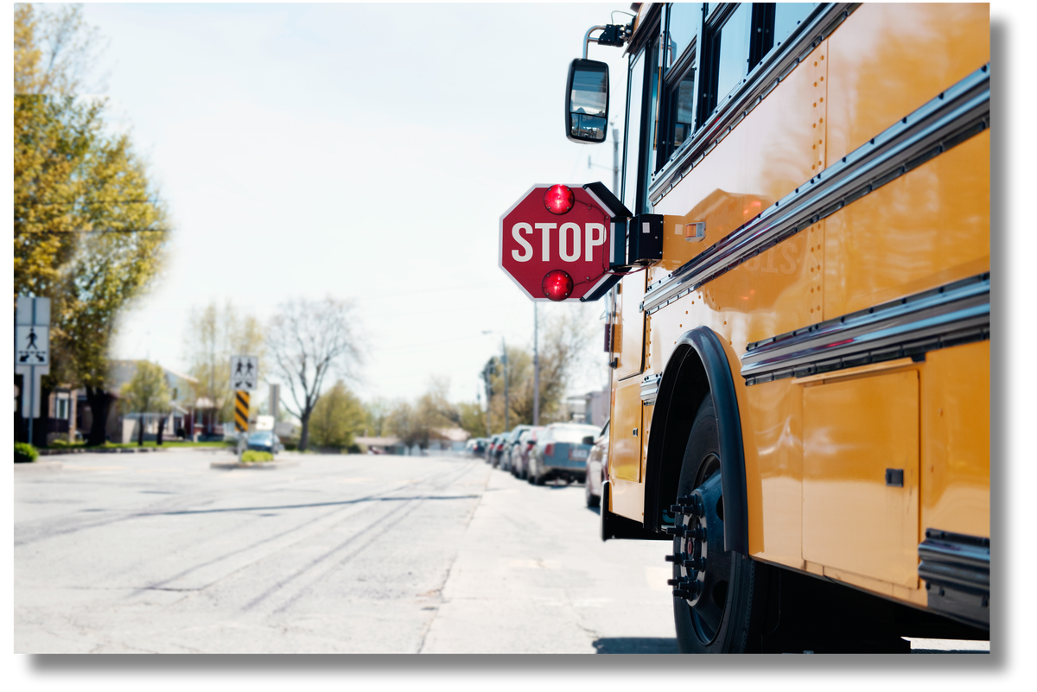

PEDESTRIAN SAFETY
  Drivers should slow down when traveling through neighborhoods and near schools.
  Be especially alert around bus stops and always stop for buses that are loading or unloading students, as well as for children walking to and from school.
  Pedestrians can improve their safety by wearing reflective clothing, carrying flashlights and crossing only at designated crosswalks.

Slide 7


DUI PREVENTION
  Fall gatherings like football games, tailgates and holiday parties often involve alcohol, which increases the risk of impaired driving.
  To stay safe, plan ahead by arranging a designated driver, using a rideshare service or choosing to stay overnight if you have been drinking.
  Never get behind the wheel if you are impaired. One poor decision can have life-changing consequences for you and others on the road.

Slide 8
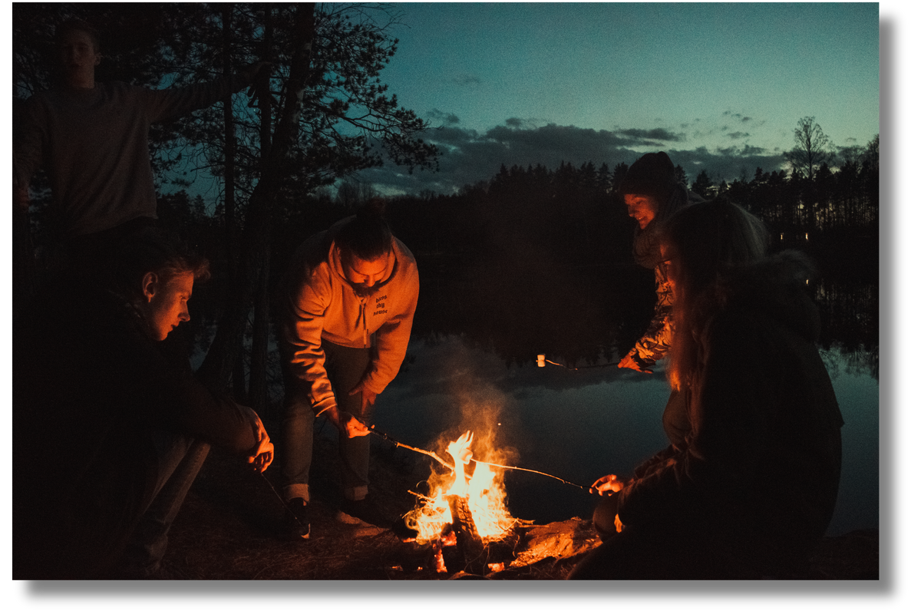
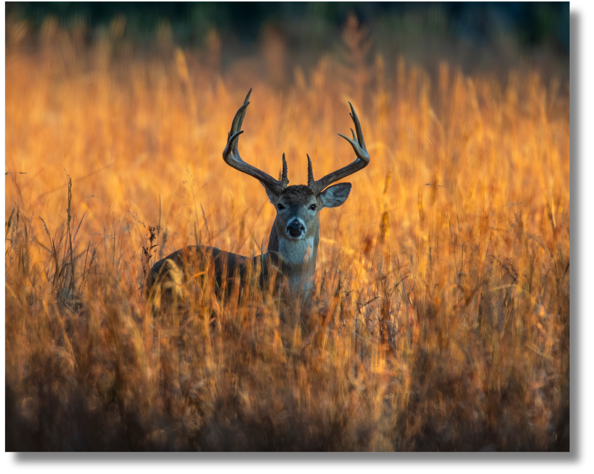
SEASONAL AWARENESS
  Be cautious when using open flames such as bonfires or when burning leaves and always follow local fire safety guidelines to prevent accidents.
  Take extra safety precautions during outdoor recreational activities in the fall, such as hiking, camping, or hunting, by wearing proper gear and letting someone know your plans.
  Watch for wildlife crossing the roads as animals migrate in the fall, especially in rural or wooded areas where deer and other animals are more active.

Slide 9
RESOURCES
  Safety is everyone’s priority. Visit navalsafetycommand.navy.mil for more resources to share with your team and family.
  For seasonal guidance and more information on fall safety topics, explore navalsafetycommand.navy.mil/Off-Duty/Fall-and-Winter-Safety.
  Remember, what you do both on and off duty can have a lasting impact on your family, friends and your team. Staying safe keeps you combat-ready and able to do what’s needed to carry out the mission.

